Slide 1

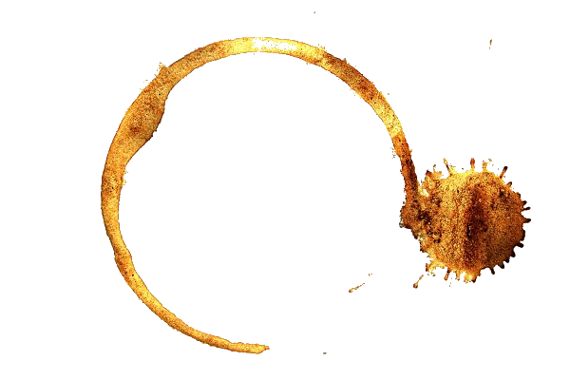











For immediate release: 06/04/2015
Internal Communication
Re: New On-Site Protocol
You’ve each been assigned a unique passcode. This is important – it will allow you to unlock doors within secure areas of this site.
Do not write your passcode down.
I trust you are all capable of memorising a simple 10-digit alphanumeric code. If you must write yourself a hint to jog your memory, please store it in safe place, out of sight.
Last week, I came across a staff member’s password on a sticky note attached to their monitor. Needless to say, they are now a former staff member.
P Levesque,
Site Director

Slide 2







