Slide 1

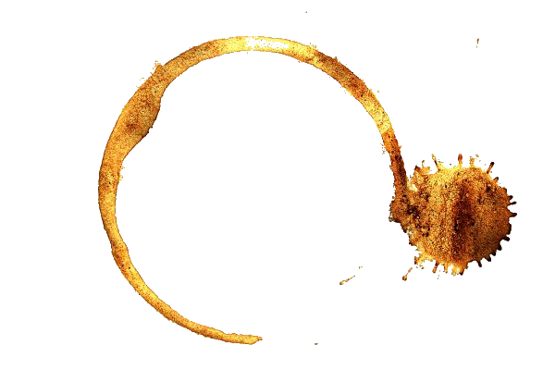











For immediate release: 06/04/2015
Internal Communication
Re: New On-Site Protocol
You’ve each been assigned a unique passcode. This is important – it will allow you to unlock doors within secure areas of this site.
Do not write your passcode down.
I trust you are all capable of memorising a simple 6-digit alphanumeric code. If you must write yourself a hint to jog your memory, please store it in safe place, out of sight.
Last week, I came across a staff member’s password on a sticky note attached to their monitor. Needless to say, they are now a former staff member.
P Levesque,
Site Director

Slide 2






When the print terminal locks up, only a support employee can unlock it by entering a valid username and access code.
I’ve narrowed it down to four possibilities (one from each department) and pulled their records from the database. Now I just need to match the usernames to access codes and figure out who works where.
Luckily, I’ve got a few clues to go on:
I recognise one of these usernames as belonging to Bill M. from maintenance.
Whoever has access code 5523, they don’t work in support or technical.
While she doesn’t work in support, I’ve seen k.ahmad type in her access code – and it definitely contains a 6.
I recently shoulder-surfed someone from operations. I don’t know what their name is, but their access code is 2297.
Three is Bill’s lucky number – he always picks an access code that starts or ends in 3.
Whoever “S.A.” is, they need to stop writing down their passwords on sticky notes. Now I know their access code is 2618.
 |  | access_code |  |  |  | department
 |  | 2297 | 2618 | 5523 | 6153 | Main. | Ops. | Tech. | Support
user_name | h.liu
 | k.ahmad
 | b.marquez
 | s.alford
department | Maintenance
 | Operations
 | Technical
 | Support

Slide 3







Slide 5

WASD for movement
Left mouse button to examine and interact with highlighted objects
Right mouse button to cancel
W
A
S
D

