Slide 1
BAN 6053 · Austin Airbnb Investment Analysis
What Homes Deliver the Best ROI in Austin's Short-Term Rental Market ?
Data-driven strategy for the Austin Airbnb investor powered by K-Means Clustering & XGBoost Regression
Yiran Liu
3/6/2026

Slide 2
BUSINESS PROBLEM & ANALYTICAL FRAMEWORK
BizML Steps: Value · Target · Performance
THE INVESTOR'S CHALLENGE
TARGET
A real estate investor is considering purchasing a property in Austin, TX to generate passive income via Airbnb but the short-term rental market is complex.
Key questions:
• What drives nightly rental price?
• What determines whether a unit stays booked?
• Which property segment offers the best risk-adjusted return?
Predict nightly rental price (continuous → regression target: log_price). Secondary: identify which segment achieves the highest booking rate (availability_90 < 40 days).
PERFORMANCE METRICS
Regression: Adjusted R² and MAPE on hold-out test set (80/20 split). Clustering: Silhouette score + elbow plot. We prioritise test Adj R² to guard against overfitting.
DEPLOYMENT GOAL (VALUE)
DATA FUEL
Identify the highest-ROI property segment and provide a data-driven listing strategy that maximises both nightly rate and occupancy.
5,835 Austin Airbnb listings · 54 variables · Source: Inside Airbnb. After cleaning (dropping missing values on key fields + 99th pct price cap): 3,130 model-ready rows.

Slide 3
DATA OVERVIEW & ANALYTICAL APPROACH
BizML Step: Algorithm two methods, one unified objective
5,835
3,130
54
70%
$286
Raw listings
Model-ready rows
Variables
Entire home/apt
Avg nightly price
Method 1: K-Means Clustering
Method 2: XGBoost Regression
01
Why: Groups the 3,130 listings into distinct segments based on price, size, room type, and availability. Provides an investor-ready segment map without requiring a labelled target.
02
Why: Predicts log(nightly price) a continuous target. Chosen because it captures non-linear relationships and feature interactions that linear regression cannot, while remaining interpretable via feature importance.
Variables: price, bedrooms, bathrooms, accommodates, room_type (encoded), review_scores_rating, availability_90
Variables: bedrooms, bathrooms, accommodates, room_type, property_type, neighbourhood, cleaning_fee, amenity flags, cluster label, instant_bookable, host_is_superhost
Validation: Elbow plot + silhouette score across k=2–6. k=3 chosen: elbow bends sharply, silhouette = 0.30 (peaked at k=2=0.35 but 2 groups lacks actionability).
Validation: 80/20 train/test split. 5 models evaluated. Hyperparameters tuned via Optuna (Bayesian optimisation). Selected on best test Adj R².

Slide 4
K-MEANS RESULTS — 3 INVESTOR SEGMENTS
BizML Step: Algorithm cluster profiles & validation
★ RECOMMENDED
HIGH RISK
AVOID
Cluster 0: Mid-Range Entire Homes
Cluster 1: Premium Large Homes
Cluster 2: Budget Private Rooms
1,581 listings
726 listings
823 listings
Avg Price
$174/night
Avg Price
$479/night
Avg Price
$85/night
Bedrooms
1.4 beds
Bedrooms
3.3 beds
Bedrooms
1.0 bed
Accommodates
Sleeps 4
Accommodates
Sleeps 8
Accommodates
Sleeps 2
Booking Rate
34%
Booking Rate
22%
Booking Rate
23%
Highest booking rate. Largest segment. Entire home/apt. Best balance of price & consistent cash flow.
High per-stay revenue but vacant 78% of the time. Suited for event / group travel only.
Low price AND low booking rate. Least attractive segment for investor returns.
Booking Rate (%)

Slide 5
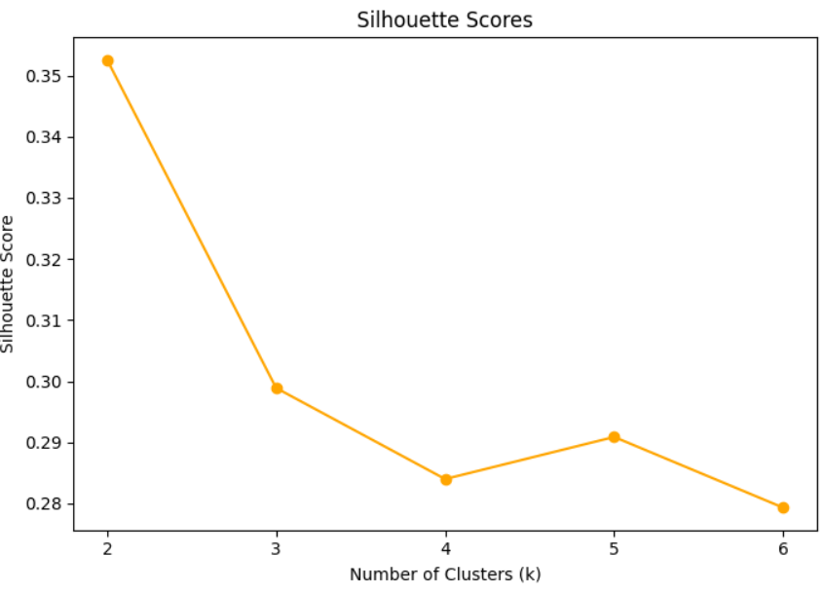
MODEL PERFORMANCE & VALIDATION
BizML Step: Algorithm evaluation metrics on train & test samples
K-MEANS CLUSTERING VALIDATION
XGBOOST REGRESSION — MODEL COMPARISON
Model | Train R² | Test Adj R² | MAPE
Log Linear | 0.714 | 0.622 | 33.1%
Random Forest | 0.958 | 0.613 | 36.4%
Base XGBoost | 0.910 | 0.652 | 32.4%
Tuned XGBoost | 0.787 | 0.671 | 31.5%
Why Tuned XGBoost is the right model:
Best test Adj R² (0.671) explains 67% of price variance on unseen data
Lowest MAPE (31.5%) predictions off by ~$55 on average
Overfitting gap of 0.116 is acceptable (Random Forest gap = 0.345)
Outperforms linear models by capturing neighbourhood & amenity non-linearity
~33% unexplained variance = unobservable factors (photos, seasonality, host discretion)
k=3 selected: Elbow plot shows steepest inertia drop at k=3. Silhouette peaks at k=2 (0.35) but yields only 2 undifferentiated groups. k=3 (score = 0.30) delivers 3 actionable investor segments Budget Private Rooms, Mid-Range Entire Homes, Premium Large Homes each with distinct pricing and booking profiles.

Slide 6
KEY INSIGHTS
BizML Step: Launch translating results into business meaning
Bedrooms = #1 Price Driver
Mid-Range Beats Premium on Occupancy
01
Finding: Bedrooms tops the XGBoost feature importance at 22.1%, followed by cluster label (15.0%) and bathrooms (7.3%). Physical size dominates pricing.
02
Finding: Cluster 0 ($174/night) achieves 34% booking rate vs. 22% for premium ($479/night) and 23% for budget ($85/night).
↑ Impact: Prioritise 2-bedroom over 1-bedroom to capture a meaningful price premium while staying in the mid-range sweet spot.
↑ Impact: 31 booked nights per 90-day window = ~$5,400/quarter in predictable revenue — vs. volatile premium strategy.
Hot Tub Adds ~$200 Nightly Premium
Location Is the Most Durable Price Driver
03
Finding: Listings with a hot tub average $472/night vs. $274 without — a $198 difference. Pool adds a smaller ~$33 premium.
04
Finding: Top neighbourhoods (Tarrytown, Zilker, Bryker Woods) command 2–4× the Austin average. Neighbourhood ranks among the top categorical price predictors.
↑ Impact: Adding a hot tub pre-listing is the highest-ROI physical upgrade. Particularly effective in the mid-range segment.
↑ Impact: Location cannot be changed post-purchase. Central/university-adjacent neighbourhoods offer the most stable long-run demand.

Slide 7
IMPACT & FINAL RECOMMENDATIONS
Cluster 0 Properties Offer the Best Risk-Adjusted Returns in the Austin Airbnb Market
★ PRIMARY RECOMMENDATION
Invest in Cluster 0 properties: 2-bedroom entire homes accommodating 3–4 guests in central Austin. This segment offers the best risk-adjusted return due to:
Highest occupancy rate (34%)
Strong nightly pricing ($150–$200, avg $174)
Large and stable market demand (1,581 listings)
PRICING STRATEGY
OPERATIONS & HOST SETUP
EXPECTED FINANCIAL IMPACT
Set nightly rate at $150–$200 (Cluster 0 avg: $174).
Use dynamic pricing (PriceLabs / Beyond) to capture event premiums during ACL, SXSW, F1.
Consider upgrading to hot tub to justify $200–$250/night.
Enable instant booking to increase booking probability.
Keep minimum nights at 1–3 to maximise availability.
Maintain high guest ratings to increase visibility, attract more bookings, and support premium pricing.
Achieve Superhost status, which improves search visibility and booking rates.
Estimated revenue:$174/night × 34% occupancy × 365 days ≈ $21,600 annual revenue
With premium amenities, such as hot tubs, revenue could increase to ~$26,000 annually
Although luxury listings can reach ~$38,500 annual revenue, their much higher vacancy rates make them significantly riskier investments

