Slide 1

H1B VISA - The Gateway to USA
Final Project - R
Diya Qu

Slide 2

Background
In 2016, Claire was a student living in China, she wanted to become an American immigrant through education.
How can we help her?

Slide 3
Dataset Selection
Dataset: 2011-2016 H1B VISA applications (1,048,576 rows, 42 columns)
The H1B visa allows U.S. companies to employ foreign talent, but its application process, controlled by the U.S. Department of Labour, is both lengthy and expensive. Employers must sponsor these visas, while employees face uncertainty as sponsorships can be withdrawn at any time.
Our H1B application data, including both approved and denied cases, will be used for predictive analysis, aiming to provide insights on the likelihood of certification. In addition, we intend to explore related socio-economic issues.

Slide 4
Data Preparation
Select Varibles：ONLY KEEP
Potentially related to our objectives
Not similar variables: like JOB_TITILE and SOC_NAME, same thing but different call. --Unique
Not overlapped variables: like Wage Range and Wage, avoid Multicollinearity
Columns of ‘h1b’ : Year, Status, Employer Name, Job Name
Modify Column Names
Clean Missing Values

Slide 5
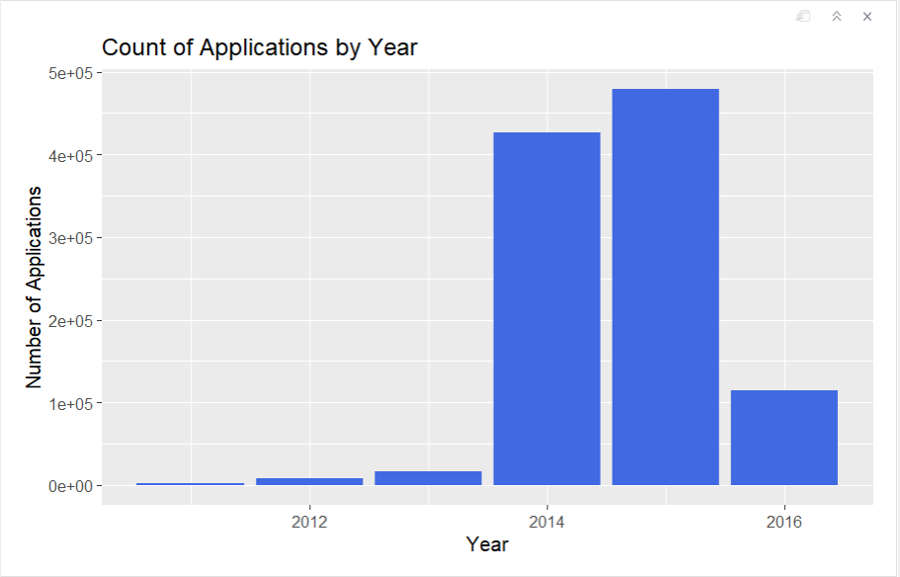
Data Visualization
Overall trend?

Slide 6
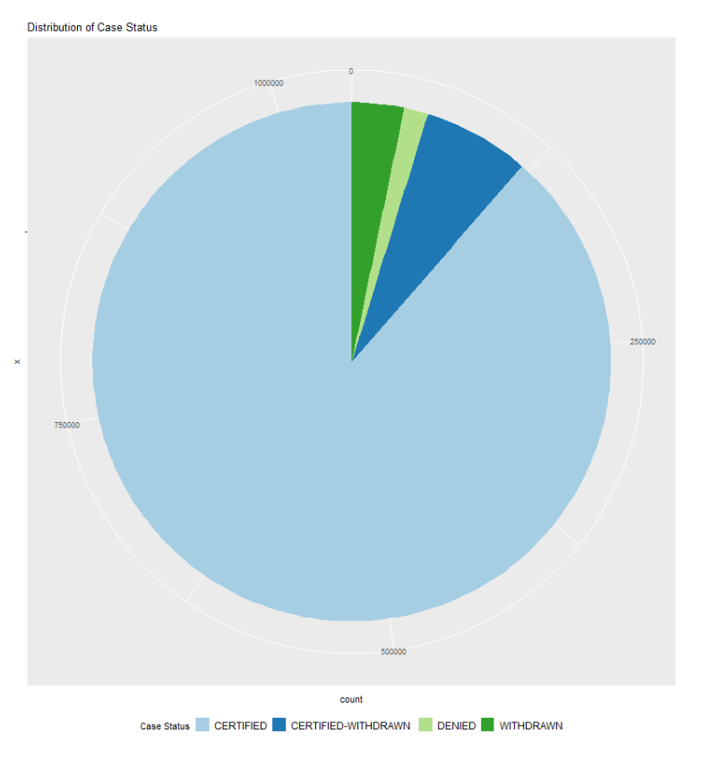
When I apply, can I get certified?
Certified cases is the majority!

Slide 7
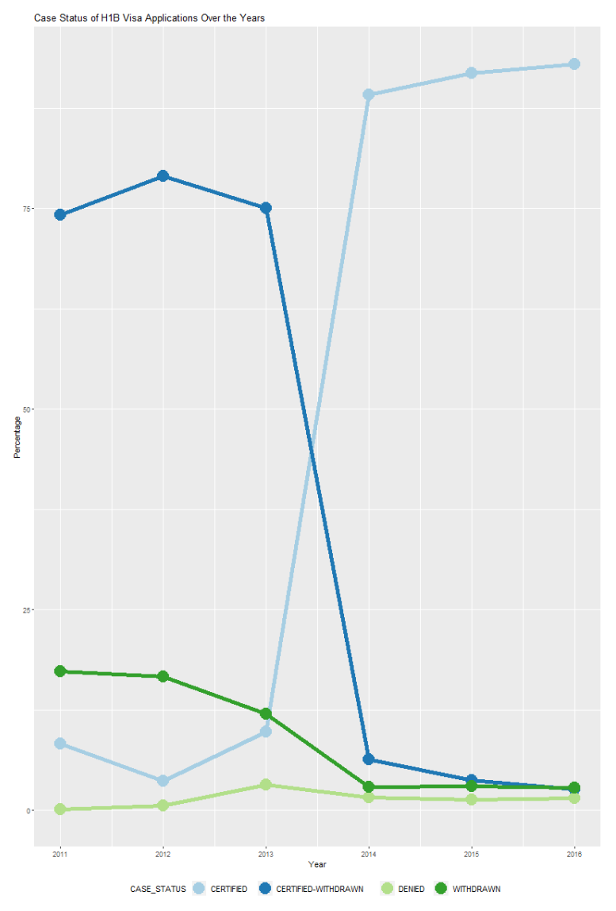
“Groupby” get more details….
Case Status of H1B VISA Applications in Percentage over the Six Years
Certified percentage rapidly grow 2013-2014 and had a great increasing trend.
The denied rate was stable.
A great signal!

Slide 8
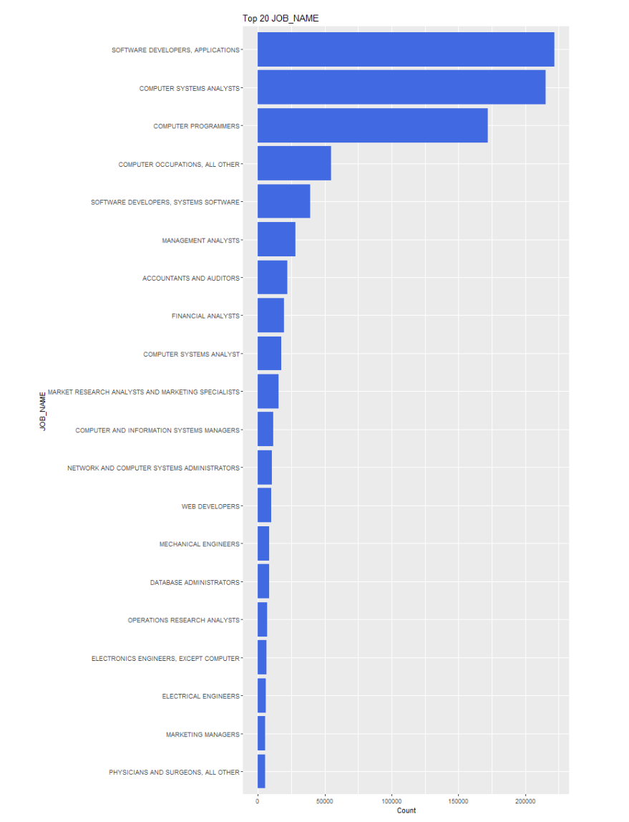
Groupe by JOB_NAME in descending order
Top 20 JOB?
# 1 SOFTWARE DEVELOPERS, APPLICATIONS 221777
# 2 COMPUTER SYSTEMS ANALYSTS 215348
# 3 COMPUTER PROGRAMMERS 171963
# 4 COMPUTER OCCUPATIONS, ALL OTHER 54675
# 5 SOFTWARE DEVELOPERS, SYSTEMS SOFTWARE 39355
# 6 MANAGEMENT ANALYSTS 28115
# 7 ACCOUNTANTS AND AUDITORS 22113
# 8 FINANCIAL ANALYSTS 19398
# 9 COMPUTER SYSTEMS ANALYST 17426
# 10 MARKET RESEARCH ANALYSTS AND MARKETING SPECIALISTS 15577
The demand for an international workforce for computer-related jobs is high!

Slide 9
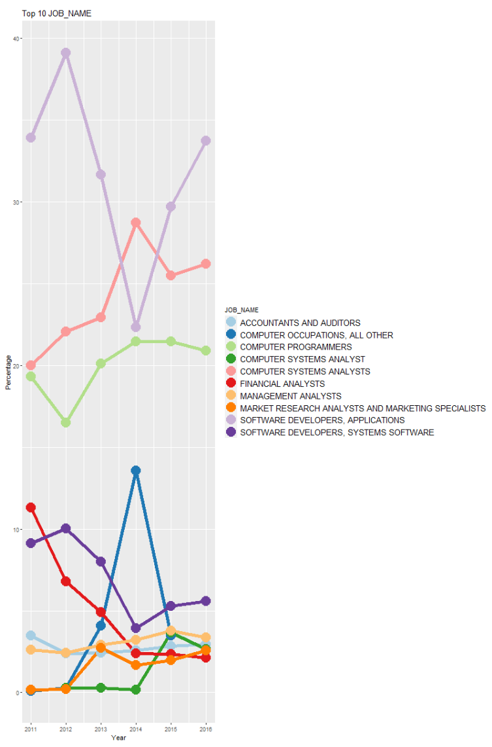
For TOP 10, how have they changed?
More Promising Jobs:
Computer Programmers
Computer Systems Analyst
Software Developer
Now we narrowed the target!

Slide 10
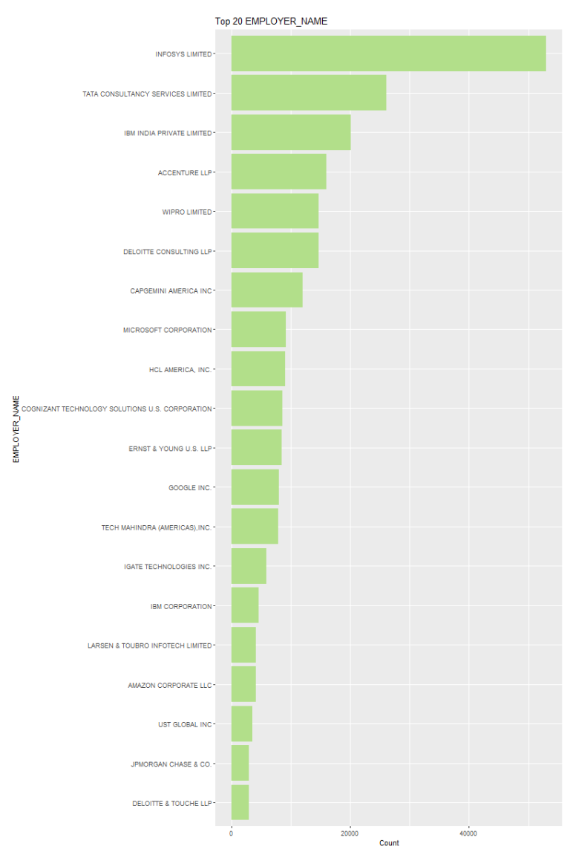
Which employers file the most petitions each year?
EMPLOYER_NAME TOP 10:
1 INFOSYS
2 TATA CONSULTANCY SERVICES
3 IBM INDIA PRIVATE
4 ACCENTURE
5 WIPRO
6 DELOITTE
7 CAPGEMINI AMERICA
8 MICROSOFT
9 HCL AMERICA
10 COGNIZANT TECHNOLOGY SOLUTIONS
The top 2 are all indian consulting companies.
A big part of BIG name companies, like IBM, Accenture.

Slide 11
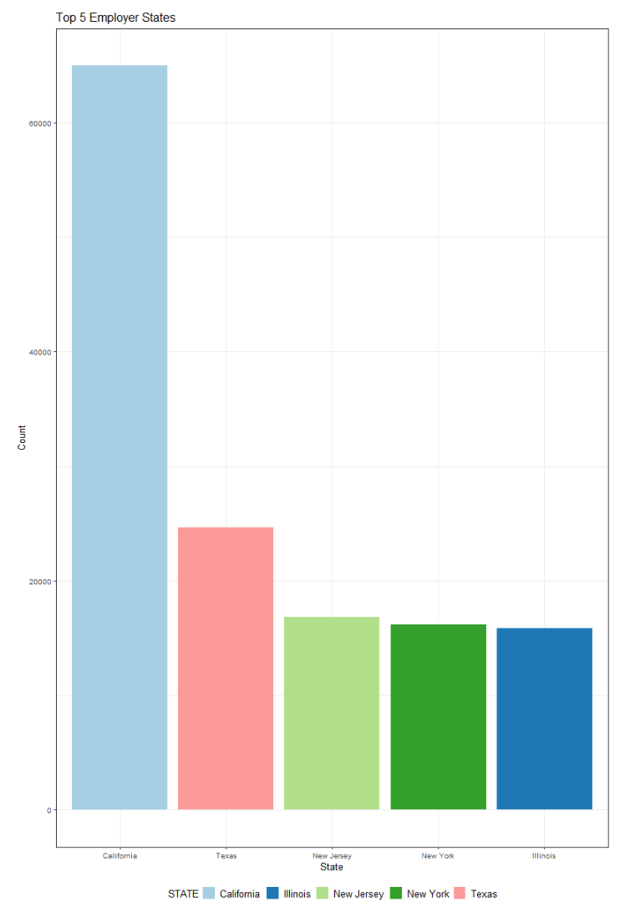
After considering, she want to work as a software developer in the US.
Where should her go to have a degree?
I used …
#change the state abbreviation to state full name
#Aggregate the JOB_NAME contain "software developer" by state
California definitely BEST choice!

Slide 12
Now, we have made a primary plan for Claire！
Enroll in a Computer Science Degree
Get a Software Engineer Job
Live in California
Let us create a model, help her predict whether she can get certified or denied!

Slide 13
Data Modeling
Class the case status to 'certified' and 'denied' as 1 and 0 – Binary Variable
Split 70% rows in training data, others as test data.
Model:
Logit Regression
Random Forest
Decision Tree
Confusion Matrix — Compare Accuracy
Compare the accuracy of the three models plotting ROC ( The highest AUC is the best )
Due to the high percentage of certified (0.89), ROC comparison could be more reliable.

Slide 14
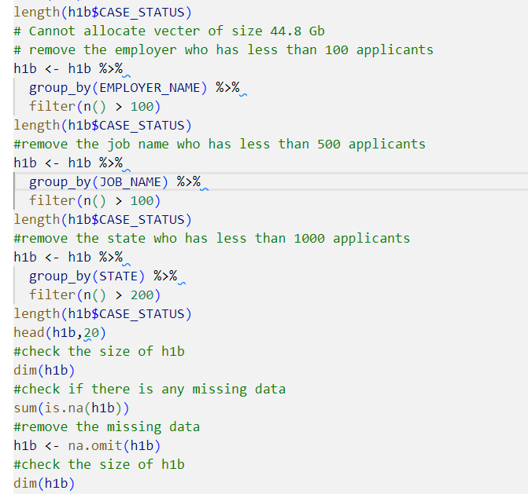
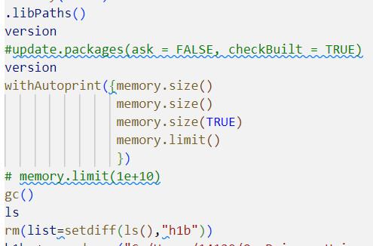
Remaining Problems and Summary
Obviously, I did not choose the best model here, because I got a problem on memory limit, I have tried almost all the methods I can find online. (attached screenshot)
But, I learned the cleaning step also includes deleting useless data, and be careful about the size, bigger is not better.

Slide 15
Remaining Problems and Summary
From the first plot, we can see the year distribution is not reasonable, I downloaded this dataset from Kaggle with very few notebooks….
It is very necessary to focus on the source and accuracy of our dataset, then do your analysis!
Overall, an enjoying trip!

