Slide 1

DQM4HEP as an Online
Monitor for Testbeams
Tom Coates, Carlos Chavez-Barajas,
Rémi Ete, Antoine Pingault
BTTB 2017
Barcelona, Spain
2017-01-26

Slide 2


Outline
Introduction to DQM4HEP
  Introduction and background
  Motivation
  Prerequisites and dependencies
  Feedback
Structure
Installation
  Downloading
  Configuration
  Optional sub-packages
  ilcsoft installation
Cont'd...

Slide 3
Outline
Running
  First-time setup
  Running manually from the command line
  Running with the job control
  Demonstration/Exercise
Analysis and Standalone Modules
  Structure and purpose of a module
  Writing steering files, sourcecode, and header files
  Demonstration/Exercise
Future Changes and Versions
  Upcoming features
  DQM4HEP as an AIDA-2020 common monitoring
Support and Contacts

Slide 4
Introduction to DQM4HEP

Slide 5
DQM4HEP
Data Quality Monitoring for High-Energy Physics
Generic C++11 framework to perform online data analysis and data quality report
Focus the physicists on the data analysis, the DAQ engineer on DAQ binding, and the shifter on monitoring tasks. Let the framework deal with online application workflow, interprocess communication and memory management.
  Project page: https://github.com/DQM4HEP
Slide by R. Ete, A. Pingault, L. Mirabito

Slide 6
DQM4HEP
Data Quality Monitoring for High-Energy Physics
Features
  Event distributed system (client/server architecture)
  User interfaces designed for data quality analysis
  Monitor element distributed system
  Graphical user interface for data visualization (Qt GUI)
  Large scale remote process management
  Generic IO to support many different experiments
  Designed for tasks from monitoring simple prototypes up to complex systems like ILD or LHC detectors
  Logbook interface (ELog)
Slide by R. Ete, A. Pingault, L. Mirabito

Slide 7
Motivation
AIDA-2020 project to create and enhance advanced infrastructures for particle detectors and testbeams
Work Package 5 – Data acquisition system for beam tests
Common and generic data acquisition frameworks speed up data taking – less set-up and “donkey work”
DQM4HEP will be part of WP5 as the online monitor, as it is generic, configurable and compartmentalised

Slide 8
Prerequisites & Dependencies
Unix-based – works on Linux or OSX/MacOS
Requires only Cmake – all other dependencies are installed by the metapackage if not present
Some sub-packages have other dependencies:
  DQMViz requires Qt and Root (compiled with Qt)
  DQM4ILC requires ilcsoft

Slide 9
Future Changes
Many changes are planned for the framework in the next 7-9 months
Aimed at increasing efficiency, speed, and usability but will break backwards compatibility
Affected code should be easily fixable but old modules will not work
Caveat emptor!

Slide 10
Feedback
DQM4HEP is still a fairly new tool and more improvements are being looked at
This session serves as an introduction to DQM4HEP but also a useful opportunity for feedback:
  What features are important to you and your team?
  What parts were easy/intuitive and what parts were confusing/difficult?
Feedback will go to the developers

Slide 11
Structure

Slide 12
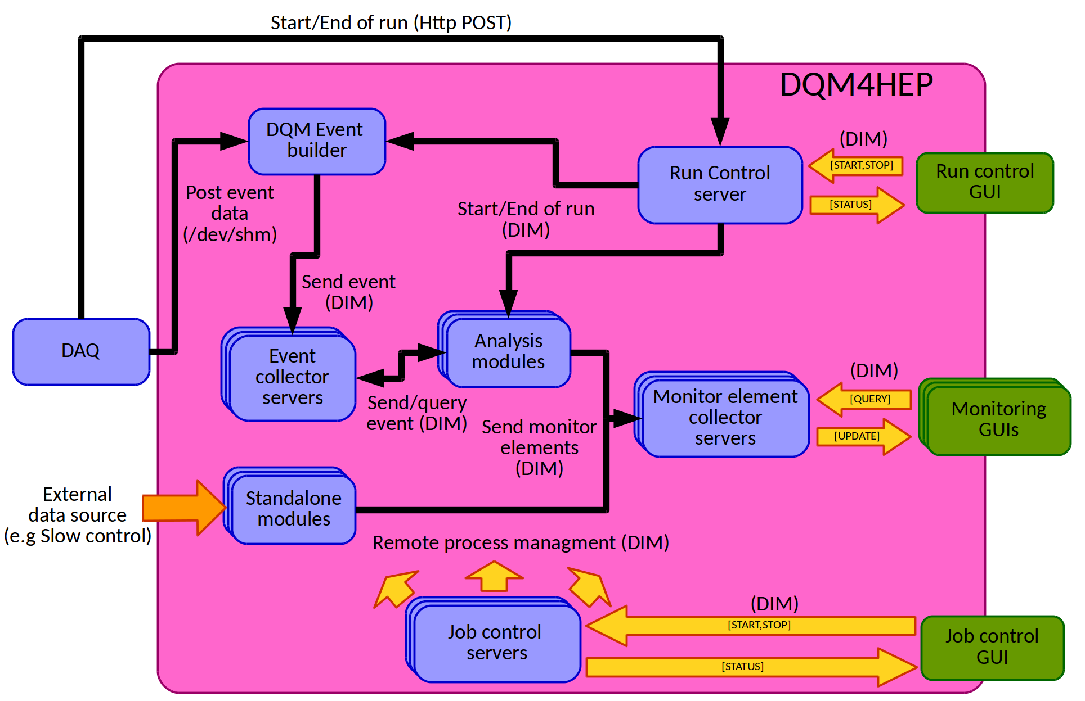
Global Structure
Slide by R. Ete, A. Pingault, L. Mirabito

Slide 13
Global Structure
Slide by R. Ete, A. Pingault, L. Mirabito

Slide 14
Event Collector
Collects events from the DAQ, event builder, or event streamer, then sends them on to the analysis module(s)
Interface between incoming data stream and the rest of the framework

Slide 15
Analysis Modules
Does the work of processing events from DAQ
Content of analysis module is user-defined, so any processing of data that is available to C++ can be done inside
Normal use case is basic selection, sorting and pre-processing of incoming data, then using this to fill plots

Slide 16
Standalone Modules
Acts identically to an analysis module but using data not coming from the event collector
Can be used for correlating or filling histograms for non-detector data, e.g. temperature
Can be used for slow control

Slide 17
Monitor Element Collector
Collects monitor elements (plots/histograms) created and published to it by modules
Acts as a server, with the monitoring interface (next slide) as the client which displays the monitor elements

Slide 18
Monitoring GUI
Graphic interface to the monitor element collector; elements published to the collector are viewable and accessible as ROOT histograms
Supports multiple canvases each with multiple windows, normal editing functions for ROOT histograms

Slide 19
Job Control and Interface
Controls and launches all other DQM4HEP processes
Used to monitor process state, restart dead or crashed processes, automate setup for running

Slide 20
Run Control
Acts as a normal run control and (optionally) may be interfaced with DAQ
Split into a server and a user interface
UI can be used to set run parameters, e.g. which values to monitor, switches, debug etc.
When not interfaced to DAQ, acts as an “on/off button” for monitoring system

Slide 21
Installation

Slide 22
Installation
DQM4HEP metapackage for installation:
  https://github.com/DQM4HEP/DQM4HEP
Requires only CMake; all other dependencies are installed automatically, except:
  DQMViz sub-package requires Qt and ROOT (compiled with --enable-qt flag on)
  DQM4ILC sub-package requires ilcsoft

Slide 23
Installation
Process:
  git clone https://github.com/DQM4HEP/DQM4HEP
  cd DQM4HEP
  mkdir build
  cd build
  cmake [options] ..
  make

Slide 24
CMake Options
-DBUILD_DQMVIZ – builds GUI package
-DBUILD_DQM4ILC – builds ILC package
-DBUILD_EXAMPLES – builds example modules
-DINSTALL_DOCS – builds doxygen
-DDIM_GUI – builds GUI for dim
-C $ILCSOFT/ILCSoft.cmake – uses ilcsoft

Slide 25
CMake Options
The format is -D[option]=[ON/OFF].
Examples:
  -DBUILD_DOCS=ON
  -DBUILD_DQM4ILC=OFF
  -DBUILD_EXAMPLES=ON

Slide 26
DQMViz
Optional package for graphics interfaces
Provides a GUI for run control interface and monitoring interface
Not required but very very useful
Requires Qt and ROOT (compiled with Qt, using the --enable-qt flag)

Slide 27
DQM4ILC
Optional package with tools and resources for ILC testbeams; requires ilcsoft
ilcsoft installation assumes access to cvmfs or afs – can be tricky in testbeams, especially with no internet access
A “reduced” ilcsoft installation is available:
  http://flcwiki.desy.de/ILCSoftInstall

Slide 28
Running

Slide 29
Pre-Running Setup
source /path/to/ilcsoft/init_ilcsoft.sh
source /path/to/root/thisroot.sh
export LD_LIBRARY_PATH=/path/to/DQM4HEP/lib:$LD_LIBRARY_PATH
export PATH=/path/to/DQM4HEP/bin:$PATH
export DIM_DNS_NODE=localhost
export DQM4HEP_PLUGIN_DLL=/path/to/DQM4HEP/lib/libDQM4ILC.so:/pa
th/to/DQM4HEP/lib/libMyModule.so

Slide 30
Running Manually
Filenames of all DQM4HEP's executables begin with dqm4hep_start_
E.g:
  dqm4hep_start_event_collector
  dqm4hep_start_dqm_monitor_gui
Most have arguments and many require some arguments; use --help to display

Slide 31
Running Manually
The dns and dim job control server are needed to manage networking processes; must be run with a root user
To set up:
  sudo su
  dns &
  dimjc_daemon

Slide 32
Running Manually
The run control issues commands to all other DQM4HEP processes – the framework will not run unless a run is started!
When used without interface to the DAQ, acts as an on/off button
To start server and client:
  dqm4hep_start_run_control_server -r [name] -k [password] &
  dqm4hep_start_run_control_interface -r [name]

Slide 33
Running Manually
Monitoring GUI is started by:
  dqm4hep_start_dqm_monitor_gui
Event collector is started by:
  dqm4hep_start_event_collector -c [name] -s [LCIO]
Monitor element collector is started by:
  dqm4hep_start_monitor_element_collector -c [name]
LCIO file service (DQM4ILC) is started by:
  dqm4hep_start_lcio_file_service -f [file] -c [event coll.]

Slide 34
Running Manually
Analysis module is started by:
  dqm4hep_start_analysis_module -f [steering file]
Event collector and ME collector names must be the same as in the analysis module steering file (more on this later)
Likewise with standalone modules:
  dqm4hep_start_standalone_module -f [steering file]

Slide 35
Demonstration/Exercise
Try these instructions on your image, if you can!
The initial environment setup is done with a bash script at /home/bttb/dqm_setup.sh
Has been added to .bashrc, so is already running
Try running the LCIO file service on the files in /home/bttb/[...]

Slide 36
Running with Job Interface
The job interface takes input from a JSON file; an example is available in:
  DQM4HEP/conf/full_test_local.js
JSON file specifies which processes to run, which libraries they use, and their arguments
Then the job interface can start, kill, or restart individual processes or groups of processes, and show status (running, sleeping, dead, etc.)

Slide 37
Running with Job Interface
[Picture goes here]

Slide 38
Analysis and
Standalone Modules

Slide 39
Analysis vs. Standalone
Analysis modules are used to process or analyse data coming from the event collector process, originating from the DAQ
Standalone modules take data coming from other sources
Structure and operation is the same otherwise

Slide 40
Components
Each module has three components:
  Steering file (e.g. MyAnalysisModule.xml)
  Sourcecode file (e.g. MyAnalysisModule.cc)
  Header file (e.g. MyAnalysisModule.h)

Slide 41
Steering File
The interface between the core DQM4HEP executable and your code
Defines and creates the module: name, what code to run, plots/histograms, etc.
Allows setting variables at runtime
Tells the module what other processes to communicate with

Slide 42
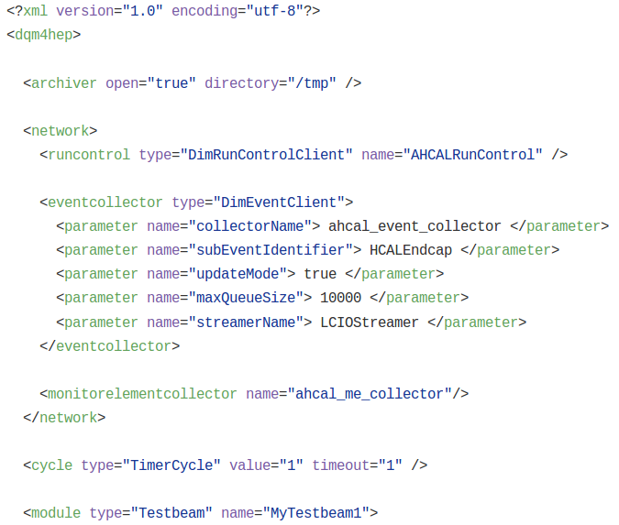
Steering File

Slide 43
Steering File
Name of run control to respond to

Slide 44
Steering File
Name of run control to respond to
Name and properties of event collector to receive events from

Slide 45
Steering File
Name of run control to respond to
Name and properties of event collector to receive events from
Name of monitor element collector to send to

Slide 46
Sourcecode File
Bulk of the module; performs all C++ tasks (processing, sorting, publishing to plots...)
Two main member functions:
  readSettings – pulls information from steering file
  processEvent – does analysis and processing

Slide 47
Functions – readSettings
The parses the steering file and performs setup
Important tasks:
  Reading any settings/switches
  Defining and booking monitor elements (plots)

Slide 48
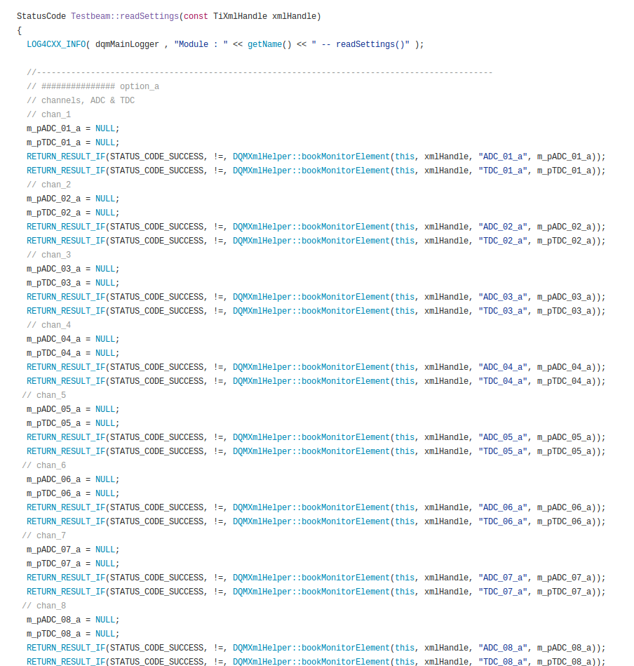
Functions – readSettings
[Pictures go here]

Slide 49
Functions – processEvent
Clue is in the name – does event-by-event processing
Opens data and performs any processing you define (which should include filling histograms with data)

Slide 50
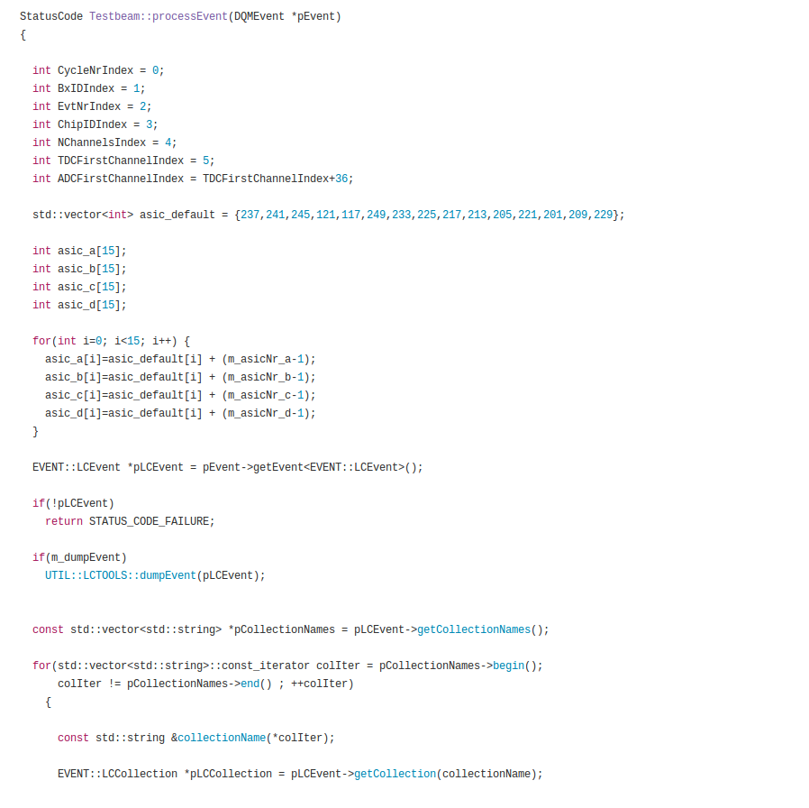
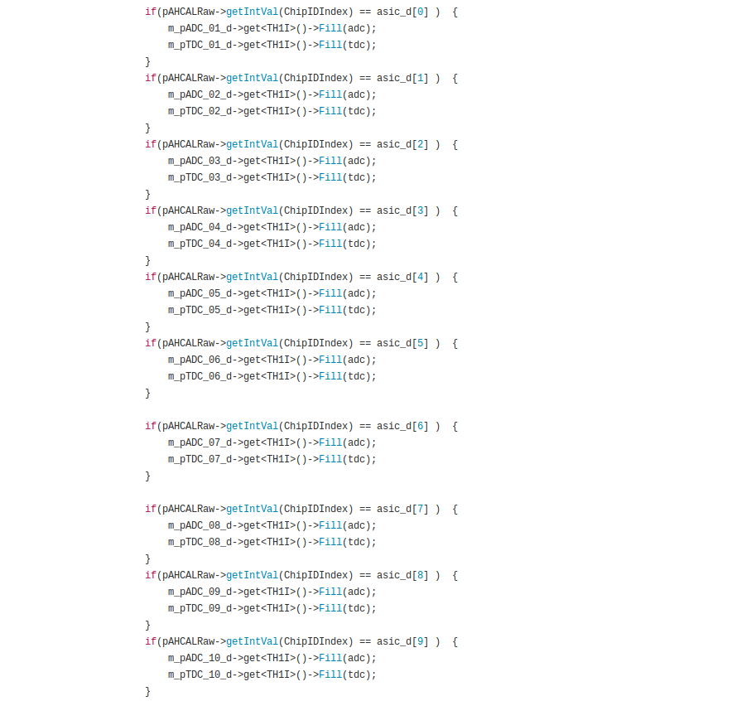
Functions – processEvent
[Pictures go here]

Slide 51
Header File
Defines any variables in the sourcecode file that must persist between member functions – as normal for a C++ header file
Notably histogram definitions and variables set by steering file

Slide 52
Data Types
Input data types don't matter – generic!
The analysis module “decodes” data within processEvent – what method is used is user-defined
Criteria for data to be compatible:
  accessible via C++ methods
  can be serialised over a network

Slide 53
Data Types
Pre-defined analysis modules are hard to make, so the github repo contains templates, rather than ready-made modules
Writing an analysis module requires knowing:
  Definition of “an event”
  Structure of data or data containers
  Geometry of detector

Slide 54
Building New Modules
CMakeLists.txt must be modified to add the directories for your module
DQM4HEP must be recompiled
New libraries must be added to DQM4HEP_PLUGIN_DLL
Then the module can be run with:
  dqm4hep_start_analysis_module -f steeringfile.xml

Slide 55
Demonstration/Exercise
There is a folder with modules from the AHCAL testbeams in /home/bttb/Downloads/
Try to copy one of these modules to the DQM4HEP installation (/home/bttb/DQM4HEP) and get it to compile and link the resulting libraries
Hint: examine the CMakeLists.txt file for other modules

Slide 56
Future Changes and Versions

Slide 57
Upcoming Features
Configuration will be done server-side, not client-side, changing the XML handing in analysis/standalone modules
ROOT will be removed – ROOT monitor elements are large and inflate serialisation buffer size; also removes a large dependency
Performance monitoring GUI

Slide 58
Upcoming Features
Cycle structures altered to allow multiple cycles per module, providing more flexibility for pulbishing of monitor elements
Refactoring of the network layer, job control, and run control
Online event display (with DD4Hep, ROOT TEve, VTK, etc.)

Slide 59
As an AIDA-2020 Monitor
DQM4HEP is situated to fulfil the milestone for common online monitoring for the AIDA-2020 project
Deliverable is due by end of October 2017
This may not be DQM4HEP's full release version, but will be a functional online monitoring framework

Slide 60
Support and Contact

Slide 61
Support
The developers are (usually) available to handle problems
Myself or Carlos can also help!
Documentation is currently either old or nonexistent; a major update of this is coming
This tutorial may form the basis of a user's guide, incorporating feedback and critique

Slide 62
Contacts
DQM4HEP e-mail – dqm4hep@gmail.com
Rémi Ete (IPNL) – rete@ipnl.in2p3.fr
Antoine Pingault (Ugent) – antoine.pingault@ugent.be
Laurent Mirabito (INPL) – laurent.mirabito@cern.ch
Tom Coates (Uni. of Sussex) – tc297@sussex.ac.uk
Carlos Chavez-Barajas (Uni. of Sussex) – carlos.chavez.barajas@cern.ch

Slide 63
Thank you
BTTB 2017
Barcelona, Spain
2017-01-26

Slide 64
[SECTION TITLE]

Slide 65
[SLIDE TITLE]
Maecenas et elit ac dui tristique egestas vitae at ante.
Donec et augue nec dui interdum laoreet.
Nullam sollicitudin nunc et eleifend ultrices.
Aliquam in est fermentum, sagittis nisl vel, condimentum dui.
Aliquam nec est sit amet velit lacinia vehicula.

