Slide 1
Welcome everyone !

Slide 2
Let’s Start with a simple video

Slide 3
Video

Slide 4


Social Media news
News are divided into two types
Fake news
Real news
54%
46%
Source: https://www.trendmicro.com

Slide 5



The effects are terrible !
It might cause
Create Fear and panic
Fights and troubles in society
Waste of time and ressources

Slide 6

How can we stop these fake news ?

Slide 7

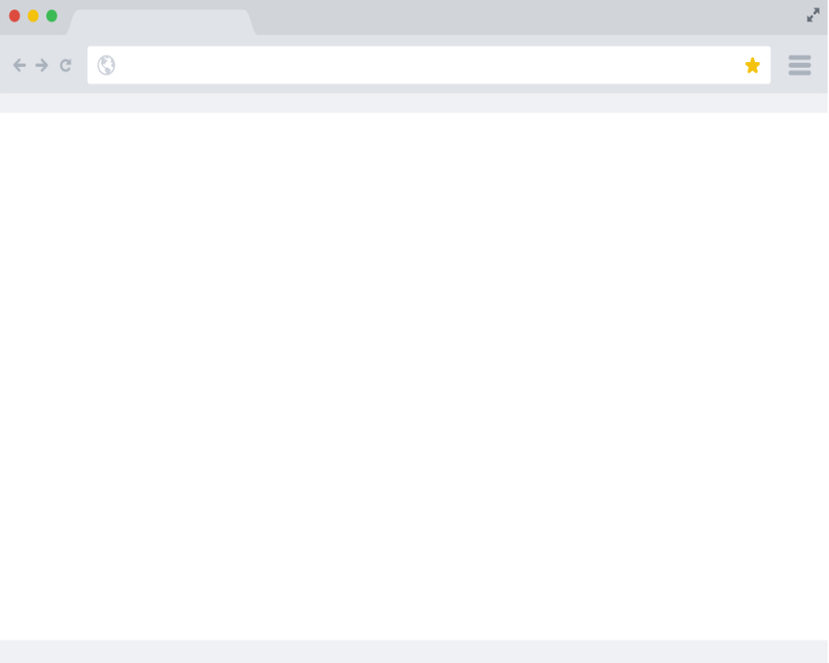
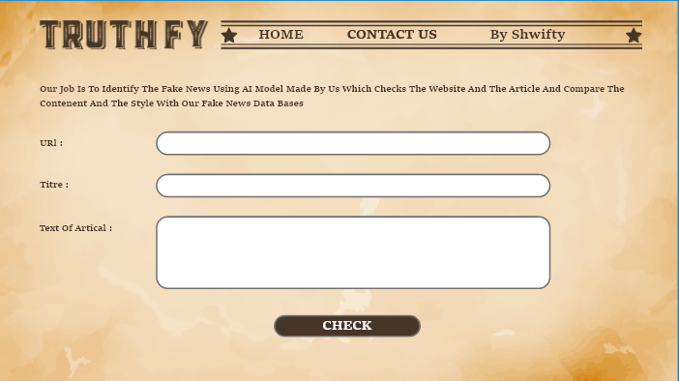
Our solution !
based on AI technologie we create a model to check websites and the articals and compare the content and style with data bases from different new websites

Slide 8


How it works ?
The website url
The name of the article
The texte of the article

Slide 9


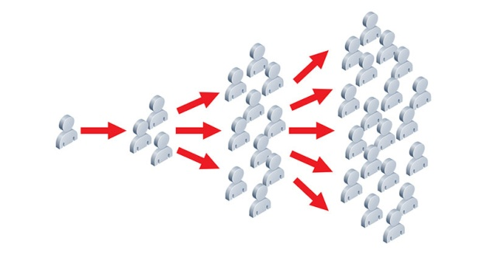
Benefits ?
Check the validity of news and trash fake ones
Prevent the fake news from spreading

Slide 10
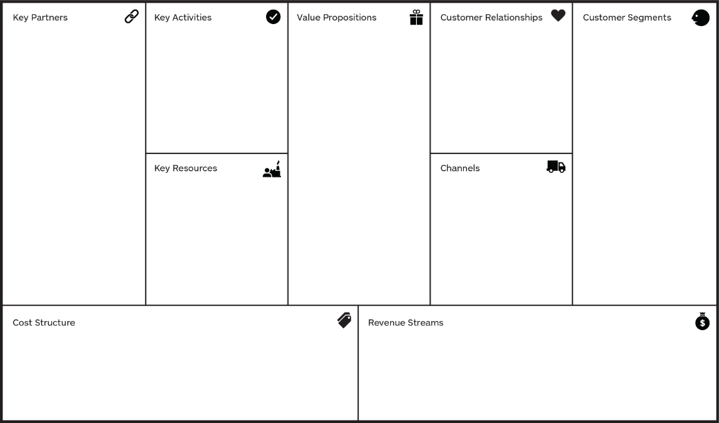
bmc
Google news
New York Times
-CNN
The Guardian
- Fox News
+ maitaining the website
+ pubs in social media
+ identifie the fake news from websites and different articles
+ everyone who wants to search for news on internet and check their validity
+ web developpement
+ web site
+ web hosting/API
+ workers payment
+ web developpement
+ office expanses (pcs, tables)
+ ads

