Slide 1
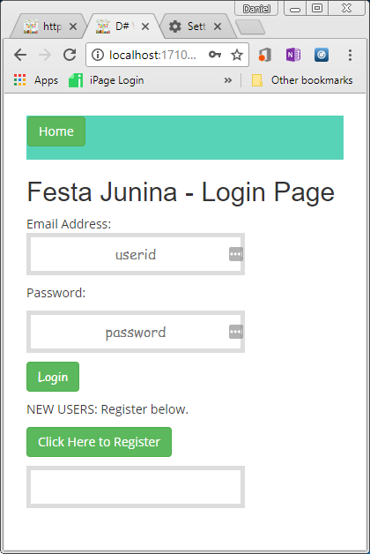
Start here

Slide 2
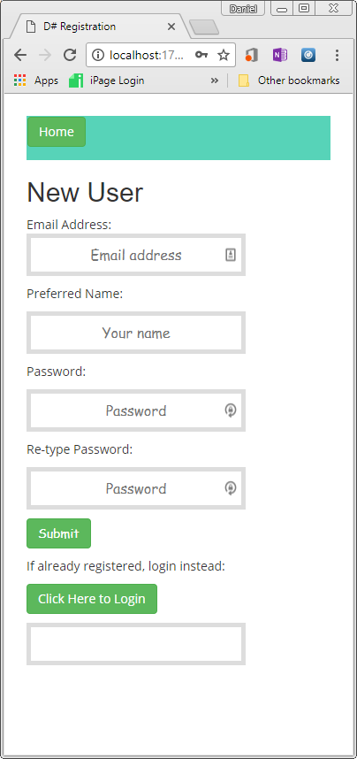
Enter your email address here
Enter your name here
Type your password
Enter your password again.
Click submit

Slide 3
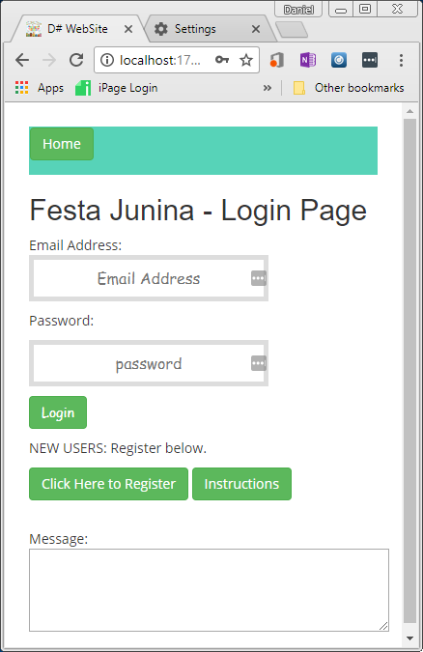
Enter your email address and password
Click login

Slide 4
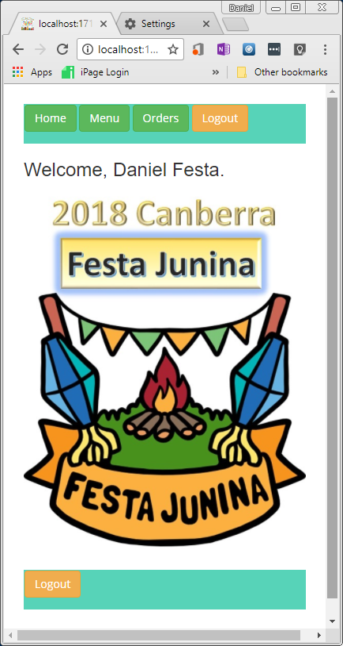
Select “Orders” to view and Place orders
Select “Menu” to see what is available.

Slide 5
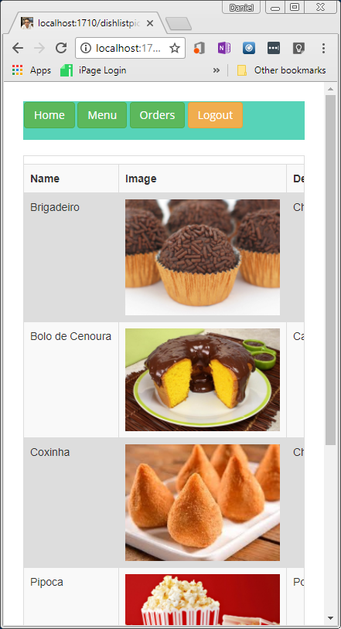
The options Menu will take you here.
In your phone you can drag and see more information about the food.

Slide 6
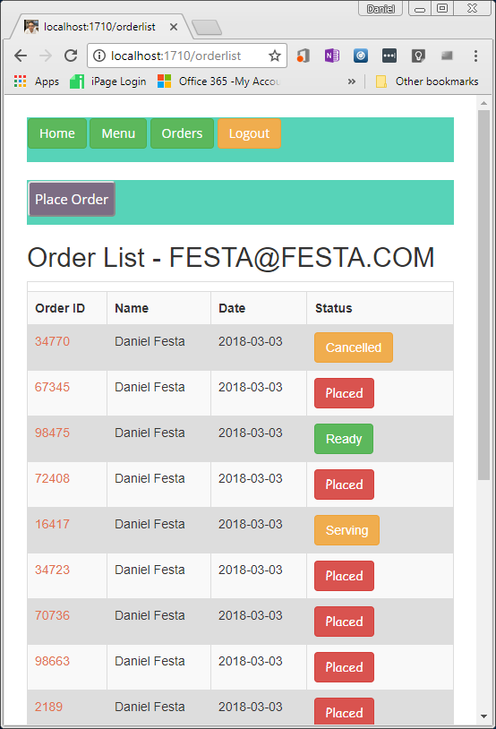
The options Menu will take you here.
You can place an order from here.
You can also check the status of your orders from here.
If you click the order ID you can see the items in your order.

Slide 7
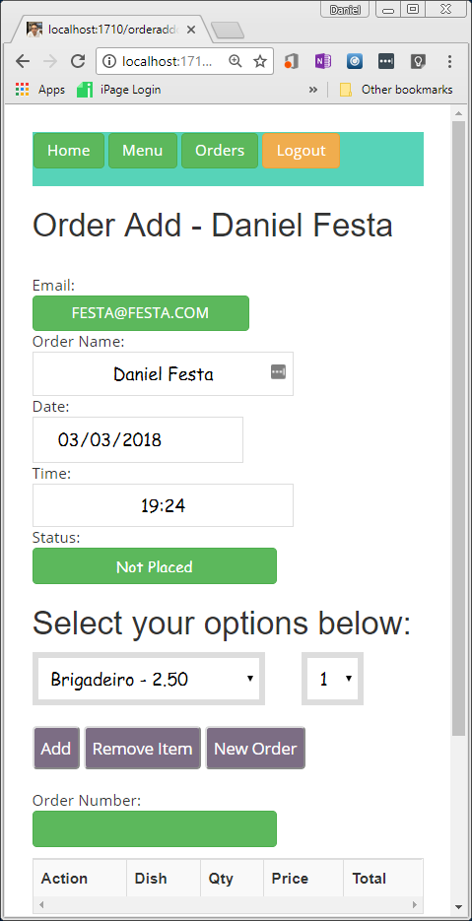
You don’t need to change these fields.
This is the status of your order
Here you select what you want
Here the quantity

Slide 8
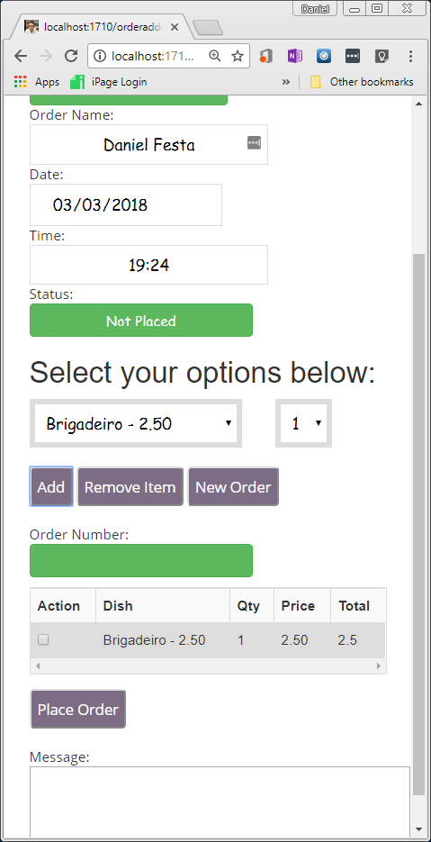
When you click Add, your item shows in the list

Slide 9
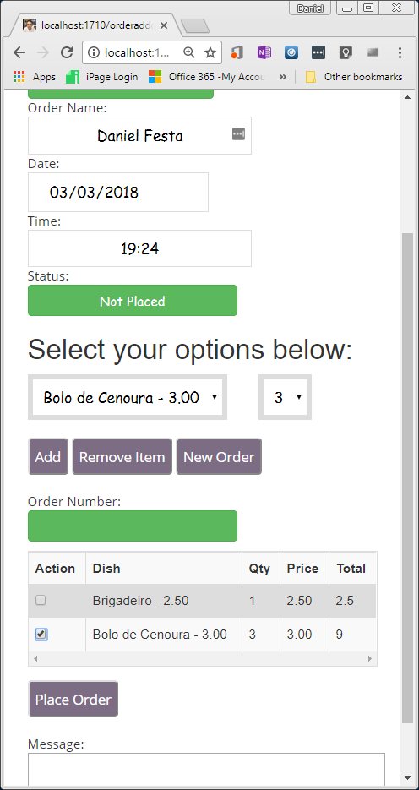
You can also remove one item by selecting the Action and clicking Remove Item
Finally you can place the order

Slide 10
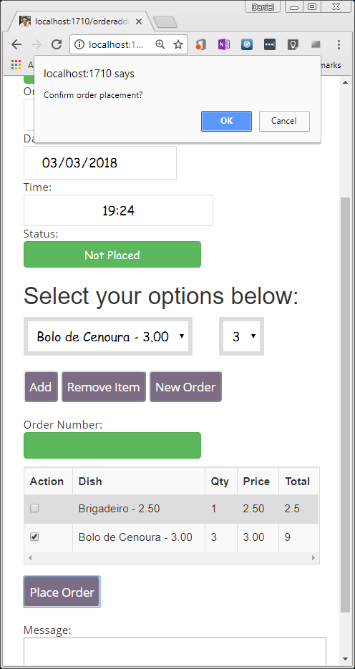
You can confirm the order by clicking OK.

Slide 11
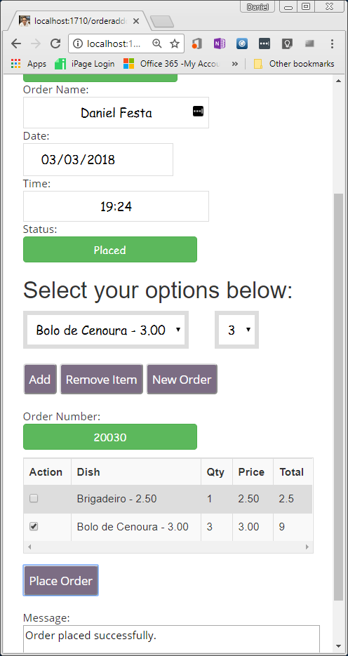
The status will change to Placed
The order number will be shown as well as a message.

Slide 12
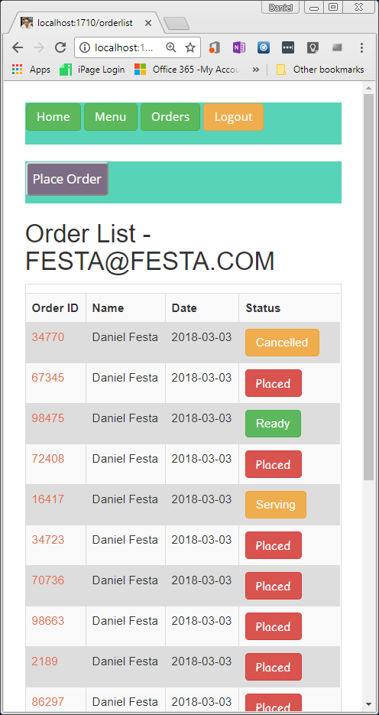
Now you show your orders and wait.
The order list automatically refreshes every 30 seconds and you will see it turning “Green” and it is “Ready” for pick-up.

