Slide 1



Exposure Java-AB 2008
Chapter 36 Slides
Algorithmic Analysis
PowerPoint Presentation
created by:
Mr. John L. M. Schram
From Materials Created
by Mr. Leon Schram

Slide 2


AP Exam Alert
Algorithmic Analysis is a big deal on the APCS Examination.
Students taking the "AB" Examination can expect questions on both the multiple choice segment and the free response segment on
this topic.
Results of previous examinations
have shown that students appear
quite unprepared and very
confused about this topic.

Slide 3


Why Algorithmic Analysis?
An understanding of algorithmic analysis, along with a good understanding of algorithms, will let you select the best
algorithm for any given situation.

Slide 4
Testing Algorithm Efficiency
with the TimeTest class

Slide 5


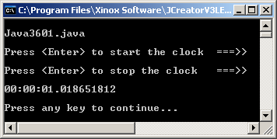
// Java3601.java
// This program uses a <TimeTest> class, which displays the elapsed time
// in hh:mm:ss.fractions for executing some program code.
import java.util.*;
import java.text.DecimalFormat;
public class Java3601
{
public static void main(String args[])
{
System.out.println("\nJava3601.java\n");
Scanner input = new Scanner(System.in);
TimeTest time = new TimeTest();
System.out.print("Press <Enter> to start the clock ===>> ");
input.nextLine();
//////////
time.startClock();
System.out.println();
System.out.print("Press <Enter> to stop the clock ===>> ");
input.nextLine();
time.stopClock();
//////////
System.out.println();
System.out.println(time);
System.out.println();
}
}
TimeTest class
shown on next slide.

Slide 6



class TimeTest
{
private long startNanos; // tick count at the start of the test
private long endNanos; // tick count at the end of the test
private long nanos; // elapsed number of nano seconds
private long hours; // elapsed hours
private long minutes; // elapsed minutes
private long seconds; // elapsed seconds
private long fractions; // elapsed fractions of a second
public TimeTest() { startNanos = 0; endNanos = 0; nanos = 0; hours = 0; minutes = 0; seconds = 0; fractions = 0; } public void startClock() { startNanos = System.nanoTime(); } public void stopClock() { endNanos = System.nanoTime(); computeTime(); } | private void computeTime() { nanos = endNanos - startNanos; hours = nanos / 3600000000000L; long leftOver = nanos % 3600000000000L; minutes = leftOver / 60000000000L; leftOver = leftOver % 60000000000L; seconds = leftOver / 1000000000L; fractions = leftOver % 1000000000L; } public String toString() { DecimalFormat twos = new DecimalFormat("00"); DecimalFormat nines = new DecimalFormat("000000000"); String temp = twos.format(hours) + ":"; temp = temp + twos.format(minutes) + ":"; temp = temp + twos.format(seconds) + "."; temp = temp + nines.format(fractions); return temp; }}

Slide 7
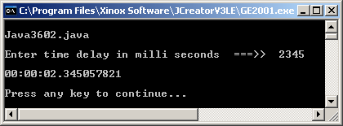
// Java3602.java This program demonstrates the <delay> method,
// which delays program execution an indicated number of milli seconds amount of time.
import java.util.*;
import java.text.DecimalFormat;
public class Java3602
{
public static void main(String args[])
{
System.out.println("\nJava3602.java\n");
Scanner input = new Scanner(System.in);
TimeTest time = new TimeTest();
System.out.print("Enter time delay in milli seconds ===>> ");
int delayTime = input.nextInt();
//////////
time.startClock();
time.delay(delayTime);
time.stopClock();
//////////
System.out.println();
System.out.println(time);
System.out.println();
}
}
class TimeTest
{
public void delay(long n)
{
n = n * 1000000;
long startDelay = System.nanoTime();
long endDelay = 0;
while (endDelay - startDelay < n)
endDelay = System.nanoTime();
}

Slide 8



// Java3603.java This program measures the time necessary to count and display integers.
import java.util.*;
public class Java3603
{
public static void main(String args[])
{
System.out.println("\nJava3603.java\n");
Scanner input = new Scanner(System.in);
TimeTest time = new TimeTest();
System.out.print("Enter an integer ===>> ");
int count = input.nextInt();
//////////
time.startClock();
counter(count);
time.stopClock();
//////////
System.out.println();
System.out.println(time);
}
public static void counter (int n)
{
for (int k = 1; k <= n; k++)
System.out.print(k + "\t");
}
}
Integer Counter
Output on
next slide

Slide 9
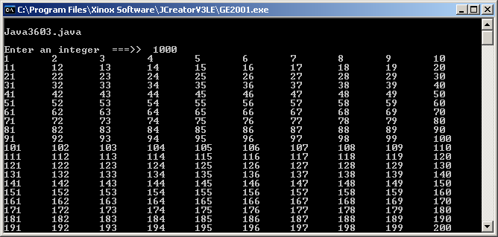
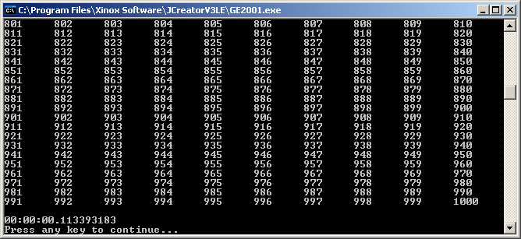
: : : : : : : : : : : : : : : : : : : : : : : : : : : : : : : : : : : : : : :

Slide 10
Accuracy Alert
Please do not be surprised when you get different results than the ones shown in this chapter. All the execution results were tested on a Pentium-IV 2.4 GHz computer.
Regardless of the computer you should get the same relative results on your computer.
If the matrix in this chapter shows elapsed time doubling with a doubling of the data size than your results should also double, even if the times are faster or slower than the textbook results.
NOTE: Since this presentation was created on a different computer,
the execution times will be different from those in the textbook.

Slide 11
Elapsed Time Matrices
Very little can be concluded by a single execution.
You will find that all the algorithms presented in this chapter will have elapsed time matrices, which show elapsed times for processing the same algorithms with four different data sizes.
The Data Size intentionally doubles each time.
Integer Counter (Java3603.java)
Data Size | 5,000 | 10,000 | 20,000 | 40,000
Elapsed Time | 0.338424 | 0.715552 | 1.605708 | 3.522277

Slide 12
Informal
Algorithmic
Analysis

Slide 13
// Java3604.java
// This program measures the time necessary to identify the largest # in an array of random integers.
import java.util.*;
public class Java3604
{
public static void main(String args[])
{
System.out.println("\nJava3604.java\n");
Scanner input = new Scanner(System.in);
TimeTest time = new TimeTest();
System.out.print("Enter array Size ===>> ");
int size = input.nextInt();
int[] list = new int[size];
createList(list,size);
time.startClock();
findLargest(time,list);
time.stopClock();
System.out.println();
System.out.println(time);
}
public static void createList (int[] list, int size)
{
Random rand = new Random(1234);
for (int k = 0; k < size; k++) {
int rndInt = rand.nextInt(9000) + 1000;
list[k] = rndInt;
}
}
public static void findLargest(TimeTest time,int[] list)
{
int largestInt = 0;
for (int k = 0; k < list.length; k++)
if (list[k] > largestInt)
largestInt = list[k];
System.out.println("Largest integer: " + largestInt);
}
}
Find Largest Integer (Java3604.java)
Data Size | 5,000 | 10,000 | 20,000 | 40,000
Elapsed Time | 0.0007808 | 0.0010071 | 0.0025458 | 0.0026964
Find Largest Integer

Slide 14
// Java3605.java
// This program measures the time necessary to remove the first element from an array.
import java.util.*;
public class Java3605
{
public static void main(String args[])
{
System.out.println("\nJava3605.java\n");
Scanner input = new Scanner(System.in);
TimeTest time = new TimeTest();
System.out.print("Enter array Size ===>> ");
int size = input.nextInt();
int[] list = new int[size];
createList(list,size);
displayList(list);
time.startClock();
removeFirstElement(time,list);
time.stopClock();
displayList(list);
System.out.println();
System.out.println(time);
}
public static void removeFirstElement(TimeTest time, int[] list)
{
for (int k = 0; k < list.length-1; k++)
list[k] = list[k+1];
list[list.length-1] = 0;
}
}
Remove 1st Array Element
Output and
matrix on
next slide

Slide 15
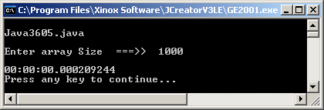
Remove First Array Element (Java3605.java)
Data Size | 1000 | 2000 | 4000 | 8000
Elapsed Time | 0.0002092 | 0.0004017 | 0.0007931 | 0.0016301

Slide 16
// Java3606.java
// This program measures the time necessary to remove the last element from an array.
import java.util.*;
public class Java3606
{
public static void main(String args[])
{
System.out.println("\nJava3606.java\n");
Scanner input = new Scanner(System.in);
TimeTest time = new TimeTest();
System.out.print("Enter array Size ===>> ");
int size = input.nextInt();
int[] list = new int[size];
createList(list,size);
displayList(list);
time.startClock();
removeLastElement(time,list);
time.stopClock();
displayList(list);
System.out.println();
System.out.println(time);
}
public static void removeLastElement(TimeTest time, int[] list)
{
list[list.length-1] = 0;
}
}
Remove Last Array Element
Output and
matrix on
next slide

Slide 17
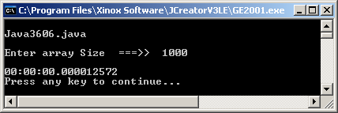
Remove Last Array Element (Java3606.java)
Data Size | 1000 | 2000 | 4000 | 8000
Elapsed Time | 0.0000126 | 0.0000153 | 0.0000159 | 0.0000156

Slide 18
// Java3607.java // This program measures the time necessary to find // an element in an array of randomly arranged // integers with a Linear Search algorithm. import java.util.*; public class Java3607 { public static void main(String args[]) { System.out.println("\nJava3607.java\n"); Scanner input = new Scanner(System.in); TimeTest time = new TimeTest(); System.out.print("Enter array Size ===>> "); int size = input.nextInt(); int[] list = new int[size]; createList(list,size); System.out.println(); displayList(list); System.out.print("Enter search item ===>> "); int searchItem = input.nextInt(); time.startClock(); int index = linearSearch(time,list,searchItem); time.stopClock(); displayIndex(index); System.out.println(); System.out.println(time); } | public static int linearSearch(TimeTest time, int[] list, int searchItem) { boolean found = false; int k = 0; while (k < list.length && !found) { if (list[k] == searchItem) found = true; else k++; } if (found) return k; else return -1; } public static void displayIndex(int index) { if (index == -1) System.out.println( "The SearchItem is not in the integer list "); else System.out.println( "The SearchItem was found at index " + index); }
Linear Search
Output and
matrix on
next slide

Slide 19
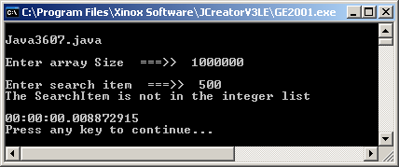
Linear Search (Java3607.java)
Data Size | 1,000,000 | 2,000,000 | 4,000,000 | 8,000,000
Elapsed Time | 0.0088729 | 0.1728655 | 0.2971969 | 0.5881012

Slide 20
// Java3608.java // This program measures the time necessary to find // an element in a sorted array with a Binary Search // algorithm. import java.util.*; public class Java3607 { public static void main(String args[]) { System.out.println("\nJava3607.java\n"); Scanner input = new Scanner(System.in); TimeTest time = new TimeTest(); System.out.print("Enter array Size ===>> "); int size = input.nextInt(); int[] list = new int[size]; createList(list,size); System.out.println(); displayList(list); System.out.print("Enter search item ===>> "); int searchItem = input.nextInt(); time.startClock(); int index = binarySearch(time,list,searchItem); time.stopClock(); displayIndex(index); System.out.println(); System.out.println(time); } | public static int binarySearch(TimeTest time, int[] list, int searchItem) { int lo = 0; int hi = list.length-1; int mid = 0; boolean found = false; while (lo <= hi && !found) { mid = (lo + hi) / 2; if (list[mid] == searchItem) found = true; else if (list[mid] > searchItem) hi = mid - 1; else lo = mid + 1; } if (found) return mid; else return -1; }
Binary Search
Output and
matrix on
next slide

Slide 21

Binary Search (Java3608.java)
Data Size | 1,000,000 | 2,000,000 | 4,000,000 | 8,000,000
Elapsed Time | 0.000029 | 0.0000301 | 0.0000312 | 0.0000316
Compare to Linear Search (Java3607.java)
Data Size | 1,000,000 | 2,000,000 | 4,000,000 | 8,000,000
Elapsed Time | 0.0088729 | 0.1728655 | 0.2971969 | 0.5881012

Slide 23
// Java3609.java // This program creates a linked list of integers. // The time is measured to see how long it takes to add // a new node at the end of the list. import java.util.*; public class Java3609 { public static void main(String args[]) { System.out.println("\nJava3609.java\n"); Scanner input = new Scanner(System.in); TimeTest time = new TimeTest(); System.out.print("Enter linked list Size ===>> "); int size = input.nextInt(); ListNode front = createList(size); System.out.println(); displayList(front); time.startClock(); addToEnd(time,front); time.stopClock(); displayList(front); System.out.println(); System.out.println(time); } | public static ListNode addToEnd(TimeTest time, ListNode p) { ListNode temp1 = new ListNode( new Integer(99999),null); if (p == null) p = temp1; else { ListNode temp2 = p; while (temp2.getNext() != null) { temp2 = temp2.getNext(); } temp2.setNext(temp1); } return p; }
Add Node to Rear
Output and
matrix on
next slide

Slide 24
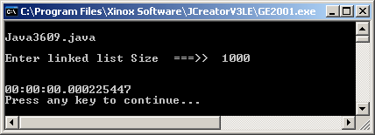
Add Node to Rear of Linked List (Java3609.java)
Data Size | 1000 | 2000 | 4000 | 8000
Elapsed Time | 0.0002254 | 0.0004422 | 0.0008579 | 0.0016884

Slide 25
// Java3610.java // This program creates a linked list of integers. // The time is measured to see how long it takes to add // a new node to the front of the list. import java.util.*; public class Java3609 { public static void main(String args[]) { System.out.println("\nJava3609.java\n"); Scanner input = new Scanner(System.in); TimeTest time = new TimeTest(); System.out.print("Enter linked list Size ===>> "); int size = input.nextInt(); ListNode front = createList(size); System.out.println(); displayList(front); time.startClock(); front = addToFront(time,front); time.stopClock(); displayList(front); System.out.println(); System.out.println(time); } | public static ListNode addToFront( TimeTest time, ListNode p) { ListNode temp = new ListNode( new Integer(9999),null); if (p == null) p = temp; else { temp.setNext(p); p = temp; } return p; }
Add Node to Front
Output and
matrix on
next slide

Slide 26
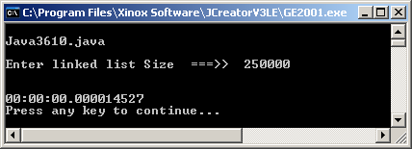
Add Node to Front of Linked List (Java3610.java)
Data Size | 250,000 | 500,000 | 1,000,000 | 2,000,000
Elapsed Time | 0.0000145 | 0.0000131 | 0.0000145 | 0.0000153

Slide 27
// Java3611.java
// This program helps to illustrate the behavior of the Bubble Sort. Method <sortOneOnly> is the
// inner comparison loop of the Bubble Sort, which only places one array element in the correct location.
import java.util.*;
public class Java3611
{
public static void main(String args[])
{
System.out.println("\nJava3611.java\n");
Scanner input = new Scanner(System.in);
TimeTest time = new TimeTest();
System.out.print("Enter array size ===>> ");
int size = input.nextInt();
int[] list = new int[size];
createList(list,size);
System.out.println();
displayList(list);
time.startClock();
sortOneOnly(time,list);
time.stopClock();
displayList(list);
System.out.println();
System.out.println(time);
}
public static void sortOneOnly(TimeTest time, int[] list)
{
for ( int q = 0; q < list.length-1; q++)
if (list[q] > list[q+1])
{
int temp = list[q]; list[q] = list[q+1]; list[q+1] = temp;
}
}
}
Sort One Only
Outputs and
matrix on the
next 2 slides

Slide 28
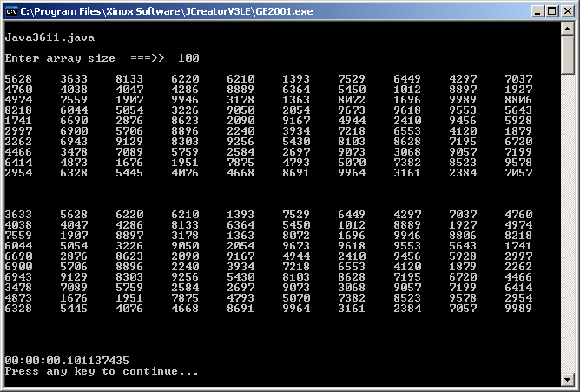

Slide 29
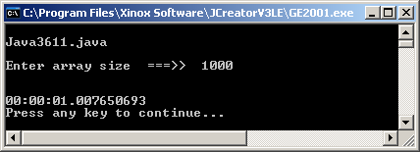
Sort Just One (Java3611.java)
Data Size | 1000 | 2000 | 4000 | 8000
Elapsed Time | 1.0076507 | 2.0190834 | 4.0340107 | 8.0532288
NOTE: The calls to the displayList method have
been commented out to keep the execution small.

Slide 30


// Java3612.java // This program tests the efficiency of a nested // loop algorithm like the Bubble Sort. import java.util.*; public class Java3612 { public static void main(String args[]) { System.out.println("\nJava3612.java\n"); Scanner input = new Scanner(System.in); TimeTest time = new TimeTest(); System.out.print("Enter array size ===>> "); int size = input.nextInt(); int[] list = new int[size]; createList(list,size); System.out.println(); displayList(list); time.startClock(); bubbleSort(list); time.stopClock(); displayList(list); System.out.println(); System.out.println(time); } | public static void bubbleSort(int[] list) { for (int p = 1; p < list.length; p++) for ( int q = 0; q < list.length-p; q++) if (list[q] > list[q+1]) { int temp = list[q]; list[q] = list[q+1]; list[q+1] = temp; } }
Bubble Sort
Output and
matrix on
next slide

Slide 31
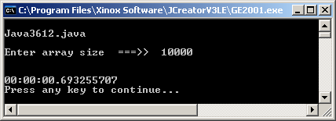
Bubble Sort (Java3612.java)
Data Size | 10,000 | 20,000 | 40,000 | 80,000
Elapsed Time | 0.6932557 | 2.4069478 | 9.3288859 | 36.573421

Slide 32
Bubble Sort with Growth Ratio (Java3612.java)
Data Size | 10,000 | 20,000 | 40,000 | 80,000
Growth Ratio | N/A | 2 | 2 | 2
Elapsed Time | 0.6932557 | 2.4069478 | 9.3288859 | 36.573421
Growth Ratio | N/A | 3.4719 | 3.8758 | 3.9204

Slide 33
// Java3613.java // This program tests the efficiency of a nested // loop algorithm like the Selection Sort. import java.util.*; public class Java3613 { public static void main(String args[]) { System.out.println("\nJava3613.java\n"); Scanner input = new Scanner(System.in); TimeTest time = new TimeTest(); System.out.print("Enter array size ===>> "); int size = input.nextInt(); int[] list = new int[size]; createList(list,size); System.out.println(); displayList(list); time.startClock(); selectionSort(list); time.stopClock(); displayList(list); System.out.println(); System.out.println(time); } | public static void selectionSort(int[] list) { int smallest = 0; for (int p = 0; p < list.length; p++) { smallest = p; for (int q = p+1; q < list.length; q++) if (list[q] < list[smallest]) smallest = q; if (list[p] != list[smallest]) { int temp = list[p]; list[p] = list[smallest]; list[smallest] = temp; } } }
Selection Sort
Output and
matrix on
next slide

Slide 34
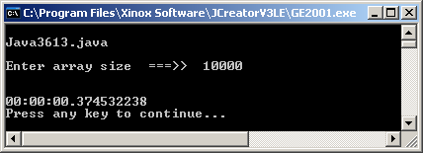
Selection Sort (Java3613.java)
Data Size | 10,000 | 20,000 | 40,000 | 80,000
Elapsed Time | 0.3745322 | 1.1203485 | 4.0757482 | 16.343745

Slide 35
Selection Sort with Growth Ratio (Java3613.java)
Data Size | 10,000 | 20,000 | 40,000 | 80,000
Growth Ratio | N/A | 2 | 2 | 2
Elapsed Time | 0.3745322 | 1.1203485 | 4.0757482 | 16.343745
Growth Ratio | N/A | 2.9913 | 3.6379 | 4.001

Slide 36
Compare the 2 Sorts:
Bubble Sort with Growth Ratio (Java3612.java)
Data Size | 10,000 | 20,000 | 40,000 | 80,000
Growth Ratio | N/A | 2 | 2 | 2
Elapsed Time | 0.6932557 | 2.4069478 | 9.3288859 | 36.573421
Growth Ratio | N/A | 3.4719 | 3.8758 | 3.9204
Selection Sort with Growth Ratio (Java3613.java)
Data Size | 10,000 | 20,000 | 40,000 | 80,000
Growth Ratio | N/A | 2 | 2 | 2
Elapsed Time | 0.3745322 | 1.1203485 | 4.0757482 | 16.343745
Growth Ratio | N/A | 2.9913 | 3.6379 | 4.001

Slide 37
Algorithmic Analysis Warnings
Never draw algorithm efficiency conclusions from processing small data lists.
Algorithms usually have some process overhead that is the same for any size of data list.
With a small list the overhead can distort the true performance of the algorithm.
Algorithm performance testing requires large data lists.
Furthermore, analysis requires multiple lists with some uniform data size pattern, such as doubling the data.
Behavior can then be measured by comparing the growth ratio of the elapsed time with the growth ratio of the data list.

Slide 38

// Java3614.java This program demonstrates the Merge Sort program.
// Note that it is a combination of an "iterative" <merge> and a recursive merge sort method.
// This <mergeSort> implementation suffers an execution penalty because a local, temporary,
// array is created and destroyed many times.
public static void merge(int list[], int first, int mid, int last) { int n = list.length; int temp[] = new int[2*n]; int p = first; int q = mid+1; int k = first; while (p <= mid && q <= last) { if (list[p] <= list[q]) { temp[k] = list[p]; p++; } else { temp[k] = list[q]; q++; } k++; } | // merge method continued while (p <= mid) { temp[k] = list[p]; p++; k++; } while (q <= last) { temp[k] = list[q]; q++; k++; } for (int h = first; h <= last; h++) list[h] = temp[h]; } | public static void mergeSort( int list[], int first, int last) { if (first < last) { int mid = (first + last) / 2; mergeSort(list,first,mid); mergeSort(list,mid+1,last); merge(list,first,mid,last); } }
Merge Sort
Output and
matrix on
next slide

Slide 39
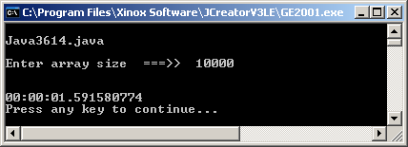


Merge Sort (Java3614.java)
Data Size | 10,000 | 20,000 | 40,000 | 80,000
Elapsed Time | 1.5915808 | 5.4826147 | 21.746571 | 86.978372
Isn't this suppose to be a fast sort?

Slide 40
Merge Sort with Growth Ratio (Java3614.java)
Data Size | 10,000 | 20,000 | 40,000 | 80,000
Growth Ratio | N/A | 2 | 2 | 2
Elapsed Time | 1.5915808 | 5.4826147 | 21.746571 | 86.978372
Growth Ratio | N/A | 3.4448 | 3.9665 | 3.9996

Slide 41

Something is
Bubble Sort with Growth Ratio (Java3612.java)
Data Size | 10,000 | 20,000 | 40,000 | 80,000
Growth Ratio | N/A | 2 | 2 | 2
Elapsed Time | 0.6932557 | 2.4069478 | 9.3288859 | 36.573421
Growth Ratio | N/A | 3.4719 | 3.8758 | 3.9204
seriously
Merge Sort with Growth Ratio (Java3614.java)
Data Size | 10,000 | 20,000 | 40,000 | 80,000
Growth Ratio | N/A | 2 | 2 | 2
Elapsed Time | 1.5915808 | 5.4826147 | 21.746571 | 86.978372
Growth Ratio | N/A | 3.4448 | 3.9665 | 3.9996
wrong!

Slide 42
// Java3614.java
// This program demonstrates the Merge Sort program.
// Note that it is a combination of an "iterative" <merge> & a recursive merge sort method.
// This <mergeSort> implementation suffers an execution
// penalty because a local, temporary, array is created
// and destroyed many times.
public static void merge(int list[], int first, int mid, int last)
{
int n = list.length;
int temp[] = new int[2*n];
int p = first;
int q = mid+1;
int k = first;
Another look...
This line causes the problem.
The next program is done
properly and is more efficient.

Slide 43

// Java3615.java
// This program demonstrates an efficient <mergeSort> method by using
// a temporary array that is only constructed once.
class IntList { private int[] intArray; private int[] tempArray; public IntList(int size) { intArray = new int[size]; tempArray = new int[size]; Random rand = new Random(1234); for (int k = 0; k < size; k++) { int rndInt = rand.nextInt(9000) + 1000; intArray[k] = rndInt; } } | public void merge(int first, int mid, int last) { int p = first; int q = mid+1; int k = first; while (p <= mid && q <= last) { if (intArray[p] <= intArray[q]) { tempArray[k] = intArray[p]; p++; } else { tempArray[k] = intArray[q]; q++; } k++; } | // merge method continued while (p <= mid) { temp[k] = list[p]; p++; k++; } while (q <= last) { temp[k] = list[q]; q++; k++; } for (int h = first; h <= last; h++) list[h] = temp[h]; }
Output and
matrix on
next slide

Slide 44
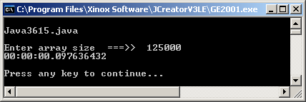
Now I'm up to speed!
Merge Sort (Java3615.java)
Data Size | 125,000 | 250,000 | 500,000 | 1,000,000 | 2,000,000
Elapsed Time | 0.09764 | 0.18857 | 0.29745 | 0.517005 | 1.020789
Compare to Bubble Sort (Java3612.java)
Data Size | 125,000 | 250,000 | 500,000 | 1,000,000 | 2,000,000
Elapsed Time | 1:18.453 | 5:27.156 | 22:22.44 | 1:29:45.52 | 6 hours

Slide 45
// Java3616.java
// This program tests the execution behavior of a triple nested loop.
// Method <computeSum) adds 1 to sum, each time the inner loop is executed.
import java.util.*;
public class Java3616
{
public static void main(String args[])
{
System.out.println("\nJava3616.java\n");
Scanner input = new Scanner(System.in);
TimeTest time = new TimeTest();
System.out.print("Enter loop size ===>> ");
int size = input.nextInt();
time.startClock();
long sum = computeSum(size);
time.stopClock();
System.out.println("Sum: " + sum);
System.out.println();
System.out.println(time);
}
public static long computeSum(int n)
{
long sum = 0;
for (int x = 1; x <= n; x++)
for (int y = 1; y <= n; y++)
for (int z = 1; z <= n; z++)
sum++;
return sum;
}
}
Triple Nested Loop
Output and
matrix on
next slide
This method
essentially
computes n³.

Slide 46
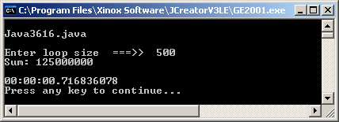
Compute Sum with Growth Ratio (Java3616.java)
Data Size | 500 | 1000 | 2000 | 4000 | 8000
Growth Ratio | N/A | 2 | 2 | 2 | 2
Elapsed Time | 0.716836 | 5.084672 | 42.58876 | 5:58.201 | 49:14.402
Growth Ratio | N/A | 7.093 | 8.376 | 8.411 | 8.248

Slide 47

The Fibonacci Sequence
The Fibonacci Sequence is a sequence of numbers, starting with two ones, which is created by taking the sum of the two previous numbers.

Slide 48
// Java3617.java
// This program computes the nth number in a Fibonacci sequence with an iterative method.
import java.util.*;
public class Java3617
{
public static void main(String args[])
{
System.out.println("\nJava3617.java\n");
Scanner input = new Scanner(System.in);
TimeTest time = new TimeTest();
System.out.print("Enter Fibonacci number ===>> ");
int n = input.nextInt();
time.startClock();
long fibo = computeFibo(n);
time.stopClock();
System.out.println("Fibonacci number " + n + " is " + fibo);
System.out.println();
System.out.println(time);
}
public static long computeFibo(int n)
{
long nr1 = 1; long nr2 = 1; long nr3 = 1;
for (int k = 3; k <= n; k++)
{
nr3 = nr1 + nr2;
nr2 = nr1;
nr1 = nr3;
}
return nr3;
}
}
Iterative Fibonacci
Output and
matrix on
next slide

Slide 49
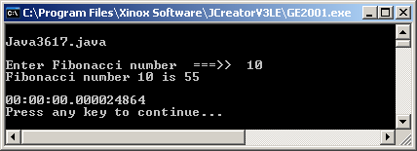
Iterative Fibonacci (Java3617.java)
Data Size | 10 | 20 | 40 | 80
Elapsed Time | 0.0000249 | 0.0000268 | 0.0000296 | 0.0000361

Slide 50
// Java3618.java
// This program computes the nth number in a Fibonacci sequence with a recursive method.
import java.util.*;
public class Java3618
{
public static void main(String args[])
{
System.out.println("\nJava3618.java\n");
Scanner input = new Scanner(System.in);
TimeTest time = new TimeTest();
System.out.print("Enter Fibonacci number ===>> ");
int n = input.nextInt();
time.startClock();
long fibo = computeFibo(n);
time.stopClock();
System.out.println("Fibonacci number " + n + " is " + fibo);
System.out.println();
System.out.println(time);
}
public static long computeFibo(int n)
{
long fiboNr = 1;
if (n == 1 || n == 2)
return fiboNr;
else
return computeFibo(n-1) + computeFibo(n-2);
}
}
Recursive Fibonacci
Output and
matrix on
next slide

Slide 51

Recursive Fibonacci (Java3618.java)
Data Size | 10 | 20 | 40 | 80
Elapsed Time | 0.0000467seconds | 0.0016164seconds | 2.7390668 seconds | 95,498 YEARS
NOTE: The book shows 88,732 years because the author's computer is faster than mine.

Slide 52
Recursive Method Calls for the 80th Fibonacci #
Every recursive call in the recursive Fibonacci solution generates two additional recursive calls.
This means that the 80th Fibonacci number generates 2⁸⁰ recursive method calls.
This is 1,208,925,819,614,629,174,706,176 calls and it takes roughly 88,732 years to make that many method calls on a 2006 Pentium IV 2.8GHz computer
Using an iterative solution for the same problem and the same 80th Fibonacci number takes 0.000021 seconds.
Selecting the correct algorithm and correct implementation can make a MAJOR difference in program performance.

Slide 53
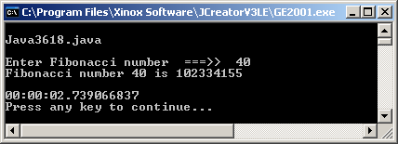
Another look
at Recursive
Fibonacci...
Recursive Fibonacci (Java3618.java)
Sequence # | 40 | 41 | 42 | 43 | 44
Elapsed Time | 2.73907 | 4.35509 | 6.90844 | 11.0581 | 18.0138
Growth Ratio | N/A | 1.59 | 1.59 | 1.81 | 1.63
At this rate, it will take 100,000,000,000
years to find the 100th Fibonacci number.

Slide 54
Another look
at Recursive
Fibonacci...
Recursive Fibonacci (Java3618.java)
Sequence # | 40 | 41 | 42 | 43 | 44
Elapsed Time | 2.73907 | 4.35509 | 6.90844 | 11.0581 | 18.0138
Growth Ratio | N/A | 1.59 | 1.59 | 1.81 | 1.63
And it would take 200,000,000,000
years to find the 101st Fibonacci number.

Slide 55
Measuring
Algorithmic
Consistency

Slide 56
Algorithmic Analysis
Focus Reminder
The focus of this chapter is algorithmic analysis.
Algorithms are presented in fully workable programs since you may not remember the code from previous chapters.
It does not matter if you remember the algorithmic logic and the source code right now.
The purpose of this chapter is to study the behavior of algorithms during program execution of different data lists.
The analysis of this behavior and the conclusions from this analysis is the primary concern.
In a later chapter you will use this algorithmic analysis and also focus on the details of the algorithmic logic.

Slide 57

// Java3619.java
// This program sorts a list of integers with the "Smart" Bubble Sort.
// This program compares sorting with three types of number
// lists: random, sorted ascending and sorted descending
import java.util.*;
public class Java3619
{
public static void main(String args[])
{
System.out.println("\nJava3619.java\n");
Scanner input = new Scanner(System.in);
TimeTest time = new TimeTest();
System.out.println("ENTER NUMBER LIST CONFIGURATION\n");
System.out.println(" [1] Random List");
System.out.println(" [2] Sorted in Ascending Order");
System.out.println(" [3] Sorted in Descending Order\n");
System.out.print("Enter Your Choice ===>> ");
int choice = input.nextInt();
System.out.print("Enter array size ===>> ");
int size = input.nextInt();
IntList x = new IntList(choice,size);
x.displayList();
time.startClock();
x.smartBubbleSort();
time.stopClock();
x.displayList();
System.out.println(time);
System.out.println();
}
}
Smart Bubble Sort
Continued on
the next few slides

Slide 58
class IntList
{
private int[] intArray;
public IntList(int choice, int size)
{
intArray = new int[size];
switch (choice)
{
case 1: Random rand = new Random(1234);
for (int k = 0; k < size; k++)
{
int rndInt = rand.nextInt(9000) + 1000;
intArray[k] = rndInt;
}
break;
case 2: for (int k = 0; k < size; k++)
intArray[k] = 1001 + k;
break;
case 3: for (int k = 0; k < size; k++)
intArray[k] = 1000 + size - k;
break;
default: System.out.println("Erroneous Input");
}
}

Slide 59
public void swap(int a, int b)
{
int temp = intArray[a];
intArray[a] = intArray[b];
intArray[b] = temp;
}
public void smartBubbleSort()
{
int p = 0;
boolean sorted = false;
while (!sorted)
{
sorted = true;
p++;
for (int q = 0; q < intArray.length-p; q++)
if (intArray[q] > intArray[q+1])
{
swap(q,q+1);
sorted = false;
}
}
}
}

Slide 60
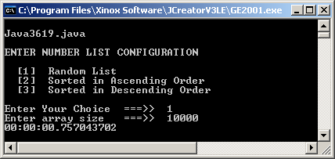


Slide 61
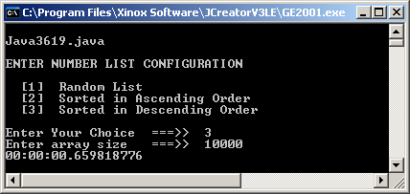
Smart Bubble Sort (Java3619.java)
Data List Type | 5,000 | 10,000 | 20,000 | 40,000 | 80,000
Random List | 0.27644 | 0.75704 | 2.66103 | 10.256 | 40.4952
Ascending List | 0.00144 | 0.0029 | 0.00526 | 0.00568 | 0.00639
Descending List | 0.24298 | 0.65981 | 2.25352 | 8.58541 | 33.819

Slide 62
Smart Bubble Sort Consistency
An algorithm is called consistent if the execution behavior is not altered by the nature of the data that is processed.
The Smart Bubble Sort is NOT CONSISTENT.
The Smart Bubble Sort executes slowly for random lists, and for lists that are sorted in reverse order.
The Smart Bubble Sort is very, very fast for lists that are already sorted in the desired order.

Slide 63
// Java3620.java
// This program sorts a list of integers with the Merge Sort.
// This program compares sorting with three types of number
// lists: random, sorted ascending and sorted descending
class IntList
{
private int[] intArray;
private int[] tempArray;
public void mergeSort(int first, int last)
{
if (first < last)
{
int mid = (first + last) / 2;
mergeSort(first,mid);
mergeSort(mid+1,last);
merge(first,mid,last);
}
}
}
Merge Sort Consistancy
Outputs and
matrix on the
next couple
slides

Slide 64



Slide 65

Merge Sort (Java3620.java)
Data List Type | 500,000 | 1,000,000 | 2,000,000 | 4,000,000
Random List | 0.2975655 | 0.527117 | 1.0924631 | 2.2295982
Ascending List | 0.2598495 | 0.4408108 | 0.8393178 | 1.6615581
Descending List | 0.2623786 | 0.4424224 | 0.8340099 | 1.643015

Slide 66
Merge Sort Consistency
The Merge Sort executes VERY CONSISTENTLY for any type of data, random, sorted or reverse sorted order.

Slide 68
The Quick Sort
The object with the Quick Sort is not to try to put any data in its right location on the first pass.
Rather, work with broad sweeping strokes and on the first pass create two groups.
One group is a list of numbers less than or equal to some pivot or partition and the second group is a list of numbers greater than the pivot.
53 | 31 | 75 | 19 | 45 | 64 | 83 | 12 | 92 | 87 | 29 | 80 | 34 | 58 | 67 | 52
The first number is the pivot.

Slide 69
Original List Before Partitioning
53 | 31 | 75 | 19 | 45 | 64 | 83 | 12 | 92 | 87 | 29 | 80 | 34 | 58 | 67 | 52
1st Partitioning
31 | 19 | 45 | 12 | 29 | 34 | 52 | 53
75 | 64 | 83 | 92 | 87 | 80 | 58 | 67
2nd Partitioning
19 | 12 | 29 | 31
45 | 34 | 52 | 53
64 | 58 | 67 | 75
83 | 92 | 87 | 80
3rd Partitioning
12 | 19
31 | 29
34 | 45
52 | 53
58 | 64
67 | 75
80 | 83
92 | 87
4th Partitioning
12 | 19 | 29 | 31 | 34 | 45 | 52 | 53 | 58 | 64 | 67 | 75 | 80 | 83 | 87 | 92

Slide 70
// Java3621.java
// This program sorts a list of integers with the Quick Sort.
// This program compares sorting with three types of number
// lists: random, sorted ascending and sorted descending
public void quickSort(int first, int last)
{
if (first < last)
{
int temp = 0;
int pivotValue = intArray[first];
int pivotIndex = first;
for (int k = first+1; k <= last; k++)
{
if (intArray[k] <= pivotValue)
{
pivotIndex++;
temp = intArray[k];
intArray[k] = intArray[pivotIndex];
intArray[pivotIndex] = temp;
}
}
temp = intArray[pivotIndex];
intArray[pivotIndex] = intArray[first];
intArray[first] = temp;
quickSort(first,pivotIndex-1);
quickSort(pivotIndex+1,last);
}
Quick Sort
Outputs and
matrix on the
next couple
slides

Slide 71



Slide 72
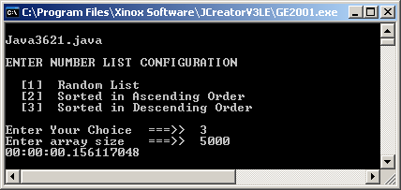
Quick Sort (Java3621.java)
Data List Type | 5,000 | 50,000 | 500,000 | 5,000,000
Random List | 0.0043106 | 0.0288579 | 0.3225231 | 14.582366
Ascending List | 0.0894734 | error | error | error
Descending List | 0.156117 | error | error | error

Slide 73
Quick Sort Consistency
The Quick Sort executes VERY INCONSISTENTLY.
Sorting efficiency is very good when the data list is randomly arranged. This means the data is not sorted at all.
Sorting efficiency is very bad when the data is already sorted in ascending or descending order.
Not only is the sorting speed very slow, the program may crash if there are too many recursive calls and the stack overflows.

Slide 74
Algorithmic Efficiency Criteria
Space Efficiency (also referred to as Space Complexity)
-- The amount of memory required to store data
Time Efficiency (also referred to as Time Complexity)
-- The amount of time required to process data
It is rarely possible to obtain optimal efficiency in both areas.
Some compromise must be reached between the demands of space and time.
The behavior studied in the previous section was concerned with time complexity, which will be the primary efficiency studied in this chapter.

Slide 75
Order of
Magnitude
"Big-O"

Slide 76
Order of Magnitude and Big-O Notation
The Order Of Magnitude expresses the relationship between the quantity of data (n) being processed and the amount of work that is needed to complete the job.
A mathematical method describes this relationship between n and the work that needs to be done.
A mathematical notation, called Big-O Notation simplifies the method by only noting the term in the method that grows the fastest relative to n.
Furthermore, constants are ignored.

Slide 77
Big-O or Reality?
Students frequently get confused about the actual processing steps performed by some algorithm and the method that describes the process. The difference is illustrated with the following program segment:
Both the outer p loop and the inner q loop repeat n-1 times. If the question is “How many times does aardvark get called?” the answer is (n-1)² times.
However, if the question is “What is the Order of Magnitude?” the answer is O(n²).
for (int p = 1; p <= n-1; p++)
for (int q = 1; q <= n-1; q++)
aardvark();

Slide 78
Big-O Notation Variables
Traditionally, the variable used to indicate the data size
in a Big-O method is n. Small n is normally used when talking about efficiency in an abstract, mathematical sense. For example, we would say in general that a nested loop has an Order of Magnitude of O(n²).
However, if a specific algorithm is analyzed then the variable(s) used in the algorithm must be used.
for (int p = 1; p <= x+1; p++)
for (int q = 1; q <= x/2; q++)
aardvark();
for (int p = 1; p <= x-1; p++)
for (int q = 1; q <= y*3; q++)
aardvark();
Big-O: O(x²)
Big-O: O(xy)

Slide 79
Look at this chart:
n | Algorithm A | Algorithm B | Algorithm C
2000 | 0.020 sec | 0.020 sec | 0.020 sec
4000 | 0.040 sec | 0.080 sec | 0.020 sec
8000 | 0.080 sec | 0.320 sec | 0.020 sec
The time of Algorithm A doubles as the size doubles.
This is linear and has an Order of Magnitude of O(n).
The time of Algorithm B quadruples as the size doubles.
This is quadratic and has a Big-O of O(n²).
The time of Algorithm C remains the same as the size doubles. This is constant and has an Big-O of O(1).

Slide 80
Big-O Notation Charts - 1
Algorithmic Analysis Method Comparisons
n | log n | n log n | n²
2 | 1 | 2 | 4
4 | 2 | 8 | 16
8 | 3 | 24 | 64
16 | 4 | 64 | 256
32 | 5 | 160 | 1,024
64 | 6 | 384 | 4,096
128 | 7 | 896 | 16,384
256 | 8 | 2,048 | 65,536
512 | 9 | 4,608 | 262,144
1,024 | 10 | 10,240 | 1,048,576
2,048 | 11 | 22,528 | 4,194,304
4,096 | 12 | 49,152 | 16,777,216
8,192 | 13 | 106,496 | 67,108,864
16,384 | 14 | 229,376 | 268,435,456
32,768 | 15 | 491,520 | 1,073,741,824
65,536 | 16 | 1,048,576 | 4,294,967,296
131,072 | 17 | 2,228,224 | 17,179,869,184
262,144 | 18 | 4,718,592 | 68,719,476,736
524,288 | 19 | 9,961,472 | 274,877,906,940
1,048,576 | 20 | 20,971,520 | 1,099,511,627,800
Linear Search
Merge Sort
Binary Search
Bubble Sort

Slide 81
Big-O Notation Charts - 2
Algorithmic Analysis Method Comparisons
n | n³ | 2^{n}
2 | 8 | 4
4 | 64 | 16
8 | 512 | 256
16 | 4,096 | 65,536
32 | 32,768 | 4,294,967,296
64 | 262,144 | 18,446,744,073,709,551,616
65 | 274,625 | 36.893,488,147,419,103,232
66 | 287,476 | 73,786,976,294,838,206,464
128 | 2,097,152 | 340,282,366,909,384,634,633,746,074,317,700,000,000
256 | 16,777,216 | 1.1579208923731619 542357098500869 * 10⁷⁷
512 | 134,217,728 | 1.3407807929942597099574024998206 * 10¹⁵⁴
Recursive Fibonacci
& Tower of Hanoi

Slide 82
Order of Magnitude Methods
Computer algorithms are rated with a small quantity of methods. Keep in mind that constants are ignored and all methods are only concerned with a single term, the one that grows the quickest when n becomes very large.
The greater majority of computer science algorithms will
display algorithmic behavior of one of the following methods:
• O(1) constant
• O(n) linear
• O(log n) logarithmic
• O(n log n) linear * logarithmic
• O(n²) quadratic
• O(n³) cubic
• O(2^{n}) exponential

Slide 83
What Good is Big-O?
It allows you to pick the best algorithm for a certain situation.
You need to be comfortable with each of the following:
Using Big-O
• Understand the meaning of the Big-O Methods
• Know the Big-O of Common Algorithms
• Understand algorithm behavior with given Big-O
• Compute Big-O of program segments and methods

Slide 84
Computing Big-O Methods
Elapsed Time Matrix
Data Size | Alg A | Alg B | Alg C | Alg D
500 | 000.283 | 000.040 | 000.105 | 005.123
1000 | 001.138 | 000.118 | 000.436 | 005.123
2000 | 004.562 | 000.232 | 001.784 | 005.123
4000 | 018.227 | 000.486 | 007.162 | 005.123
O(n²)
O(n)
O(n²)
O(1)
Growth Ratio Matrix
Data Size | Alg A | Alg B | Alg C | Alg D
500 | N/A | N/A | N/A | N/A
1000 | 4.021 | 2.950 | 4.152 | 1
2000 | 4.008 | 1.966 | 4.091 | 1
4000 | 3.995 | 2.094 | 4.014 | 1

Slide 85
Constants & Growth Ratios
The process time of most algorithms involves some constant that distorts algorithmic analysis when the data size to be processed is small.
The behavior of an algorithm is not determined by comparison with another algorithm, but by comparing the behavior of an algorithm as the data size grows.
The most accurate information is provided by the study of the time growth ratio at regular data size intervals when the data size is very large.

Slide 86
Time Complexity: O(1)
Here is the key question:
Does the time change when the list gets bigger?

Slide 87
O(1) Notes
O(1) is the time complexity of an algorithm that operates in constant time.
The process time required stays constant regardless of the data size.
Algorithm Examples with O(1)
• Adding a new front node to a linked list
• Deleting the front node from a linked list
• Removing the last element of an array
• Adding a new node to the end of a linked list
with a rear reference to the last node.

Slide 88
Time Complexity: O(n)
Look at the two display methods below. The first method displays every element in an array and the second method displays only every other array element. display1 requires twice as much processing as display2, but they both operate in linear time.
public static void display1 (int[] list) { int n = list.length; for (int k = 0; k < n; k++) System.out.print(list[k] + " "); }
public static void display2 (int[] list) { int n = list.length; for (int k = 0; k < n; k++) if (k % 2 == 0) System.out.print(list[k] + " "); }

Slide 89
O(n) Notes
O(n) is the time complexity of an algorithm that operates in linear time.
The process time changes in the same ratio as the data size.
Algorithm Examples with O(n)
• Linear search
• Displaying elements in a one-dimensional array
• Traversing a linked list
• Traversing a binary tree
• Smart Bubble Sort with a sorted list

Slide 90
Time Complexity: O(log n)
When we discuss logs (abbreviation for logarithms) it is customary to mention the base of the log. A table follows below with a variety of logs. Some of the tables use base 10 that is often used in Algebra II text books. Other columns show expressions with base 2, which is more appropriate for our algorithmic analysis:
N | 2^{log} = N | Log₂ N = | 10^{log} = N | Log₁₀ N =
2 | 2¹ = 2 | 1.0000 | 10^{0.0301} = 2 | 0.0301
4 | 2² = 4 | 2.0000 | 10^{0.6020} = 4 | 0.6020
8 | 2³ = 8 | 3.0000 | 10^{0.9030} = 8 | 0.9030
16 | 2⁴ = 16 | 4.000 | 10^{1.2041} = 16 | 1.2041
32 | 2⁵ = 32 | 5.000 | 10^{1.5051} = 32 | 1.5051
64 | 2⁶ = 64 | 6.000 | 10^{1.8061} = 64 | 1.8061
100 | 2^{6.6459} = 100 | 6.6459 | 10² = 100 | 2.0000
128 | 2⁷ = 128 | 7.000 | 10^{2.1072} = 128 | 2.1072
256 | 2⁸ = 256 | 8.000 | 10^{2.4232} = 256 | 2.4232
512 | 2⁹ = 512 | 9.000 | 10^{2.7092} = 512 | 2.7092
1000 | 2^{9.9658} = 1000 | 9.9658 | 10³ = 1000 | 3.0000
1024 | 2¹⁰ = 1024 | 10.0000 | 10^{3.0102} = 1024 | 3.0102

Slide 91
O(log n) Notes
O(log n) is the time complexity of an algorithm that operates in logarithmic time.
This means that process time is incremented by one unit of time every time the size of the data doubles.
Algorithm Examples with O(log n)
• Binary Search of a sorted array
• Binary Search of a Binary Search Tree
(fairly balanced)
• Inserting a new node in a Binary Search Tree
• Number of merges performed in a Merge Sort

Slide 92
Time Complexity: O(n²)
Look at the two bubbleSort methods below.
bubbleSort1 has the inner loop iterate almost as many times as there are array elements.
Method bubbleSort2 handles the efficiency problem nicely by subtracting p from the length of the list array.
bubbleSort1 requires twice as much processing as bubbleSort2, but they both operate in quadratic time.
public static void bubbleSort1 ( int[ ] list) { for (int p = 1; p < list.length; p++) for (q = 0; q < list.length-1; q++) if (list[q] > list[q+1] swap(list[q],list[q+1]); }
public static void bubbleSort2 ( int[ ] list) { for (int p = 1; p < list.length; p++) for (q = 0; q < list.length-p; q++) if (list[q] > list[q+1] swap(list[q],list[q+1]); }

Slide 93
O(n²) Notes
O(n²) is the time complexity of an algorithm that operates in quadratic time.
This means that process time increases with the square of the data size increase.
Algorithm Examples with O(n²)
• Bubble Sort
• Selection Sort
• Insertion Sort

Slide 94
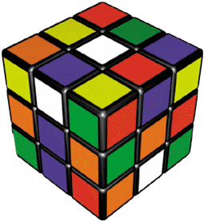
Time Complexity: O(n³)
You will not see popular sorting and searching algorithms behave in O(n³) time.
Yet, it still needs to be mentioned because algorithms do use triple loops and the popularity of graphics and 3D images can involve considerable processing in 3D space.
// From Java3616.java
public static long computeSum(int n)
{
long sum = 0;
for (int x = 1; x <= n; x++)
for (int y = 1; y <= n; y++)
for (int z = 1; z <= n; z++)
sum++;
return sum;
}
It is not a coincidence that this method computes n³.

Slide 95

O(n³) Notes
O(n³) is the time complexity of an algorithm that operates in cubic time.
This means that process time increases with the cube of the data size increase.
Algorithm Examples with O(n³)
• Matrix Multiplication
• 3D Graphics Algorithms

Slide 96
Time Complexity: O(n log n)
This Order of Magnitude occurs when some process -- with a Big-O of O(log n) -- is placed inside a loop that repeats n times. This results in an Order of Magnitude of O(n * log n). Processes like this behave in linear * logarithmic time though some find it easier to say simply n log n.
The Binary Tree Sort is an example.
Inserting 1 node into a
Binary Search Tree
has a Big-O of O(log n).
Inserting n nodes into a
Binary Search Tree
has a Big-O of O(n log n).
500
300
700
200
400
600
800
150
250
350
550
750
850
575
825

Slide 97
O(n log n) Notes
O(n log n) is the time complexity of an algorithm that operates in n times logarithmic time.
If you take a close look at this behavior you will note that it is just about linear when n is very large.
Algorithm Examples with O(n log n)
• Merge Sort
• Binary Tree Sort
• Quick Sort
• Heap Sort (introduced in Chapter 38)

Slide 98
Time Complexity: O(2^{n})
Algorithms with O(2^{n}) time complexity do not need a very large n before they reach outside any chart, and the process capability of the fastest computers.
This behavior is the exact opposite of the logarithmic behavior. Logarithmic behavior is terrific because you can double the size of the list and the process only increases by one process unit.
Now O(2^{n}) is bad because increasing the data size by just 1 doubles the process time.

Slide 99
O(2^{n}) Notes
O(2^{n}) is the time complexity of an algorithm that operates in exponential time.
This means that process time doubles with the addition of each data element.
This is the least efficient process behavior and cannot be used in any practical application for n any value but very small, even with the fastest computers.
Algorithm Examples with O(2^{n})
• Recursive Fibonacci Sequence method
• Tower of Hanoi solution

Slide 100
Different Cases
Most students are comfortable with the Linear Search, which will be used to give examples for the three cases below.
• Best Case
The very first comparison is a match.
The search is finished immediately.
• Worst Case
The very last comparison is a match.
The search has to compare every element
in the data structure.
• Average Case
The search makes about as many comparisons
as half the total comparisons possible.

Slide 101
AP Exam Alert
Be very careful with APCS Examination questions involving Algorithmic Analysis.
Watch carefully for clues about cases.
For instance, if the question states
arbitrary list or tree then you cannot
assume anything and you need to be
watchful for a worst case scenario.
Most Big-O questions involve
average-case and worst-case scenarios.

Slide 102
Measuring Consistency Again
It has been said that an algorithm is consistent if it behaves the same way with each of the following data lists?
• Random
• Sorted in Ascending Order
• Sorted in Descending Order
We can also say that an algorithm is consistent if the Order of Magnitude remains the same for all 3 data lists.
For example, the Merge Sort has O(n log n) for all 3 data lists. Therefore, the Merge Sort is a CONSISTENT algorithm.
The Smart Bubble Sort has O(n) for data Sorted in Ascending Order and O(n²) for the other 2 data lists. Therefore, the Smart Bubble Sort is considered NOT CONSISTANT.

