Slide 1
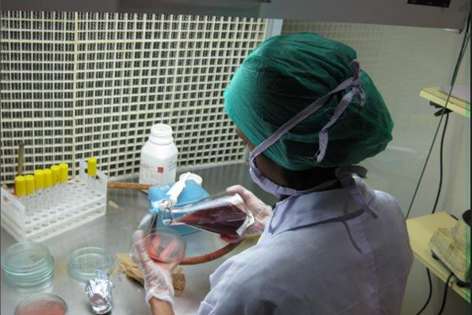

Quantum Simulations of Molecules
ACM Winter School on Quantum Computing
Lecturers: Shampa Sarkar, Nirmal M R
11 January 2022

Slide 2
We will cover
Towards a Variational Quantum Framework (VQF) – a brief overview
Influence of Molecular Orbital (MO) Basis Sets on the accuracy and efficiency of quantum simulation
IRC-VQE algorithm (Intrinsic reaction coordinate driven variational quantum eigensolver)
Summary

Slide 3
Variational Quantum Framework

Slide 4
Variational Quantum Framework
System of observation :
Molecule
Macro-molecule
Input variables
Bond Lengths
Bond Angles
Intrinsic Reaction Coordinates (IRC)
Overall Charge
Spin Multiplicity
Variational Framework
For molecular simulation (WFT ψ(r) + DFT (n(r))
Goal: Improve the Accuracy and Efficiency of simulation
Output observables
Equilibrium bond lengths, Bond angles,
Equilibrium ground state energy, etc.
Bond Dissociation Energy,
Chemical reactivity
Excited State Energy
Other Properties :
Thermodynamics (specific Heat)
Dipole moment, magnetic polarization, etc.
Molecular Dynamics
Electronic Structure Problem

Slide 5
Intrinsic Reaction Coordinates (IRC)
Intrinsic Reaction Coordinates (IRC)
Spin Multiplicity
Bond Lengths
Spin Multiplicity
Bond Lengths
Bond Angles
Bond Angles
Overall Charge
Overall Charge
WORKFLOW FOR Electronic Ground state /property simulation of (macro) MOLECULES
WORKFLOW FOR Electronic Ground state /property simulation OF (macro) MOLECULES
(Macro)Molecular Geometry Definition
- Select the (macro)molecule of interest
- Fix the location of each nucleus (BO)
(Macro)Molecular Geometry Definition
- Select the (macro)molecule of interest
- Fix the location of each nucleus (BO)
(MO) Basis Set
(MO) Basis Set
Bond Dissociation Energy
Bond Dissociation Energy
Equilibrium Bond Lengths, Angles
Equilibrium Bond Lengths, Angles
Equilibrium Ground-State Energy
Equilibrium Ground-State Energy
Construction of Fermionic Hamiltonian
- Compute one-body and two-body integrals
Construction of Fermionic Hamiltonian
- Compute one-body and two-body integrals
Molecular Dynamics
Molecular Dynamics
Dipole Moment vs Configuration
Dipole Moment vs Configuration
PES
PES
Reduction of Orbitals
- Freeze Core Electrons
- Remove Unoccupied Orbitals
- Specify electrons requiring QC treatment
Active Space Transformation
Reduction of Orbitals
- Freeze Core Electrons
- Remove Unoccupied Orbitals
- Specify electrons requiring QC treatment
Active Space Transformation
Backend
- Simulator
- Real Hardware
Backend
- Simulator
- Real Hardware
Within chemical accuracy
Compare
Compare
Ansatz/ Trial
- Chem(UCCSD,..)
- Hardware(Two Local)
Construction of Qubit Hamiltonian
- Parity, Jordan-Wigner, Bravyi-Kitaev
Ansatz/ Trial
- Chem(UCCSD,..)
- Hardware(Two Local)
Qubit Mapping
Construction of Qubit Hamiltonian
- Parity, Jordan-Wigner, Bravyi-Kitaev
Qubit Mapping
Classical Eigen Solver
Classical Eigen Solver
VQE
VQE
Reduction of Qubits
- Z2 Symmetries
- Two-qubit Reduction (Parity)
Reduction of Qubits
- Z2 Symmetries
- Two-qubit Reduction (Parity)
Optimizer
- COBYLA, SLSQP
- SPSA
Symmetry Operation
Optimizer
- COBYLA, SLSQP
- SPSA
Symmetry Operation

Slide 6
Intrinsic Reaction Coordinates (IRC)
Intrinsic Reaction Coordinates (IRC)
Spin Multiplicity
Bond Lengths
Spin Multiplicity
Bond Lengths
Bond Angles
Bond Angles
Overall Charge
Overall Charge
WORKFLOW FOR Electronic Ground state /property simulation of (macro) MOLECULES
WORKFLOW FOR Electronic Ground state /property simulation OF (macro) MOLECULES
(Macro)Molecular Geometry Definition
- Select the (macro)molecule of interest
- Fix the location of each nucleus (BO)
(Macro)Molecular Geometry Definition
- Select the (macro)molecule of interest
- Fix the location of each nucleus (BO)
(MO) Basis Set
(MO) Basis Set
Bond Dissociation Energy
Bond Dissociation Energy
Equilibrium Bond Lengths, Angles
Equilibrium Bond Lengths, Angles
Equilibrium Ground-State Energy
Equilibrium Ground-State Energy
Construction of Fermionic Hamiltonian
- Compute one-body and two-body integrals
Construction of Fermionic Hamiltonian
- Compute one-body and two-body integrals
Molecular Dynamics
Molecular Dynamics
Dipole Moment vs Configuration
Dipole Moment vs Configuration
PES
PES
Reduction of Orbitals
- Freeze Core Electrons
- Remove Unoccupied Orbitals
- Specify electrons requiring QC treatment
Active Space Transformation
Reduction of Orbitals
- Freeze Core Electrons
- Remove Unoccupied Orbitals
- Specify electrons requiring QC treatment
Active Space Transformation
Backend
- Simulator
- Real Hardware
Backend
- Simulator
- Real Hardware
Within chemical accuracy
Compare
Compare
Ansatz/ Trial
- Chem(UCCSD,..)
- Hardware(Two Local)
Construction of Qubit Hamiltonian
- Parity, Jordan-Wigner, Bravyi-Kitaev
Ansatz/ Trial
- Chem(UCCSD,..)
- Hardware(Two Local)
Qubit Mapping
Construction of Qubit Hamiltonian
- Parity, Jordan-Wigner, Bravyi-Kitaev
Qubit Mapping
Classical Eigen Solver
Classical Eigen Solver
VQE
VQE
Reduction of Qubits
- Z2 Symmetries
- Two-qubit Reduction (Parity)
Reduction of Qubits
- Z2 Symmetries
- Two-qubit Reduction (Parity)
Optimizer
- COBYLA, SLSQP
- SPSA
Symmetry Operation
Optimizer
- COBYLA, SLSQP
- SPSA
Symmetry Operation

Slide 7
Intrinsic Reaction Coordinates (IRC)
Intrinsic Reaction Coordinates (IRC)
Spin Multiplicity
Bond Lengths
Spin Multiplicity
Bond Lengths
Bond Angles
Bond Angles
Overall Charge
Overall Charge
WORKFLOW FOR Electronic Ground state /property simulation of (macro) MOLECULES
WORKFLOW FOR Electronic Ground state /property simulation OF (macro) MOLECULES
(Macro)Molecular Geometry Definition
- Select the (macro)molecule of interest
- Fix the location of each nucleus (BO)
(Macro)Molecular Geometry Definition
- Select the (macro)molecule of interest
- Fix the location of each nucleus (BO)
(MO) Basis Set
(MO) Basis Set
Bond Dissociation Energy
Bond Dissociation Energy
Equilibrium Bond Lengths, Angles
Equilibrium Bond Lengths, Angles
Equilibrium Ground-State Energy
Equilibrium Ground-State Energy
Construction of Fermionic Hamiltonian
- Compute one-body and two-body integrals
Construction of Fermionic Hamiltonian
- Compute one-body and two-body integrals
Molecular Dynamics
Molecular Dynamics
Dipole Moment vs Configuration
Dipole Moment vs Configuration
PES
PES
Reduction of Orbitals
- Freeze Core Electrons
- Remove Unoccupied Orbitals
- Specify electrons requiring QC treatment
Active Space Transformation
Reduction of Orbitals
- Freeze Core Electrons
- Remove Unoccupied Orbitals
- Specify electrons requiring QC treatment
Active Space Transformation
Backend
- Simulator
- Real Hardware
Backend
- Simulator
- Real Hardware
Within chemical accuracy
Compare
Compare
Ansatz/ Trial
- Chem(UCCSD,..)
- Hardware(Two Local)
Construction of Qubit Hamiltonian
- Parity, Jordan-Wigner, Bravyi-Kitaev
Ansatz/ Trial
- Chem(UCCSD,..)
- Hardware(Two Local)
Qubit Mapping
Construction of Qubit Hamiltonian
- Parity, Jordan-Wigner, Bravyi-Kitaev
Qubit Mapping
Classical Eigen Solver
Classical Eigen Solver
VQE
VQE
Reduction of Qubits
- Z2 Symmetries
- Two-qubit Reduction (Parity)
Reduction of Qubits
- Z2 Symmetries
- Two-qubit Reduction (Parity)
Optimizer
- COBYLA, SLSQP
- SPSA
Symmetry Operation
Optimizer
- COBYLA, SLSQP
- SPSA
Symmetry Operation

Slide 8

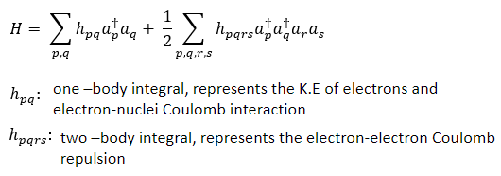

Molecular Hamiltonian
A mathematical model for the interaction of a set of electrons and set of nuclei
An operator associated with the energy observable
Born Oppenheimer Approximation
Stationary Nuclei
K.E. of electrons
K.E. of nucleus
Electron – nucleus interaction
Electron – electron interaction
Nucleus – nucleus interaction
Under BO, just an energy shift
In Second Quantization notation – states and observables are represented by operators
Computed classically using PySCF package

Slide 9
Intrinsic Reaction Coordinates (IRC)
Intrinsic Reaction Coordinates (IRC)
Spin Multiplicity
Bond Lengths
Spin Multiplicity
Bond Lengths
Bond Angles
Bond Angles
Overall Charge
Overall Charge
WORKFLOW FOR Electronic Ground state /property simulation of (macro) MOLECULES
WORKFLOW FOR Electronic Ground state /property simulation OF (macro) MOLECULES
(Macro)Molecular Geometry Definition
- Select the (macro)molecule of interest
- Fix the location of each nucleus (BO)
(Macro)Molecular Geometry Definition
- Select the (macro)molecule of interest
- Fix the location of each nucleus (BO)
(MO) Basis Set
(MO) Basis Set
Bond Dissociation Energy
Bond Dissociation Energy
Equilibrium Bond Lengths, Angles
Equilibrium Bond Lengths, Angles
Equilibrium Ground-State Energy
Equilibrium Ground-State Energy
Construction of Fermionic Hamiltonian
- Compute one-body and two-body integrals
Construction of Fermionic Hamiltonian
- Compute one-body and two-body integrals
Molecular Dynamics
Molecular Dynamics
Dipole Moment vs Configuration
Dipole Moment vs Configuration
PES
PES
Reduction of Orbitals
- Freeze Core Electrons
- Remove Unoccupied Orbitals
- Specify electrons requiring QC treatment
Active Space Transformation
Reduction of Orbitals
- Freeze Core Electrons
- Remove Unoccupied Orbitals
- Specify electrons requiring QC treatment
Active Space Transformation
Backend
- Simulator
- Real Hardware
Backend
- Simulator
- Real Hardware
Within chemical accuracy
Compare
Compare
Ansatz/ Trial
- Chem(UCCSD,..)
- Hardware(Two Local)
Construction of Qubit Hamiltonian
- Parity, Jordan-Wigner, Bravyi-Kitaev
Ansatz/ Trial
- Chem(UCCSD,..)
- Hardware(Two Local)
Qubit Mapping
Construction of Qubit Hamiltonian
- Parity, Jordan-Wigner, Bravyi-Kitaev
Qubit Mapping
Classical Eigen Solver
Classical Eigen Solver
VQE
VQE
Reduction of Qubits
- Z2 Symmetries
- Two-qubit Reduction (Parity)
Reduction of Qubits
- Z2 Symmetries
- Two-qubit Reduction (Parity)
Optimizer
- COBYLA, SLSQP
- SPSA
Symmetry Operation
Optimizer
- COBYLA, SLSQP
- SPSA
Symmetry Operation

Slide 10
Intrinsic Reaction Coordinates (IRC)
Intrinsic Reaction Coordinates (IRC)
Spin Multiplicity
Bond Lengths
Spin Multiplicity
Bond Lengths
Bond Angles
Bond Angles
Overall Charge
Overall Charge
WORKFLOW FOR Electronic Ground state /property simulation of (macro) MOLECULES
WORKFLOW FOR Electronic Ground state /property simulation OF (macro) MOLECULES
(Macro)Molecular Geometry Definition
- Select the (macro)molecule of interest
- Fix the location of each nucleus (BO)
(Macro)Molecular Geometry Definition
- Select the (macro)molecule of interest
- Fix the location of each nucleus (BO)
(MO) Basis Set
(MO) Basis Set
Bond Dissociation Energy
Bond Dissociation Energy
Equilibrium Bond Lengths, Angles
Equilibrium Bond Lengths, Angles
Equilibrium Ground-State Energy
Equilibrium Ground-State Energy
Construction of Fermionic Hamiltonian
- Compute one-body and two-body integrals
Construction of Fermionic Hamiltonian
- Compute one-body and two-body integrals
Molecular Dynamics
Molecular Dynamics
Dipole Moment vs Configuration
Dipole Moment vs Configuration
PES
PES
Reduction of Orbitals
- Freeze Core Electrons
- Remove Unoccupied Orbitals
- Specify electrons requiring QC treatment
Active Space Transformation
Reduction of Orbitals
- Freeze Core Electrons
- Remove Unoccupied Orbitals
- Specify electrons requiring QC treatment
Active Space Transformation
Backend
- Simulator
- Real Hardware
Backend
- Simulator
- Real Hardware
Within chemical accuracy
Compare
Compare
Ansatz/ Trial
- Chem(UCCSD,..)
- Hardware(Two Local)
Construction of Qubit Hamiltonian
- Parity, Jordan-Wigner, Bravyi-Kitaev
Ansatz/ Trial
- Chem(UCCSD,..)
- Hardware(Two Local)
Qubit Mapping
Construction of Qubit Hamiltonian
- Parity, Jordan-Wigner, Bravyi-Kitaev
Qubit Mapping
Classical Eigen Solver
Classical Eigen Solver
VQE
VQE
Reduction of Qubits
- Z2 Symmetries
- Two-qubit Reduction (Parity)
Reduction of Qubits
- Z2 Symmetries
- Two-qubit Reduction (Parity)
Optimizer
- COBYLA, SLSQP
- SPSA
Symmetry Operation
Optimizer
- COBYLA, SLSQP
- SPSA
Symmetry Operation

Slide 11
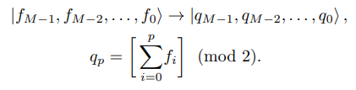

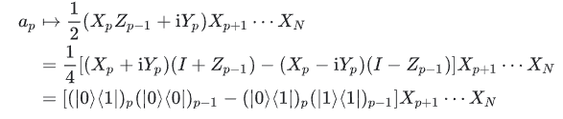

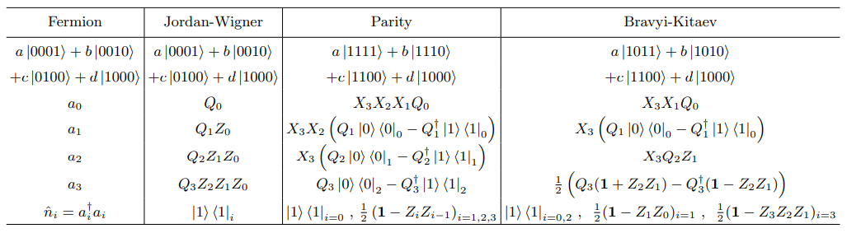
Fermion to Qubit Mappings
Jordan-Wigner Mapping (O(M))
Parity Mapping
One-one mapping between the spin orbitals and qubits
p^{th} qubit stores the parity of the first p modes
Encodes the occupation number of a spin orbital to the state of a qubit
No of qubits = No of spin orbitals - 2
No of qubits = No of spin orbitals

Slide 12
Intrinsic Reaction Coordinates (IRC)
Intrinsic Reaction Coordinates (IRC)
Spin Multiplicity
Bond Lengths
Spin Multiplicity
Bond Lengths
Bond Angles
Bond Angles
Overall Charge
Overall Charge
WORKFLOW FOR Electronic Ground state /property simulation of (macro) MOLECULES
WORKFLOW FOR Electronic Ground state /property simulation OF (macro) MOLECULES
(Macro)Molecular Geometry Definition
- Select the (macro)molecule of interest
- Fix the location of each nucleus (BO)
(Macro)Molecular Geometry Definition
- Select the (macro)molecule of interest
- Fix the location of each nucleus (BO)
(MO) Basis Set
(MO) Basis Set
Bond Dissociation Energy
Bond Dissociation Energy
Equilibrium Bond Lengths, Angles
Equilibrium Bond Lengths, Angles
Equilibrium Ground-State Energy
Equilibrium Ground-State Energy
Construction of Fermionic Hamiltonian
- Compute one-body and two-body integrals
Construction of Fermionic Hamiltonian
- Compute one-body and two-body integrals
Molecular Dynamics
Molecular Dynamics
Dipole Moment vs Configuration
Dipole Moment vs Configuration
PES
PES
Reduction of Orbitals
- Freeze Core Electrons
- Remove Unoccupied Orbitals
- Specify electrons requiring QC treatment
Active Space Transformation
Reduction of Orbitals
- Freeze Core Electrons
- Remove Unoccupied Orbitals
- Specify electrons requiring QC treatment
Active Space Transformation
Backend
- Simulator
- Real Hardware
Backend
- Simulator
- Real Hardware
Within chemical accuracy
Compare
Compare
Ansatz/ Trial
- Chem(UCCSD,..)
- Hardware(Two Local)
Construction of Qubit Hamiltonian
- Parity, Jordan-Wigner, Bravyi-Kitaev
Ansatz/ Trial
- Chem(UCCSD,..)
- Hardware(Two Local)
Qubit Mapping
Construction of Qubit Hamiltonian
- Parity, Jordan-Wigner, Bravyi-Kitaev
Qubit Mapping
Classical Eigen Solver
Classical Eigen Solver
VQE
VQE
Reduction of Qubits
- Z2 Symmetries
- Two-qubit Reduction (Parity)
Reduction of Qubits
- Z2 Symmetries
- Two-qubit Reduction (Parity)
Optimizer
- COBYLA, SLSQP
- SPSA
Symmetry Operation
Optimizer
- COBYLA, SLSQP
- SPSA
Symmetry Operation

Slide 13
Intrinsic Reaction Coordinates (IRC)
Intrinsic Reaction Coordinates (IRC)
Spin Multiplicity
Bond Lengths
Spin Multiplicity
Bond Lengths
Bond Angles
Bond Angles
Overall Charge
Overall Charge
WORKFLOW FOR Electronic Ground state /property simulation of (macro) MOLECULES
WORKFLOW FOR Electronic Ground state /property simulation OF (macro) MOLECULES
(Macro)Molecular Geometry Definition
- Select the (macro)molecule of interest
- Fix the location of each nucleus (BO)
(Macro)Molecular Geometry Definition
- Select the (macro)molecule of interest
- Fix the location of each nucleus (BO)
(MO) Basis Set
(MO) Basis Set
Bond Dissociation Energy
Bond Dissociation Energy
Equilibrium Bond Lengths, Angles
Equilibrium Bond Lengths, Angles
Equilibrium Ground-State Energy
Equilibrium Ground-State Energy
Construction of Fermionic Hamiltonian
- Compute one-body and two-body integrals
Construction of Fermionic Hamiltonian
- Compute one-body and two-body integrals
Molecular Dynamics
Molecular Dynamics
Dipole Moment vs Configuration
Dipole Moment vs Configuration
PES
PES
Reduction of Orbitals
- Freeze Core Electrons
- Remove Unoccupied Orbitals
- Specify electrons requiring QC treatment
Active Space Transformation
Reduction of Orbitals
- Freeze Core Electrons
- Remove Unoccupied Orbitals
- Specify electrons requiring QC treatment
Active Space Transformation
Backend
- Simulator
- Real Hardware
Backend
- Simulator
- Real Hardware
Within chemical accuracy
Compare
Compare
Ansatz/ Trial
- Chem(UCCSD,..)
- Hardware(Two Local)
Construction of Qubit Hamiltonian
- Parity, Jordan-Wigner, Bravyi-Kitaev
Ansatz/ Trial
- Chem(UCCSD,..)
- Hardware(Two Local)
Qubit Mapping
Construction of Qubit Hamiltonian
- Parity, Jordan-Wigner, Bravyi-Kitaev
Qubit Mapping
Classical Eigen Solver
Classical Eigen Solver
VQE
VQE
Reduction of Qubits
- Z2 Symmetries
- Two-qubit Reduction (Parity)
Reduction of Qubits
- Z2 Symmetries
- Two-qubit Reduction (Parity)
Optimizer
- COBYLA, SLSQP
- SPSA
Symmetry Operation
Optimizer
- COBYLA, SLSQP
- SPSA
Symmetry Operation

Slide 14
Intrinsic Reaction Coordinates (IRC)
Intrinsic Reaction Coordinates (IRC)
Spin Multiplicity
Bond Lengths
Spin Multiplicity
Bond Lengths
Bond Angles
Bond Angles
Overall Charge
Overall Charge
WORKFLOW FOR Electronic Ground state /property simulation of (macro) MOLECULES
WORKFLOW FOR Electronic Ground state /property simulation OF (macro) MOLECULES
(Macro)Molecular Geometry Definition
- Select the (macro)molecule of interest
- Fix the location of each nucleus (BO)
(Macro)Molecular Geometry Definition
- Select the (macro)molecule of interest
- Fix the location of each nucleus (BO)
(MO) Basis Set
(MO) Basis Set
Bond Dissociation Energy
Bond Dissociation Energy
Equilibrium Bond Lengths, Angles
Equilibrium Bond Lengths, Angles
Equilibrium Ground-State Energy
Equilibrium Ground-State Energy
Construction of Fermionic Hamiltonian
- Compute one-body and two-body integrals
Construction of Fermionic Hamiltonian
- Compute one-body and two-body integrals
Molecular Dynamics
Molecular Dynamics
Dipole Moment vs Configuration
Dipole Moment vs Configuration
PES
PES
Reduction of Orbitals
- Freeze Core Electrons
- Remove Unoccupied Orbitals
- Specify electrons requiring QC treatment
Active Space Transformation
Reduction of Orbitals
- Freeze Core Electrons
- Remove Unoccupied Orbitals
- Specify electrons requiring QC treatment
Active Space Transformation
Backend
- Simulator
- Real Hardware
Backend
- Simulator
- Real Hardware
Within chemical accuracy
Compare
Compare
Ansatz/ Trial
- Chem(UCCSD,..)
- Hardware(Two Local)
Construction of Qubit Hamiltonian
- Parity, Jordan-Wigner, Bravyi-Kitaev
Ansatz/ Trial
- Chem(UCCSD,..)
- Hardware(Two Local)
Qubit Mapping
Construction of Qubit Hamiltonian
- Parity, Jordan-Wigner, Bravyi-Kitaev
Qubit Mapping
Classical Eigen Solver
Classical Eigen Solver
VQE
VQE
Reduction of Qubits
- Z2 Symmetries
- Two-qubit Reduction (Parity)
Reduction of Qubits
- Z2 Symmetries
- Two-qubit Reduction (Parity)
Optimizer
- COBYLA, SLSQP
- SPSA
Symmetry Operation
Optimizer
- COBYLA, SLSQP
- SPSA
Symmetry Operation

Slide 15
Influence of Molecular Orbital (MO) Basis

Slide 16
Molecular Orbital Basis
Various molecular orbital basis sets have been employed to calculate potential energy surface and bond dissociation energy for LiH, using VQE
There is a Trade-off : The accuracy improved with larger basis sets, subject to retaining higher order orbitals in computation

Slide 17
Different MO basis sets
STO-kG (k=3,6,etc.) approximates each STO with k GTO functions in the least squares. Produces reasonable computation for an atomic orbital, however, falls on accuracy for molecular computation
Split-valence basis sets with double zeta functions on the valence orbital, eg: 3-21G, 6-31G, 6-31G*. Exhibits trade-off between accuracy and quantum resources
Correlation-consistent basis sets are widely used for post Hartree-Fock wavefunction based calculations, eg: cc-pVDZ, cc-pVTZ (consider unoccupied or virtual orbitals, to consider correlation energy in computation)

Slide 18
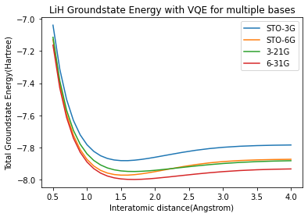

Lithium Hydride (LiH)
Optimizer: SLQP
Bond Dissociation Energy
Trade-off: Accuracy and Resources
Equilibrium GS Energy
Equilibrium Bond Length
Basis Set​ | Atomic Orbitals | No. Of Molecular Orbitals​ | No. Of Spin Orbitals​ ​ | Without Removal of 2px and 2py Orbitals​ (Frozen Core + Parity Mapping + Z₂ Symmetries) |  | With Removal of 2px and2py Orbitals​ (Frozen Core + Parity Mapping + Z2 Symmetries) ​
​ |  | ​ | ​ | No. Of qubits​ | Ansatz Depth​ | No. Of qubits​ ​ | Ansatz Depth​
STO-3G​ | 1s, 2s, 2px, 2py, 2pz (Li) ; 1s (H) | 6​ | 12​ | 6​ | 596 | 4​ | 311
STO-6G​ | 1s, 2s, 2px, 2py, 2pz (Li) ; 1s (H) | 6​ | 12​ | 6​ | 596 | 4​ | 311
6-31G​ | 1s,2s,2px,2py,2pz,3s,3px,3py,3pz (Li) ; 1s, 2s (H) | 11​ | 22​ | 17​ | 7537 | 12​ | 3831
6-31G*​ | 1s,2s,2px,2py,2pz,3s,3px,3py,3pz, 5 3d (Li) ; 1s, 2s (H) | 16​ | 32​ | 27​ | 26755 | 23​ | 18803
Published in QTML 2021

Slide 19
Key Takeaways...
Variational framework for molecular simulation
Higher order molecular orbital basis sets for enhancing the accuracy in estimating ground state properties
Associated trade-off between accuracy and quantum resources

Slide 20
IRC-VQE (Intrinsic Reaction Coordinate driven VQE)
How to trace the reaction pathway on the PES for a molecule, demonstrating transition/dynamics?

Slide 21
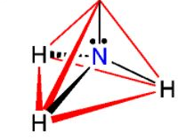



IRC-VQE for NH₃
Molecular Geometry
Overall Charge
Spin Multiplicity
Choose & fix intrinsic reaction coordinate (IRC) (z-coordinate) of Nitrogen
Relax the 3 hydrogen atoms by perturbing around their mean position.
Constraints:
All 3 N-H bond lengths are the same for each perturbation
All 3 H-N-H bond angles are the same for each perturbation
C_{3v}
D_{3h}
C_{3v}
Compute the ground state energy for each perturbation using VQE
Minimum computed ground state energy gives equilibrium energy and the mean position of H atoms for the next IRC of N atom
No
Perform for all IRC of N atom?
Accepted in QIP 2022
Yes
BOPES

Slide 22
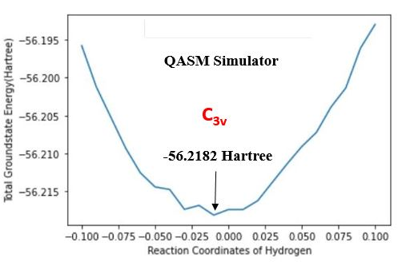
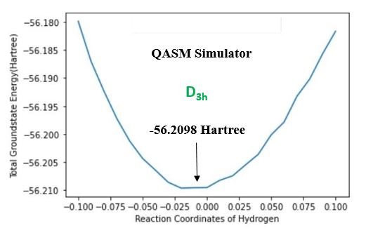
Accepted in QIP 2022

Slide 23
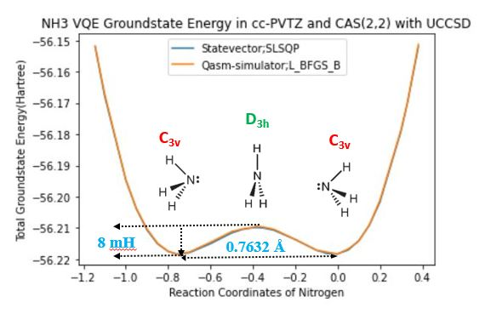
Extremely small potential barrier height and width, that had been simulated accurately
IRC-VQE can be employed to probe intra-molecular dynamics of ND₃, PH₃, fluxional molecules
Accepted in QIP 2022

Slide 24
Summary
Variational framework for simulation of molecular systems
Higher order molecular orbital basis sets for enhancing the accuracy in estimating ground state properties
Associated trade-off between accuracy and quantum resources
Formalism of a new algorithm IRC-VQE – to probe reaction pathway for molecules showing transition /dynamics

Slide 25
References
Quantum computational chemistry, McArdle, Sam and Endo, Suguru and Aspuru-Guzik, Alán and Benjamin, Simon C. and Yuan, Xiao, APS 2020, DOI:10.1103/revmodphys.92.015003.
Peruzzo, A. et al. A variational eigenvalue solver on a photonic quantum processor. Nat. Commun. 5 (2014).
T. Helgaker, P. Jørgensen, and J. Olsen, Molecular Electronic-Structure Theory, John Wiley & Sons, Ltd, 2000.
Quantum HF/DFT-Embedding Algorithms for Electronic Structure Calculations: Scaling up to Complex Molecular Systems, Rossmannek, Max and Barkoutsos, Panagiotis Kl. and Ollitrault, Pauline J. and Tavernelli, Ivano, The Journal of Chemical Physics 2021.
Qiskit Global Summer School 2020, Lectures 23,24,25, Obtaining the Qubit Hamiltonian for H2 and LiH – Antonio Mezzacapo
Reducing qubit requirements for quantum simulation using molecular point group symmetries, Kanav Setia, Richard Chen, Julia E. Rice, Antonio Mezzacapo, Marco Pistoia, and James D. Whitfield
https://cccbdb.nist.gov/ - A standard website hosted by National Institute of Standards and Technology, US Department of Commerce, contains both experimental and classically computed data for various properties of small molecules

Slide 27
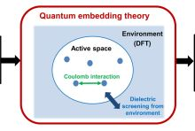

Embedding Theory & Active Space Transformation
Environment : Classical (HF) or DFT
Mapping
Molecule
Electronic Structure of the active region described by an effective Hamiltonian
VQE
Ground-state properties
Qubit Hamiltonian
The full system is separated into an active space consisting of active orbitals, and its environment, which includes the remaining orbitals called the inactive orbitals.
Orbitals near the Fermi-level are usually taken as active orbitals.
Only the active orbitals are mapped to qubits and given a quantum computing treatment whereas the rest is treated with an efficient classical algorithm like DFT or HF.
The effective Hamiltonian incorporates a mean field potential generated by the inactive electrons, hence replaces the mapping of inactive orbitals to qubits.
Advantage: Less no. Of qubits are necessary to calculate the ground state properties making the entire calculation efficient while keeping a good level of accuracy
Quantum
Classical
ECP

Slide 28
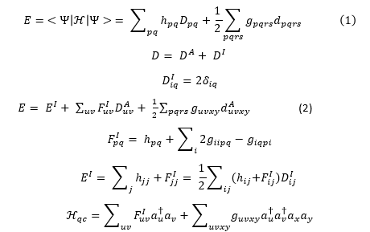
Embedding Theory & Active Space Transformation
Hartree-Fock Emedding Scheme
h_{pq} : one-body integral
g_{pqrs} : two-body integral
D_{pq} : one-elctron density matrix
d_{pqrs} : two-elctron density matrix
p,q,r,s : general orbitals
i,j,k,l : inactive orbitals
u,v,x,y: active orbitals
Inactive Fock operator F^{I} embeds the quantum computation to a classically computed environment.
Note: All indices in the effective Hamiltonian are restricted to the Active Space (AS).

Slide 29
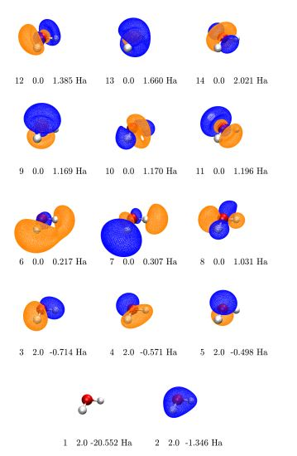
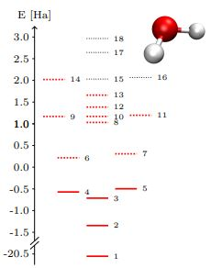
Water (H₂O)
https://arxiv.org/abs/2009.01872.
Energy diagram of the HF-MOs of H₂O in the 6- 31G* basis. Solid lines correspond to occupied MOs while dotted lines represent virtual ones.
Visualization of the active HF-MOs of water in the 6-31G* basis. The orbital coefficients, energies and occupation numbers are obtained with PySCF using a RHF calculation.
29

Slide 30
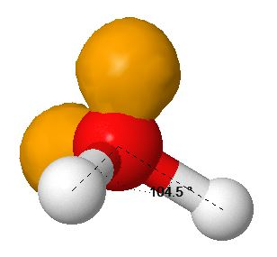
Water (H₂O)
Atom​ | x(Å)​ | y(Å)​ | z(Å)​
O1​ | 0.0000​ | 0.0000​ | 0.1173​
H2​ | 0.0000​ | 0.7572​ | -0.4692​
H3​ | 0.0000​ | -0.7572​ | -0.4692​
z
y
Accuracy improved with
more active electrons and orbitals
x
Basis​​ | Active Space​​ | No. Of Spin Orbitals | No. Of qubits​​ | Ground-state Energy​​ (hartree)​​
6-31G*​​ | CAS (2,2)​​ | 4 | 2​​ | -76.00926​​
6-31G*​​ | CAS (4,4)​​ | 8 | 4​​ | -76.010138​​
6-31G*​​ | CAS (6,6)​​ | 12 | 8​​ | -76.022054​​
6-31G*​​ | CAS (8,8)​​ | 16 | 12​​ | ​-76.042247​

Slide 31
Key Takeaways...
Resolved the trade-off using embedding approach
Partitioned the whole system into an active space and its environment
The active space is embedded in a mean-field potential generated by the environment
Construct an effective Hamiltonian (incorporating the mean-field potential) that replaces the mapping of inactive orbitals to qubits
Active space transformation enabled to employ higher-order orbital basis sets in electronic structure calculation, thereby enhancing the accuracy and improving the efficiency

Slide 32

Vibrational Energy Calculation
Limitation of Born Oppenheimer (BO) Approximation
Nuclear Schrodinger Equation
Obtain the BOPES
Fit the BOPES through Cubic Spline
V(r) : Fitted BOPES
m_{eff} : Reduced mass
Discretize (i) and numerically compute the eigenvalues

Slide 33
Summary
Variational framework for simulation of molecular systems
Higher order molecular orbital basis sets for enhancing the accuracy in estimating ground state properties
Associated trade-off between accuracy and quantum resources
Resolved the trade-off using embedding approach
Construct an effective Hamiltonian (incorporating the mean-field potential) that replaces the mapping of inactive orbitals to qubits
Allowed to employ higher-order orbital basis sets in electronic structure calculation, thereby enhancing the accuracy and improving the efficiency
Vibrational energy calculation by solving nuclear Schrodinger equation using a 4-step technique

