Slide 1
DEVOPS CAPSTONE PROJECT — 3RD YEAR
VulnTrack
Vulnerability Management Platform with End-to-End DevOps Automation
8 phases · 1 pipeline
React 18 + Spring Boot 3.3
TypeScript SPA · REST API · PostgreSQL 16
Docker · GitHub Actions
Trivy + GitLeaks gates · GHCR images
Terraform · Helm · HPA · Ingress
Prometheus + Grafana observability
October 2026 · Built for the capstone defense

Slide 2
01 — PROBLEM STATEMENT
Critical findings get lost without a system of record
Without VulnTrack
With VulnTrack
Findings scattered across spreadsheets and inboxes
No severity triage — CRITICAL bugs buried in noise
Remediation has no owner, no state, no audit trail
Every audit becomes a manual archaeology project
Single source of truth for assets and findings
Severity-first triage: LOW → MEDIUM → HIGH → CRITICAL
OPEN → IN_PROGRESS → FIXED lifecycle with RBAC owners
Dashboard KPIs give instant security posture
6 asset types tracked
4 severity levels enforced
3 lifecycle stages per finding

Slide 3
02 — SYSTEM ARCHITECTURE
One modular monolith, three decoupled tiers
REACT 18 + TYPESCRIPT
SPRING BOOT 3.3
POSTGRESQL 16
Frontend
Backend
Data
Vite SPA with axios client
HTTP Basic Auth sessions
Promise.all parallel dashboard fetch
Inline validation from error envelope
REST API — DTO in, DTO out
Bean Validation on every input
RBAC: VIEWER vs ADMIN roles
Global exception handler
Flyway versioned migrations
BCrypt-hashed credentials
FK constraints + severity index
H2 profile for local dev
React SPA · :5173
Spring Boot API · :8080
PostgreSQL · :5432

Slide 4
03 — BACKEND DEEP DIVE
Every request passes five defense layers
1 · Auth + RBAC
2 · Validation
3 · DTO mapping
4 · JPA + index
5 · Flyway
Basic Auth credentials checked before any handler runs
@NotNull, @Size and CVE format pattern enforcement
Entities never cross the HTTP boundary — DTOs only
Spring Data JPA, B-tree index on severity column
Versioned, repeatable SQL schema migrations
19/19
backend tests green — unit + @DataJpaTest integration, enforced on every pull request

Slide 5
04 — APPLICATION SECURITY
Passwords hashed for the worst-case scenario
12
RBAC enforced at the framework layer
viewer POST → live-verified 403 — not just hidden UI buttons
Standardized error envelope
status + machine-readable code field; zero stack-trace leakage
BCrypt cost factor — 2^12 rounds of key stretching per password hash
Strict input validation
Bean Validation incl. CVE pattern; bad enum values → clean 400
Secrets never reach git
GitLeaks gate fails CI on any credential pattern in the diff

Slide 6
05 — CI/CD QUALITY GATES
GitHub Actions: four gates between commit and registry
GATE 01 · TESTS
GATE 02 · GITLEAKS
GATE 03 · TRIVY
GATE 04 · REGISTRY
19/19
0
CVE scan
GHCR
Maven test suite
secrets tolerated
image scanning
immutable images
unit + integration tests run on every push and PR
scans every diff for credential and key patterns
critical vulnerabilities block image publishing
digest-pinned artifacts — no mutable latest tags
Shift-left: security checks run on every push and pull request — before anything reaches a cluster

Slide 7
06 — INFRASTRUCTURE AS CODE
Terraform: four resources, one reproducible baseline
RESOURCE 01
RESOURCE 02
Namespace
ResourceQuota
vulntrack isolates every workload, quota, and network policy from other tenants on the cluster.
Hard caps on total CPU and memory stop noisy-neighbor exhaustion before it starts.
RESOURCE 03
RESOURCE 04
LimitRange
ServiceAccount
Every pod inherits default request and limit bounds — nothing launches unbounded.
Workloads run under a dedicated least-privilege identity — never the cluster default.
terraform plan → apply — the entire cluster baseline is reviewable in a pull request.

Slide 8
07 — KUBERNETES & AUTOSCALING
HPA scales the backend between 2 and 5 pods
Horizontal Pod Autoscaler
NGINX Ingress routing
CPU 70%
one entry point: /api → backend service, / → frontend service
minReplicas
2 pods
Two probes, two jobs
readiness gates traffic until healthy; liveness restarts deadlocked containers
maxReplicas
5 pods
Helm packaging
one command templates deployments, services, ingress, and the autoscaler
Bars = replica count. Red marker = scale-up threshold at 70% CPU utilization.
HPA prerequisites: metrics-server for utilization data + declared CPU requests — both enforced in our chart.

Slide 9
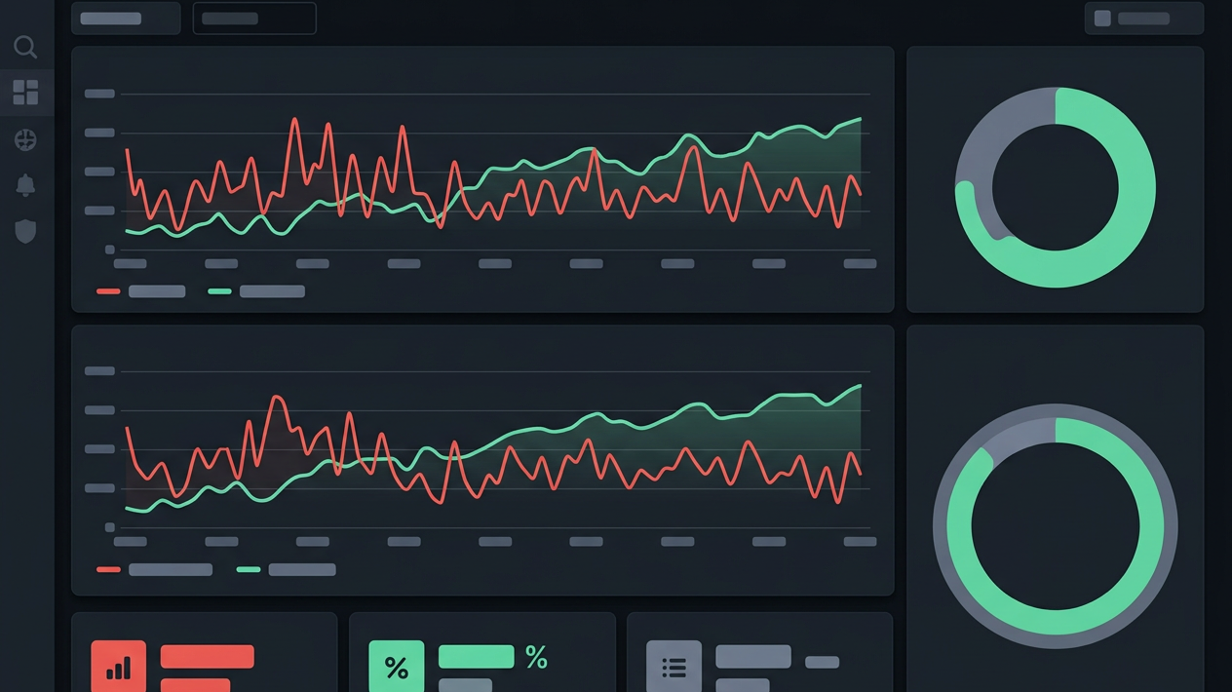
08 — OBSERVABILITY
Prometheus scrapes. Grafana explains.
Spring Boot Actuator exposes /actuator/prometheus
Dashboards track JVM memory, P95 latency, and error ratio
Alert rules warn before saturation becomes an outage
Prometheus
metrics scraping + alert rules
Grafana
dashboards + visualization

Slide 10
Thank you.
Live demo: register an asset → log a CRITICAL finding → hit a 403 as viewer → watch Grafana move.
1 · Create asset
2 · Log finding
3 · Switch role
4 · Verify 403
5 · See metrics
VulnTrack · DevOps Capstone · October 2026 — questions welcome

