Slide 1

Akhil Lohchab | 2k10/IT/008
Amanpreet Singh | 2k10/IT/011
Ashish Mahajan | 2k10/IT/017

Slide 2
FAQ Retrieval Systems
FAQ’s or Frequently Asked Questions form an important part of almost all websites today, as they provide answers to the most basic and pertinent questions.
A good FAQ section is a necessity for service oriented industries like airlines, railways, telecommunications, health supplies etc.
An FAQ Retrieval System allows a user to put forth his/her questions remotely and “retrieve” the answer to the corresponding query.

Slide 3
The SMS platform
2011

Slide 4
The SMS platform
Why ?
Has a wider reach.
Easier to use as compared to computers.
There are already services like Google Search via SMS that allow users to get search results through SMS.
How?
A centralized retrieval system that selects the relevant question after understanding the query from the user “autonomously” and sends the corresponding answer back to the user.

Slide 5
The SMS Language
Limited to 160 characters for 1 SMS.
Use of short-hand is common.
Different words could represent the same thing (There = der/thr)
Numerals, sometimes, represent words. (eg: 4 = for, 2= to)
Use of multiple languages in a single SMS.
Grammar rules almost always not followed
Two words may be combined which leads to ambiguity (I will= I’ll = Ill which is the same as ill (sick) )

Slide 6
Approach
Text Normalization
Stop Words
Phonetic Equivalents
FAQ Retrieval
Assigning a score to each token
Ranking items based on score

Slide 7
Normalizing the SMS query
Compile a Stop Word List
Remove the Stop words
Generate Phonetic Equivalents

Slide 8
FAQ Retrieval
Build Index of FAQs
Search the Index

Slide 9
FAQ Retrieval
1. Build_Index
Remove stop words from token stream obtained in step 1.
Use output of step 2 for parsing to generate phonetic equivalents.
Add FAQ to index
Transform input FAQ into sequence of tokens

Slide 10
FAQ Retrieval
2. Search_Index
Transform input SMS into sequence of tokens
Initially score for each document is 0 for the sms query
Use output of step 2 for parsing to generate phonetic equivalents.
Remove stop words from token stream obtained in step 1.
Search for each token in Index and select top 100 documents
Select top 5 documents, if the score < (No of tokens in query)*c, do not report the document

Slide 11
Lucene
Open source information retrieval library
Runs on java
Supports full text indexing searching capability
Useful in implementation of internet search engines and single-site searching

Slide 12
Metaphone
Algorithm to index words by their English pronunciation
Uses 16 consonant symbols 0BFHJKLMNPRSTWXY
‘0’ represents ‘th’
‘X’ represents ‘sh’ or ‘ch’
Others represent their usual English pronunciations
Vowels AEIOU are also used but only at the beginning of the code.

Slide 13


Tf*idf
Term-Frequency(tf) * Inverse-document-frequency(idf)
reflects how important a word is to a document in a collection or corpus
*
where,
D: cardinality

Slide 14
Ranks
given SMS text will be divided into tokens
each token is queried separately in index
Top 100 matching documents are extracted and given the score (tf-idf) as provided by Lucene.
Score for a document (FAQ) is computed by summing over scores obtained for all tokens.
Top 5 documents are then selected. The documents that have score less than a threshold value - No. of Tokens * C were discarded.
if all the documents have a score less than No. of Tokens * C, it is marked as out of domain

Slide 15
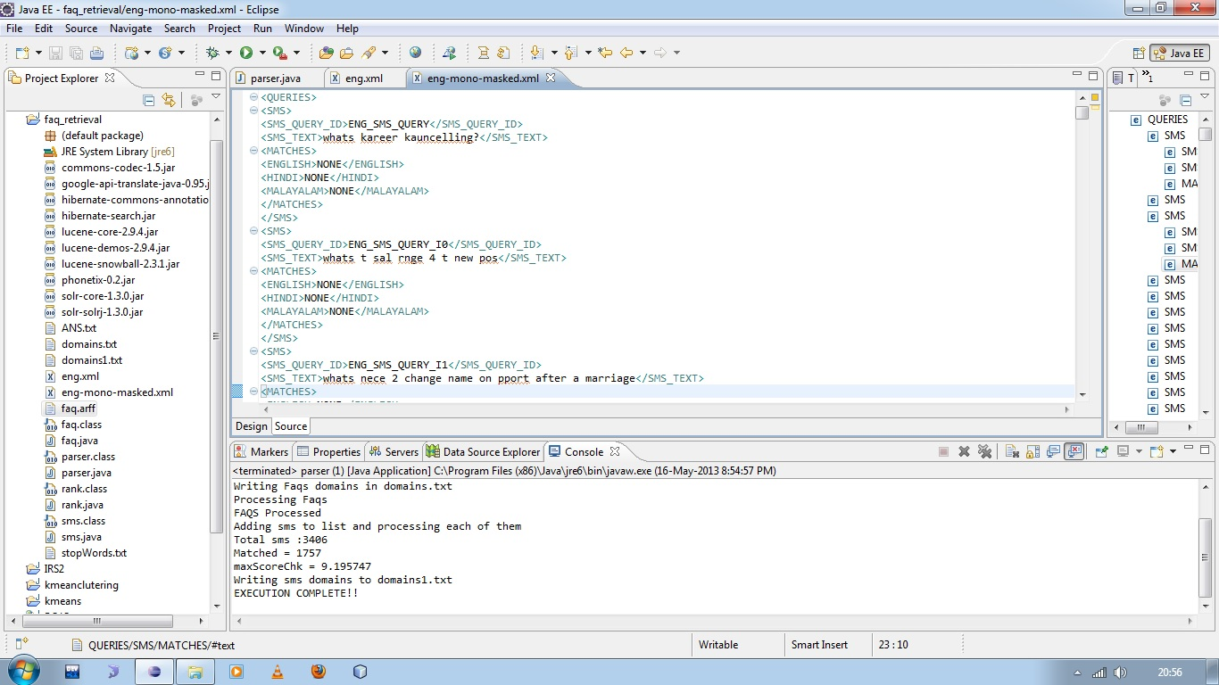
Result

Slide 16
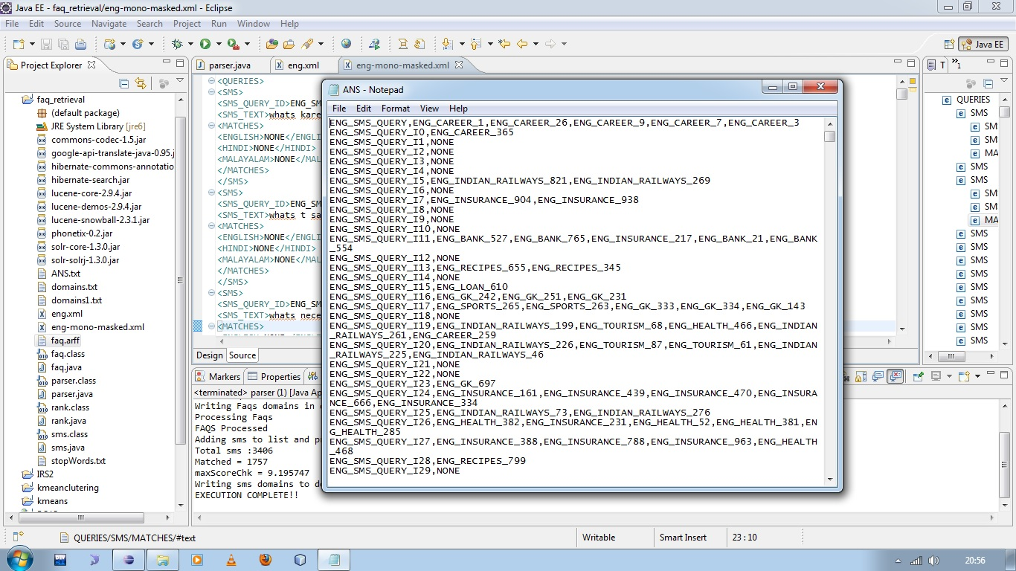
Result

Slide 17
DEMO

Slide 18
Conclusion
Given the problem of mapping an SMS to its equivalent plain text FAQ problem, we obtained reasonable accuracy when SMS was queried against FAQs of the same category.

Slide 19
Future Work
Try to increase the efficiency by implementing optimization techniques.
Synonyms etc.
Include cross lingual support
English
Hindi
Other regional languages

Slide 20
References
Catherine Kobus, François Yvon, and Géraldine Damnati, Normalizing SMS: are two metaphors better than one? In COLING ’08: Proceedings of the 22nd International Conference on Computational Linguistics, pages 441–448, Morristown, NJ, USA, 2008. Association for Computational Linguistics.
Stéphanie Weiser, Louise-Amélie Cougnon, and Patrick Watrin, Temporal Expressions Extraction in SMS messages, Proceedings of the Workshop on Information Extraction and Knowledge Acquisition, pages 41–44, Hissar, Bulgaria, 16 September 2011.
DCU@FIRE 2011: SMS-based FAQ Retrieval by Deirdre Hogan1, Johannes Leveling1, Hongyi Wang1,Paul Ferguson2, and Cathal Gurrin2
A Query-Based SMS Translation in Information Access System by Ademola O. Adesina, Kehinde K. Agbele, Nureni A. Azeez, Ademola P. Abidoye (International Journal of Soft Computing and Engineering (IJSCE))
A Phrase based model for SMS Text Normalization by AiTi Aw, Min Zhang, Juan Xiao and Jian Su.
en.wikipedia.org/wiki/Metaphone
Speech and Language Processing : An Introduction to Natural Language Processing, Computational Linguistics and Speech Recognition (Prentice Hall)

