Slide 1




Data Analytics A Final Project
By David Blessent

Slide 2

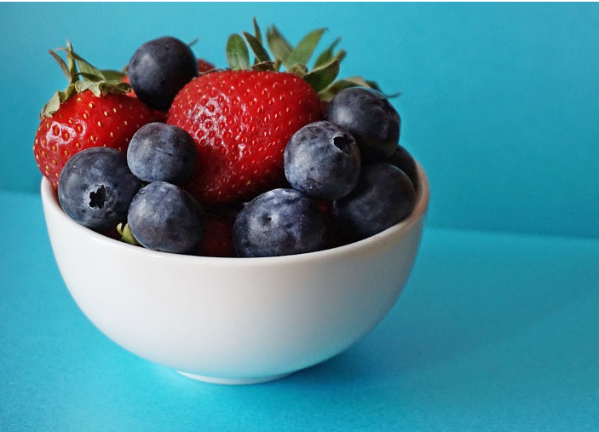
The Assignment
Survey Size:
125 students
Survey Response Data:
food_coded.csv
I have been tasked with deciding if any changes need to be made at the student cafeteria at the college.
In order to make recommendations to the department that manages the cafeteria’s operations, I conducted a survey of students who attend the college.
Analysis Tools:
Python
Data Analysis Libraries
Jupyter Notebooks
Visual Studio Code
R
R Studio

Slide 3
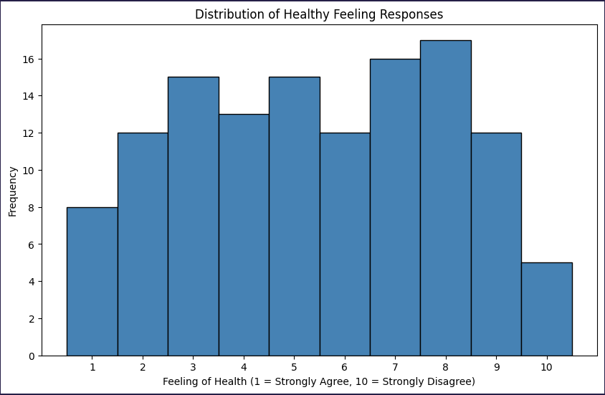
How Health Conscious Are The Students?
Many are active one or several sports
In general, the quality of diet for students has gone down
Most students are likely to eat fruits and vegetable everyday
The is a normal distribution for student responses on how healthy they feel
Most students exercise at least once a week, with many students exercising every day
Most students live on campus and would potentially eat meals and snacks at the cafeteria

Slide 4
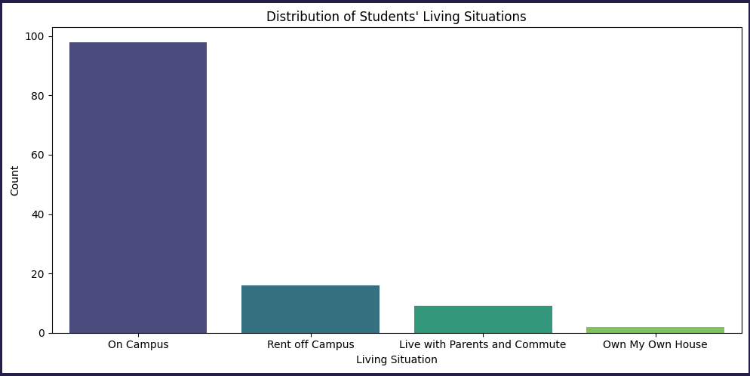
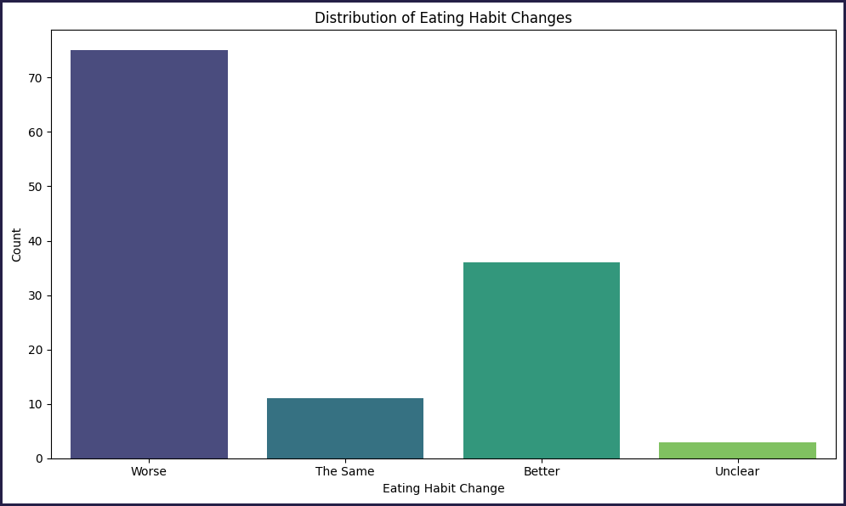
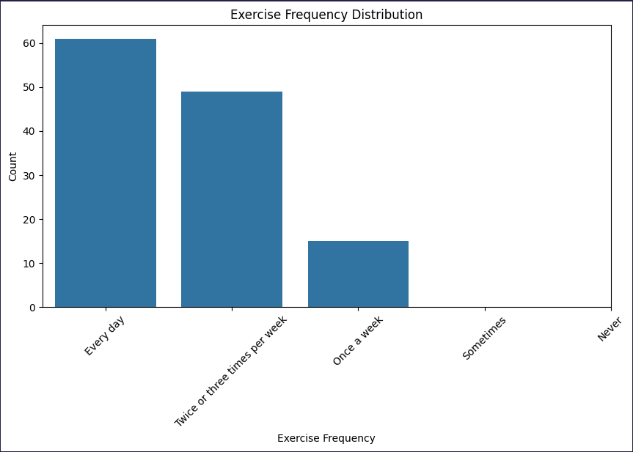
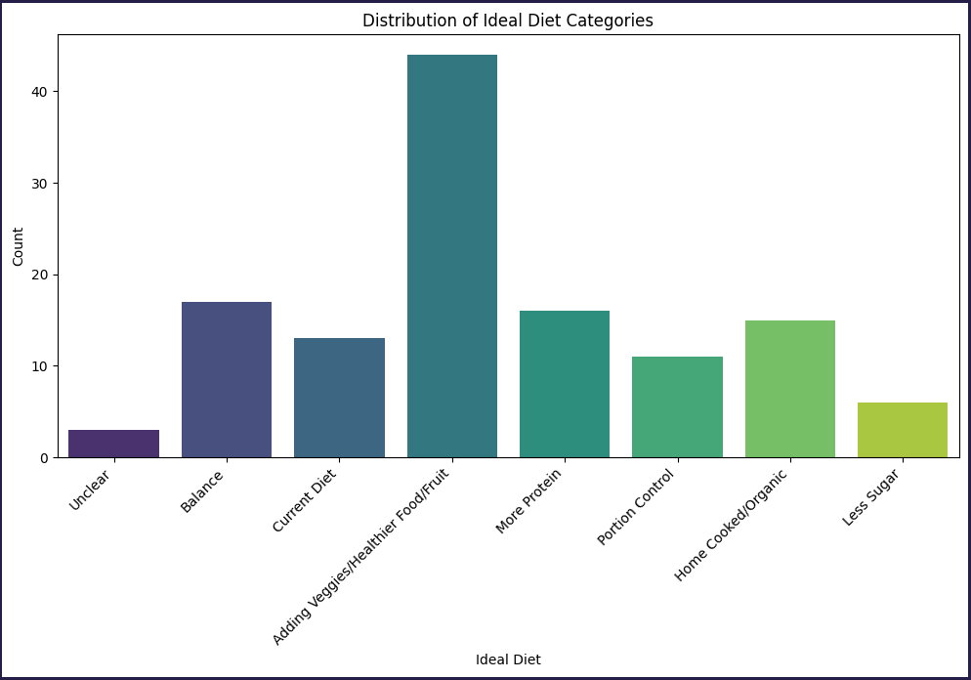

Slide 5
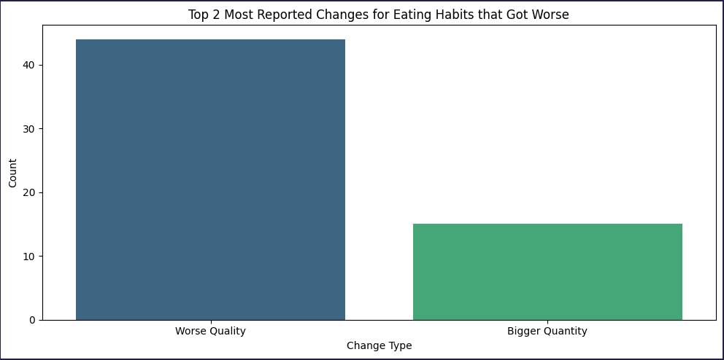
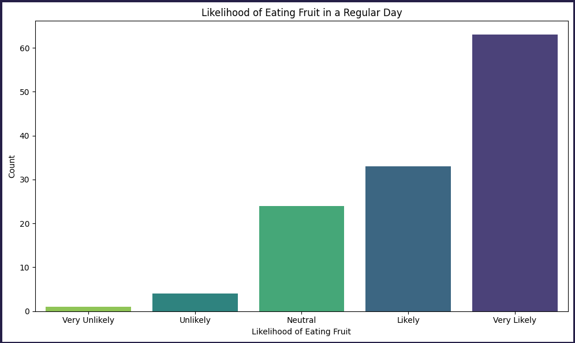
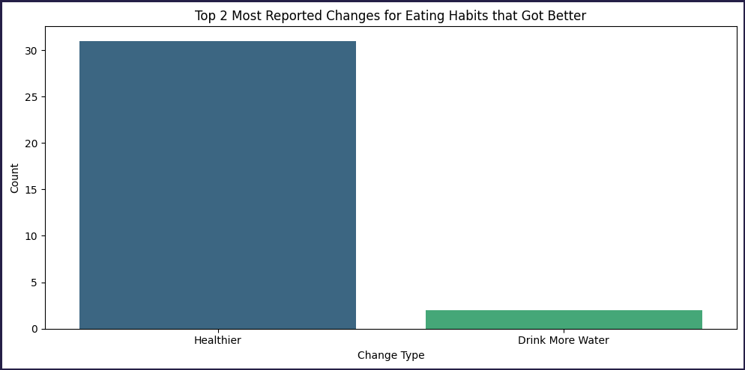
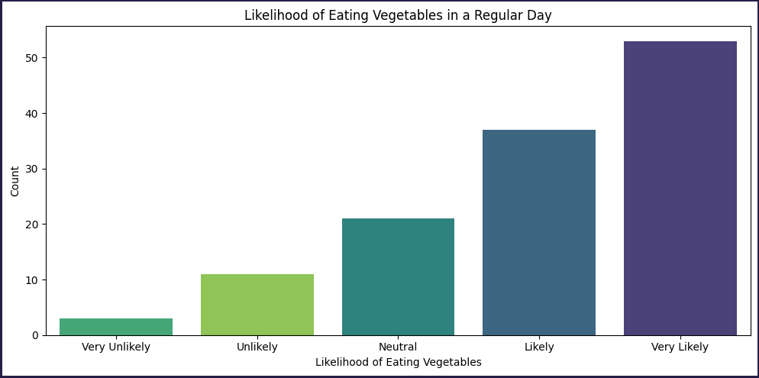

Slide 6
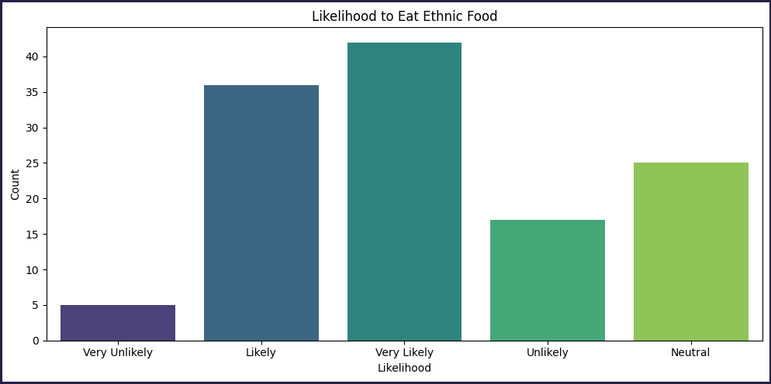
If you offered ethnic food would students be likely to eat it?

Slide 7
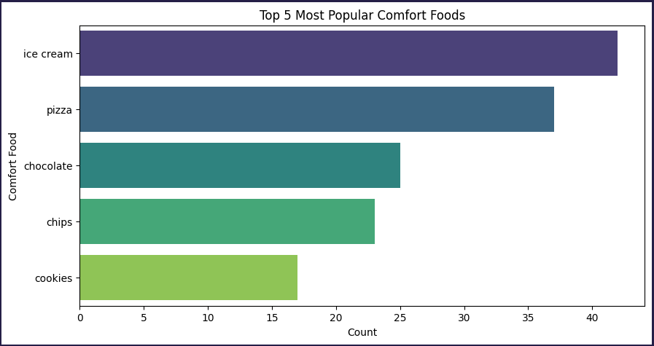
What are students’ Top 5 favorite comfort foods?

Slide 8
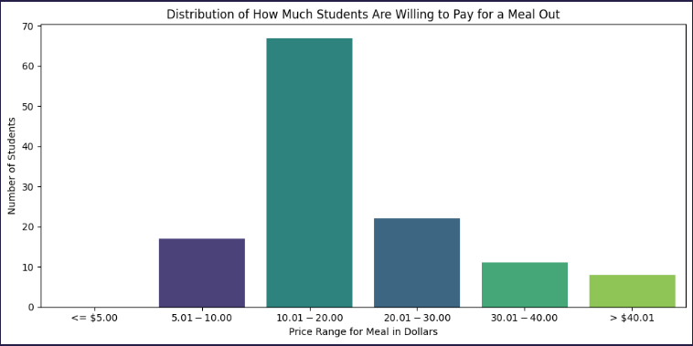
Based on willingness to pay, how much should the cafeteria price meals?

Slide 9
RECOMMENDATIONS
Add ethnic food offerings, students want them!
Italian/French/Greek, Asian/Chinese/Thai, and Spanish/Mexican are the favorite ethnic cuisines of students
Ice cream, pizza, chocolate, chips, and cookies are the comfort foods students are going to be looking for when student life has them down
Offer both fruits and veggies as snack options because most students will eat them everyday
Price meals between 10 and 20 dollars, while considering the income realities of many students and their families
Add more protein based meals, more home-style meals, and make sure meal options are nutritionally balanced

