Slide 1
P3MAI · METHOD MAP
Architecture & Design
Technical design of the P3MAI Method Map — summary
DOC-01 · Summary · v1.0 · 1 August 2026 · OFFICIAL

Slide 2
What it is
An explorable picture of a project-, programme- or agile-delivery method.
• Four methods as interactive network graphs: PRINCE2 7, MSP 5th ed, SAFe 6.0 Essential, PMBOK 6th ed.
• Each cross-references its activities/processes to the roles, artefacts, tools and principles around them.
• Single-origin web app; config-driven, framework-agnostic model — a new method is (almost) just data.
OFFICIAL
DOC-01 · 2

Slide 3
Technology stack
Layer | Technology
Backend | FastAPI + SQLAlchemy + SQLite (Python 3.12)
Front end | React 19 + Vite, react-force-graph-2d
Exports | openpyxl (CSV/Excel), reportlab (PDF)
Packaging | Docker (multi-stage), single image
Hosting | Render — Docker web service
OFFICIAL
DOC-01 · 3

Slide 4
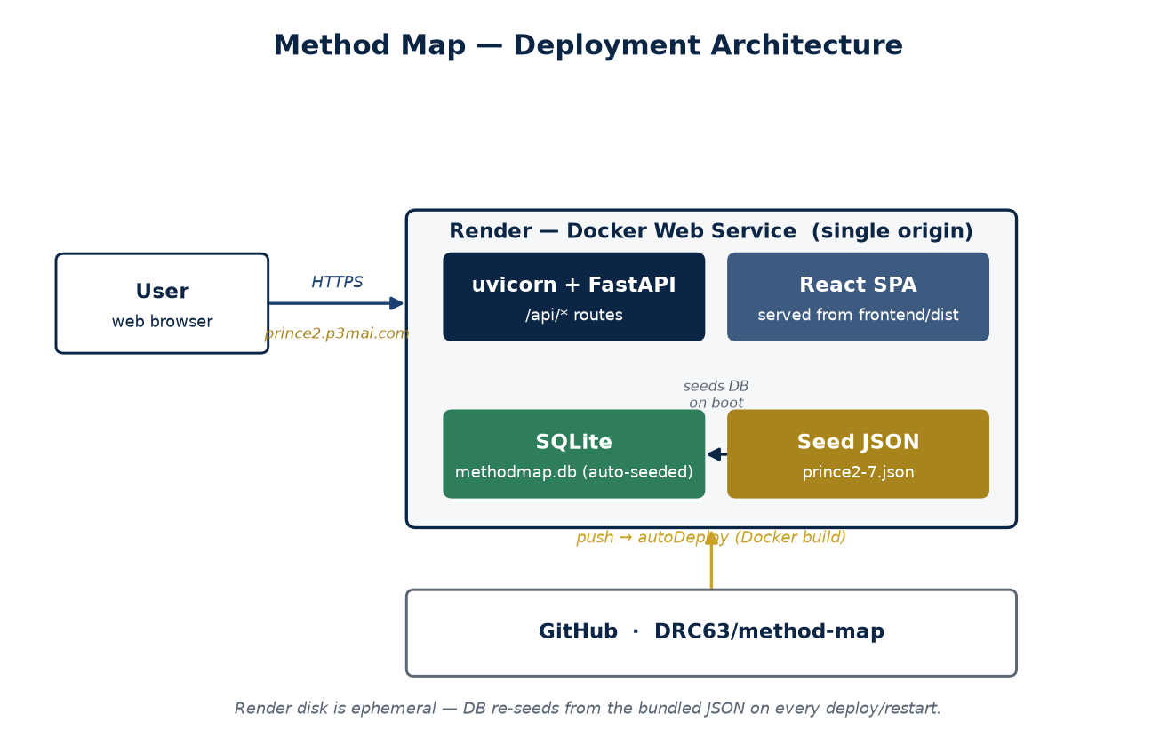
Deployment architecture
One container serves the API and the built React app — a single origin.
OFFICIAL
DOC-01 · 4

Slide 5
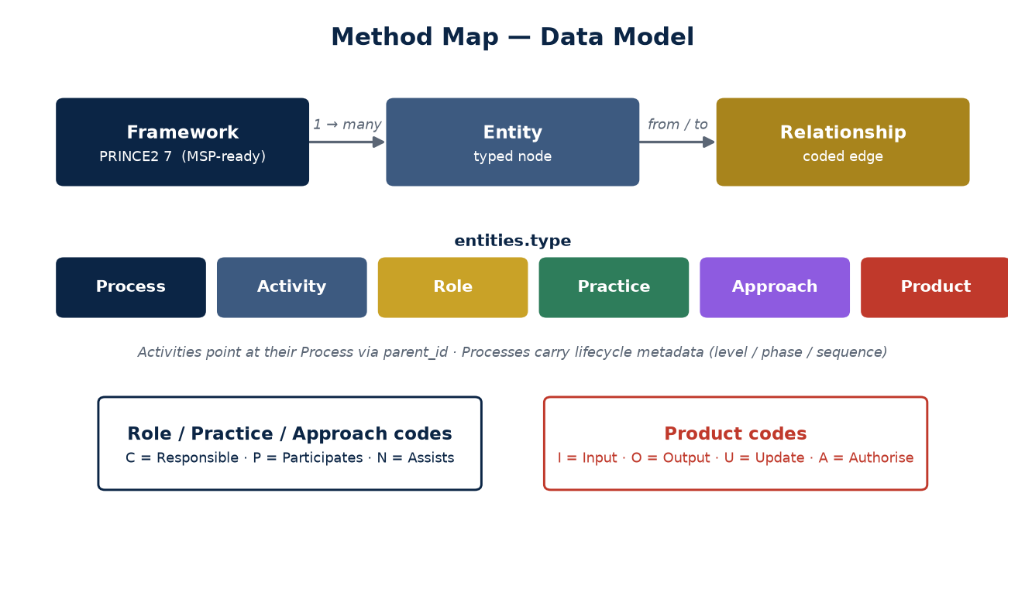
Data model
Framework → entities → relationships; each framework's config (types/codes/lanes/phases) makes the app generic — adding MSP or SAFe is a data file.
OFFICIAL
DOC-01 · 5

Slide 6
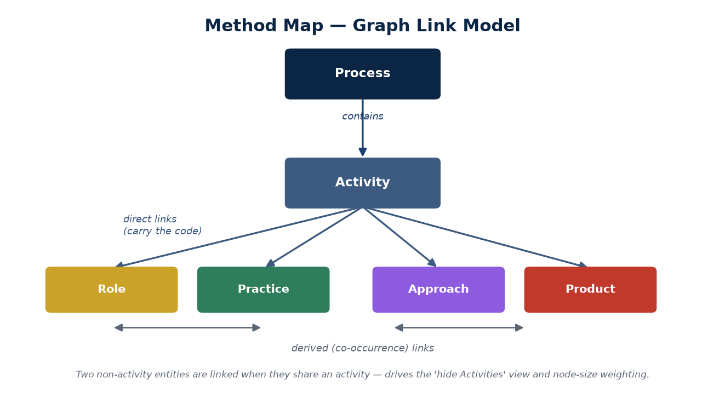
The graph link model
Contains, direct and derived links are built from activity-centric data.
OFFICIAL
DOC-01 · 6

Slide 7
Two fixed layouts
Positional meaning instead of an organic blob.
• Matrix — processes top, activities beneath, products below; roles left, practices right, approaches bottom.
• Timeline — lifecycle swimlanes (Directing / Managing / Delivering) with a stage scrubber.
• Both pin node positions; node size reflects direct responsibilities (C/P/N/I/O/U/A count).
OFFICIAL
DOC-01 · 7

Slide 8
Security & deployment
• Reads are open (public reference, no personal data).
• Writes need a single admin password (X-Admin-Password header).
• Render Blueprint: one service per framework (FRAMEWORK_KEY + APP_BASE); push to main auto-deploys all.
• Shared front door apps.p3mai.com (apps-gateway) routes /prince2, /msp, /safe.
• DB auto-seeds its framework on boot — ephemeral disk, so edits reset on redeploy.
OFFICIAL
DOC-01 · 8

Slide 9
Key design decisions
Decision | Why
Config-driven, framework-agnostic model | PRINCE2, MSP & SAFe on one codebase; new method = data
One image, one service per framework | FRAMEWORK_KEY selects each; shared front door
Activity-centric relationships | One row per real mark; higher links derived
Fixed layouts + direct_degree size | Readable structure; stable weighting
OFFICIAL
DOC-01 · 9

Slide 10
Roadmap
• Done — MSP, SAFe 6.0 Essential and PMBOK 6th ed are live behind the front door.
• SME-verify the indicative activity breakdowns / PMBOK ITTO cross-references.
• Extend SAFe beyond Essential; consider PMBOK 7/8 (principles + performance domains).
• Persistent storage (disk / Postgres) so authoring edits survive redeploys.
OFFICIAL
DOC-01 · 10

