Slide 1
P3MAI · METHOD MAP
User Manual
Using the P3MAI Method Map — summary
DOC-02 · Summary · v1.0 · 1 August 2026 · OFFICIAL

Slide 2
What the Method Map does
A picture of how a method fits together — this deck uses PRINCE2 as the example.
• Turns a method's cross-reference into an explorable network — PRINCE2, MSP or SAFe.
• See which roles, practices/competencies, and products/artefacts each activity touches.
• Tailor engagements, onboard teams, and explain governance visually.
OFFICIAL
DOC-02 · 2

Slide 3
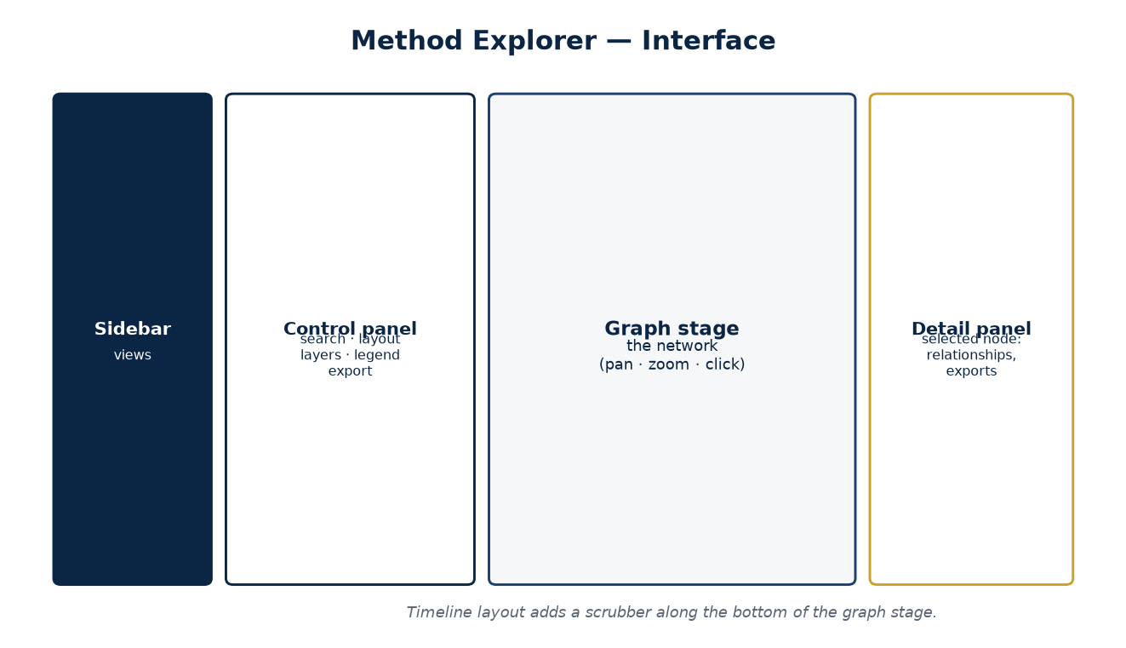
The screen at a glance
Sidebar · control panel · graph stage · detail panel.
OFFICIAL
DOC-02 · 3

Slide 4
Reading the codes
The most important thing to learn — labels on every link.
Where | Codes
Roles / practices / approaches | C Responsible · P Participates · N Assists
Products | I Input · O Output · U Update · A Authorise
OFFICIAL
DOC-02 · 4

Slide 5
The Matrix layout
• Processes top, activities beneath, products in a band below.
• Roles left, practices right, management approaches along the bottom.
• Bigger nodes = more direct responsibilities.
• Drag to pan, scroll to zoom, click a node for detail.
OFFICIAL
DOC-02 · 5

Slide 6
The Timeline layout
Watch the project unfold over time.
• Processes in swimlanes (Directing / Managing / Delivering), left→right in order.
• A scrubber walks the lifecycle stage by stage.
• Play to auto-advance; Spotlight one stage, or Cumulative to build up.
• Reset (gold button) clears the selection and scrubber back to the full view.
OFFICIAL
DOC-02 · 6

Slide 7
Select a node → the detail panel
• The node glows gold; its neighbours stay bright, the rest dim.
• The panel lists every relationship, with codes and owning process.
• A process lists its activities in sequence.
• Export a PDF summary or a CSV of just that element.
OFFICIAL
DOC-02 · 7

Slide 8
Project Lifecycle view
• The classic PRINCE2 process model as a swimlane.
• Time runs left→right: Pre-project → Initiation → Delivery ⟳ → Final.
• Click a process to see its activities in sequence; jump into the graph.
OFFICIAL
DOC-02 · 8

Slide 9
Exporting
Export | Gives you
Graph as PNG | A picture of the current view for slides
CSV / Excel | The whole cross-reference as a spreadsheet
Entity PDF | A branded one-element relationship summary
OFFICIAL
DOC-02 · 9

Slide 10
The other frameworks (same tool)
Open each at apps.p3mai.com/prince2 · /msp · /safe · /pmbok.
• MSP 5th ed — programme processes across Identify → Define → Delivery ⟳ → Close; codes C/P/N, CO/CR/RF/RV/UP/IM.
• SAFe 6.0 Essential — events across the PI cadence (PI Planning → Iterations ⟳ → IP → Inspect & Adapt); codes F/A/P/I and I/C/U/R/E.
• PMBOK 6th ed — the 49-process matrix, 10 Knowledge Areas × 5 Process Groups; codes I/O (inputs/outputs) and T (tools).
• Same screens and exports; only the layers and codes differ. The Guide always describes the map you're on.
OFFICIAL
DOC-02 · 10

Slide 11
Good to know
• First load after a quiet spell can take up to a minute (the app wakes).
• A dashed ring means the data is indicative — verify before formal use.
• Authoring mode (password) lets authorised users correct the data.
OFFICIAL
DOC-02 · 11

