Slide 1
P3MAI · WEBSITE
Architecture & Design
Structure & design of the P3MAI website — summary (v2.0)
DOC-01 · Summary · v1.0 · 1 August 2026 · OFFICIAL

Slide 2
What it is
“AI-Enabled · Sovereign · Safe · Proven.”
• Public business site for P3MAI — Board-level positioning.
• 12 pages + 2 estimators + ONE PHP endpoint (contact.php).
• Hand-built HTML/CSS/JS — no framework, no build step.
OFFICIAL
DOC-01 · 2

Slide 3
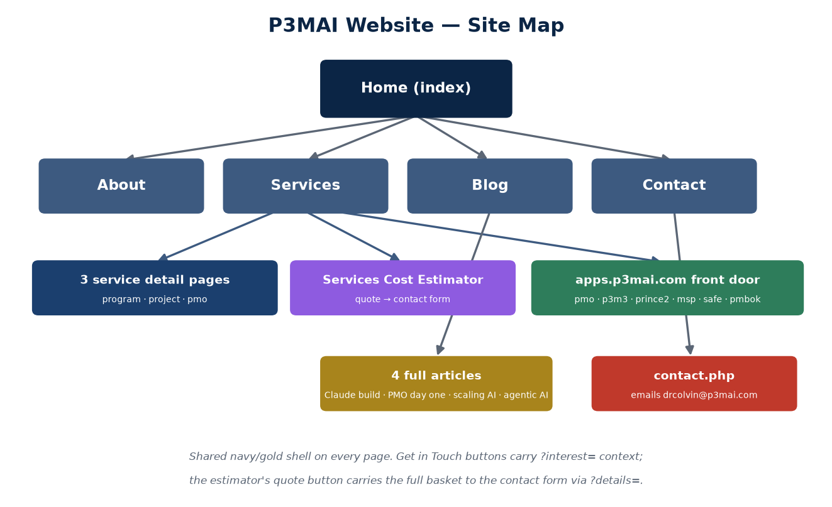
Site map
Services opens 3 detail pages, the estimator and 6 live apps; Blog opens 4 full articles.
OFFICIAL
DOC-01 · 3

Slide 4
Technology
Aspect | Choice
Markup / style | HTML5 · one CSS design system (?v=N versioned)
Behaviour | Vanilla JS (script.js ?v=N) — env-aware links, context CTAs
Server-side | contact.php only — the mail handler
Brand | Navy #0B2545 · gold #C9A227 · Poppins · two-tone P3M+AI wordmark
Hosting | Rise (UK cPanel/FTP) behind StackCDN
OFFICIAL
DOC-01 · 4

Slide 5
Front-end behaviour (script.js)
• Env-aware app links — six buttons swap to apps.p3mai.com/<slug> in prod.
• Context CTAs: ?interest= (service) and ?details= (estimator basket) prefill the contact form.
• Real form submission via fetch → contact.php → drcolvin@p3mai.com.
• Page transitions, hamburger nav, reveal-on-scroll, validation.
OFFICIAL
DOC-01 · 5

Slide 6
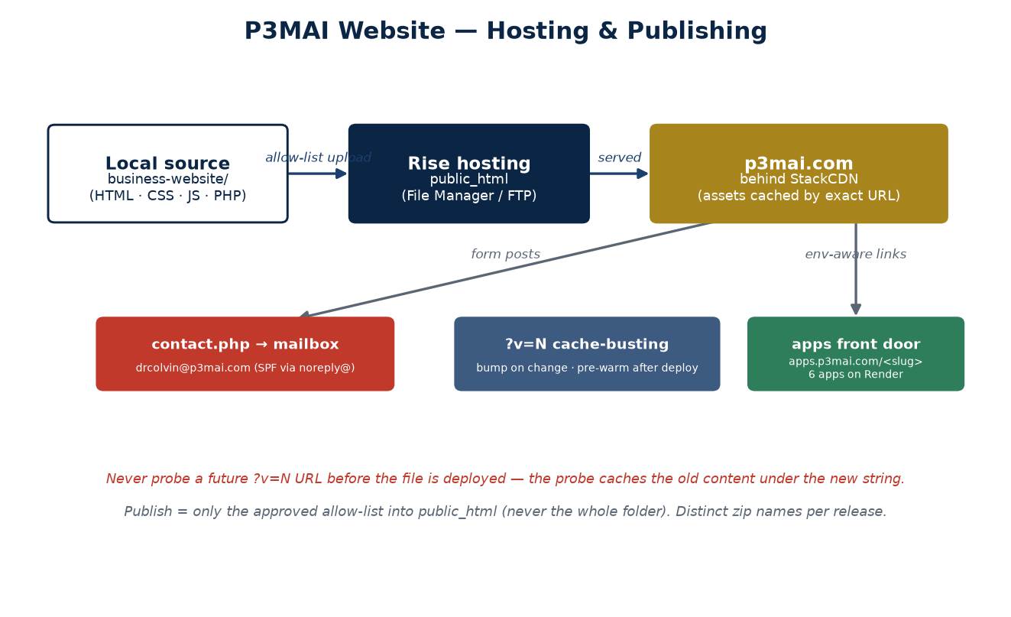
Hosting & publishing
Rise + StackCDN for the site; Render front door for the apps; PHP mail pipeline.
OFFICIAL
DOC-01 · 6

Slide 7
Key design decisions
Decision | Why
Static + one PHP endpoint | Fast, robust; email needs exactly one server file
Byte-identical header/footer | One consistent shell
Context-carrying CTAs | Every enquiry arrives naming its origin
?v=N asset versioning | StackCDN caches by exact URL
No fabricated content | Grounded in the real CV; testimonials dormant until real
OFFICIAL
DOC-01 · 7

Slide 8
Roadmap
• Activate testimonials when real quotes land (MKT-08) → CTA pivot (MKT-09).
• Analytics + email capture (MKT-01/02) — the funnel runs unmeasured today.
OFFICIAL
DOC-01 · 8

