Slide 1
P3MAI · WEBSITE
User Manual
A guide to the P3MAI website — summary (v2.0)
DOC-02 · Summary · v1.0 · 1 August 2026 · OFFICIAL

Slide 2
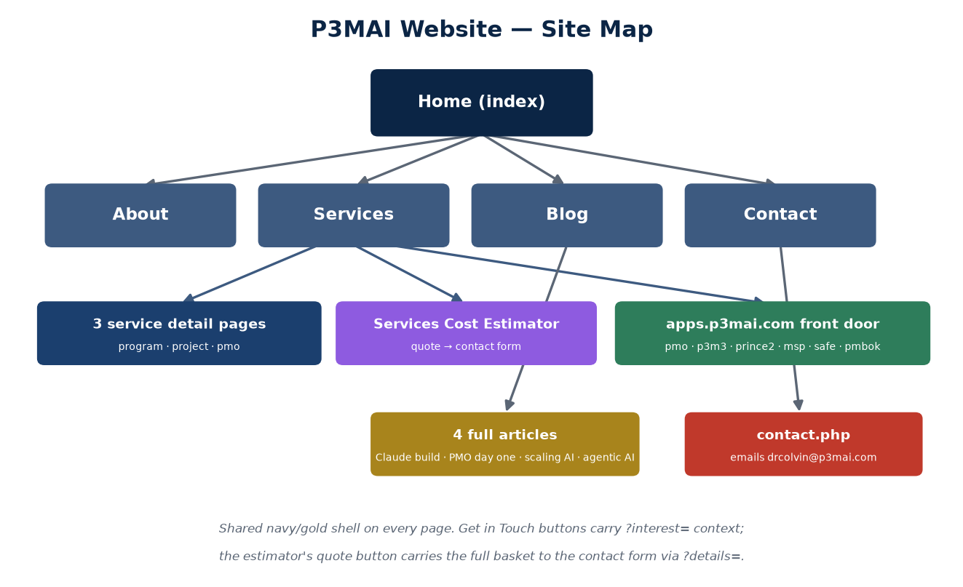
Site map
5 main areas → 3 service pages, 4 articles, the estimator, 6 live apps.
OFFICIAL
DOC-02 · 2

Slide 3
The pages
• Home — problem-led hero, named clients, story, track record, the 3-step ladder.
• About — nine industries, six-milestone timeline, sovereign-and-safe credentials.
• Services — 3 cards with who-it's-for, Service Details pages, 6 app buttons.
• Blog — 4 posts, each with a full Read-more article.
• Contact — the form knows where you came from; enquiries email P3MAI directly.
OFFICIAL
DOC-02 · 3

Slide 4
Services Cost Estimator
P3MAI's real catalogue, priced interactively.
• Pick a service line, products, POTI dimensions, tier, licence, days, maintenance.
• Live totals in AED / GBP / USD in the summary rail.
• Get a Detailed Quote → contact form with your full basket pre-written.
• Nothing stored until you choose to send.
OFFICIAL
DOC-02 · 4

Slide 5
The six apps (all free to explore)
• PMO Example + P3M3 Maturity Assessment (PMO card).
• PRINCE2 / SAFe / PMBOK Method Maps (Project card).
• MSP Method Map (Program card).
• All at apps.p3mai.com/<slug>; each links back to the site.
OFFICIAL
DOC-02 · 5

Slide 6
Good to know
• Start Where It Suits You: free tools → products → talk to Douglas.
• Estimates are indicative — final pricing follows a scoping conversation.
• Fully responsive; consistent navy/gold shell throughout.
OFFICIAL
DOC-02 · 6

