Slide 1
P3MAI · PMO SERVICE
Architecture & Design
Technical design of the P3MAI PMO Service — summary
DOC-01 · Summary · v1.0 · 1 August 2026 · OFFICIAL

Slide 2
What it is
One place to run a delivery portfolio.
• Internal PMO tool for P3MAI.
• Projects, milestones, resources, allocations, risks — plus dashboard & reports.
• Single-origin web app; SQLite auto-seeds a sample portfolio.
OFFICIAL
DOC-01 · 2

Slide 3
Technology stack
Layer | Technology
Backend | FastAPI + SQLAlchemy + SQLite
Front end | React 19 + Vite, react-router
Packaging | Docker (multi-stage), single image
Hosting | Render — Docker web service (apps.p3mai.com/pmo via the front door)
OFFICIAL
DOC-01 · 3

Slide 4
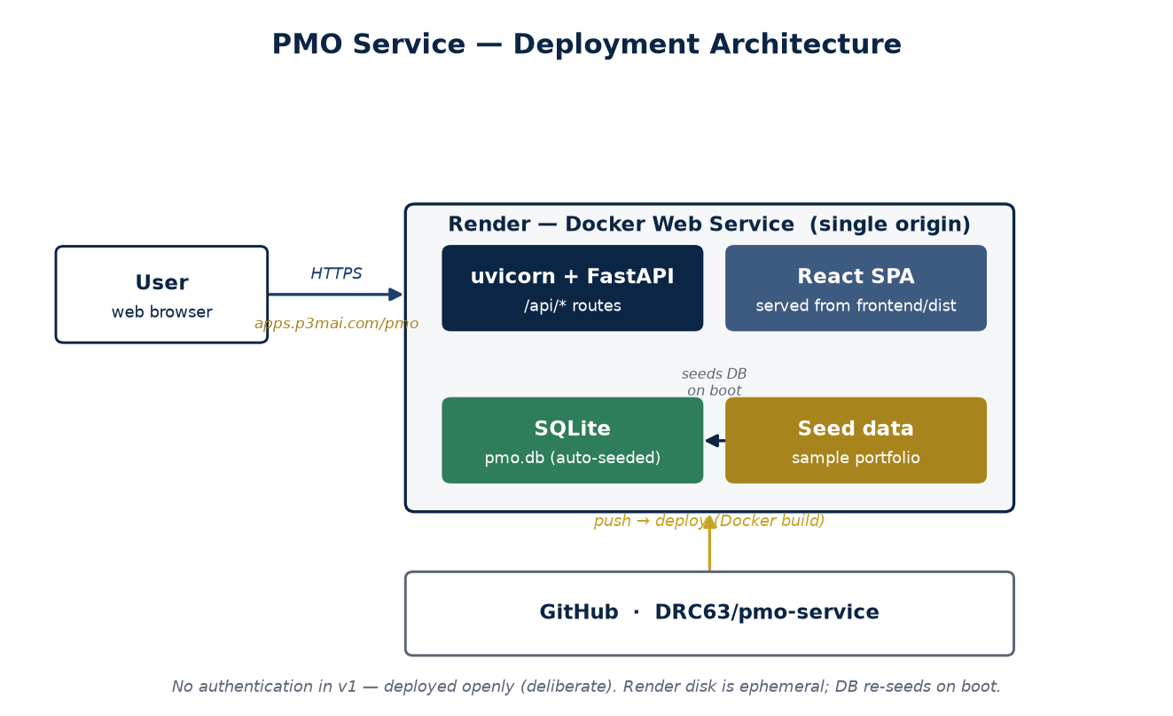
Deployment architecture
One container serves the API and the built React app.
OFFICIAL
DOC-01 · 4

Slide 5
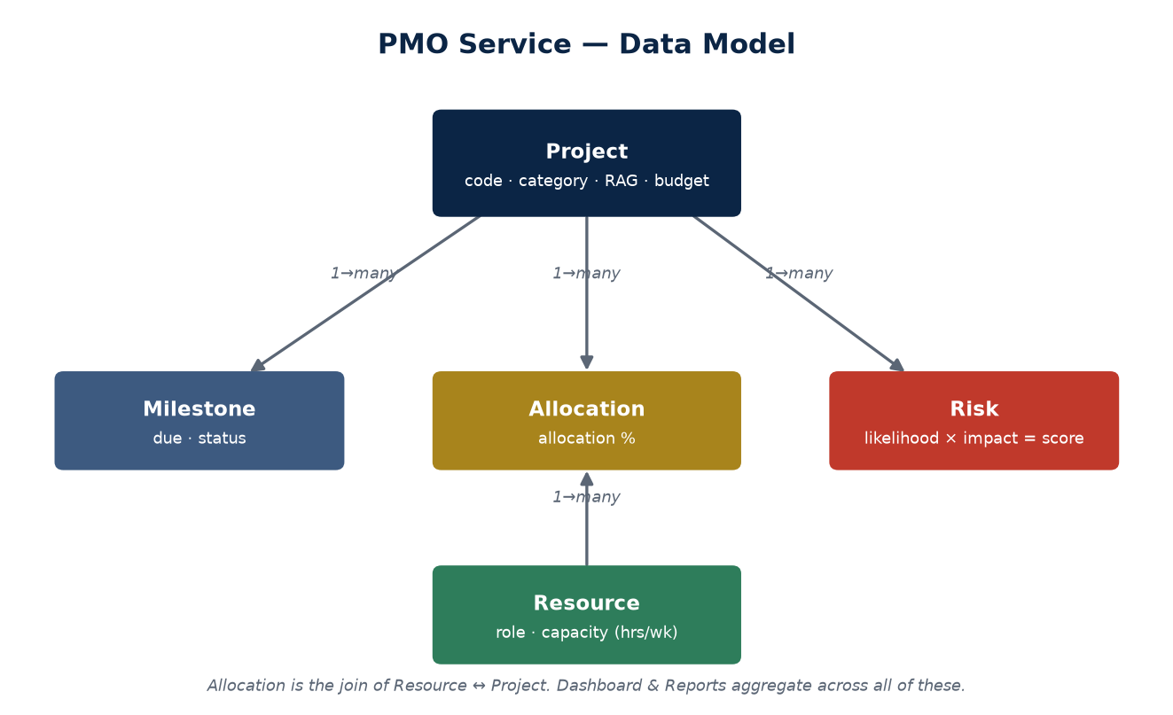
Data model
Project → Milestones/Risks/Allocations; Resource via Allocation.
OFFICIAL
DOC-01 · 5

Slide 6
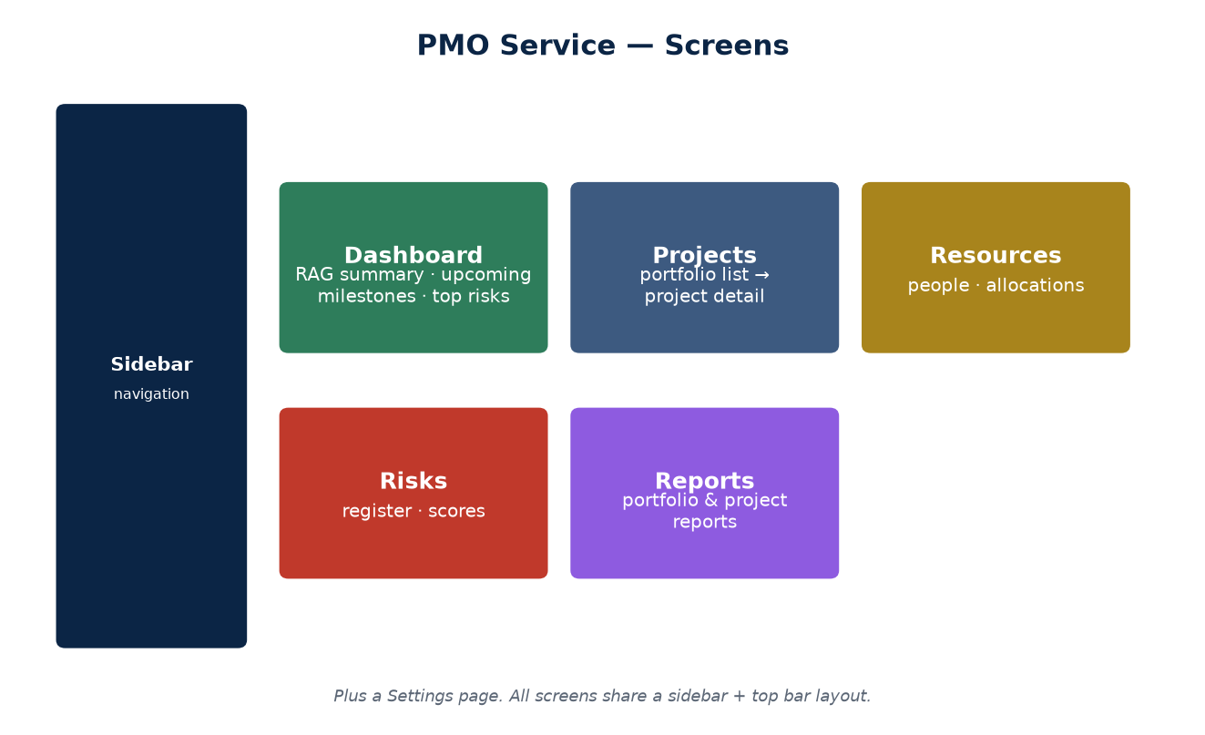
The screens
Dashboard, Projects, Resources, Risks, Reports (+ Settings).
OFFICIAL
DOC-01 · 6

Slide 7
Backend
• REST routers per resource; explicit serializers add computed fields.
• Dashboard aggregates RAG, upcoming milestones, high-severity risks, overdue.
• Reports: portfolio table + per-project drill-down.
OFFICIAL
DOC-01 · 7

Slide 8
Security & deployment
• No authentication in v1 — open by deliberate choice (single-user).
• Deployed on Render from the Dockerfile; DB re-seeds on boot.
• Ephemeral disk — entered data is not durable yet.
OFFICIAL
DOC-01 · 8

Slide 9
Key design decisions
Decision | Why
Single-origin Docker image | One container serves API + UI
SQLite + auto-seed | Zero-config; self-populating
No auth in v1 | Frictionless single-user tool (revisit)
Explicit serializers | Deliberate computed fields (RAG, overdue, %)
OFFICIAL
DOC-01 · 9

Slide 10
Roadmap
• Authentication and multi-user before real data.
• Persistent storage (disk / Postgres).
• Richer reporting and export.
OFFICIAL
DOC-01 · 10

