Slide 1
P3MAI · PMO SERVICE
User Manual
Using the P3MAI PMO Service — summary
DOC-02 · Summary · v1.0 · 1 August 2026 · OFFICIAL

Slide 2
What the PMO Service does
• Track projects, milestones, resources, allocations and risks.
• See portfolio health on a dashboard and in reports.
• Pre-loaded with a sample portfolio to explore.
OFFICIAL
DOC-02 · 2

Slide 3
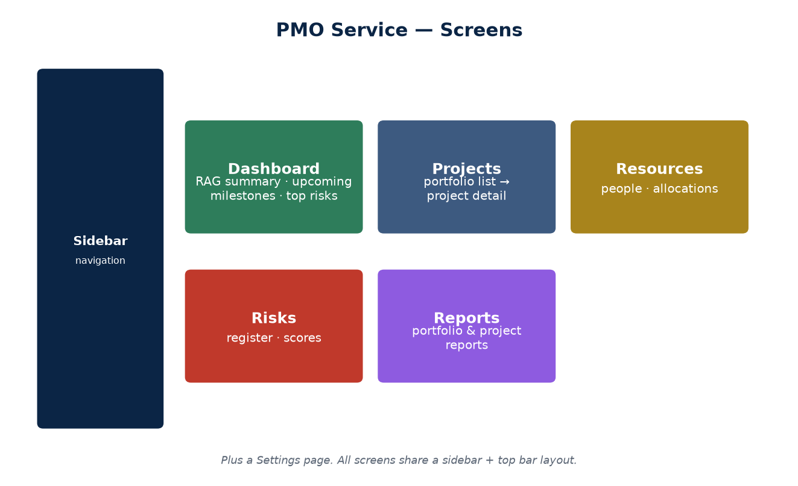
The screens
A sidebar switches between screens.
OFFICIAL
DOC-02 · 3

Slide 4
Dashboard
• RAG counts across the portfolio.
• Upcoming milestones with days remaining.
• High-severity risks (score 15+).
• Overdue-milestone count.
OFFICIAL
DOC-02 · 4

Slide 5
Projects
• Filterable portfolio list; create/edit projects.
• Project detail brings milestones, risks and allocations together.
• Budget vs. spend and percent-complete per project.
OFFICIAL
DOC-02 · 5

Slide 6
Resources & allocations
• People with role, email and weekly capacity.
• Allocation = % of a person on a project.
• Over-allocation is shown so you can rebalance.
OFFICIAL
DOC-02 · 6

Slide 7
Risks
• Register scored by likelihood × impact (1–25).
• 15+ is high severity and shows on the dashboard.
• Set status (Open / Mitigating / Closed), owner, mitigation.
OFFICIAL
DOC-02 · 7

Slide 8
Reading the colours
Indicator | Meaning
Green / Amber / Red | Project health (on track / at risk / in trouble)
Risk-score badge | likelihood × impact — higher & redder = more severe
Overdue flag | Milestone past its due date, not complete
OFFICIAL
DOC-02 · 8

Slide 9
Good to know
• No login in v1 — don't store sensitive data yet.
• 'Back to Website' returns you to p3mai.com.
• Sample data can be edited or deleted freely.
OFFICIAL
DOC-02 · 9

