Slide 1
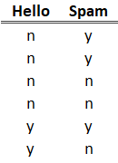
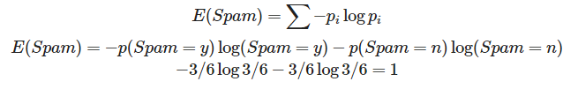
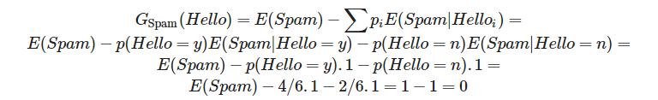
Entropia
E(Spam)
Ganho de Informação
GSpam(Hello)
Notes:
$$ E(Spam) = \sum -p_i \log p_i$$
$$ E(Spam) = -p(Spam = y) \log(Spam = y) -p(Spam = n) \log(Spam = n) $$
$$ -3/6 \log 3/6 -3/6 \log 3/6 = 1 $$
<br>
$$ G_\text{Spam}(Hello) = E(Spam) - \sum p_i E(Spam | Hello_i) =$$
$$ E(Spam) - p(Hello=y) E(Spam | Hello=y) - p(Hello=n) E(Spam | Hello=n) = $$
$$ E(Spam) - p(Hello=y) . 1 - p(Hello=n) . 1 =$$
$$ E(Spam) - 4/6 . 1 - 2/6 . 1 = 1 - 1 = 0$$

