Slide 1
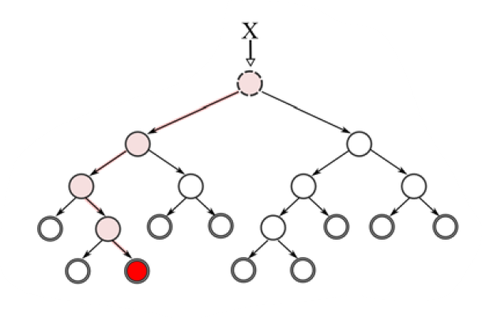
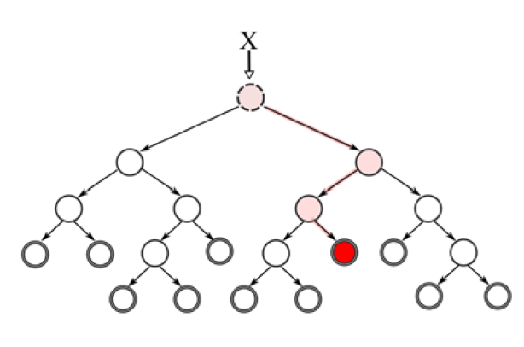
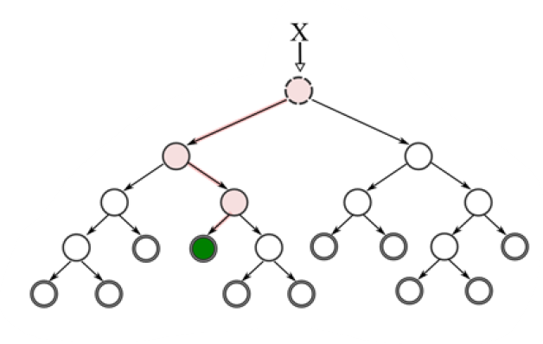
Bagging (Bootstrap Aggregation)
Feature Randomness
X = 1,2,3,3,6,6
X = 1,2,3,4,5,5
X = 2,2,3,4,5,6
feature a1
feature a4
feature a2
train_data
a1 a2 a3 a4 Class
1 ...
2 ...
... ...
6 ...

