Slide 1
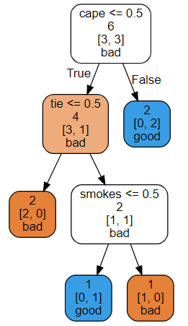

cape
cape
smokes
tie
nenhuma decisão
no primeiro nível!
tie
smokes
cape
cape
tie
smokes
cape
good
good
good
good
good
bad
smokes
bad
tie
bad
tie
bad
tie
...
good
bad
good
bad
good
bad
good
bad

