Slide 1
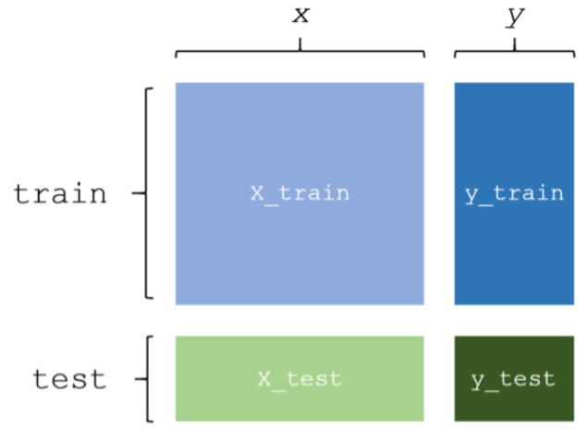
y_train
Model
1. Train
3. Output
2. Predict
y_pred
y_test
4. Compare

