Slide 1
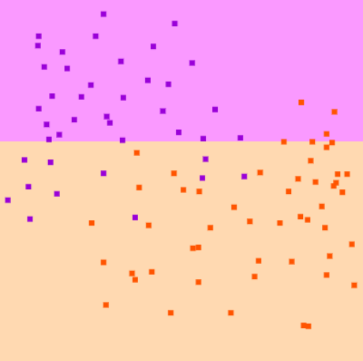
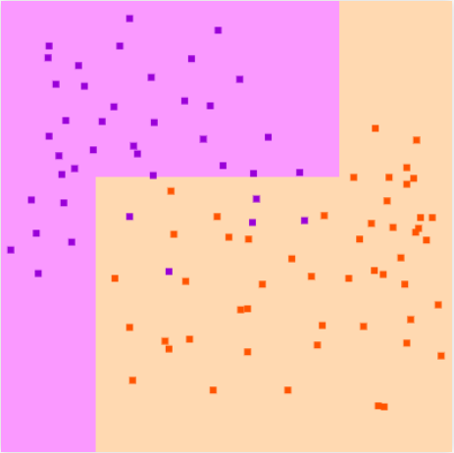
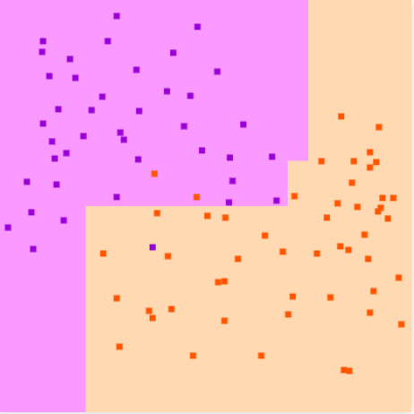
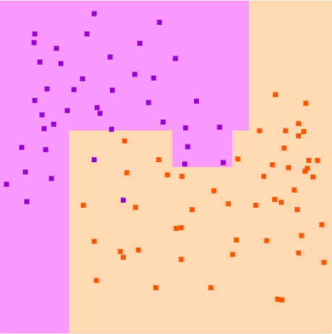
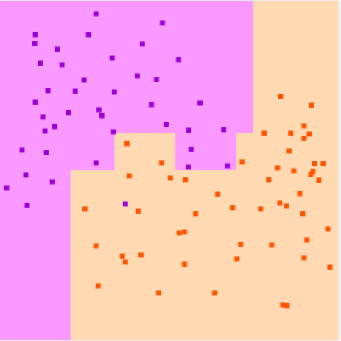

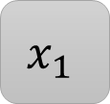

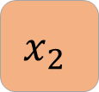



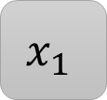






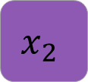



1 level Tree
2 level Tree
3 level Tree
4 level Tree
5 level Tree
$$x_{1 }>t_{1 }$$
$$x_{1 }>t_{1 }$$
$$x_{2 }≤t_{2 }$$
$$x_{1 }≤t_{1 }$$
$$x_{1 }≤t_{1 }$$
$$x_{2 }>t_{2 }$$
$$x_{1}$$
$$x_{1}$$
$$≤t_{1 }$$
$$>t_{1 }$$
$$≤t_{1 }$$
$$>t_{1 }$$
Pure partitions
$$x_{2}$$
$$x_{2}$$
$$≤t_{2 }$$
$$>t_{2 }$$
$$≤t_{2 }$$
$$>t_{2 }$$

