Slide 1
Dynamic Bayesian Estimation of COVID-19 Prevalence
DRAFT
Steven Horn, DRDC CORA

Slide 2
Issue and Motivation
What is the risk to individuals and teams to contract COVID-19?
Extension of previous work by Mirshak and Horn
Stochastic point of view:
If the probability of becoming infected on a given day is p0. It is a function of the prevalence in the population, and the infection rate.
The prevalence changes over time (outbreak or remission), and p0 can change day to day.
Can one estimate the prevalence from the available data?
Many infectious individuals are possibly not detected, have no symptoms, or are not tested.
Can one estimate the population of asymptomatic/undetected cases?

Slide 3
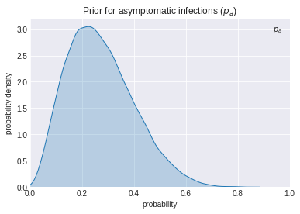
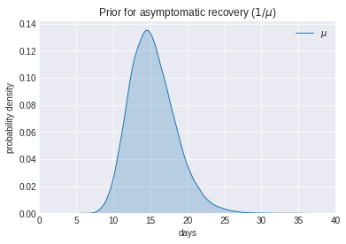
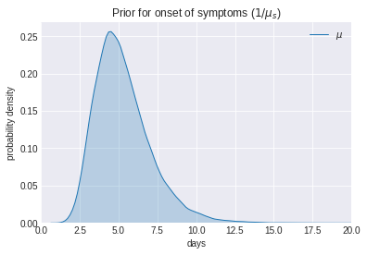
Dynamic estimation
SEIR-like model, with partially observed compartments and transitions.
Infectious
Susceptible
Incubating
I asym + undetected
Recovered
S
E
Removed from infectious pool later
I pre-s
Symptomatic / Isolated
Removed from infectious pool earlier
Infecting
New Case Data
Minus untested

Slide 4
Model overview
Assume
New cases reported are primarily symptomatic and that testing is biased for symptomatic cases. If test outcome is known (symptomatic/asymptomatic/pre-symptomatic) this can also be used
Asymptomatic individuals may not be equally as infectious as pre-symptomatic
Testing is not perfect – many cases may be missing from case data
Key Model Parameters
Population size
Prior estimate of initial infection rate
Prior estimate of asymptomatic likelihood
Incubation and Recovery time distributions
Asymptomatic infectiousness factor ( less than pre-symptomatic *? )
Under-reporting factor (not all symptomatic cases are reported)
* mentioned on CDC planning website

Slide 5
Model details
Stochastic Bayesian model.
Define initial conditions (asymptomatic/symptomatic infections) at start
Run stochastic simulations and observe at each time step, how many infections there are. Use observed data to update parameters.
Compare cases with data over time and do a Bayesian update of parameters
Initial parameter tuning with automatic differentiation variational inference (ADVI).
MCMC to handle uncertainty in model parameters, represent posterior distributions, and predict the model forward in time.

Slide 6
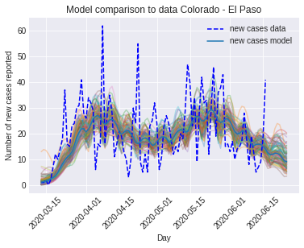
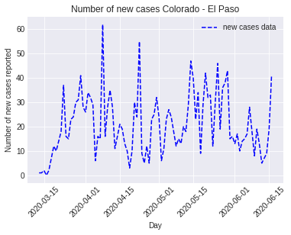
Running the model
The model is developed using pyMC3, and uses the onset of symptoms and a distribution for a reporting delay to fit to the new case data.
Leverage components from Priesemann Research Group (Germany) *
fit
Fit Model Parameters
prediction
Inferred posteriors and populations (next slide)
* https://github.com/Priesemann-Group/covid19_inference

Slide 7
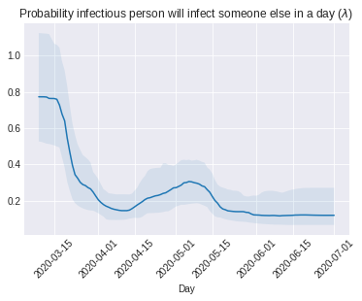
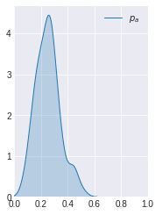
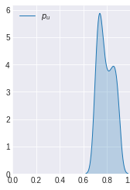
Inferred Parameters
To fit the model to new case data hysteresis results in posterior estimates:
Note that infection rate is driven by social behaviour changes – but the factor was extracted from data.
Prob. density
Asymptomatic Likelihood
Under-reporting Likelihood
Infection rate over time

Slide 8

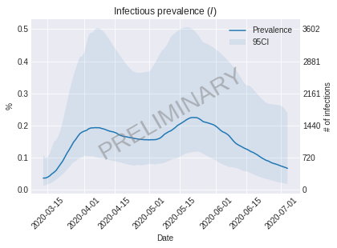
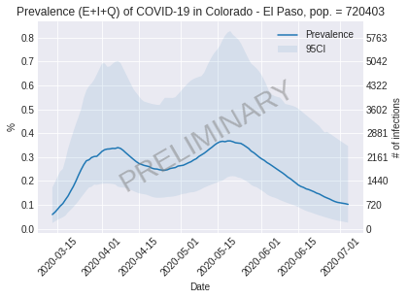
Situation and prediction
Estimate the number of undetected pre-symptomatic and asymptomatic infectors in the population over time.
Prevalence vs point prevalence vs infectious point prevalence
Should incubating or quarantined individuals be included in prevalence?
In terms of the risk to operations – only infectious prevalence matters.
Don’t consider Incubating or Isolated individuals as risk unless able to infect others.

Slide 9
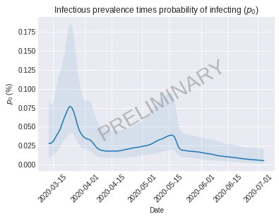
Dynamic probability of infection
Infectious population x Likelihood to infect = p0 (t)
This is the key factor for risk of infection of an individual in the team on a given day, or period of time.

Slide 10
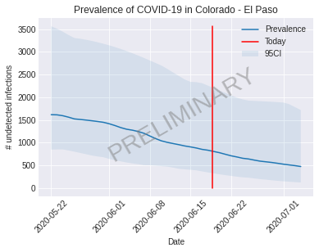
Situation assessment and prediction
Using this method, one can also make predictions on the number of remaining cases in the population now, and near future.

Slide 11
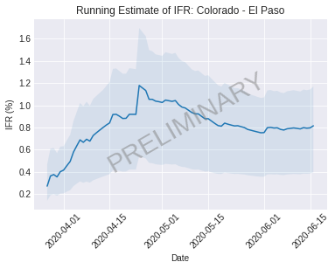
Cross-checking with fatality rates
The Infection Fatality Rate has been estimated through sero-prevalence studies. This is a cumulative estimate of infections compared to cumulative deaths attributed to COVID-19.
A running cumulative infection comparison from this model is shown for the given parameters and priors.

Slide 12
Conclusion
Potential method to dynamically monitor risk in different communities.
Potential application to set thresholds for relaxing or tightening risk mitigation measures such as testing frequency, sequestration, etc.
This method has not yet been formally reviewed or validated.
Limitations:
Only considering community spread – imported cases could be added
Not including infections from healthcare services (i.e. healthcare workers providing care to infected patients)

