Slide 1


Steam Game Analytics & Ranking System
Design brief for a web app that ingests game metadata, player activity, sales and ratings — then computes a live popularity ranking and visualises trends for developers and product teams.

Slide 2
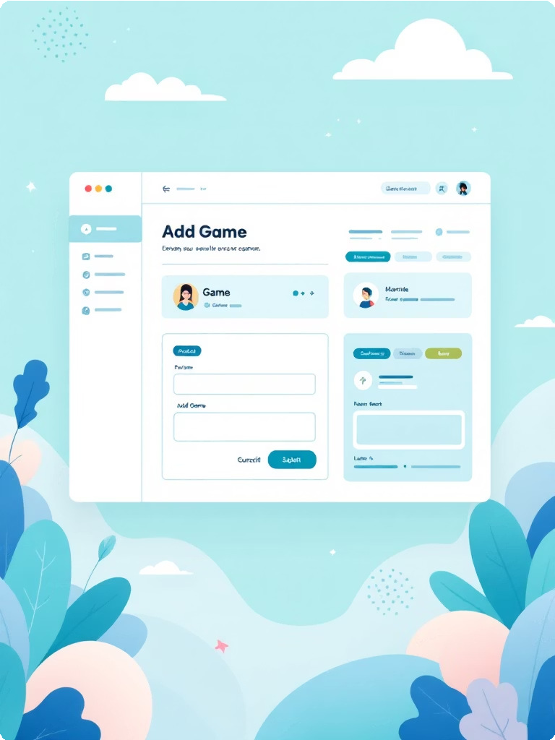
OBJECTIVE
1. Game Popularity Analysis
The system analyzes player count, ratings, and discounts to determine which games are trending.
2. Marketing Strategy Optimization
Gaming platforms can study which sales attract more players.
3. Game Recommendation Systems
Using rankings and popularity scores, platforms can recommend trending games to users.
4. Player Trend Tracking
The system records player statistics over time.
.

Slide 3
Core Capabilities
PROJECT SCOPE
Admin: add/edit games and manage metadata
Telemetry: record current & peak player counts over time Sales tracking: capture discounts and sale windows
Automated ranking: compute popularity score and top-10 lists Visualisations: growth graphs and trend charts (Chart.js) Authentication: secure user login and role-based access

Slide 4
Database Design (Overview)
Relational schema stored in MySQL. Tables designed for time-series player data, discrete sale events, and computed rankings for quick reads.
games
game_id (PK), name, developer, release_date, base_price
player_stats
stat_id (PK), game_id (FK), current_players, peak_players, recorded_at
sales
sale_id (PK), game_id (FK), discount_percent, sale_start, sale_end
users
user_id (PK), name, email, password_hash
rankings
rank_id (PK), game_id (FK), popularity_score, rank_position, computed_at

Slide 5
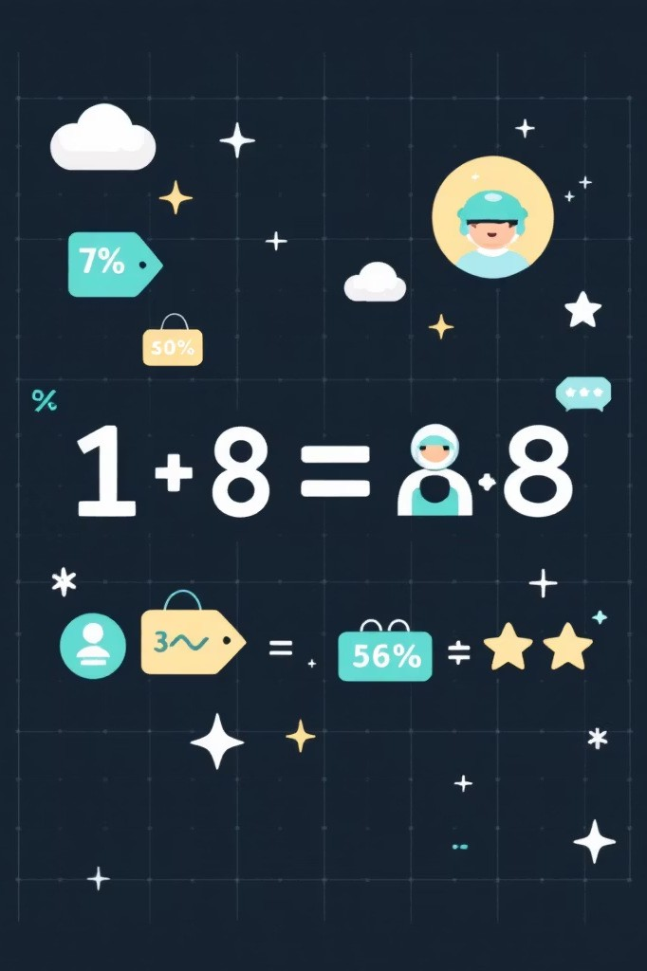
Ranking Formula & Rationale
Use a weighted score to balance live activity, promotional intensity and user sentiment. Tunable weights make the ranking responsive to business goals.
Example formula
popularity_score = (current_players * 0.6) + (discount_percent * 0.2) + (rating * 0.2)
Notes
current_players is the latest sampled value; consider smoothing (EMA) to reduce noise.
discount_percent uses numeric value (0–100).
rating is normalized to same scale as players or scaled before weighting.

Slide 6

Data Flow & Processing
Sales Events
Aggregat e
Telemetry
Ratings
Score
Pipeline handles periodic ingestion, aggregation (hourly), score computation, and materialised ranking table updated on schedule or triggered by major events.

Slide 7
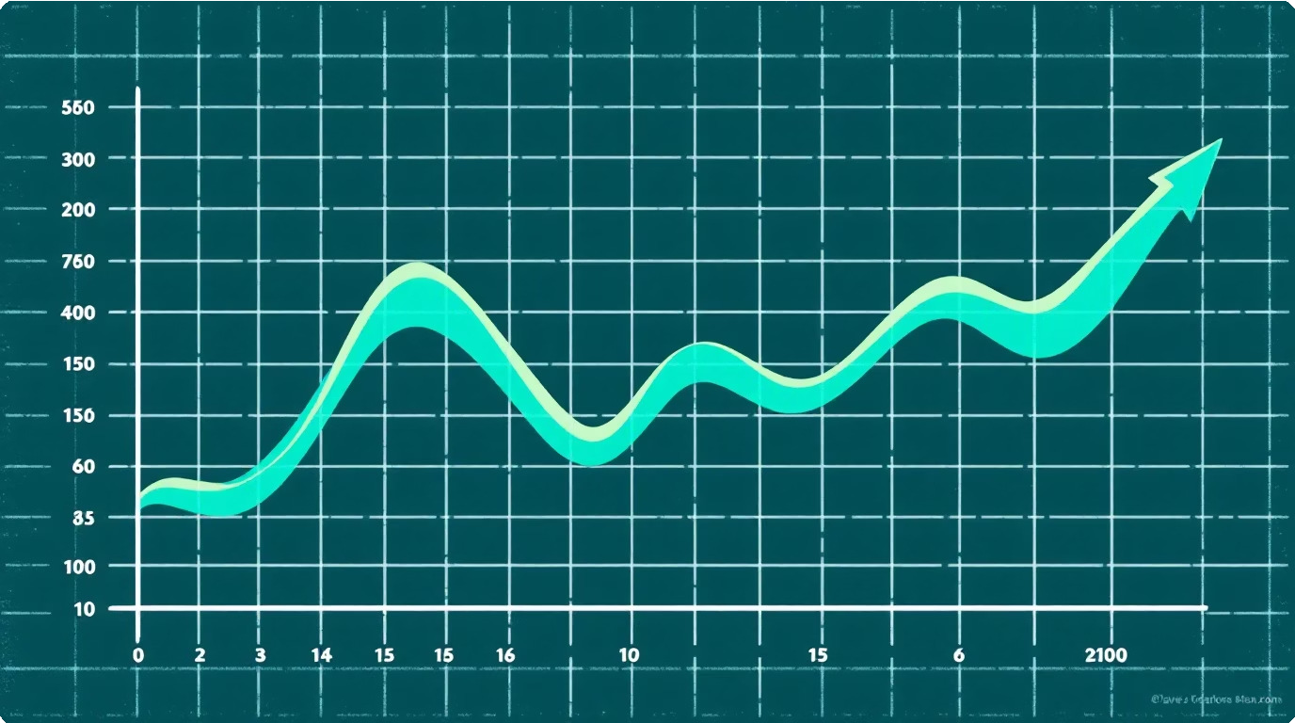
Charts & Visuals (Frontend)
Key visual components to build with Chart.js:
Time-series line: active players (support zoom & brush)
Bar/column: discount impact vs player lift during sale
Top-10 leaderboard: sortable table with sparklines
Trend indicator: % change over 24h / 7d
Use server-side aggregation for sparklines to avoid transferring large time-series to clients.

Slide 8
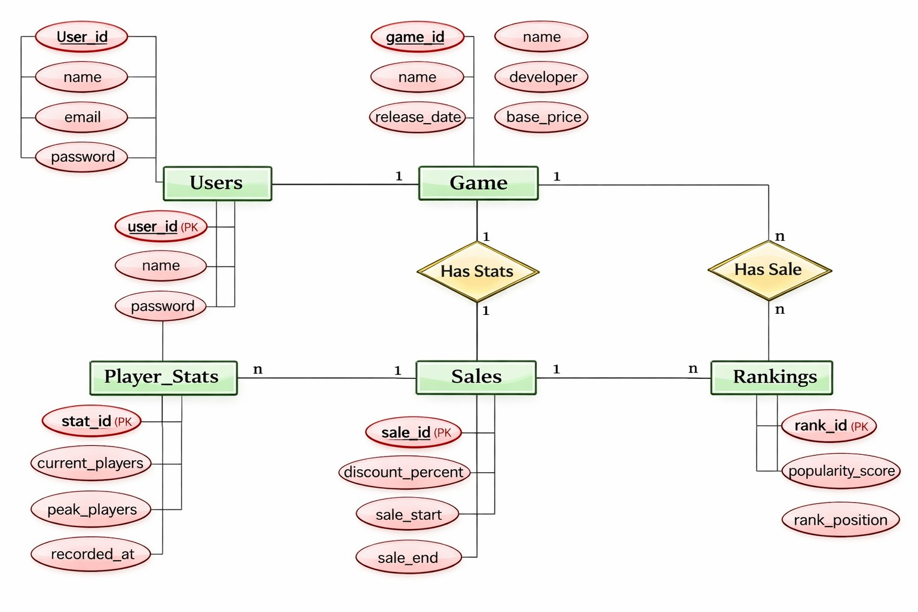

Slide 9

Security, Privacy & Data Quality
Authentication Store password_hash, implement salted bcrypt/argon2; offer OAuth integration.
Data validation Sanitise inputs, enforce types, discard suspicious telemetry spikes before aggregation.
Privacy Collect only necessary data; anonymise PII; GDPR-ready controls for user deletion.

Slide 10

Roadmap & Next Steps
Phase 1 — MVP
Core DB + ingestion, basic ranking job, leaderboard UI, auth
Phase 2 — Metrics
Charting (Chart.js), smoothing algorithms, sales correlation dashboards
Phase 3 — Scale & polish
Performance tuning, caching, role-based admin UI, A/B of weighting formula
Recommended immediate actions: scaffold schema, implement ingestion API, wire up a scheduled ranking worker, and build the top-10 leaderboard as the first public-facing feature.

