Slide 1
FIA Demonstration Plot
SAF Headquarters – Bethesda, MD
Introduction
This document gives an overview of the steps associated with installation of an FIA plot, from plot location procedures to measurement of the basic data elements that are collected. This example includes information from our Phase 2 (P2, or forest inventory plot) as well as our Phase 3 (P3, or forest health plot) sample protocols. P3 plots are a subset of P2 plots; there is one P2 plot for roughly every 6,000 acres, and approximately one out of every 17 P2 plots are identified also as P3 plots (or roughly one P3 plot every 100,000 acres).
Although this example includes paper data recording (or “tally”) sheets, all FIA units use electronic data recorders in the field for recording P2 and P3 data elements. By using electronic data recorders, there is no need for someone in the office to enter the data into a computer; the crews do all data entry in the field, with checks built in so that many errors are prevented or corrected on site. The process of real time error checking and correction is a key component of our Quality Assurance Program.
The National Core Field Guide for P2 and P3 is used by all FIA units to describe how to collect a core set of common forest inventory and forest health data. In addition, each FIA unit collects additional variables at the regional level to meet their regional and local needs. Some of these data elements are necessary to link current data with previously collected data from prior inventories or meet users needs at the regional level. The National Core Data Elements are consistent across all of the US. As this plot is located in Maryland, the procedures used for the plot installation and data collection reflect the regional data elements of the Northeastern Forest Inventory and Analysis Unit, in addition to the National Core Data Elements.
1

Slide 2
Phase 1 – Remote Sensing
The first step in installing an FIA plot involves the identification of a geographical coordinate for the plot and the placing of this coordinate on some type of geo-referenced map or image. This step may vary slightly between units but generally involves the use of topographic quad maps and/or the use of aerial photographs. FIA is currently in the process of transitioning from aerial photography to use of satellite imagery for all Phase 1 work. Phase 1 is used to stratify lands into forest and non-forest classes and to estimate the area in each class. This information is used to expand the plot data up to population-level estimates. The specific procedures may vary between FIA units but the basic function is to interpret whether a point on the photograph is forest or non-forest. The image interpretation is validated by visiting the P2 plots and adjusting interpretation as appropriate. This process is called ‘ground truthing’. FIA plots are intended to be permanent; by remeasuring these locations over time, we can produce precise estimates of growth, mortality, land conversion, and other estimates of change.
Once the plots have been identified, the field crews are provided with the coordinates, aerial photographs, and other information needed to help them navigate to the plot center (PC). The PC is usually pin-pricked to identify the exact location. The circle on the photograph is to help the crews to identify the location of the pin-prick. FIA crews now use Global Positioning Systems (GPS) to assist in locating plots. Once the crew is near the plot, the crew will identify an easily recognizable landmark such as a tree or trail intersection that can seen on the photo. This starting point (SP) will be used a reference point for future crews to navigate to the plot location. Once the SP is identified, a course to PC is determined. The SP and PC is written on the photo, usually the back, along with the calculations.
Note: Most aerial photographs are oriented with north at the top of the photo.
2

Slide 3
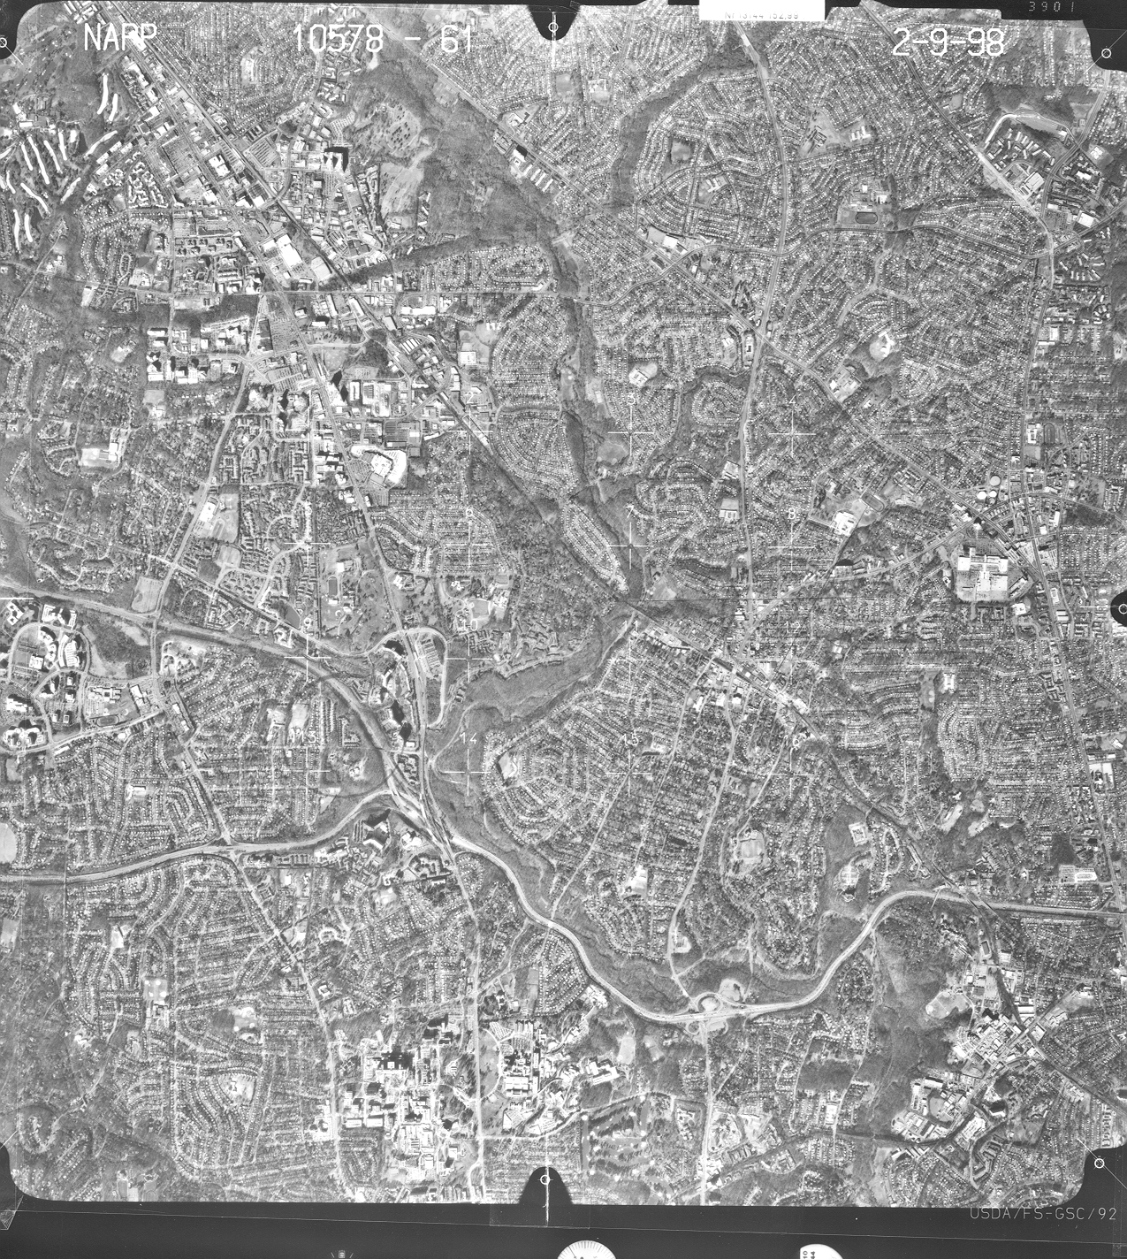
N
3

Slide 4
Plot Establishment
Once the crew is in the vicinity of the plot, the crew will identify and contact the landowner for permission to enter the plot. This activity may occur several days prior to the the actual visit to the plot and may entail a trip to the county courthouse to identify the owner of the land where the plot is located. The purpose of this section of the tally sheet is to provide this information to future crews.
Private landowners are essential partners for the FIA Program. Without a landowners’ permission, field crews cannot collect data on private lands. To protect the privacy of a participating landowner, the exact plot location coordinates are kept confidential and the owners identity is never linked to the plot data. In addition, exact plot coordinates are never included in public data bases nor released to individuals outside of FIA.
The information on the photo is used to establish a SP. The SP is a easily recognizable monument that can seen on the photo and/or found by using land use patterns. This can be a tree, field corner, telephone pole, or other recognizable landscape feature. The SP is “witnessed” is with an azimuth and direction to two other trees. The information on the course-to-plot from SP to PC is recorded on this page of the tally sheet.
The crew will then navigate to the PC. Once the crew has traversed along the azimuth and distance to PC from the SP, the crew will examine the photo and verify that they are actually at PC. Some type of stake is used to identify the PC. In addition, the PC is also “witnessed” in the same manner as the SP. GPS readings are recorded. All of this information is useful for future FIA field crews to re-locate the plot.
Note: On this and other pages of the tally sheets, the numbers under the variable name correspond to the section of the field guide that describes the procedures for this variable. The large “X’s” identify the width of the field.
4

Slide 5
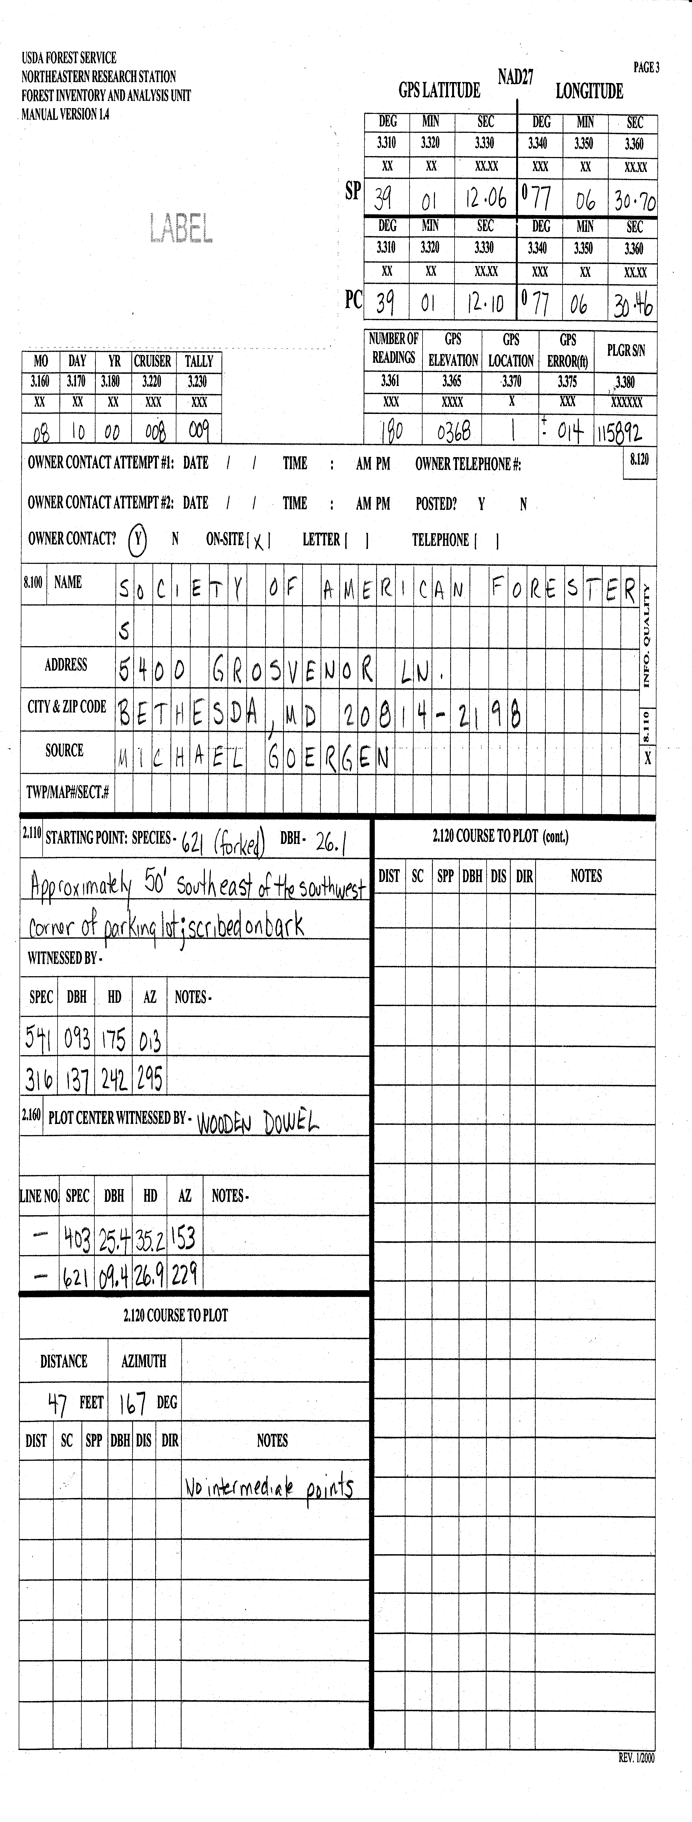
5

Slide 6
General Plot Notes and Sketch Map of Plot Location
This information is completed when a plot is first installed. During future visits, this information along with the photo will be used by the field crews to navigate to the general plot area. The sketch map should provide road intersections and other easily recognizable landmarks to assist future crews in locating the plot. This may also include mileage and road names. This information along with the aerial photograph, GPS, and the sketch map are all tools used to ensure that the field plot can be re-located.
Any additional information that future crews need in collecting the data is also included in the general notes. This information may relate to special equipment necessary such as a boat, extra-long increment borers to age large diameter trees, etc. If the area has changed or a different SP has been established, this information and the previous page of the tally sheet should be re-done.
6

Slide 7
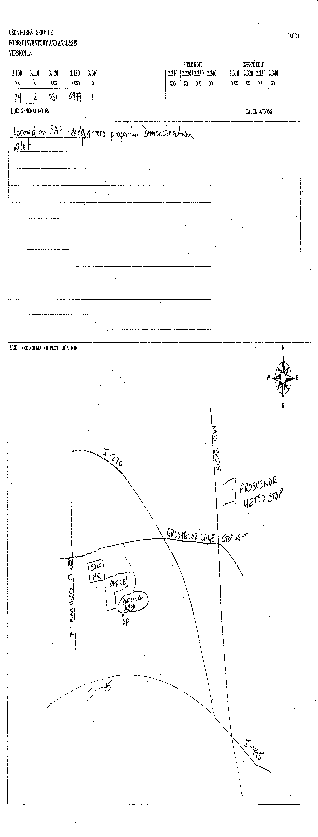
7

Slide 8
Plot Level and Condition Level Data
Once the PC has been established, crews begin to collect plot data. The first step involves the collection of information that relates to the general plot area. Most of the data at the plot level are fairly obvious, but the codes used are numeric. For example, the state code for Maryland is 24. Most data collected for FIA plots are designed to be recorded in this manner so as to minimize the amount of information which must be written or entered into the data recorder.
An FIA plot consists of a cluster of four circular subplots spaced out in a fixed pattern. Subplots are never reconfigured or moved; a plot may straddle more than one ‘condition class’ such as two different forest types or a forest and a meadow. A condition class is defined as a specific combination of environmental attributes such as land use, forest type, stand age, and other attributes which collectively describe a homogeneous area. Every plot exists in at least one condition class, and may include more than one. If multiple condition classes occur on a plot, each condition class is described separately.
The Condition Class Status is the first attribute used to describe a condition class. The categories are: accessible forest land, non-forest land, non-census water, census water, denied access area, area too hazardous to visit, or area outside the sample (e.g. Canada or Mexico). Each condition class is assigned a sequential number, starting with 1, to differentiate the various condition classes on a plot. The Northeastern FIA Unit also codes each condition class within a land use class. Within the ‘accessible forest land’ category of the Condition Class Status code, the forest land is further subdivided by the following groups (listed in order of priority): reserved status, owner group, forest type, stand size class, regeneration status, and tree density. If any of these attributes changes within a plot, then an additional condition class is defined and described. On this tally sheet, these critical variables are highlighted by a darker box to denote their significance to field crews. The rest of the variables within the condition class level data are used to describe the condition class in more detail, but changes in these auxiliary variables are not used to define an additional condition class.
The information from this portion of the data collection is used in reporting and analyses to stratify (classify) the data into subsets for reporting.
8

Slide 9
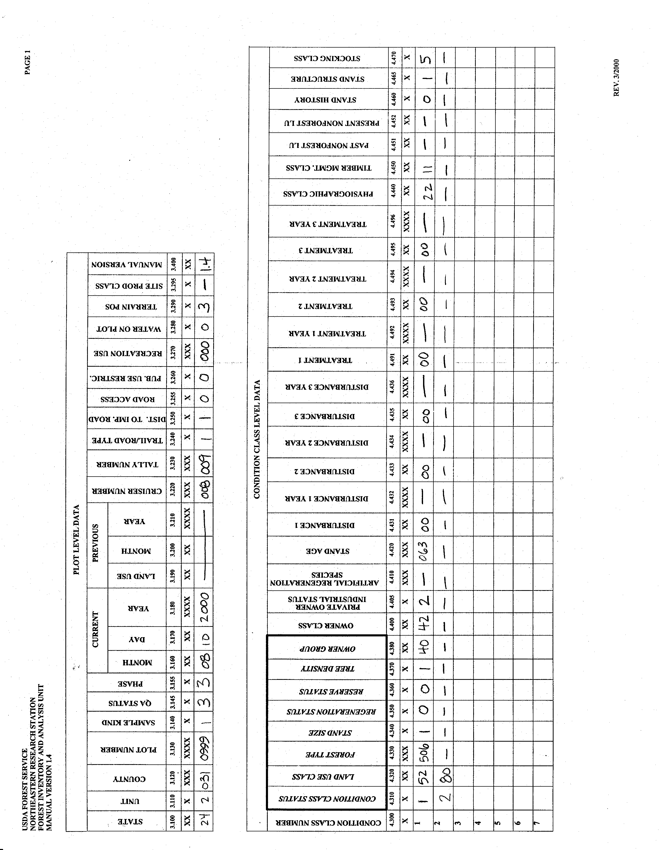
9

Slide 10
Plot Diagram
This page of the tally sheet is completed by the crew to show the general location of the various condition classes on the plot. This information can be used during the data editing stage to assist in correcting some data errors. For example, if a crew had measured a tree on subplot two, this tree would be deleted because it occurs in a non-forest condition. Although trees may exist in a non-forest condition, such trees are not sampled within the FIA program. FIA is a forest inventory and monitoring program, not a tree monitoring program; as such, FIA collects data on trees only within forested conditions.
10

Slide 11
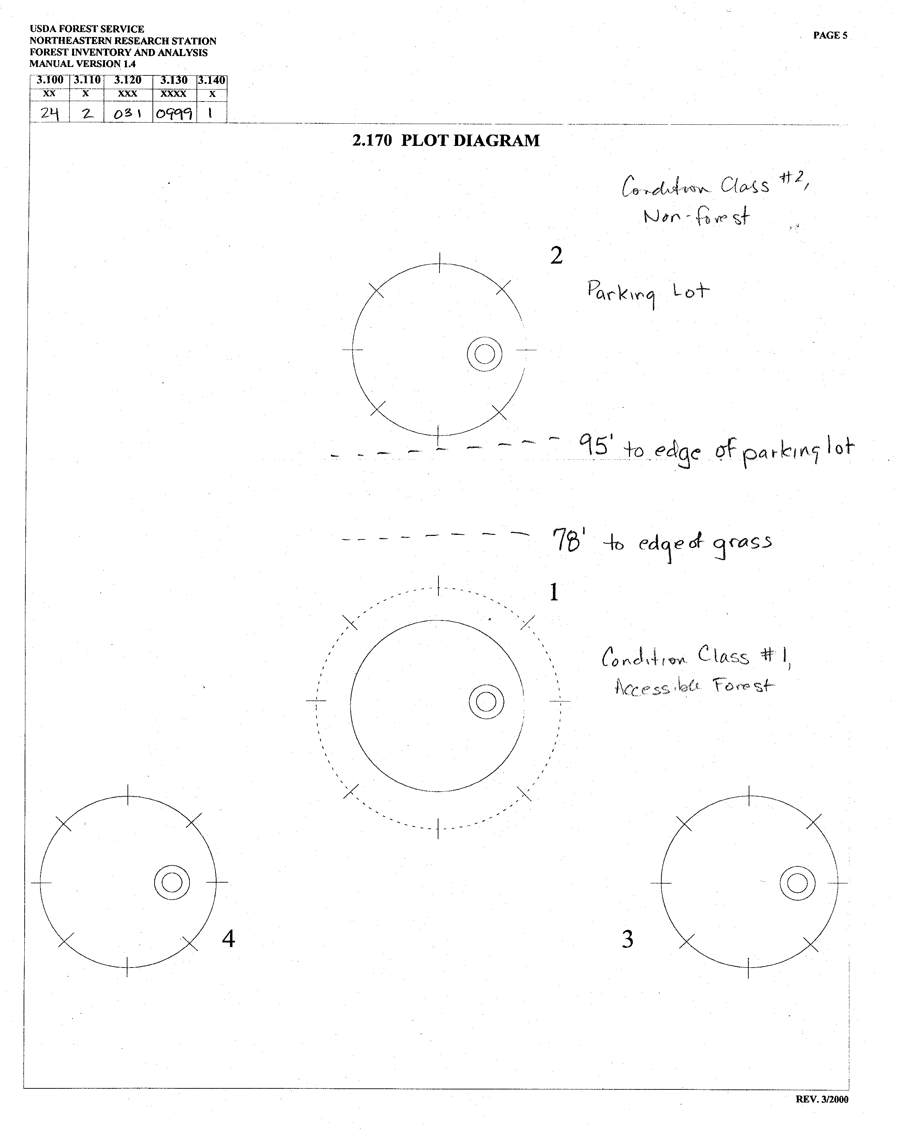
11

Slide 12
Subplot Level, Boundary, and Site-Index Data
This Subplot Level Data tally sheet is used to record information at each of the subplots. The Subplot Center Condition and Microplot Center Condition is recorded to assist in the data editing activity. Snow/Water Depth is used to identify subplots where some variables (e.g., seedling count, total tree length) may be measured or collected with less certainty due to conditions at the time of measurement.
Boundary Data is only used if there are two different conditions existing on a single subplot. [See adjacent diagram on how to determine boundaries on a subplot.] Because the radius of a subplot is 24 feet, a distance does not have to be recorded unless the boundary includes a corner, in which case a distance and azimuth from subplot center to the corner point is recorded.
boundary
right azimuth 030 degrees
Condition 2
Condition 1
boundary
left azimuth 225 degrees
Site trees are a measure of site productivity expressed by the tree length-to-age relationship of dominant and co-dominant trees. Site tree data are collected for every accessible forest land condition on the plot and are recorded in the Site Tree Data portion of the tally sheet. Tree age is determined by coring the tree to the pith with an increment corer and counting the tree rings. Site index is determined in the office with site index curves for specific tree species.
12

Slide 13
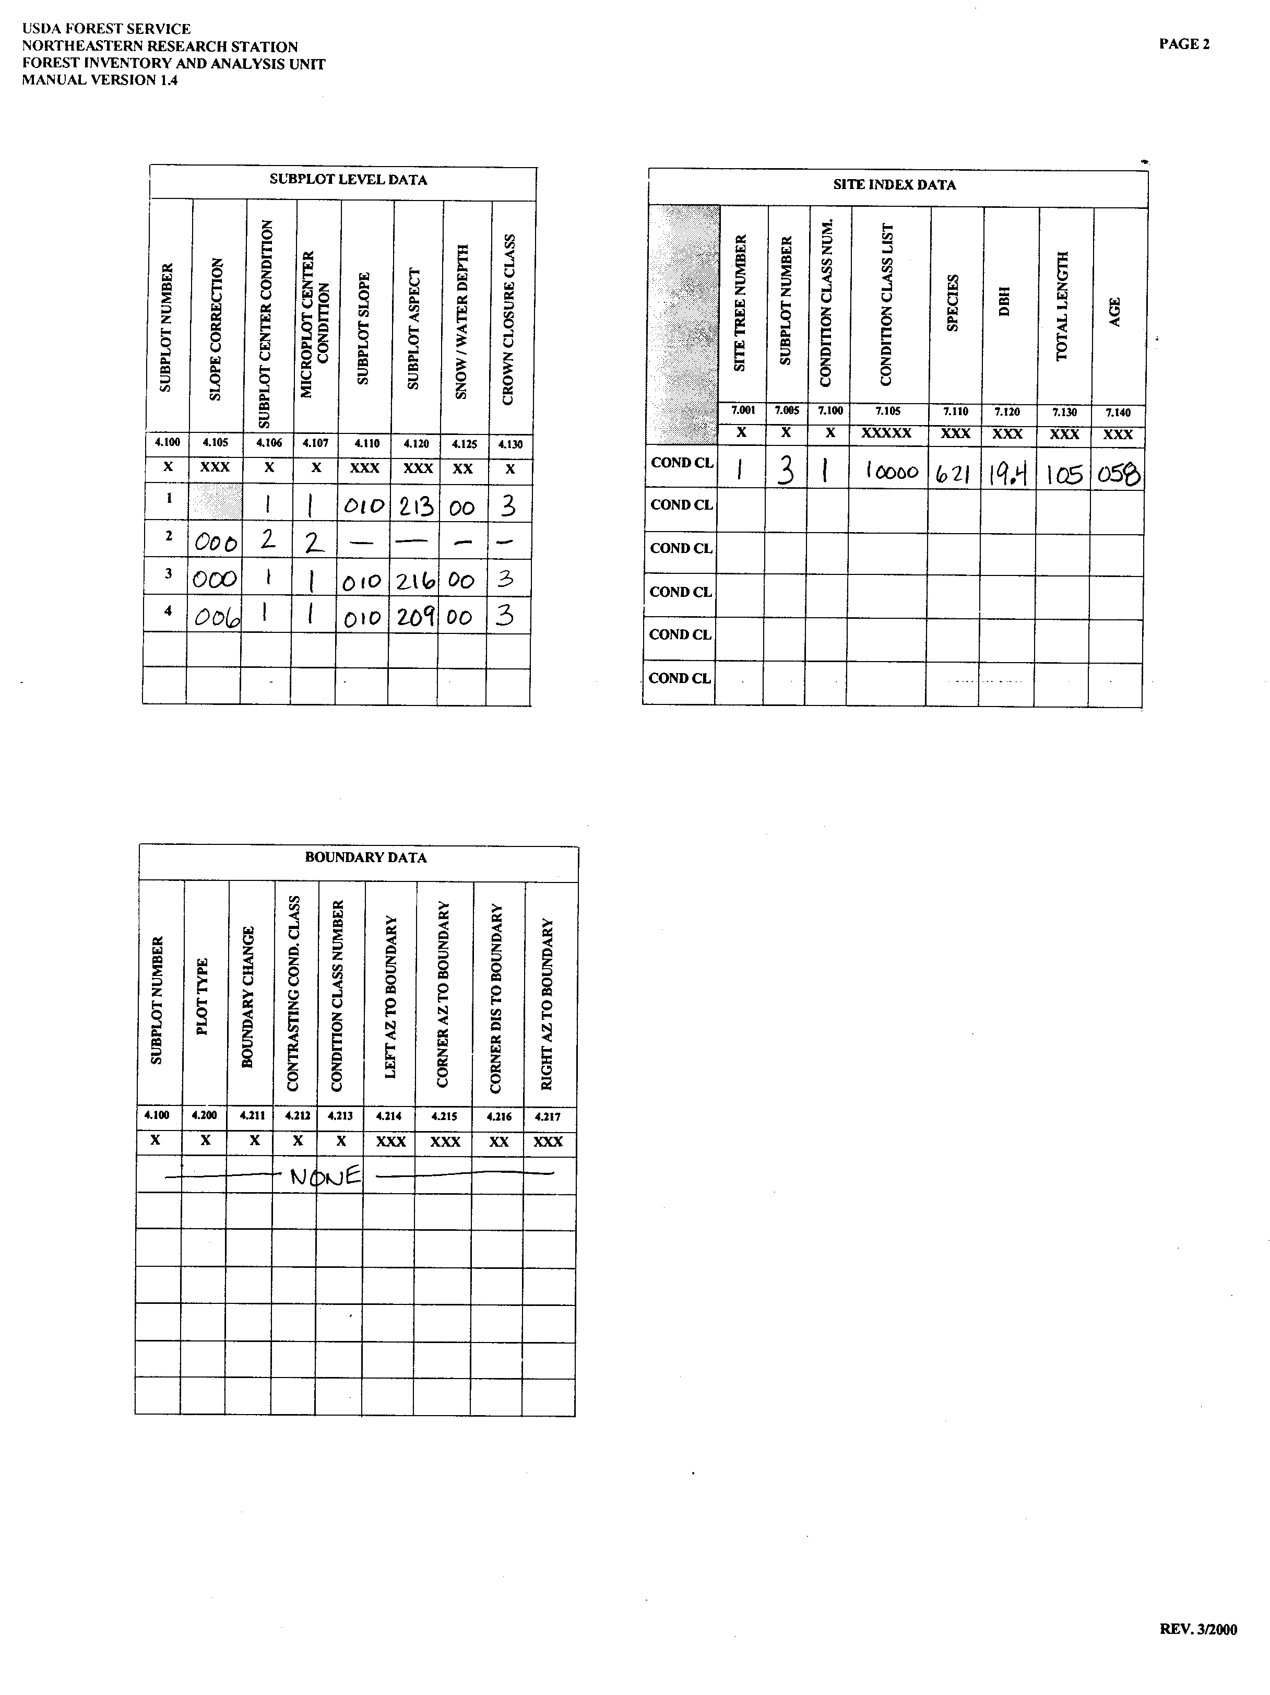
13

Slide 14
Reproduction Data
Seedling counts on the microplot are used in the determination of stocking (the relative level of site occupancy by trees, including seedlings) and regeneration. The seedling definitions are as follows:
  Conifers (evergreens) - must be at least 6 inches in length and less than 1.0 inch in diameter;
  Hardwoods (deciduous) – must be at least 12 inches in length and less than 1.0 inch in diameter.
Any individual with a diameter-breast-height (DBH) greater than or equal to 1.0 inch is either a sapling or a tree and thus is recorded on the next portion of the tally sheet.
Seedlings are counted by species and condition class. Any count over 5 individuals by species is coded as 6. DBH is always recorded as 001 for seedlings.
14

Slide 15
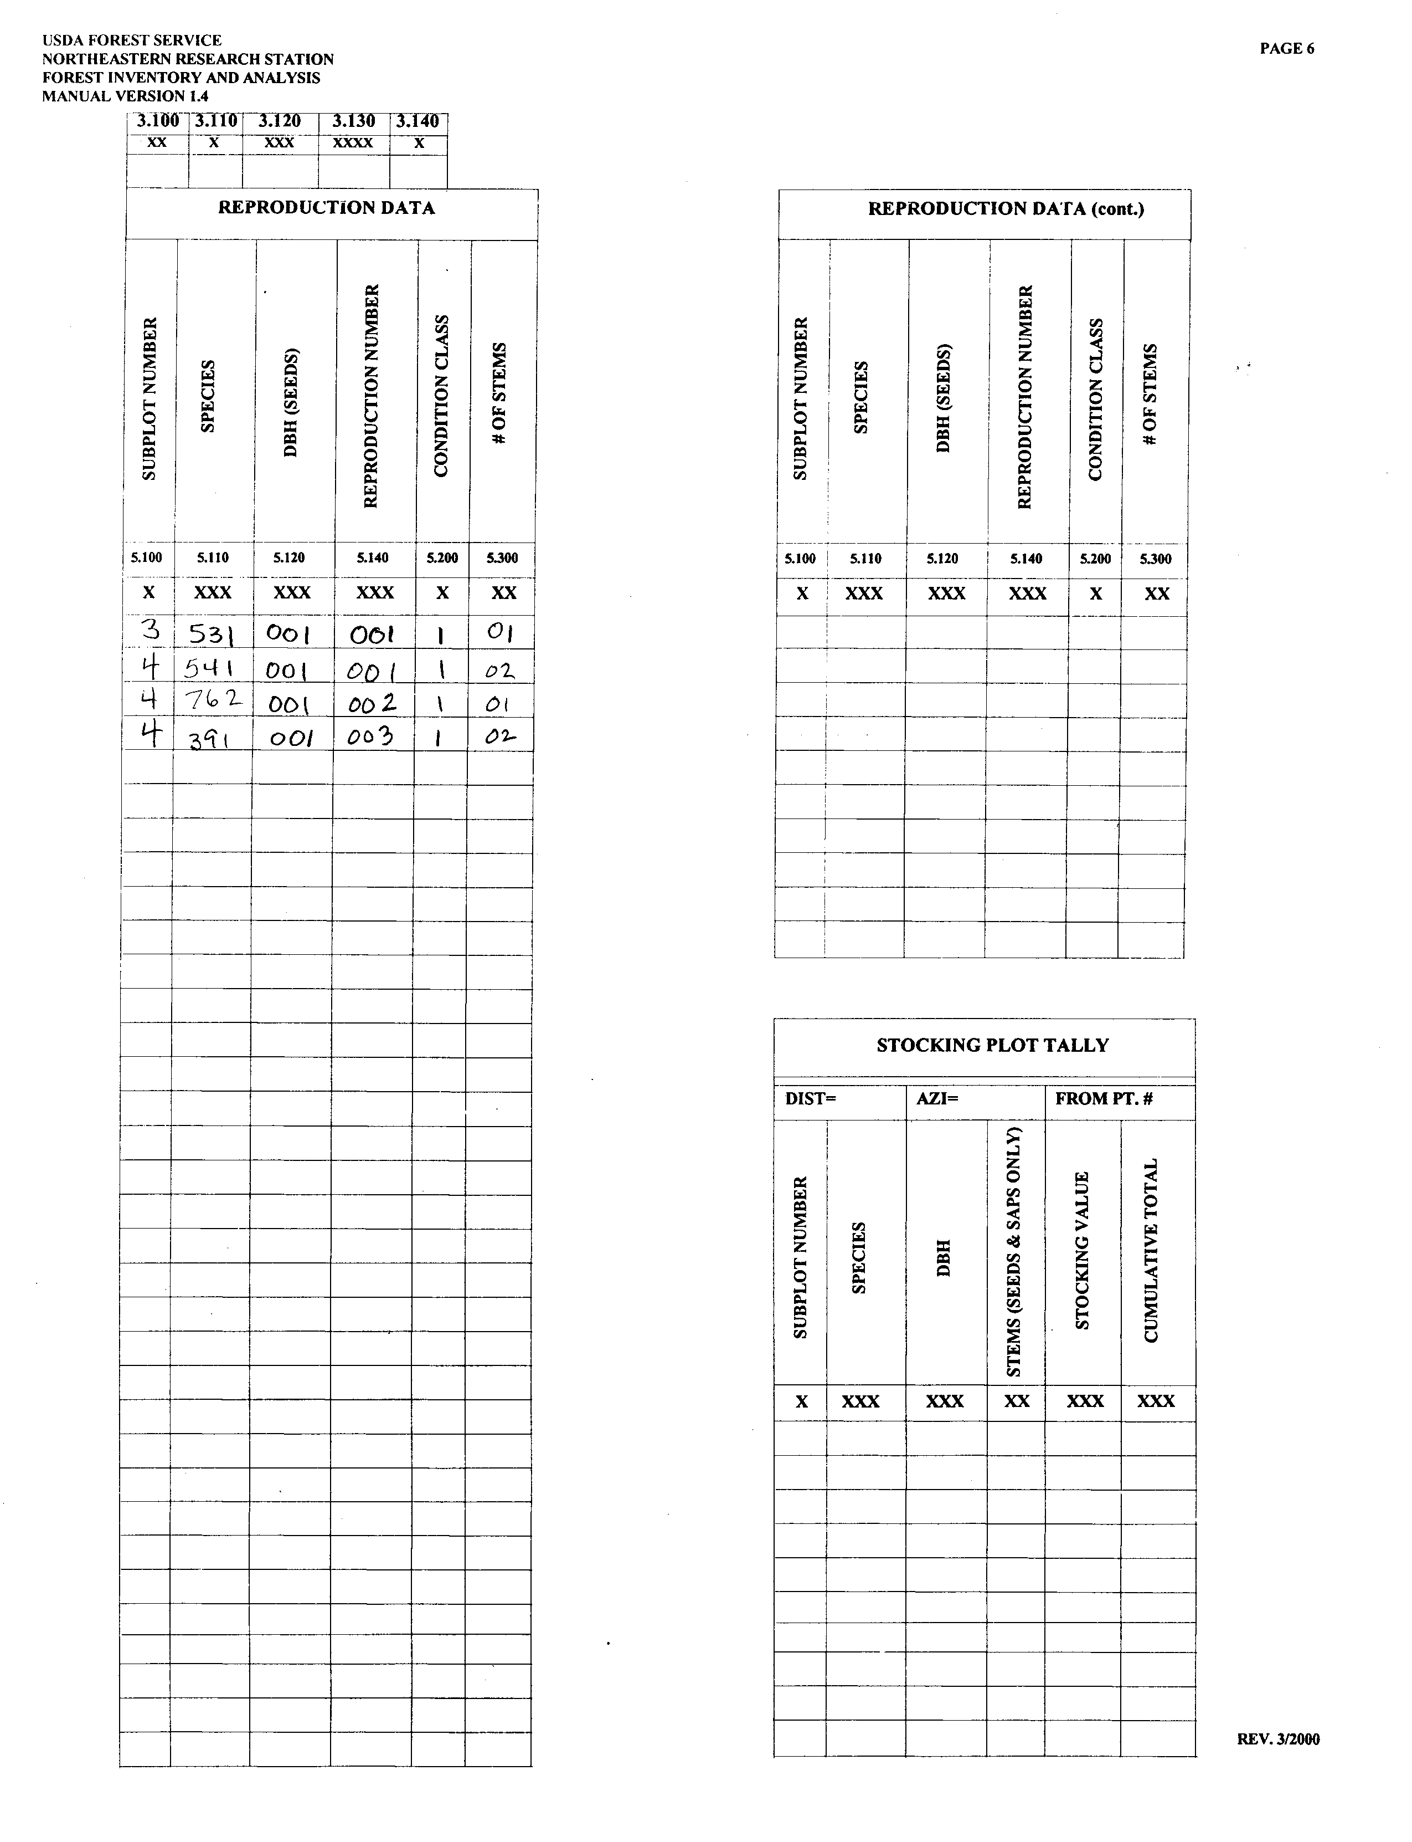
15

Slide 16
Tree Level Data
Much of the key forest inventory and health data are recorded on this portion of the tally sheet. The first five columns are used to organize, describe, and monument the sample trees for analyses and future relocation. The field crew begins on the microplot center facing north and proceeds clockwise on the microplot to record information for saplings (trees at least 1.0 inches in DBH but less than 5.0 inches). Once finished with a microplot, the crew moves to the subplot center and follows the same procedure to gather data on sample trees (trees 5.0 inches or greater in DBH). The horizontal distance and azimuth (along with species and DBH) will be used by future crews to identify the sample trees at the next measurement time. In order to be considered “in” the plot, the center of the tree (or “pith”) must be within the limiting horizontal distance of 6.8 feet from microplot center for saplings, or 24.0 feet from subplot center for trees.
Measures of DBH, tree grade, sawlog length, bole length, total length, and the various cull variables are used to calculate tree volume and biomass. “Cull” is the portion of tree that is considered unusable for commercial wood products because of rot, form (e.g., crookedness), or other defect. DBH is also used to calculate the trees basal area (BA). BA is the cross-sectional area of a tree at 4.5 feet above the ground. The results are usually presented as the BA per acre of land. BA is indicative of the stand density and volume; high basal areas indicate large numbers of trees or large volumes or biomass per acre. Changes in the tree dimensions over time are used to estimate ecosystem productivity. Information on forest species composition and structure (sizes) is used to study a variety of features including wildlife habitat, ecological succession, fire risk, and impacts of human disturbance.
The next nine variables comprise the crown symptoms measurements: crown class, compacted and uncompacted live crown ratio, crown light, crown position, crown vigor, crown density, crown dieback, and foliage transparency. Crown class, compacted live crown ratio, and crown class are collected on all saplings and trees on all P2 plots. These same three plus uncompacted live crown ratio, crown light, crown position, and crown vigor are collected on all saplings for the P3 plots. For trees on P3 plots, all of the variables are collected except for crown vigor. The P3 measures are collected during the growing season (June, July, and August). Poor crown conditions are generally indicative of poor tree health and may be precursors) are collected on all plots. Tree damage symptoms also have the same general functions as the crown measures.
The remaining measurements are collected to provide additional information for forest status and change which is accomplished by comparing data from two measurement time periods, usually 5 to 10 years.
16

Slide 17
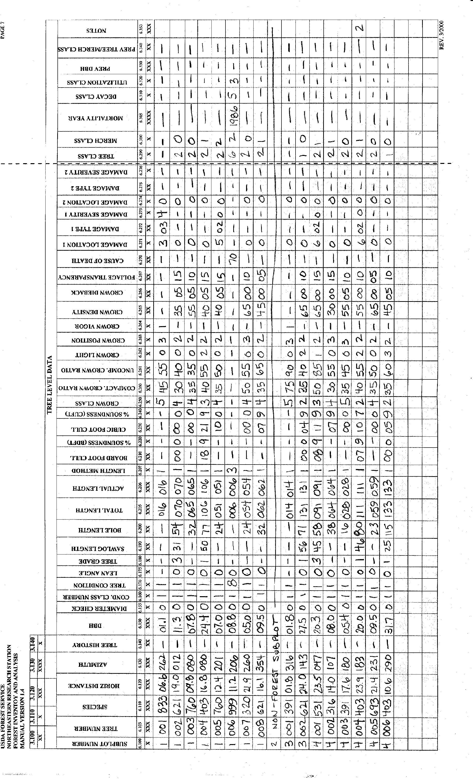
17

Slide 18
Soils Data
The Soils Data include three components: collection of soil and litter samples for chemical analysis, measurements to estimate potential soil erosion, and measurements that identify soil compaction. All three components on done only on the forested conditions of P3 plots. The measurements are designed such that data collection does not require extensive expertise in soil science.
Soils are sampled adjacent to subplots 2, 3, and 4 but are not collected within the subplots so as to prevent disturbance of the subplot. Soils are collected from two depths: 0 to 10 cm and 10 to 20 cm. Litter samples are collected only once from the first soil sampling location that is forested. Samples are labeled and sent weekly to a lab. At the lab the samples are analyzed for pH (a measure of acidity); total organic carbon; total nitrogen; exchangeable calcium, magnesium, potassium, and aluminum; and available phosphorus. The litter layer is analyzed for total carbon, organic carbon, and nitrogen. Measurements of carbon in the soils and litter are used to study the role of the forest in storing carbon, which is a key question related to global climate change.
The soil erosion and compaction measurements are collected on the forest portion of the plots at the subplot level. The measurements relating to potential soil erosion are used in an equation the will estimate the potential soil loss in tons of soil eroded per acre. Increased slope length and high percentages of bare soil have the most impact on potential soil erosion estimates. Soil compaction is important because compacted soils limit the tree roots ability to grow and access nutrients, water, and oxygen from the soil, ultimately resulting in reduced growth.
18

Slide 19
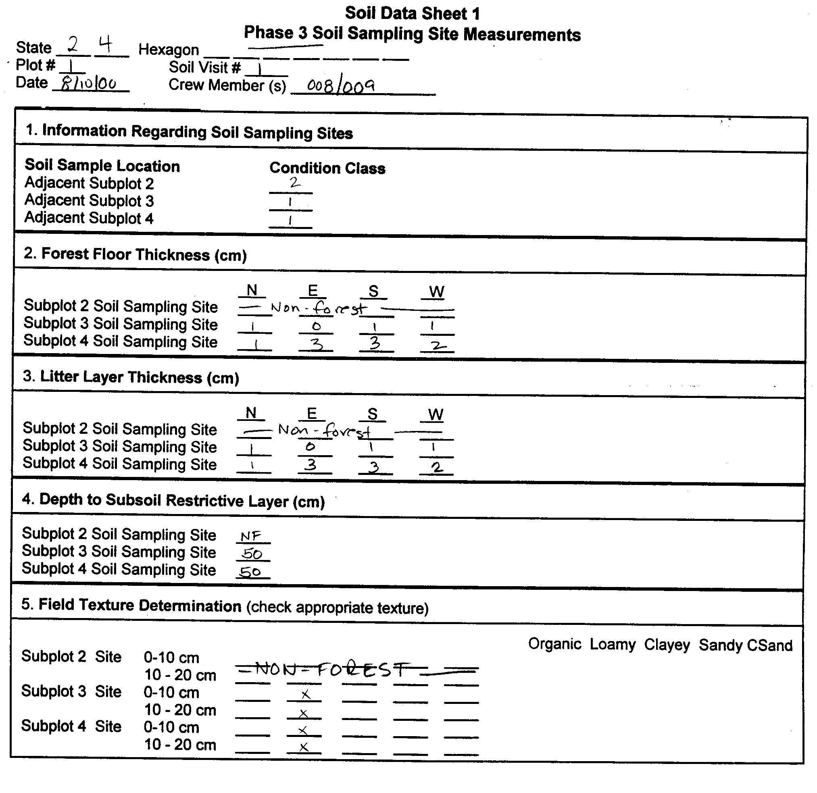
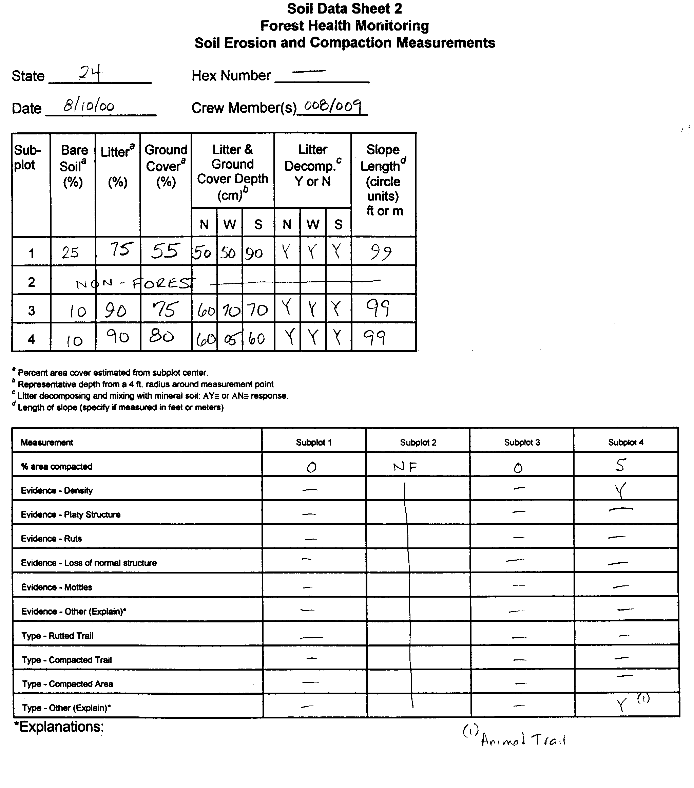
19

Slide 20
Plot Summary Data
Once all of the data from all of the required plots are collected and entered into the data recorder, the data are processed through a rigorous edit check. After the edit check has been completed the data are processed and prepared for summarization and reporting. The basic method of reporting results is through issuing statistical reports by states or substate unit. The reports contain tabular data, analytical statements, graphs, maps, and definitions. Many of the data are stratified or grouped by various attributes that were collected on the plot, such as forest type, owner group, stand size, and stand age. Once edited, the data are loaded into a public database and made available for others to use.
The data from this plot are summarized on the adjacent page. These results are fairly typical for the forest stands in this part of the US.
20

Slide 21
SAF Demonstration Plot - Summary Statistics
Subplot # Tree # Species Total DBH (in) Cull (%) Tree BA (ft2) Gross Tree Net Tree
Length (ft) Volume (ft3) Volumne (ft3)
1 1 N. Red Oak 16 1.1 0 0.007 0.00 0.00
1 2 Yellow-poplar 70 11.3 0 0.696 16.64 16.64
1 3 Cherry spp. 65 7.8 0 0.332 6.96 6.96
1 4 Pignut Hickory 106 24.4 21 3.247 118.10 93.30
1 5 Cherry spp. 51 7.0 10 0.267 4.26 3.83
1 7 Norway Maple 54 5.0 0 0.136 2.50 2.50
1 8 Yellow-poplar 62 9.5 7 0.492 10.20 9.49
3 1 Am. Hornbeam 14 1.8 0 0.018 0.00 0.00
3 2 Yellow-poplar 131 27.5 4 4.125 179.50 172.32
4 1 Am. Beech 91 20.3 11 2.248 67.66 60.21
4 2 Red Maple 64 8.0 7 0.349 7.47 6.95
4 3 Am. Hornbeam 28 5.4 0 0.159 1.14 1.14
4 4 Pignut Hickory 111 20.0 10 2.182 82.86 74.57
4 5 Blackgum 59 9.5 0 0.492 9.90 9.90
4 6 Pignut Hickory 133 31.7 5 5.481 251.00 238.45
Plot BA (ft2/plot) - 20.231
Stand BA (ft2/acre) - 161.846
Gross Plot Volume (ft3/plot) - 758.19
Gross Stand Volume (ft3/acre) - 6065.49
Net Plot Volume (ft3/plot) - 696.26
Net Stand Volume (ft3/acre) - 5570.11
Number of Trees, 1.0 in diameter and greater (number/plot) - 15
Number of Trees, 1.0 in diameter and greater (number/acre) - 120
Site Index - 100 for yellow -poplar (58 yrs. @ 105 ft.)
Revised Universal Soil Loss Equation (RUSLE) Potential Soil Erosion – 0.8 tons/acre/year
21

Slide 22
Other P3 Data (Not on this plot currently)
Two other P3 data elements are currently being implemented – lichens diversity and ozone bio-indicator plants. The lichen diversity is not being collected in this part of the country at this time but will be collected in future years. Ozone bio-indicator plants are sampled on suitable areas within a 3-mile radius surrounding the plot. No suitable ozone bio-indicator site was located within this area.
For lichen diversity, the field crews search within a circular area with a radius of 120 feet of PC. The crews look for different lichen species on boles and downed limbs and collect a representative specimen to send to a certified lichenologist for identification at the species level. The crews also note the relative abundance of each specimen. These data are used to describe overall lichen species composition. Since certain lichen species are known to be sensitive to certain pollutants, changes in lichen species composition over time can identify the presence of pollutants which may be affecting forests.
Ozone bio-indicator sites mapped according to the plot mapping procedures in use on the FIA plots so that future crews can locate the ozone bio-indicator sites. Ozone sites need to be at least 1 acre in size, must include individual species that are known to be sensitive to ozone, and must be open to the air. Some of the most common plant species that are susceptible to ozone injury are black cherry, common milkweed, yellow-poplar, blackberry, and white ash. Areas that do not meet these previous criteria or are excessively wet or dry, adjacent to powerlines, or other right-of-ways are avoided, since these conditions can cause conflicting symptoms.
After the ozone sites have been established, the crew returns between late-July through mid-August and evaluate the sensitive plants for the presence and severity of ozone injury. Ozone injury generally requires both the presence of ozone as well as the proper weather conditions. Ozone injury symptoms are expressed as stippling, flecking, bleaching, and necrosis. Stippling is the most common symptom and is defined as dark pigmentation, commonly purple, of leaf surfaces. The amount of damage is related to both the level of ozone exposure as well as the recent weather trends.
22

Slide 23
Quality Assurance
Once a crew has completed measurement of a plot, the same plot may be selected for a remeasurement by an experienced Quality Assurance (QA) crew. The QA crew will repeat some or all of the measurements. The information is used both to monitor the quality of data collection performed by FIA crews, as well as to document the repeatability of the measurements used by the FIA program. QA data are analyzed, summarized, and reported along with other data.
23

Slide 24

For More Information:
For more information on the FIA program, contact the National FIA Program staff at:
USDA Forest Service
Forest Inventory and Analysis Program, 1NW
201 14th Street SW
Washington, DC 20250
(202) 205-1507
Or visit our web site at
http://fia.fs.fed.us
10/18/00
24

