Slide 1
ML-Based Passive
Human Verification
System
Alternative to
CAPTCHA
An AI-powered invisible verification system that distinguishes
humans from bots using behavioral intelligence.
Team Members
Rudra Chauhan · Drishti Makkar · Anushka Karwa
1 / 6

Slide 2
PROBLEM STATEMENT
Why CAPTCHA is Failing
The Impact
94%
✗
Interrupts Users
Breaks flow during login,
onboarding & transactions
of users abandon a site
after CAPTCHA failure
✗
Bots Solve CAPTCHA
AI tools bypass modern
CAPTCHA with 95%+ accuracy
3×
more bot traffic since
AI-based CAPTCHA solvers
✗
User Frustration
High drop-off rates on
CAPTCHA-protected pages
$5B+
✗
No Enterprise Scale
Can't handle millions of
requests seamlessly
annual losses from
bot-driven fraud globally
Enterprises need seamless, invisible verification — without ever interrupting the real user.
2 / 6

Slide 3
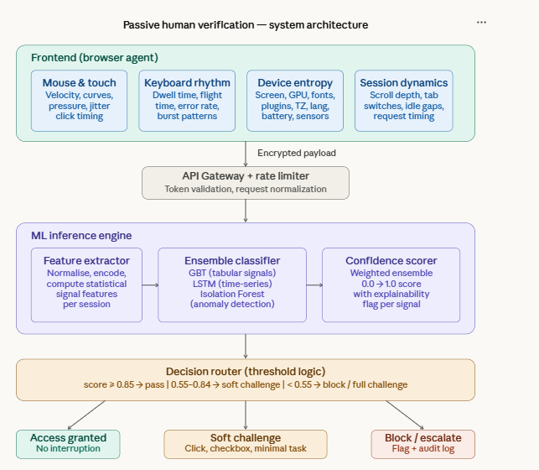
SYSTEM ARCHITECTURE
How the System Works
User
Browser
Frontend
Collector
Feature
Processor
ML Engine
Decision
Engine
Sends signals
Captures behavior
ML features
Classifies traffic
Confidence score
Enterprise API Gateway
Protects enterprise services & enforces decisions
Frontend Collector
Feature Processor
ML Engine
Decision Engine
Privacy Layer
Captures mouse paths, keystroke timing, scroll behavior, device fingerprint
Converts raw events to statistical ML features — velocity, entropy, dwell time
Ensemble of GBT, LSTM, and Isolation Forest classifies bot vs human
Produces 0–1 confidence score → Pass / Challenge / Block
No keystrokes stored. Only timing metadata. GDPR-compliant design.
3 / 6

Slide 4
PROPOSED SOLUTION
Passive Verification Signals
Environmental Signals
Behavioral Signals
Network Signals
Browser fingerprint
Mouse movement paths
Request timing patterns
Operating system type
Cursor speed & curves
API call frequency
Screen resolution
Typing rhythm & dwell
IP reputation check
Device characteristics
Scroll depth & speed
Proxy / VPN detection
Time zone & language
Click timing patterns
Session duration
GPU & audio context
Micro-pause detection
Request rate anomalies
ML Classification Engine
≥ 0.85
0.55–0.84
< 0.55
Random Forest · Gradient Boosting · LSTM · Isolation Forest
Human Confidence Score →
PASS
CHALLENGE
BLOCK
4 / 6

Slide 5
IMPACTFUL IDEAS
What Makes This Different
✦
Behavioral Biometrics
✦
Invisible Verification
✦
Adaptive Risk Engine
Captures natural human interaction patterns — mouse curvature, keystroke rhythm, micro-pauses — invisible to users, impossible for bots to fake.
Real users are never interrupted. The system makes decisions silently in the background. Zero friction — zero CAPTCHA popups.
Increases monitoring intensity during sensitive actions such as login or payment. Low-risk pages get lighter analysis.
✦
Continuous Learning
✦
Fraud Detection
Retrains weekly using new labeled session data. Adapts to evolving bot attack patterns automatically without manual tuning.
Detects credential stuffing, fake account creation, and scraping bots. Protects APIs, login endpoints, and transaction flows.
5 / 6

Slide 6
SCALABILITY & IMPACT
Built for Enterprise Scale
SCALABILITY
ENTERPRISE IMPACT
☁
Cloud-Native Microservices
99%
<1%
Each module deploys independently. ML inference separated from API gateway.
Docker + Kubernetes
User Experience
Bot Prevention
⬡
Containerized deployment. Auto-scales to demand. Zero-downtime rollouts.
users never see a challenge
false positive rate
⚡
Real-Time REST APIs
10ms
↑ 40%
Sub-10ms inference. Handles burst traffic with horizontal pod scaling.
Millions of Requests
API Protection
Digital Trust
∞
Stateless design enables linear scaling. Tested at 10,000 req/sec.
average decision latency
reduction in fraud attempts
BotGuard · ML-Based Passive Human Verification · Built for Enterprise · Zero CAPTCHA. Full Protection.
6 / 6

