Slide 1

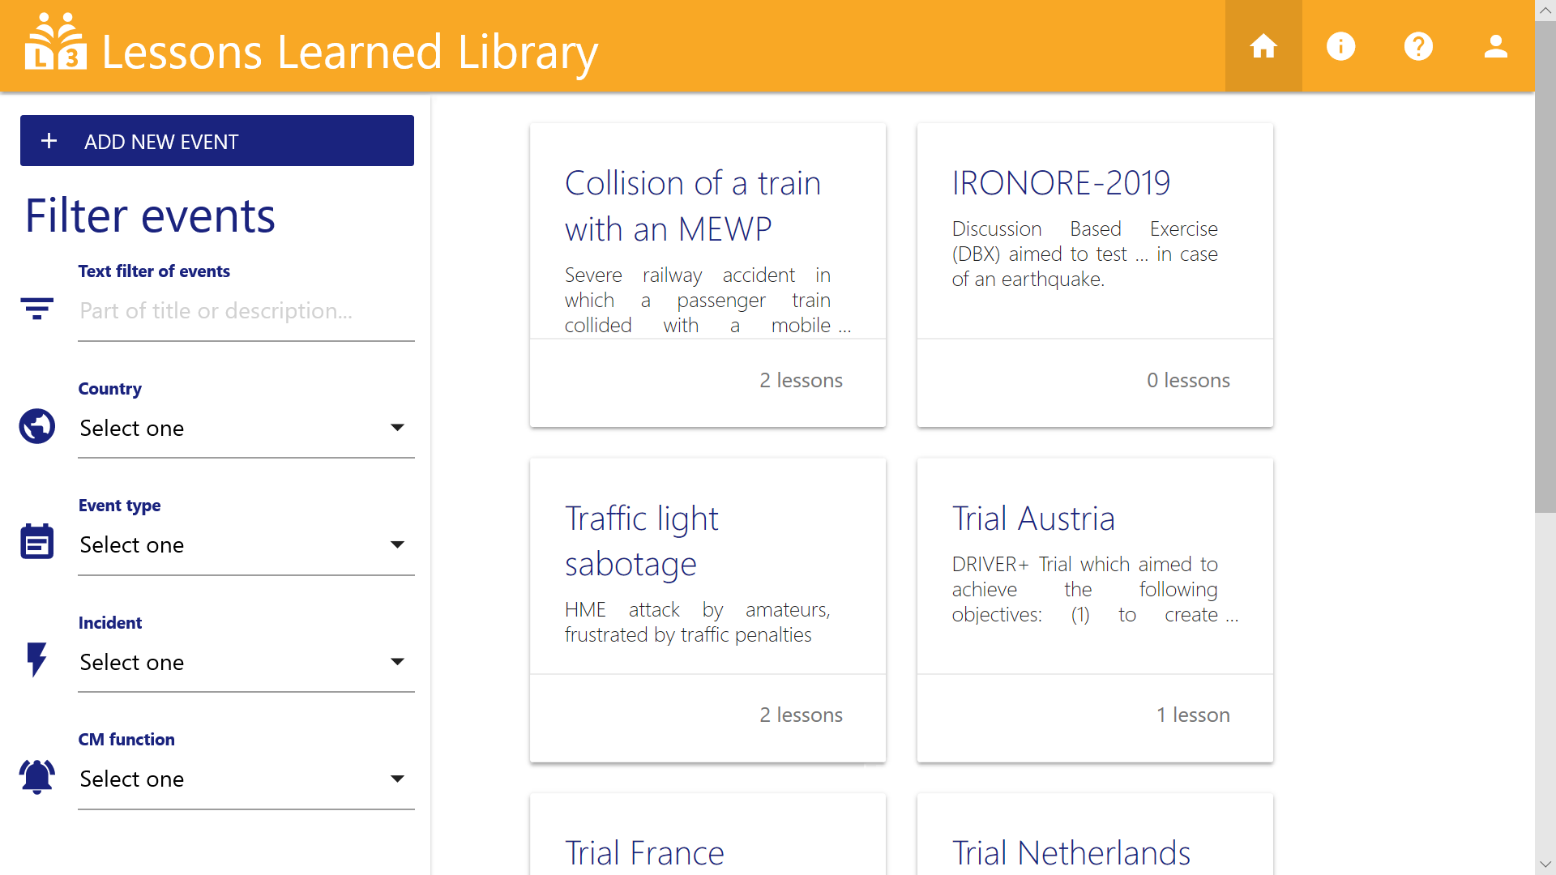



L
3
LESSONS LEARNED LIBRARY
SHARING KEY LESSONS FROM EVENTS
The Lessons Learned Library is a repository in the domain of Crisis Management for collecting and sharing lessons from severe incidents, crisis situations, tests or exercises

Share your experience: help your colleagues, so they can take advantage of your experiences
To develop a comprehensive Portfolio of Crisis Management solutions

Quick and easy: in a short period of time you can edit information and key lessons from an event in a well-structured way

Open to any professional: not locked away in a safe or hidden in some report, but open to any professional interested to learn from others
Activities
By enabling to share key lessons across organisations, sectors and countries, L3 contributes to the improvement of handling crisis situations in Europe
ARE YOU DRIVING INNOVATION IN CRISIS MANAGEMENT?
ADD YOUR KEY LESSONS LEARNED TO L3
https://l3crisis.eu/
The Lessons Learned Library has been launched in the framework of the DRIVER+ project
www.driver-project.eu
The DRIVER+ project has received funding from the European Union’s 7th Framework Programme for Research, Technological Development and Demonstration under Grant Agreement n°607798

