Slide 1
Bauer Linux Training
W41 – 2016-10-13

Slide 2
Agenda
Videos (Password: BauerLinuxTraining2016)
User Control
16 Adding and Removing Users.AVI
17 Password Control.AVI
18 Group Administration.AVI
19 Account Configuration Files.AVI
13 Elevating Privileges.AVI
20 User Accounts with LDAP.avi
LVM management in CentOS 7
47 LVM Overview.AVI
48 Creating a Logical Volume pt- 1.AVI
49 Creating a Logical Volume pt- 2.AVI
50 LVM Snapshots.AVI
51 GUI LVM Management.AVI

Slide 3
User Control
useradd, adduser
userdel
usermod
GUI
passwd
chage
groupadd
groups
groupmod
gpasswd
groupdel
GUI
/etc/passwd
/etc/shadow
/etc/group
/etc/gshadow

Slide 4
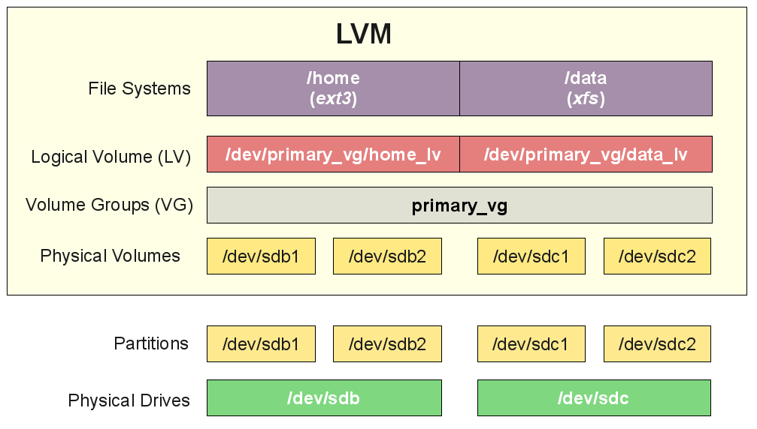
LVM

Slide 5
LVM Commands
[root@lxrhcsado01 ~]# pv
pvchange pvck pvcreate pvdisplay pvmove pvremove pvresize pvs pvscan
[root@lxrhcsado01 ~]# vg
vgcfgbackup vgchange vgconvert vgdisplay vgextend vgimportclone vgmknodes vgremove vgs vgsplit
vgcfgrestore vgck vgcreate vgexport vgimport vgmerge vgreduce vgrename vgscan
[root@lxrhcsado01 ~]# lv
lvchange lvcreate lvextend lvmchange lvmconfig lvmdump lvmpolld lvmsar lvremove lvresize lvscan
lvconvert lvdisplay lvm lvmconf lvmdiskscan lvmetad lvmsadc lvreduce lvrename lvs
[root@lxrhcsado01 ~]#

Slide 6
Lets create LVM disks
/dev/sda -> 60GB. Main system 20GB. Rest should be LVM.
Create 3 more physical partitions
Create 3 PVs
Create 1 VG
Create a few LVs
Using LVM Partitions for QEMU-KVM Guests?

