Slide 1
Bauer Linux Training
W45 – 2016-11-10

Slide 2
Agenda
Software RAID in Linux
mdadm
LVM management in CentOS 7
47 LVM Overview.AVI
48 Creating a Logical Volume pt- 1.AVI
49 Creating a Logical Volume pt- 2.AVI
50 LVM Snapshots.AVI
51 GUI LVM Management.AVI

Slide 3
Software RAID
mdadm
https://raid.wiki.kernel.org/index.php/RAID_setup

Slide 4
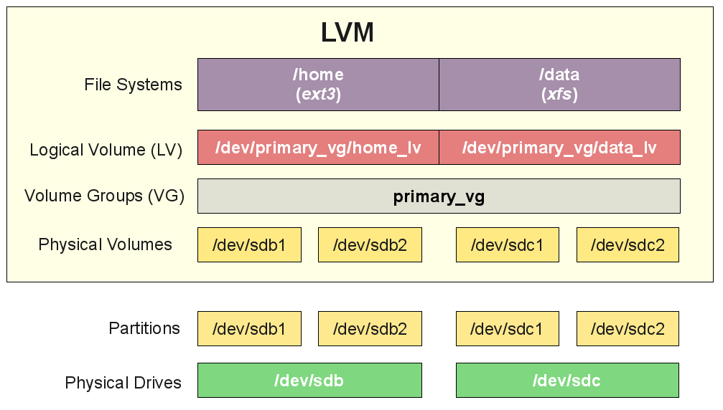
LVM

Slide 5
LVM Commands
[root@lxrhcsado01 ~]# pv
pvchange pvck pvcreate pvdisplay pvmove pvremove pvresize pvs pvscan
[root@lxrhcsado01 ~]# vg
vgcfgbackup vgchange vgconvert vgdisplay vgextend vgimportclone vgmknodes vgremove vgs vgsplit
vgcfgrestore vgck vgcreate vgexport vgimport vgmerge vgreduce vgrename vgscan
[root@lxrhcsado01 ~]# lv
lvchange lvcreate lvextend lvmchange lvmconfig lvmdump lvmpolld lvmsar lvremove lvresize lvscan
lvconvert lvdisplay lvm lvmconf lvmdiskscan lvmetad lvmsadc lvreduce lvrename lvs
[root@lxrhcsado01 ~]#

Slide 6
Create LVM disks
/dev/sda -> 60GB. Main system 20GB. Rest should be LVM.
Create 3 more physical partitions
Create 3 PVs
Create 1 VG
Create a few LVs
Using LVM Partitions for QEMU-KVM Guests?

Slide 7
Network Devices.avi
ifconfig, ifup, ifdown, ip
netstat, route
/etc/sysconfig/network-scripts
nmcli, nmtui
https://access.redhat.com/documentation/en/red-hat-enterprise-linux/7/
https://access.redhat.com/documentation/en-US/Red_Hat_Enterprise_Linux/7/html/Networking_Guide/index.html

