Slide 1
Bauer Linux Training
W41 – 2016-10-13

Slide 2
Agenda
Check homework
Book: https://dl.dropboxusercontent.com/u/531976/rhcsa-rhce-linux-certification-study-guide-7th.pdf
Setup RHCSA Training Lab:
qemu-kvm, brctl, libvirt, virsh, virt-host-validate, virt-manager
nested virtualization
iptables, ip_forward
dnsmasq
nfs
tftp
http
kickstart
Bonus: Ansible automation of main vm roles

Slide 3
Nested virtualization in vSphere 6
What is Nested Virtualization? https://www.google.co.uk/search?q=nested+virtualization
CPU
Hardware virtualization Tick
CPU/MMU Virtualization -> Hardware CPU and MMU
VM Options
General Options
Guest OS: Other
Guest OS Version: Other (64-bit) # you can add a name tag here

Slide 4
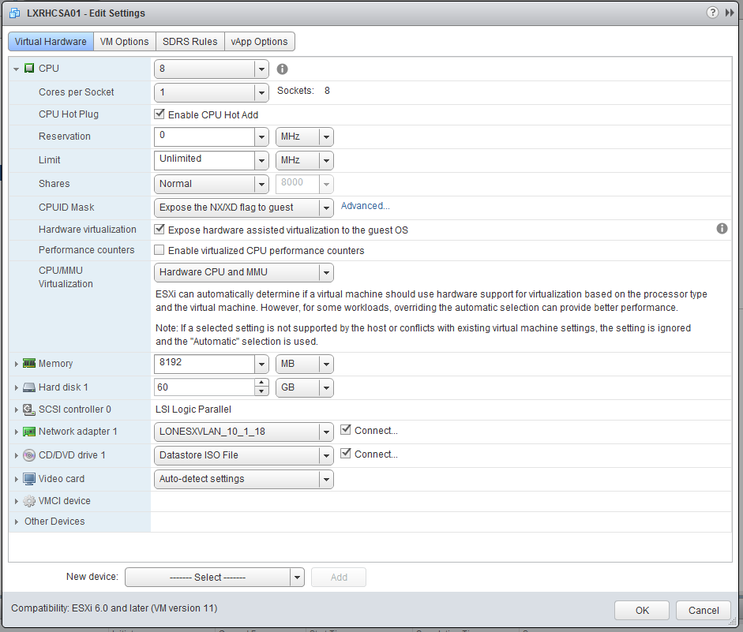
Nested virtualization in vSphere 6

Slide 5
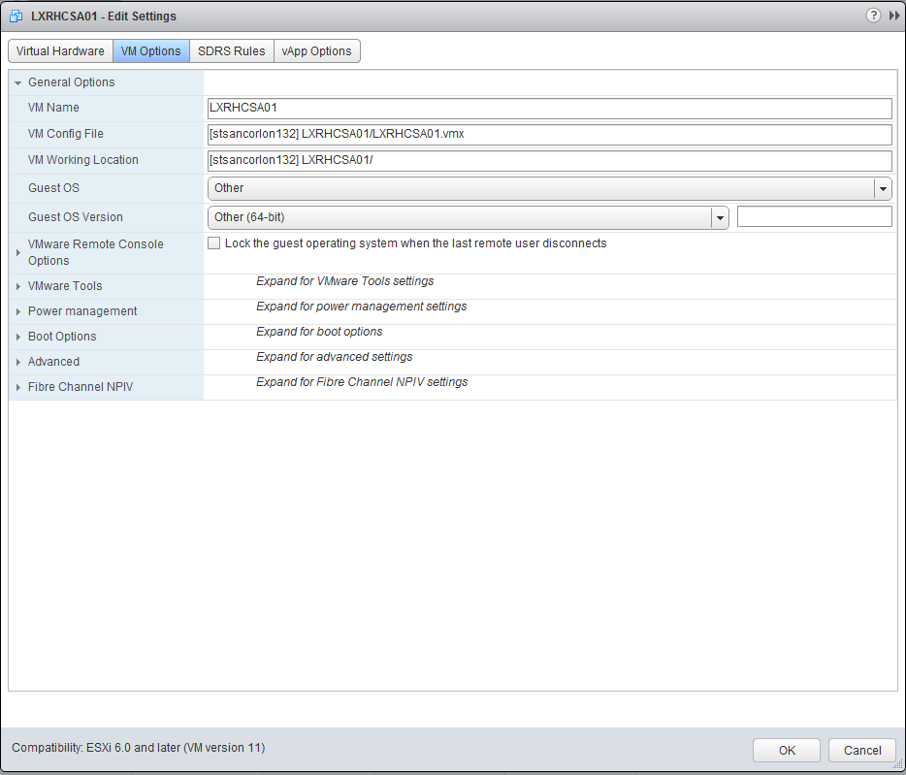
Nested virtualization in vSphere 6

Slide 6
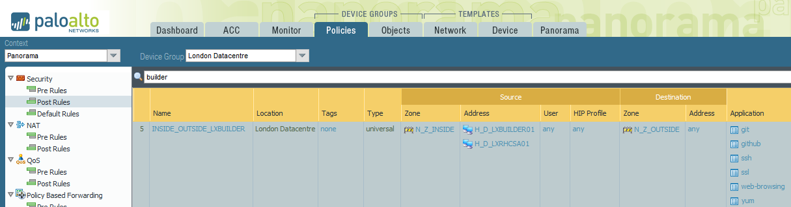
Networking requirements
Network wizards can set this up for you

Slide 7
qemu-kvm virtualization
Install required packages
[root@LXRHCSA01 ~]# yum -y install qemu-kvm libvirt virt-manager bridge-utils
[root@LXRHCSA01 ~]# brctl show
bridge name bridge id STP enabled interfaces
virbr0 8000.525400d6148e yes virbr0-nic
[root@LXRHCSA01 ~]#

Slide 8
Nested virtualization in vSphere 6
To verify if Nested Virtualization works:
[root@LXRHCSA01 ~]# yum -y install libvirt-client
[root@LXRHCSA01 ~]# virt-host-validate
QEMU: Checking for hardware virtualization : PASS
QEMU: Checking for device /dev/kvm : PASS
QEMU: Checking for device /dev/vhost-net : PASS
QEMU: Checking for device /dev/net/tun : PASS
LXC: Checking for Linux >= 2.6.26 : PASS
[root@LXRHCSA01 ~]#

Slide 9
qemu-kvm virtualization
Setting up virt-manager with rsa key pair
ssh-keygen -t rsa -b 4096 -C virtmanagerkey
# copy public key to /root/.ssh/authorized_keys
# chmod 700 /root/.ssh; chmod 600 /root/.ssh/authorized_keys
# allow root login with ssh keys only: /etc/ssh/sshd_config → PermitRootLogin without-password
# systemctl restart sshd
# set up your ~/.ssh/config to use this key when you connect to your main vm
Host lxrhcsa01
# StrictHostKeyChecking no
# UserKnownHostsFile /dev/null
User root
IdentityFile ~/.ssh/virtmanagerkey

Slide 10
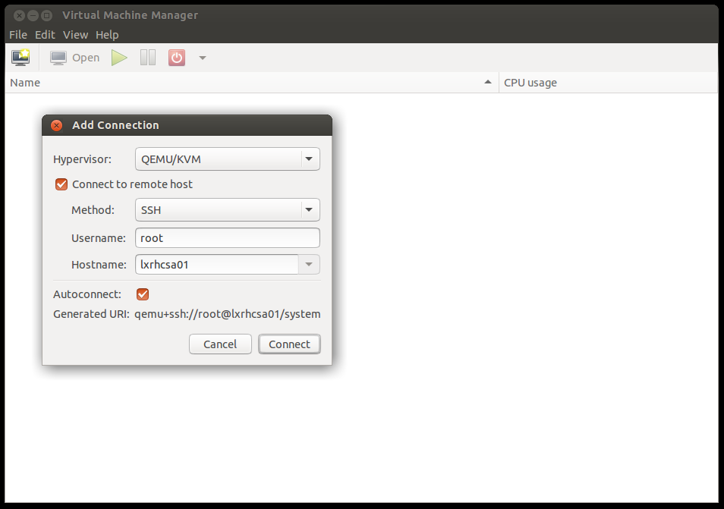
Connecting with virt-manager

Slide 11
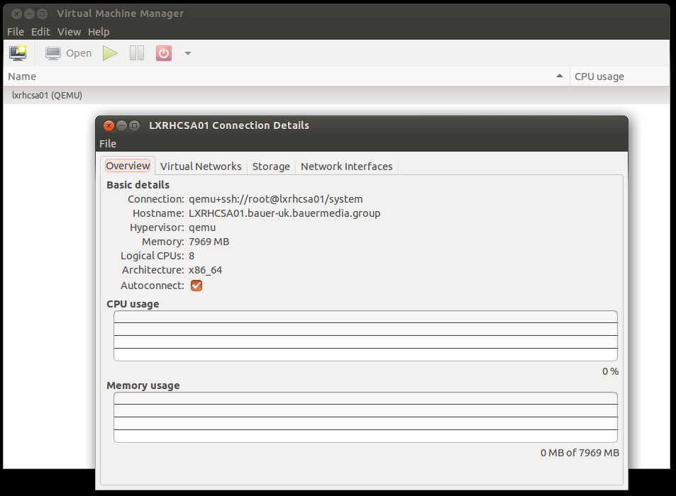
Exploring virt-manager

Slide 12
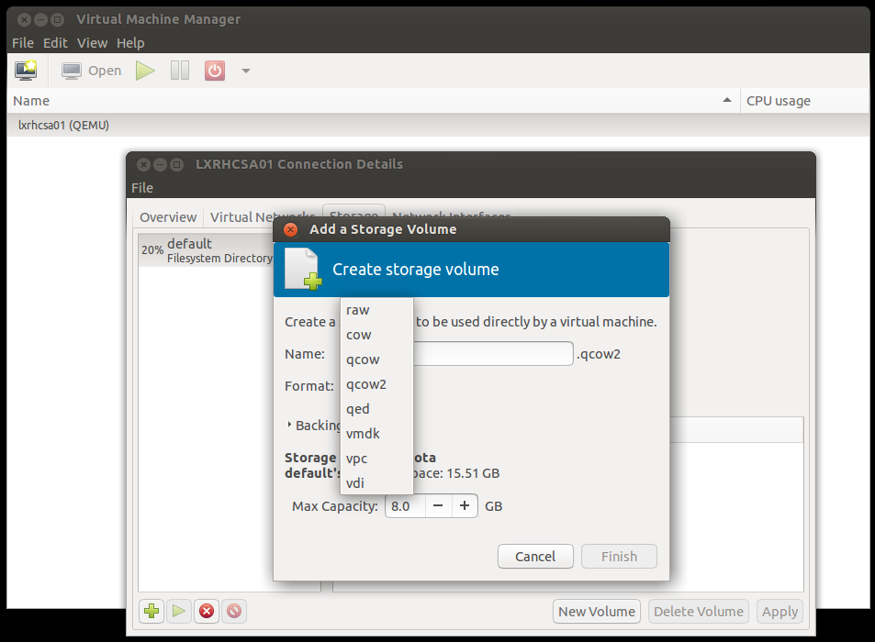
Exploring virt-manager

Slide 13
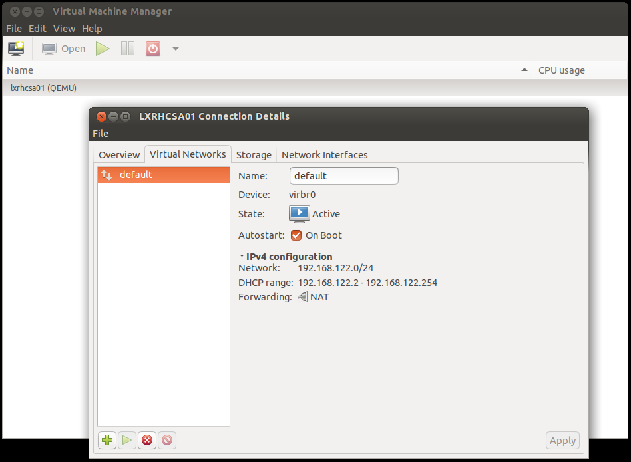
Exploring virt-manager

Slide 14
iptables and ip_forward
firewalld - Page 201
I personally disable firewalld and use simple iptables:
[root@LXRHCSA01 ~]# systemctl stop firewalld
[root@LXRHCSA01 ~]# systemctl disable firewalld
[root@LXRHCSA01 ~]# iptables -vnL --line-num
Chain INPUT (policy ACCEPT 15994 packets, 1387K bytes)
num pkts bytes target prot opt in out source destination
1 0 0 ACCEPT udp -- virbr0 * 0.0.0.0/0 0.0.0.0/0 udp dpt:53
2 0 0 ACCEPT tcp -- virbr0 * 0.0.0.0/0 0.0.0.0/0 tcp dpt:53
3 0 0 ACCEPT udp -- virbr0 * 0.0.0.0/0 0.0.0.0/0 udp dpt:67
4 0 0 ACCEPT tcp -- virbr0 * 0.0.0.0/0 0.0.0.0/0 tcp dpt:67
Chain FORWARD (policy ACCEPT 0 packets, 0 bytes)
num pkts bytes target prot opt in out source destination
1 0 0 ACCEPT all -- * virbr0 0.0.0.0/0 192.168.122.0/24 ctstate RELATED,ESTABLISHED
2 0 0 ACCEPT all -- virbr0 * 192.168.122.0/24 0.0.0.0/0
3 0 0 ACCEPT all -- virbr0 virbr0 0.0.0.0/0 0.0.0.0/0
4 0 0 REJECT all -- * virbr0 0.0.0.0/0 0.0.0.0/0 reject-with icmp-port-unreachable
5 0 0 REJECT all -- virbr0 * 0.0.0.0/0 0.0.0.0/0 reject-with icmp-port-unreachable
Chain OUTPUT (policy ACCEPT 1458 packets, 286K bytes)
num pkts bytes target prot opt in out source destination
1 0 0 ACCEPT udp -- * virbr0 0.0.0.0/0 0.0.0.0/0 udp dpt:68
[root@LXRHCSA01 ~]#

Slide 15
iptables and ip_forward
[root@LXRHCSA01 ~]# iptables -vnL --line-num -t nat
Chain PREROUTING (policy ACCEPT 767 packets, 145K bytes)
num pkts bytes target prot opt in out source destination
Chain INPUT (policy ACCEPT 761 packets, 144K bytes)
num pkts bytes target prot opt in out source destination
Chain OUTPUT (policy ACCEPT 78 packets, 5991 bytes)
num pkts bytes target prot opt in out source destination
Chain POSTROUTING (policy ACCEPT 78 packets, 5991 bytes)
num pkts bytes target prot opt in out source destination
1 1 32 RETURN all -- * * 192.168.122.0/24 224.0.0.0/24
2 0 0 RETURN all -- * * 192.168.122.0/24 255.255.255.255
3 0 0 MASQUERADE tcp -- * * 192.168.122.0/24 !192.168.122.0/24 masq ports: 1024-65535
4 0 0 MASQUERADE udp -- * * 192.168.122.0/24 !192.168.122.0/24 masq ports: 1024-65535
5 0 0 MASQUERADE all -- * * 192.168.122.0/24 !192.168.122.0/24
[root@LXRHCSA01 ~]#

Slide 16
virbr0 bridge interface
https://access.redhat.com/documentation/en-US/Red_Hat_Enterprise_Linux/6/html/Virtualization_Administration_Guide/chap-Virtualization_Administration_Guide-Virtual_Networking.html
Page 66 - Network Interfaces on a Hypervisor
[root@LXRHCSA01 ~]# brctl show
bridge name bridge id STP enabled interfaces
virbr0 8000.525400d6148e yes virbr0-nic
[root@LXRHCSA01 ~]# brctl
Usage: brctl [commands]
commands:
addbr <bridge> add bridge
delbr <bridge> delete bridge
addif <bridge> <device> add interface to bridge
delif <bridge> <device> delete interface from bridge
hairpin <bridge> <port> {on|off} turn hairpin on/off
setageing <bridge> <time> set ageing time
setbridgeprio <bridge> <prio> set bridge priority
setfd <bridge> <time> set bridge forward delay
sethello <bridge> <time> set hello time
setmaxage <bridge> <time> set max message age
setpathcost <bridge> <port> <cost> set path cost
setportprio <bridge> <port> <prio> set port priority
show [ <bridge> ] show a list of bridges
showmacs <bridge> show a list of mac addrs
showstp <bridge> show bridge stp info
stp <bridge> {on|off} turn stp on/off
[root@LXRHCSA01 ~]#

Slide 17
dnsmasq configuration
It is managed by virsh
default running config of dnsmasq is located here:
/var/lib/libvirt/dnsmasq/default.conf
We need to extend this file for PXE boot
https://access.redhat.com/documentation/en-US/Red_Hat_Enterprise_Linux/6/html/Virtualization_Host_Configuration_and_Guest_Installation_Guide/chap-Virtualization_Host_Configuration_and_Guest_Installation_Guide-Libvirt_network_booting.html

Slide 18
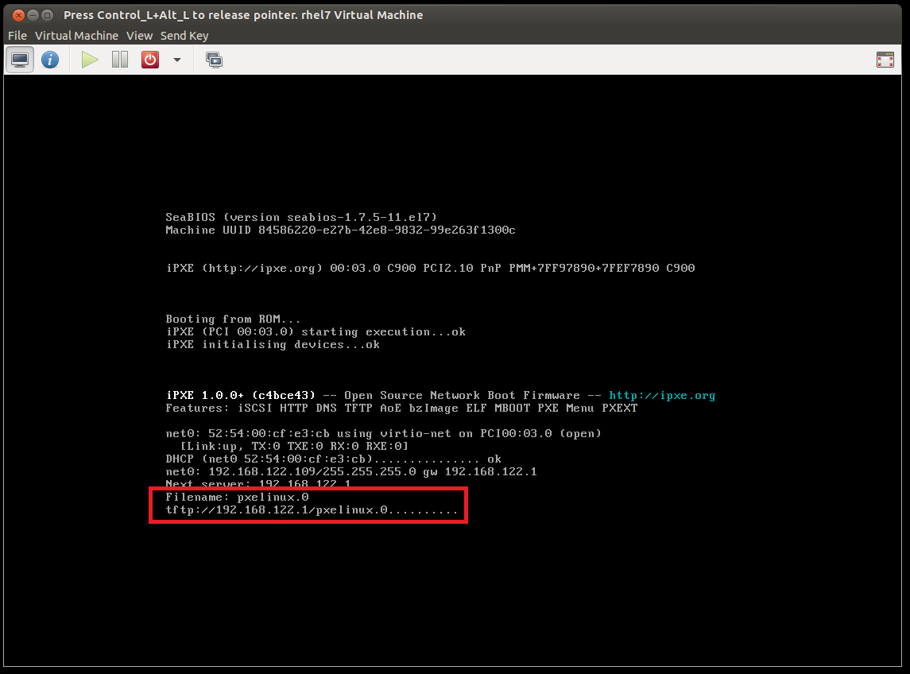
Test dnsmasq pxe setup

Slide 19
NFS Server setup
yum -y install nfs-utils
systemctl enable nfs-server
systemctl start nfs-server
mkdir -p /opt/rhcsa
cat << 'EOT' > /etc/exports
/opt/rhcsa 192.168.122.0/24
EOT
exportfs -var
showmount -e 127.0.0.1
[root@LXRHCSA01 opt]# showmount -e 127.0.0.1
Export list for 127.0.0.1:
/opt/rhcsa 192.168.122.0/24
[root@LXRHCSA01 opt]#
SELinux might be blocking. Some useful bools: Page 227
virt_use_nfs

Slide 20
tftp-server setup
yum -y install tftp-server tftp xinetd
systemctl enable tftp
systemctl enable xinetd
systemctl start tftp
systemctl start xinetd
[root@LXRHCSA01 opt]# cat /etc/xinetd.d/tftp
service tftp
{
socket_type = dgram
protocol = udp
wait = yes
user = root
server = /usr/sbin/in.tftpd
server_args = -s /var/lib/tftpboot
disable = no
per_source = 11
cps = 100 2
flags = IPv4
}
[root@LXRHCSA01 opt]#

Slide 21
tftp-server setup
[root@LXRHCSA01 opt]# netstat -atnpu | grep -i xinetd
udp 0 0 0.0.0.0:69 0.0.0.0:* 11703/xinetd
[root@LXRHCSA01 opt]# cat /usr/lib/systemd/system/tftp.service
[Unit]
Description=Tftp Server
Requires=tftp.socket
Documentation=man:in.tftpd
[Service]
ExecStart=/usr/sbin/in.tftpd -s /var/lib/tftpboot
StandardInput=socket
[Install]
Also=tftp.socket
[root@LXRHCSA01 opt]#

Slide 22
http setup with nginx
yum -y install nginx
cd /etc/nginx
# nginx.conf; default server settings: /usr/share/nginx/html
# IMPORTANT: Comment out server section in default nginx.conf. All of it
# Let's create a new minimalistic virtualhost
[root@LXRHCSA01 conf.d]# pwd
/etc/nginx/conf.d
[root@LXRHCSA01 conf.d]# cat rhcsa.conf
server {
listen 80;
server_name _;
root /opt/rhcsa;
autoindex on;
}
[root@LXRHCSA01 conf.d]#
systemctl enable nginx
systemctl restart nginx

Slide 23
Prepare environment for PXE install
# Download CentOS 7 Everything ISO:
wget http://mirror.sov.uk.goscomb.net/centos/7/isos/x86_64/CentOS-7-x86_64-Everything-1511.iso -O /root/CentOS-7-x86_64-Everything-1511.iso
mkdir -p /opt/rhcsa/cdrom
cat << 'EOT' >> /etc/fstab
/root/CentOS-7-x86_64-Everything-1511.iso /opt/rhcsa/cdrom iso9660 loop,ro 0 0
EOT
mount -a
yum -y install syslinux-tftpboot
# copy pxeboot files to /var/lib/pxeboot. Unfortunately tftp does not like symlinks
mkdir -p /var/lib/tftpboot/pxeboot
cp -r /opt/rhcsa/cdrom/images/pxeboot/* /var/lib/tftpboot/pxeboot/

Slide 24
Prepare environment for PXE install
mkdir -p /var/lib/tftpboot/pxelinux.cfg
cat << 'EOT' > /var/lib/tftpboot/pxelinux.cfg/default
DEFAULT menu.c32
PROMPT 100
TIMEOUT 100
ONTIMEOUT centos
MENU TITLE PXE Network Boot
LABEL localdisk
MENU LABEL ^Local Hard Drive
MENU DEFAULT
LOCALBOOT 0
LABEL centos
MENU LABEL ^CentOS 7 PXE
KERNEL pxeboot/vmlinuz
APPEND initrd=pxeboot/initrd.img inst.repo=http://192.168.122.1/cdrom devfs=nomount
EOT

Slide 25
Prepare environment for PXE install
[root@LXRHCSA01 tftpboot]# pwd
/var/lib/tftpboot
[root@LXRHCSA01 tftpboot]# tree pxeboot/ pxelinux.cfg/
pxeboot/
├── initrd.img # Kernel modules
├── TRANS.TBL
├── upgrade.img
└── vmlinuz # Linux kernel
pxelinux.cfg/
└── default # isolinux pxe config file
0 directories, 5 files
[root@LXRHCSA01 tftpboot]#

Slide 26
qemu-kvm virtualization

