Slide 1
Bauer Linux Training
w33
2016-08-18

Slide 2
Agenda
Git commands
Building Vagrant sandbox environment
Linux terminal commands
Linux file types
Filesystem permissions
OpenSSH and keys
Basic programming
Basic algorithms

Slide 3



Building our Vagrant box to practice
Install Virtualbox - https://www.virtualbox.org/wiki/Downloads
Install Vagrant - https://www.vagrantup.com/downloads.html
Install GIT - https://git-scm.com/

Slide 4
Building our Vagrant box to practice
Repository: https://github.com/DRN88/blt
mkdir ~/githubrepos
git clone https://github.com/DRN88/blt.git
drn@drn /githubrepos $ tree blt
blt
├── README.md
└── w33
├── evilcorp_users1.csv
└── vagrant
├── shellprovision.sh
└── Vagrantfile
2 directories, 4 files

Slide 5
Building our Vagrant box to practice
cd githubrepos/blt/vagrant
vagrant up
C:\DATA\githubrepos\blt\w33\vagrant>vagrant status
Current machine states:
sandbox running (virtualbox)
The VM is running. To stop this VM, you can run `vagrant halt` to
shut it down forcefully, or you can run `vagrant suspend` to simply
suspend the virtual machine. In either case, to restart it again,
simply run `vagrant up`.
C:\DATA\githubrepos\blt\w33\vagrant>

Slide 6
Terminal commands
mkdir, echo, cat, touch, ln, ln -s >, >>, 2>&1, &> /dev/null <, cat << ‘EOT’
tac, more, less, head, tail, watch
chmod, chown, chgrp
id, who, w, finger
nano, vi, vim
sort, cut, uniq, wc, grep, egrep, fgrep sed awk variants of these command with ‘z’ first letter

Slide 7
Linux file types
“In linux everything is a file” - http://www.howtogeek.com/117939/htg-explains-what-everything-is-a-file-means-on-linux/
Regular files ( - ) Directories ( d ) Block file ( b ) Character device file ( c ) Named pipe ( p ) Symbolic link file ( l ) Unix Socket file ( s )

Slide 8
Filesystem permissions
chmod, chown, chgrp -rw-rw-r-- 1 drn drn 215516 Aug 12 16:34 evilcorp_users1.csv
https://docs.oracle.com/cd/E19683-01/816-4883/secfile-69/index.html
Setuid, Setgid, Sticky
 | r | w | x
Placeholder Value | 4 | 2 | 1
type | user |  |  | group |  |  | other
 | 6 |  |  | 6 |  |  | 4
- | r | w | - | r | w | - | r | - | -
 | 2^2 | 2^1 |  | 2^2 | 2^1 |  | 2^2

Slide 9
Filesystem permissions test
type | user |  |  | group |  |  | other
d | r | w | x | r |  | x | r | - | x
type | user |  |  | group |  |  | other
- | r |  | x | r |  |  |  |  | x

Slide 10
Changing ownership on files and folders
chown -R user:group file_or_dir chown -R dorian:linuxguys evilcorp_users2.csv
man chown

Slide 11
Changing permissions on files and folders
chmod 0755 /home/superman chmod 0700 /home/batman
chmod 0700 /home/spiderman/.ssh chmod 0600 /home/spiderman/.ssh/id_rsa
find . /var/www/nextcloud -type f -exec chmod 0640 {} \; find . /var/www/nextcloud -type d -exec chmod 0750 {} \;
“-not”, “-path” switches are useful.

Slide 12
Changing permissions on files and folders
getfacl setfacl
Temporary: mount –o remount,acl / Permanent: add ‘acl’ option in /etc/fstab
lsattr chattr

Slide 13
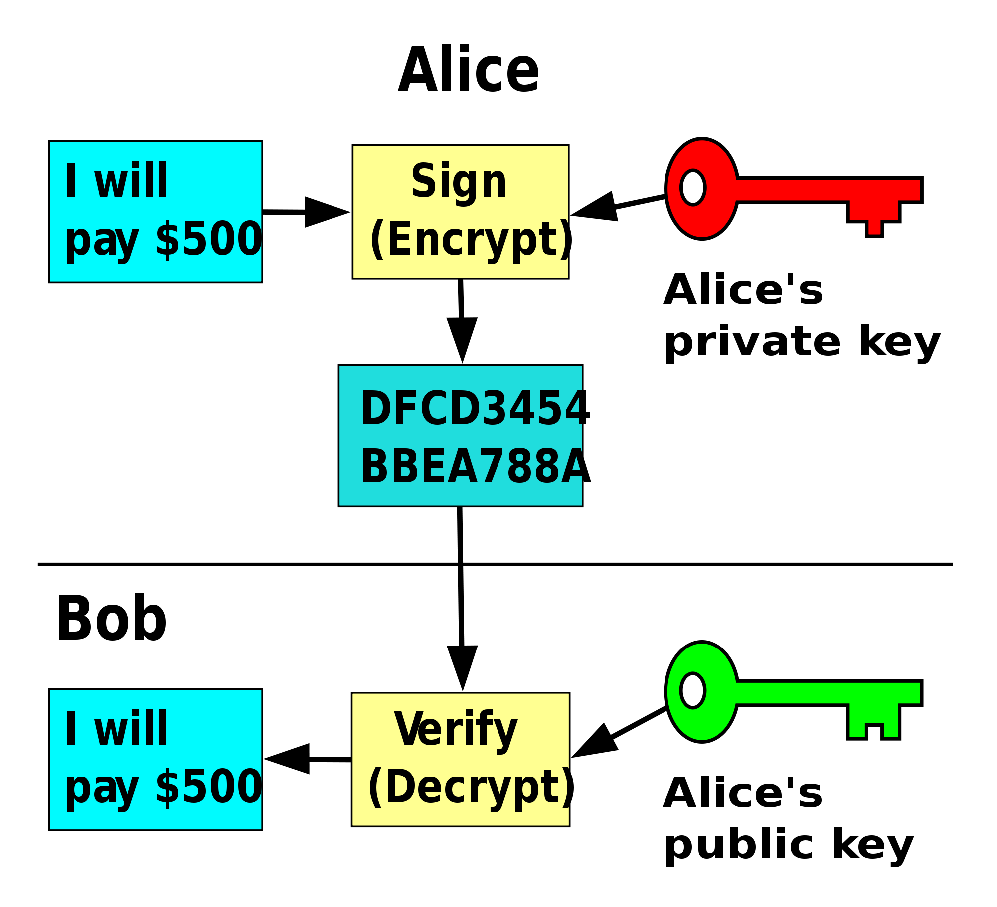
OpenSSH and Keys
ssh, scp, rsync
Public Key: Free to distribute and share
Private Key: Secret
ssh-keygen –t rsa –b 4096 –C MyComment
chmod 0700 ~/.ssh
chmod 0600 ~/.ssh/id_rsa
chmod 0600 ~/.ssh/authorized_keys
/etc/ssh/sshd_config

Slide 14
Basic Programming
Variables, variable types and data types (const, integer, char, string, float, double, boolean, etc.)
Operators (+ - * / %)
Decisions (if, else, elseif, switch case)
Loops (for iteration, repeat-until back test, do-while forward test)
Functions – Block of algorithms with parameters. in -> [BOX] -> out
http://www.tutorialspoint.com/data_structures_algorithms/index.htm
http://www.tutorialspoint.com/pascal/pascal_data_types.htm
http://www.tutorialspoint.com/pascal/pascal_variable_types.htm
http://www.tutorialspoint.com/pascal/pascal_operators.htm
http://www.tutorialspoint.com/pascal/pascal_decision_making.htm
http://www.tutorialspoint.com/pascal/pascal_loops.htm

Slide 15
Basic algorithms
Algorithm definition: A process or set of rules to be followed in calculations or other problem-solving operations, especially by a computer.
List of basic algorithms:
count
sum
avg
min
max
Plus sorting algorithms. (bubble, heap, quicksort, etc) – Advanced topic
https://www.toptal.com/developers/sorting-algorithms

Slide 16
Basic algorithms
Algorithm definition: A process or set of rules to be followed in calculations or other problem-solving operations, especially by a computer.
List of basic algorithms:
count
sum
avg
min
max
Plus sorting algorithms. (bubble, heap, quicksort, etc) – Advanced topic
https://www.toptal.com/developers/sorting-algorithms

Slide 17
Homework
Learn git (clone, pull, push, checkout, branching, pull-requests, deployment keys) https://try.github.io/levels/1/challenges/1
Set yourself up with a git repository (github.com or bitbucket.org) and practice git
Learn basic programming and algorithms (bash or python)
Get familiar with Vagrantfile. Look up all vagrant options at vagrant documentation https://www.vagrantup.com/docs/getting-started/
Practice simple linux commands
Learn about public and private keys.

