Slide 1

Car Sales Data Analysis Project
Analyzing Customer Demographics, Sales Performance, Dealer Effectiveness, and Car Preferences

Slide 2
Table of Contents
Problem Statement
Database Creation
Basic Level SQL Questions
Intermediate Level SQL Questions
Advanced Level SQL Questions
Conclusion & Recommendations

Slide 3

Problem Statement
The objective of this project is to analyze car sales data to understand customer demographics, sales performance, dealer effectiveness, and car preferences. This analysis aims to derive actionable insights to improve sales strategies and customer targeting.

Slide 4

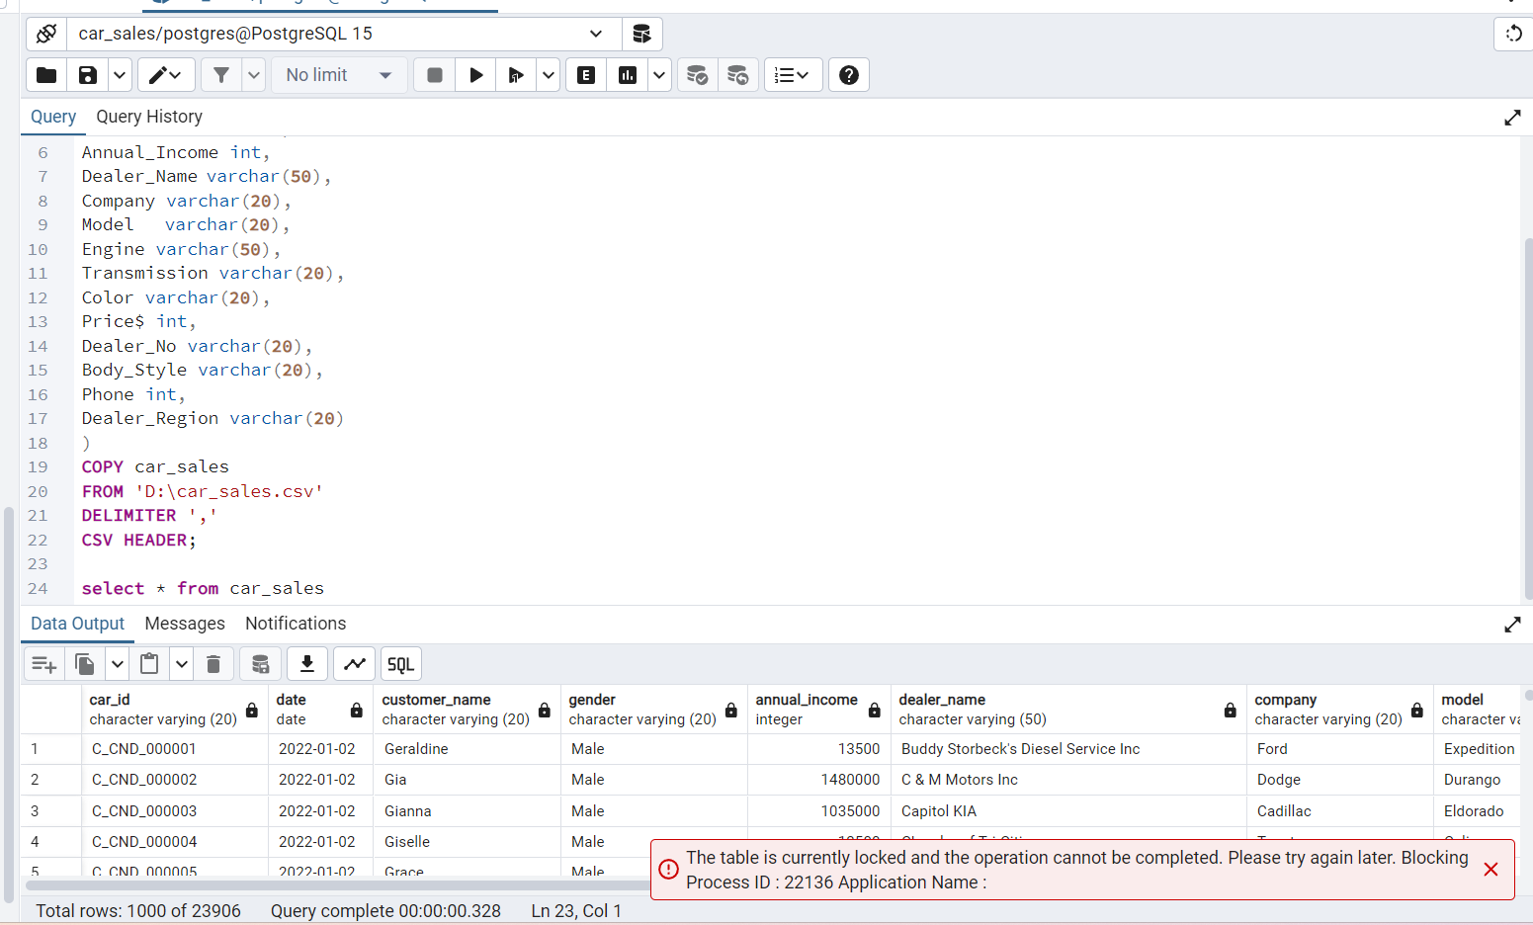
Creating Database

Slide 5
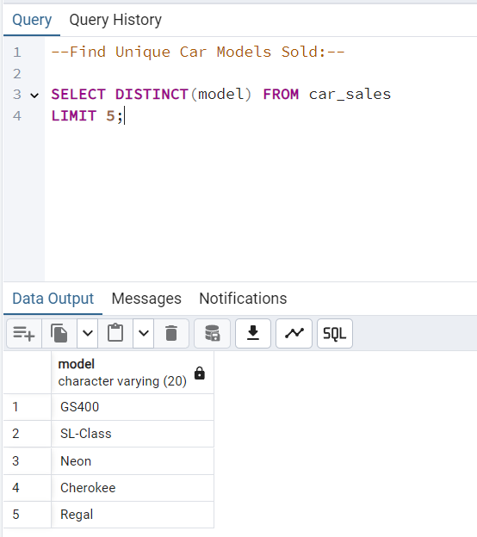
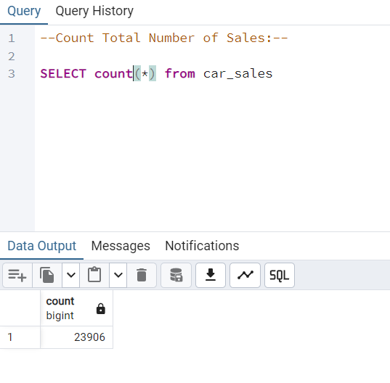
Basic Level SQL Questions
Count Total Number of Sales:
Find Unique Car Models Sold:

Slide 6
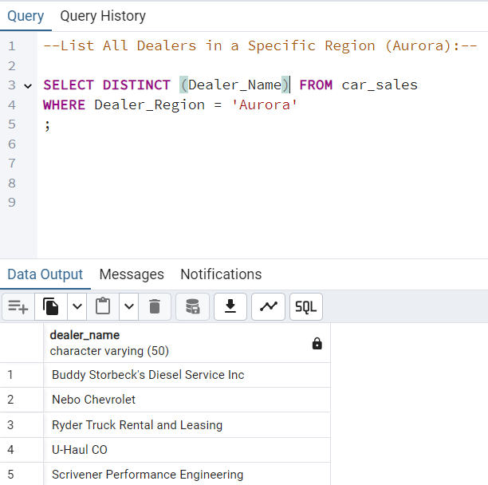
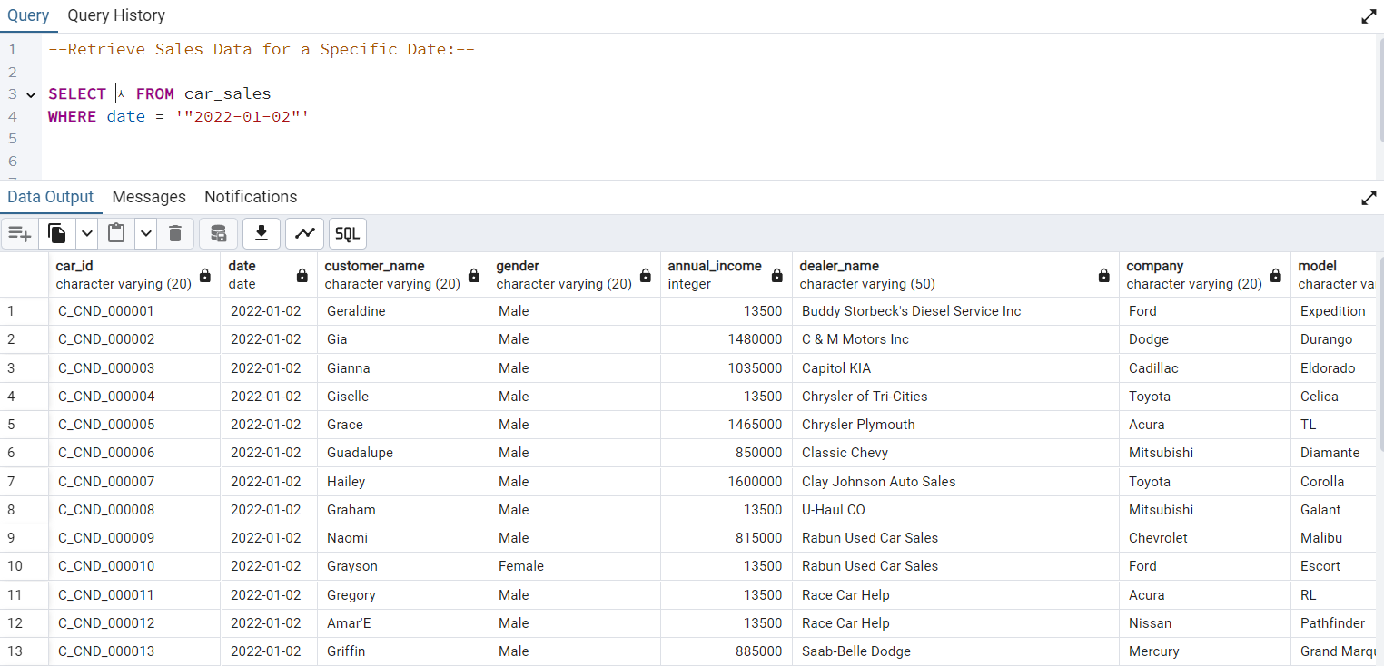
List All Dealers in a Specific Region:
Retrieve Sales Data for a Specific Date:

Slide 7
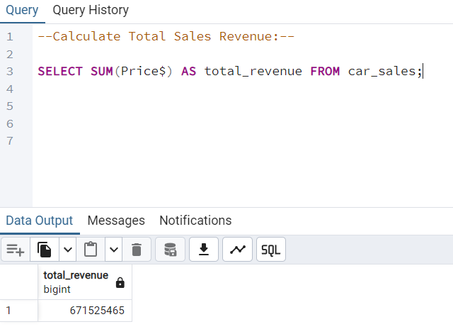
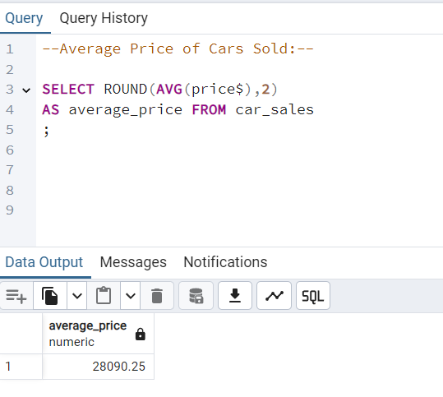
Intermediate Level SQL Questions:
Calculate Total Sales Revenue:
Average Price of Cars Sold:

Slide 8
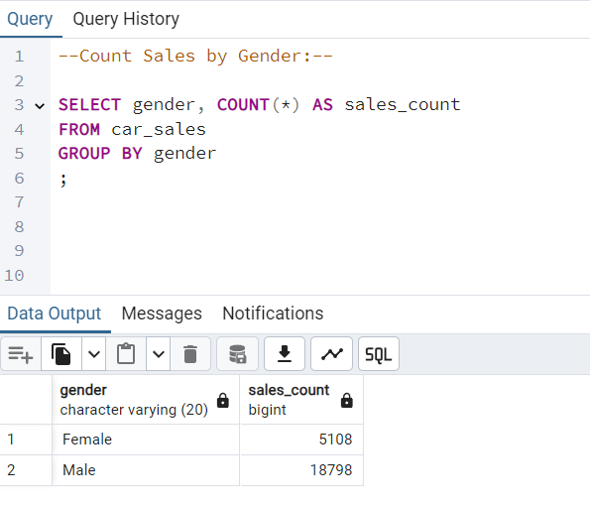
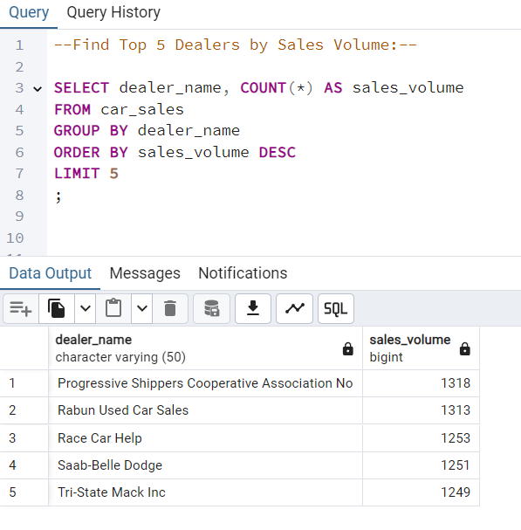
Count Sales by Gender:
Find Top 5 Dealers by Sales Volume:

Slide 9
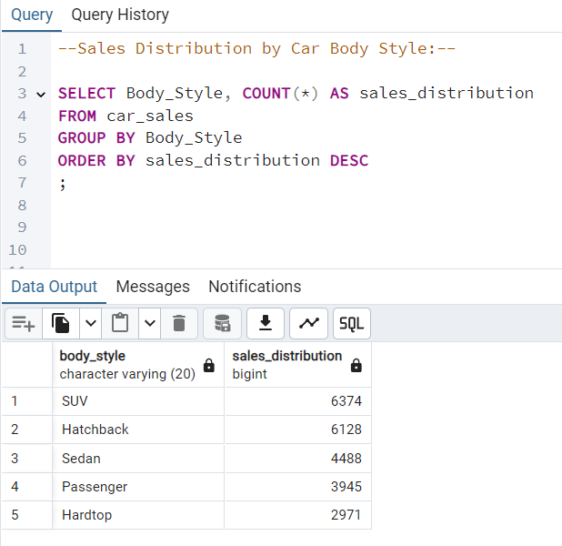
Sales Distribution by Car Body Style:

Slide 10
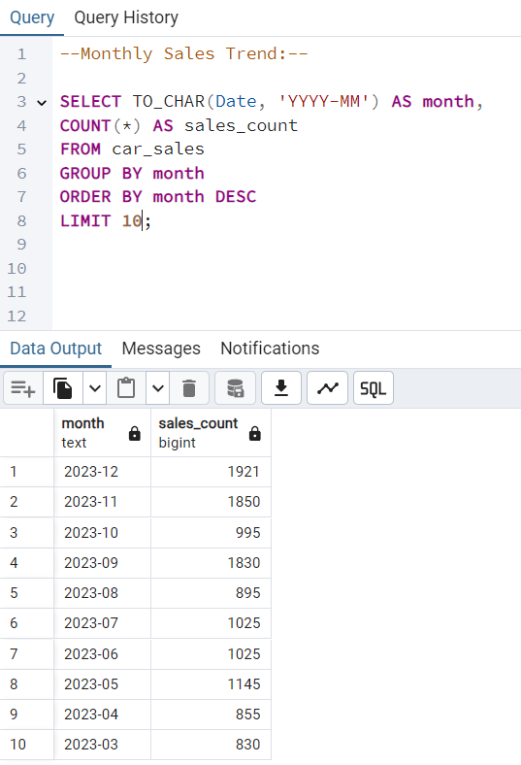
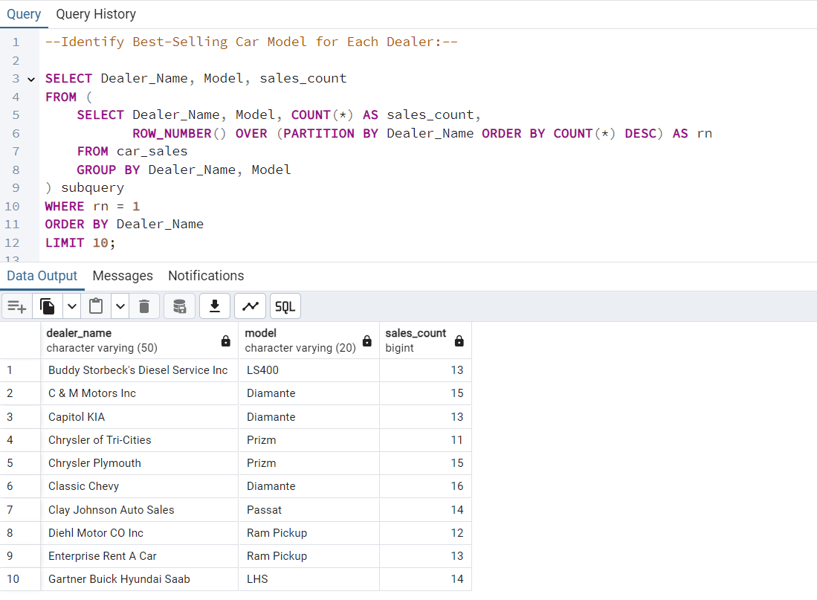
Advanced Level SQL Questions:
Monthly Sales Trend:
Identify Best-Selling Car Model for Each Dealer:

Slide 11
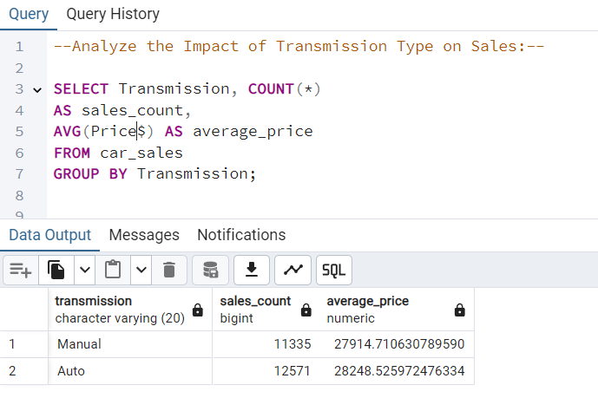
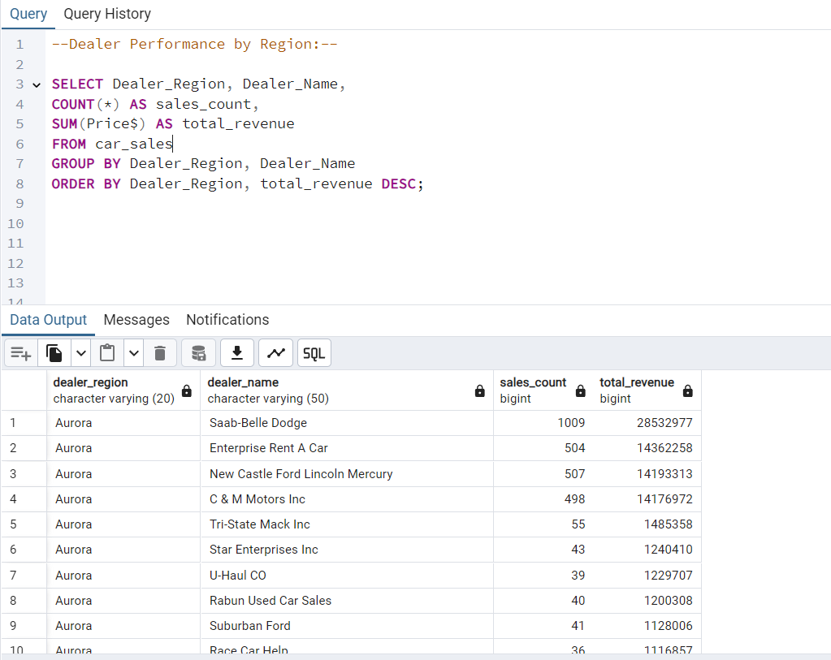
Analyze the Impact of Transmission Type on Sales:
Dealer Performance by Region:

Slide 12
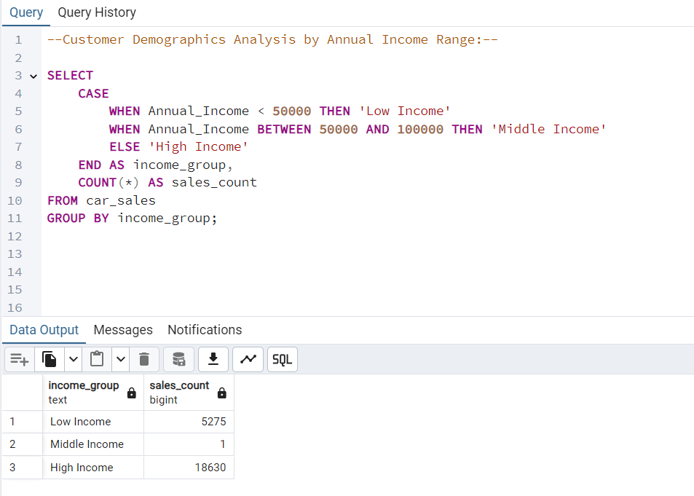
Customer Demographics Analysis by Annual Income Range:

Slide 13
Conclusion:
Customer Demographics: Middle-income customers dominate sales; balanced gender distribution.
Sales Performance: Monthly trends highlight seasonal impacts; top 5 dealers drive significant sales volume.
Dealer Effectiveness: Performance varies by region; best-selling models differ across dealers.
Car Features: Transmission type and body style significantly influence sales.

Slide 14
Recommendations:
Targeted Marketing: Focus on middle-income customers and regional preferences.
Dealer Support: Enhance strategies for underperforming regions.
Inventory Management: Align stock with popular models and features.
Seasonal Promotions: Mitigate sales dips with timely promotions.

