Slide 1

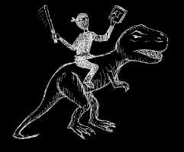

The Board Ultimatum
Columbus Area Boardgaming Society
team members
http://drsnjm.github.com/
Introduction
Design
People like to play board games
Sometimes they don’t know what games to play
Many of these people are members at CABS (Columbus Area Boardgaming Society)
We made an app for them
Written in 100% Clojure!
Haven’t head of it?
You must not be one of the “cool kids”
Noir Web Framework
It’s dark and mysterious
Just kidding, it’s super easy
Hiccup Templating
Markup shmarkup
Bootstrap UI
Forms in a flash
System Architecture
Rule-based Recommendation Engine
We’ve got it!
Similarity Engine
Someday, it may work!
Beautiful and User-Friendly Frontend
From the people who brought you Twitter
Persistent Data-store
No SQL in this application
Significance
People really like this app
We are kind of a big deal
Acknowledgements
We would like to thank the members of CABS, especially our experts
I would like to thank my laptop for allowing me to complete this undertaking

