Slide 1

Lab Book 0.1. ModeSolver
Student:

Slide 2
Instructions
General
SCRIPTS
From GitHub →
  Fork the repo: https://github.com/cccanvas-upv/pic-upv-lab0.git
  Clone the repo using VSCode
Run the Jupyter Notebook:
  010_MODESOLVER_Student.ipynb
INSTRUCTIONS
We are going to work with different Cross-Sections. In general, we will need: Materials definitions and the Geometrical parameters of each Cross-section.
W (width)
W (width)
Core
Core
h_core
h
(height)
Cladding
Cladding
Slab
XY Cross-section
h_slab
deep waveguide
shallow waveguide
LAB 0.1. MODESOLVER

Slide 3
Learning outcome #1 – Effective index of a waveguide
INSTRUCTOR:
Present Python and GDSFactory: materials, output, results.
Explain how to run a simulation for a particular cross-section.
Showcase how to change between shallow and deep waveguide.
Describe how to change the wavelength and width for the waveguide analysis.
Describe the outputs.
ALL EXAMPLE #1: waveguide width 1.2 µm, deep wvg, wavelength start and end same 1.55 µm → all ”Run”
ALL: Follow instructor, that will show how to 1) plot mode, 2) explore the results (neff …)
Document all your results (neff, plot fields of different modes, comparison between different polarizations…)
LAB 0.1. MODESOLVER

Slide 4
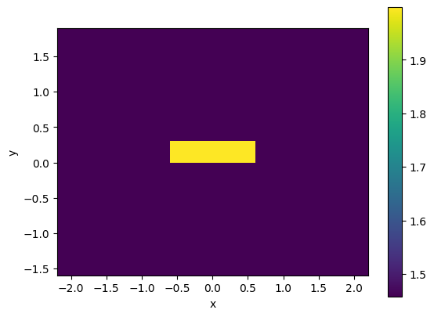
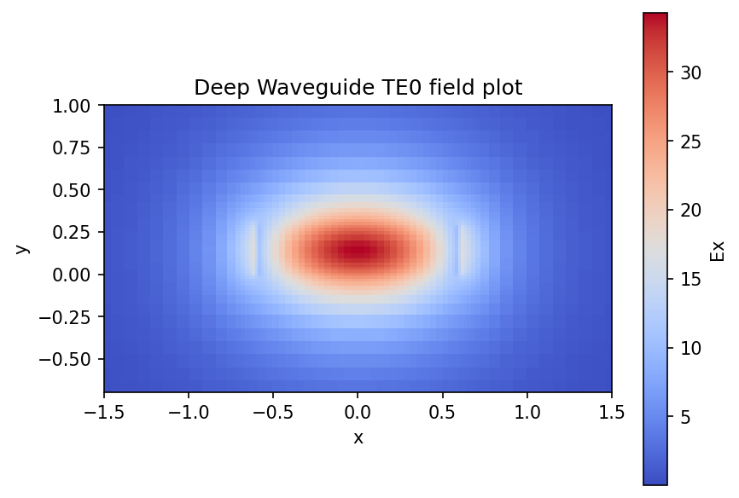
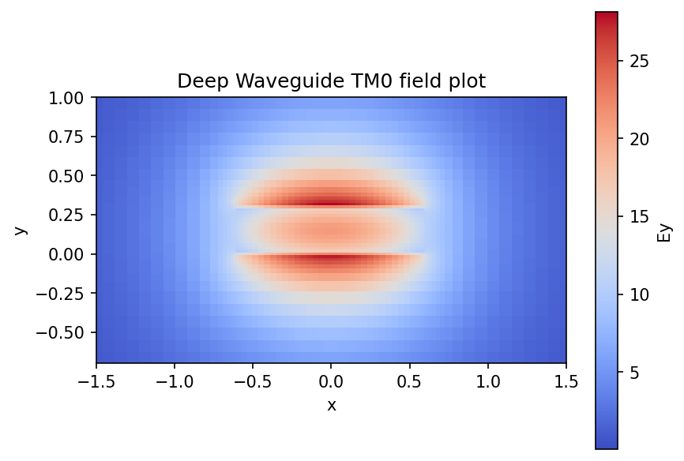
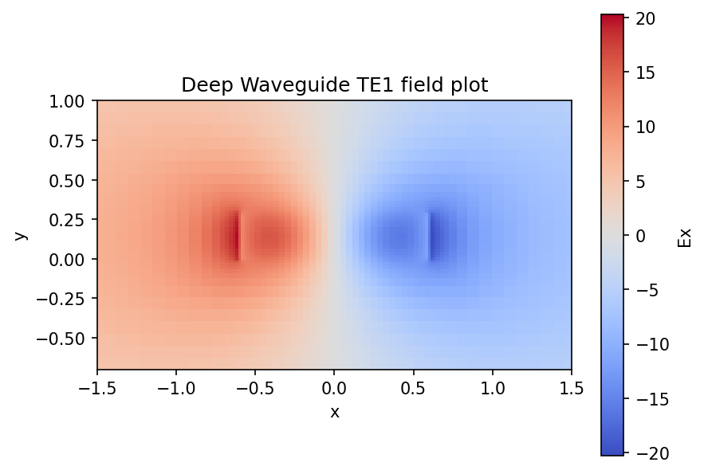
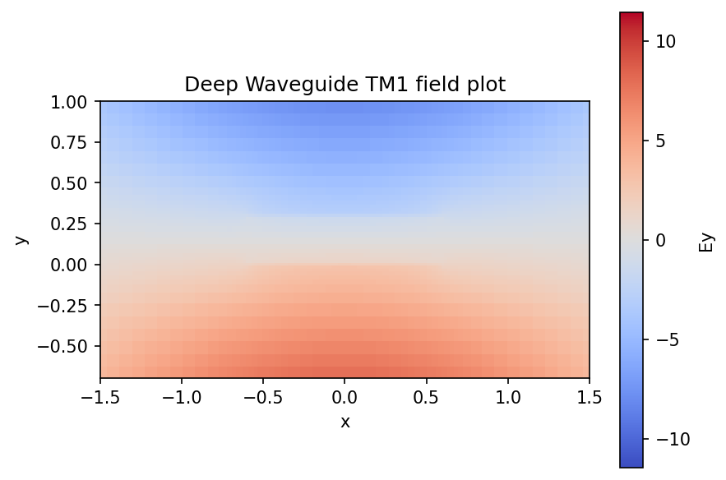
Learning outcome #1 – Effective index of a waveguide
Deep Waveguide
Figure 1
Figure 2a
Figure 2b
Figure 1 shows the cross section of a deep waveguide, with the waveguide core material (in yellow) being silicon nitride, SiN, and the cladding material (purple) made of silicon oxide, SiO2. The effective indices for this waveguide system, calculated for the first 4 modes, are:
  neff(mode 1) = 1.60524792+0.00010066j
  neff(mode 2) = 1.52829803+0.00017753j
  neff(mode 3) = 1.45072999+0.00019228j
  neff(mode 4) = 1.43325817+0.00021838j
These modes can be evaluated to determine if they are TE or TM modes;
modes 1 & 3 are both TE modes, and modes 2 & 4 are both TM.
Figures 2a-d show the field plots for each of these modes, and it is clear that the TE0 mode (Figure 2a) is the only mode that can propagate through the waveguide. The other plots show that the fields propagate through the boundary of the core-cladding.
Figure 2c
Figure 2d

Slide 5
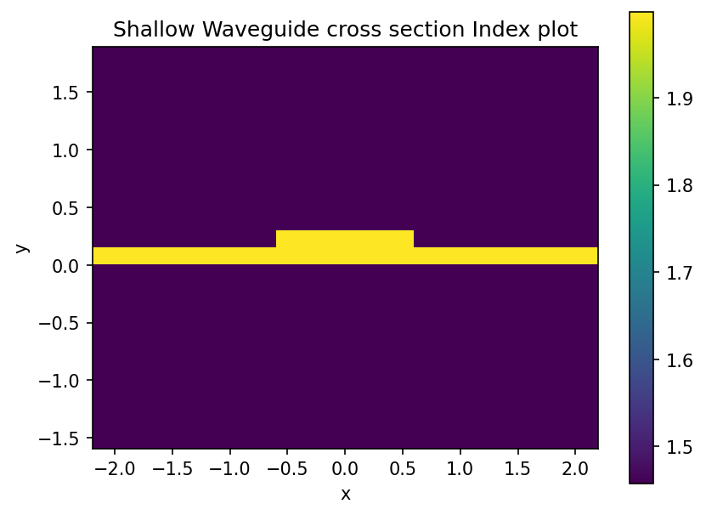
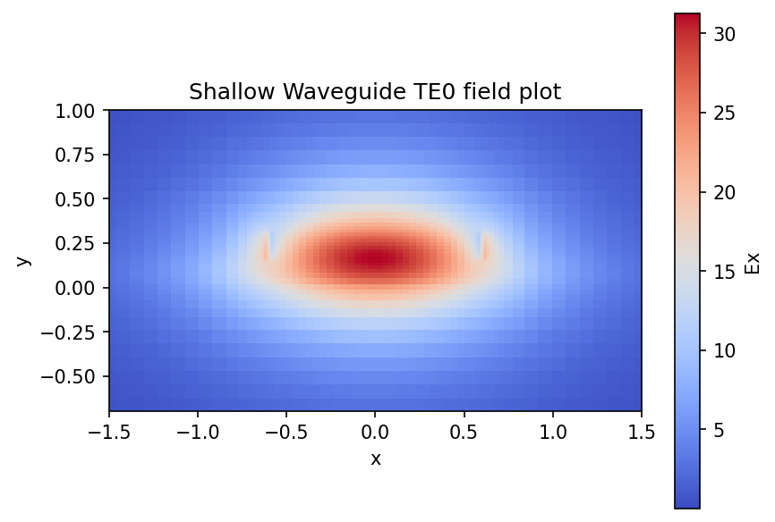
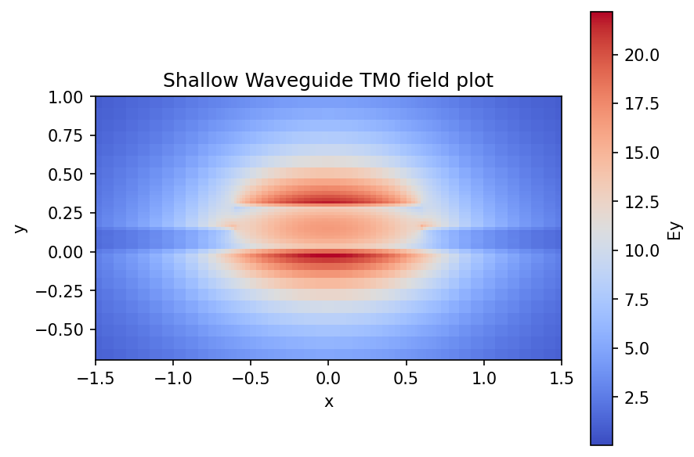
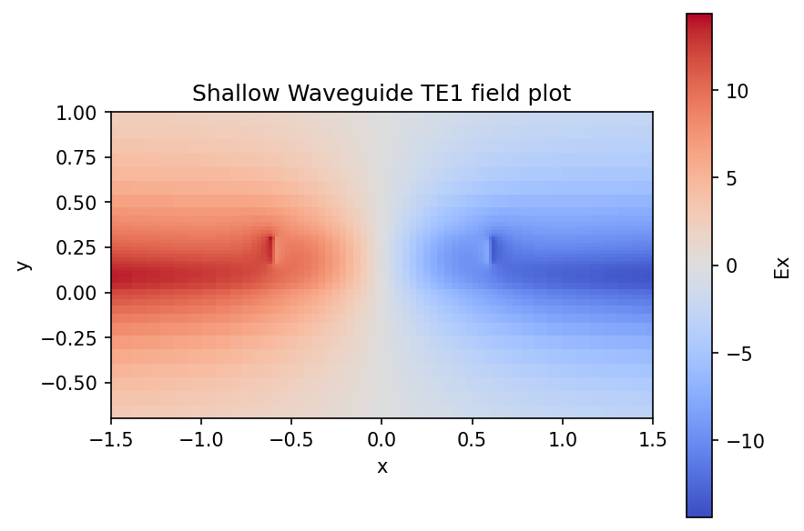
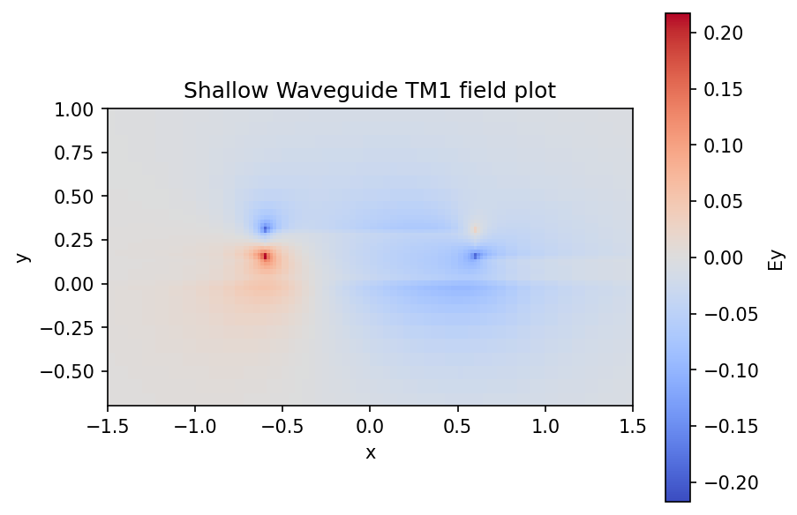
Learning outcome #1 – Effective index of a waveguide
Deep Waveguide
Figure 3
Figure 4a
Figure 4b
Figure 3 shows the cross section of a shallow waveguide, with the waveguide core and base material (in yellow) being silicon nitride, SiN, and the cladding material (purple) made of silicon oxide, SiO2. In the same way as with the deep etched waveguide, the effective indices for this waveguide system, calculated for the first 4 modes, are:
  neff(mode 1) = 1.61898883+9.81885909e-05j
  neff(mode 2) = 1.53875678+1.67919690e-04j
  neff(mode 3) = 1.53307816+1.59765102e-04j
  neff(mode 4) = 1.51966321+1.55534208e-04j
These modes can be evaluated to determine if they are TE or TM modes;
modes 1 & 3 are both TE modes, and modes 2 & 4 are both TM.
Figures 4a-d show the field plots for each of these modes, and it is clear that the TE0 mode (figure 4a) is the only mode that can propagate through the waveguide. Figures 4b and 4c show that modes TM0 and TE1 don’t propagate through the core, and figure 4d shows that the TM1 mode doesn’t really propagate in the system at all.
Figure 4c
Figure 4d

Slide 6
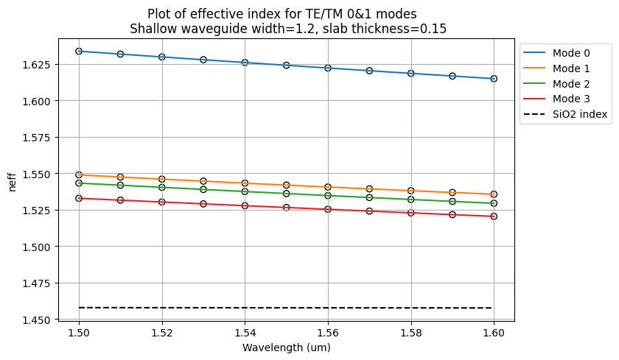
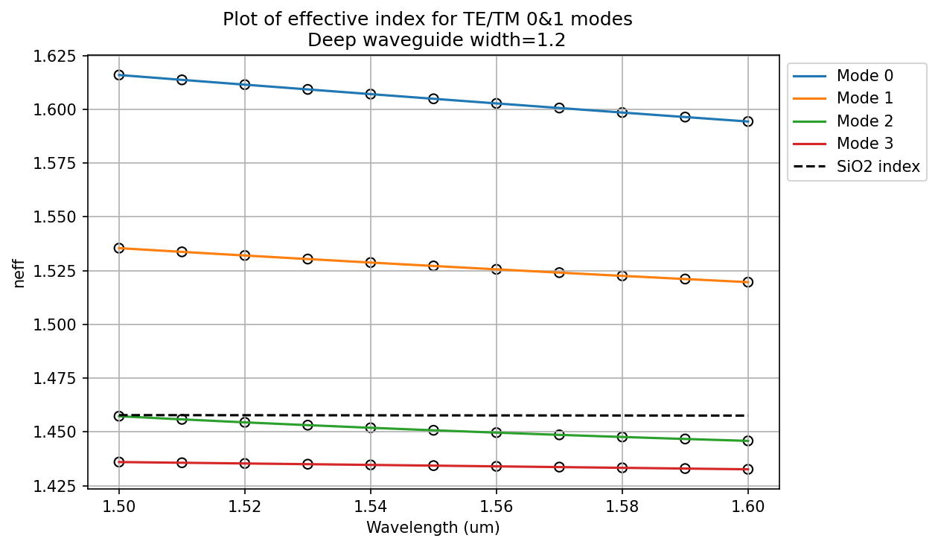
Learning outcome #2 – Wavelength behavior
Wavelength 1.5-1.6 µm (step 0.02 µm) – width 1.2 µm
shallow waveguide
Paste plot here
deep waveguide
Paste plot here
slab = 150nm
The plots show that the effective index for each of the 4 modes calculated for these systems all decrease linearly with increasing wavelength, as expected. For the deep waveguide it is very clear which modes are able to propagate through the waveguide core, since all values for the effective indices (in this range) for modes 0 and 1 are much higher than the refractive index of the cladding material SiO2. Where modes 2 and 3 have effective indices below the cladding index.
The shallow waveguide plot shows how significant the etch depth is on light propagation, it is very clear that Mode 0, a TE mode, is able to be most easily guided through the core. But all modes have effective indices greater than the cladding refractive index.
LAB 0.1. MODESOLVER

Slide 7

Thank you

