Slide 1

Lab Book 0.2. Couplers
Student: Daniel Brown

Slide 2
Instructions
General
SCRIPTS
From GitHub →
  Fork the repo: https://github.com/cccanvas-upv/pic-upv-lab0.git
  Clone the repo using VSCode
Run the Jupyter Notebook:
  020_COUPLERS_Student.ipynb
Cross-Sections to be studied:
w (width)
w (width)
h
(height)
Core
Core
h
(height)
MMI Body
g
(gap)
Cladding
Cladding
Directional coupler (DC)
Multimode Interference (MMI) coupler
LAB 0.2. COUPLERS

Slide 3
Learning outcome #1 – Directional coupler cross-section in GDSFactory
INSTRUCTOR:
Present Python and GDSFactory implementation of DC cross-section
Describe how to obtain the beating length $L_{π}$
Describe the outputs.
ALL EXAMPLE #1: waveguide width 1.2 µm, gap between waveguides 0.6 µm, deep wvg, wavelength start and end same 1.55 µm → all ”Run”
ALL: Follow instructor, that will show how to 1) plot mode, 2) explore the results (neff …)
Document all your results (neff, plot fields of different modes, comparison between different polarizations…)
LAB 0.2. COUPLERS

Slide 4
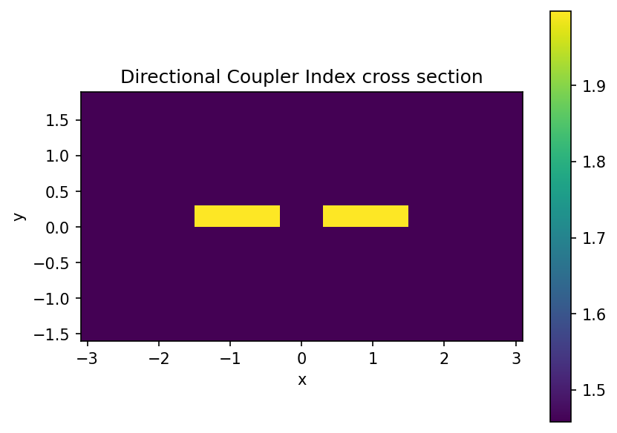
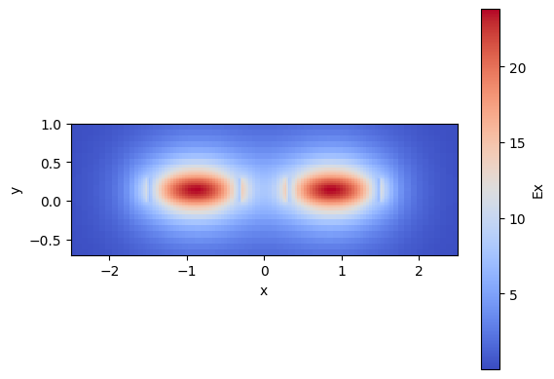
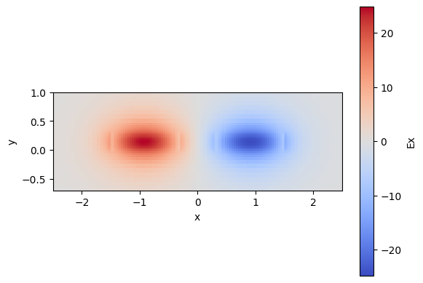
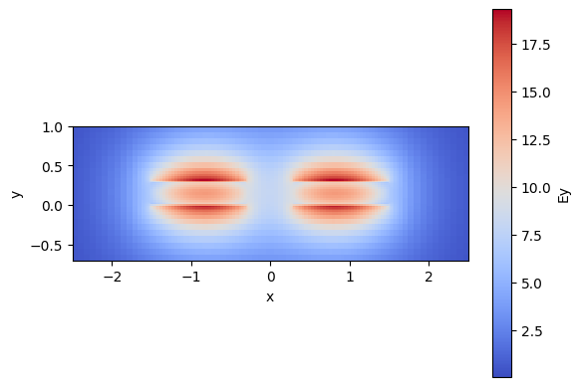
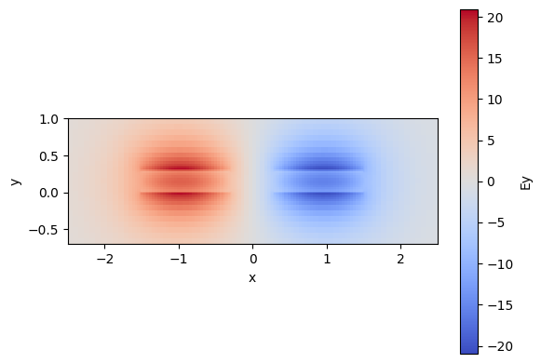
LO.1 - Directional coupler
Figure 1
Figure 2a
Figure 2b
Figure 2c
Figure 2d
Figure 1 shows the cross section of a directional coupler waveguide system, with the waveguide core material (in yellow) being silicon nitride, SiN, and the cladding material (purple) made of silicon oxide, SiO2. The effective indices for this waveguide system, calculated for the first 4 modes, are:
  neff(mode 1) = 1.60942484+1.02849974e-04j
  neff(mode 2) = 1.60116589+9.83178135e-05j
  neff(mode 3) = 1.53540293+1.77367472e-04j
  neff(mode 4) = 1.52057329+1.77190584e-04j
These modes can be evaluated to determine if they are TE or TM modes;
modes 1 & 2 are both TE modes, and modes 3 & 4 are both TM.
Figures 2a-d show the field plots for each of these modes. Figure 2a shows the TE0 mode in both waveguides of the directional coupler propagating symmetrically in the same direction, where figure 2b has the modes propagating anti-symmetrically.
Figures 2c-d demonstrate the analogue for the TM0/TM1 modes.
The Beating length, L$π$, for each TE/TM mode can be calculated for this directional coupler with the formula
$L_{π,TE}=\frac{λ}{2⋅(n_{eff,TE0}-n_{eff,TE1})}$, $L_{π,TM}=\frac{λ}{2⋅(n_{eff,TM0}-n_{eff,TM1})}$
$L_{π,TE}=93.83nm$, $L_{π,TE}=52.26nm$

Slide 5
Learning outcome #2 – Multimode Interference (MMI) Coupler cross-section
INSTRUCTOR:
Present Python and GDSFactory implementation of DC cross-section
Describe how to obtain the beating length $L_{π}$
Describe the outputs.
ALL EXAMPLE #2: waveguide width 12 µm, gap between waveguides 0.6 µm, deep wvg, wavelength start and end same 1.55 µm → all ”Run”
ALL: Follow instructor, that will show how to 1) plot mode, 2) explore the results (neff …)
Document all your results (neff, plot fields of different modes, comparison between different polarizations…)
LAB 0.2. COUPLERS

Slide 6
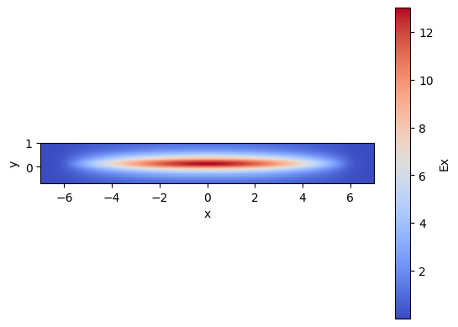
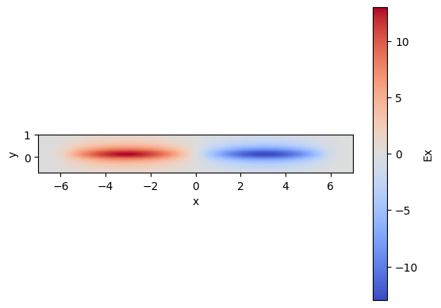
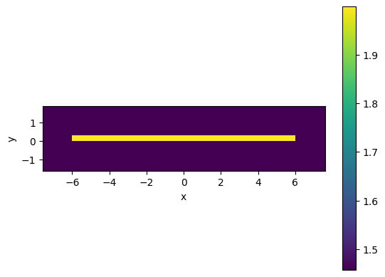
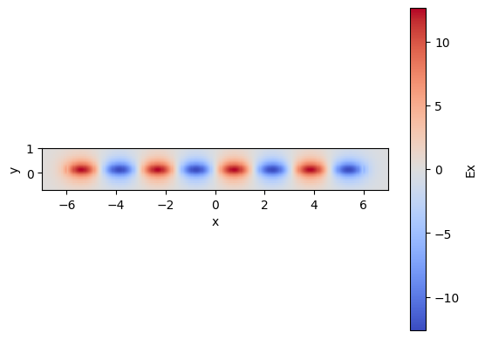
LO.2 - MMI Coupler
Figure 1 shows the cross section of a Multi-Mode Interferometer (MMI) coupler, with the waveguide core material (in yellow) being silicon nitride, SiN, and the cladding material (purple) made of silicon oxide, SiO2. As the name suggests, there are many modes that are able to propagate, and interfere with each other. The effective indices of the first 4 propagating TE modes for this MMI are:
  neff(mode 1) = 1.6786595 +7.78934672e-05j
  neff(mode 2) = 1.67512732+7.81571827e-05j
  neff(mode 3) = 1.66922847+7.86028340e-05j
  neff(mode 4) = 1.66094525+7.92401466e-05j
Figures 3a, b and c show the field plots for the TE0, TE1 and TE7 modes, respectively.
The Beating length, L$π$, for this MMI can be calculated with
$$L_{π,TE}=\frac{λ}{2⋅(n_{eff,TE0}-n_{eff,TE1})}$$
$$L_{π,TE}=219.48nm$$
Figure 4a
Figure 4b
Figure 3
Figure 4c

Slide 7

Thank you

