Slide 1
T41-EP SDT
By
Jack Purdum, W8TEE
Al Peter, AC8GY
Bill Schmidt, K9HZ
Greg Raven, KF5N

Slide 2
Some Background for the T41-EP
1. Started in 2019

Slide 3
Some Background for the T41-EP
1. Started in 2019
2. Feature set:
a. 5 band HF 80, 40, 20, 15, 10M

Slide 4
Some Background for the T41-EP
1. Started in 2019
2. Feature set:
a. 5 band HF 80, 40, 20, 15, 10M
b. 20W, CW - SSB (Fuzzy QRP)

Slide 5
Some Background for the T41-EP
1. Started in 2019
2. Feature set:
a. 5 band HF 80, 40, 20, 15, 10M
b. 20W, CW - SSB (Fuzzy QRP)
c. Self-contained, no PC, laptop, tablet, or phone needed

Slide 6
Some Background for the T41-EP
1. Started in 2019
2. Feature set:
a. 5 band HF 80, 40, 20, 15, 10M
b. 20W, CW - SSB (Fuzzy QRP)
c. Self-contained, no PC, laptop, tablet, or phone needed
d. Large spectrum/waterfall display

Slide 7
Some Background for the T41-EP
1. Started in 2019
2. Feature set:
a. 5 band HF 80, 40, 20, 15, 10M
b. 20W, CW - SSB (Fuzzy QRP)
c. Self-contained, no PC, laptop, tablet, or phone needed
d. Large spectrum/waterfall display
e. No touch display – FFS

Slide 8
Some Background for the T41-EP
1. Started in 2019
2. Feature set:
a. 5 band HF 80, 40, 20, 15, 10M
b. 20W, CW - SSB (Fuzzy QRP)
c. Self-contained, no PC, laptop, tablet, or phone needed
d. Large spectrum/waterfall display
e. No touch display – FFS
f. Luggable

Slide 9
Some Background for the T41-EP
1. Started in 2019
2. Feature set:
a. 5 band HF 80, 40, 20, 15, 10M
b. 20W, CW - SSB (Fuzzy QRP)
c. Self-contained, no PC, laptop, tablet, or phone needed
d. Large spectrum/waterfall display
e. No touch display – FFS
f. Luggable
g. Reasonable cost

Slide 10
Some Background for the T41-EP
1. Started in 2019
2. Feature set:
a. 5 band HF 80, 40, 20, 15, 10M
b. 20W, CW - SSB (Fuzzy QRP)
c. Self-contained, no PC, laptop, tablet, or phone needed
d. Large spectrum/waterfall display
e. No touch display – FFS
f. Luggable
g. Reasonable cost
h. Open Source on both hardware and software

Slide 11
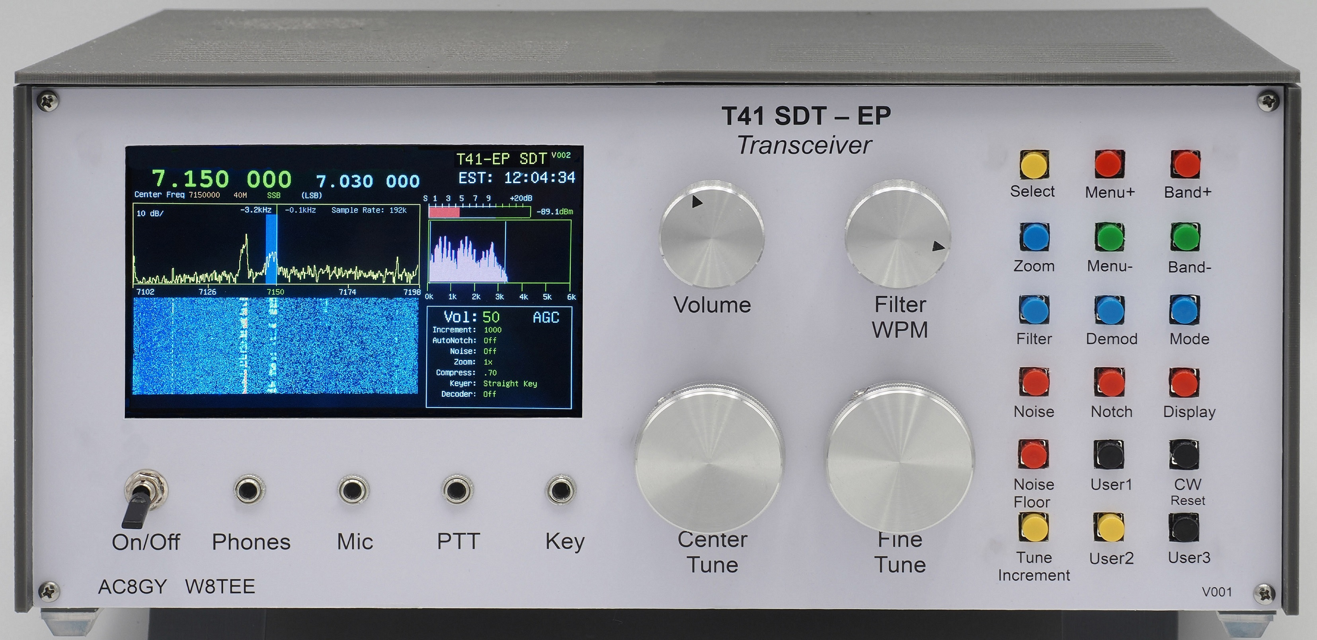
The Result:
The T41-EP
It only took 5 years!

Slide 12
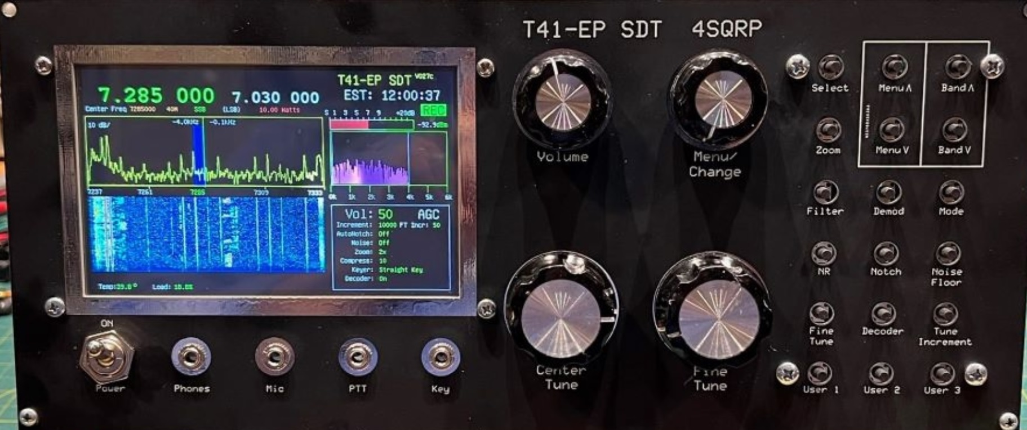
4 States QRP
T41-EP
Semi-Kit

Slide 13
Building an SDT
SDT??

Slide 14
Building an SDT
SDT??
Software Defined Transceiver.

Slide 15
Building an SDT
SDT??
Software Defined Transceiver.
  We make the distinction to differentiate what we are
  building from the SDR's that are receive-only devices.

Slide 16
Building an SDT
SDR – Software Defined Radio
  A radio communication system in which components that have been traditionally implemented in hardware are instead implemented by means of software on a personal computer or embedded system.

Slide 17
Building an SDT
SDT??
Software Defined Transceiver.
  We make the distinction to differentiate what we are
  building from the SDR's that are receive-only devices.
  SDR's range from $10 “dongles” to full-featured units
  like SDR Play, which costs several hundred dollars.

Slide 18
Building an SDT
What advantages do SDR's have?

Slide 19
Building an SDT
What advantages do SDR's have?
1. Replace (high-cost) hardware components
with software
    a. less expensive radios for a given feature-set.

Slide 20
Building an SDT
What advantages do SDR's have?
1. Replace (high-cost) hardware components with software
      a. less expensive radios for a given feature-set.
2. Ability to improve feature-set over time – with the same hardware!

Slide 21
Building an SDT
What advantages do SDR's have?
1. Replace (high-cost) hardware components with software
      a. less expensive radios for a given feature-set.
2. Ability to improve feature-set over time – with the same hardware!
3. For us, the T41 is an addition to the Open Source community

Slide 22
The T41 SDT
Development Time – over 10 man-years.

Slide 23
The T41 SDT
Development Time – over 10 man-years.
1. How can it take that long?

Slide 24
The T41 SDT
Development Time – over 4 man-years.
1. How can it take that long?
EASY!

Slide 25
The T41 SDT
Development Time – over 4 man-years.
1. How can it take that long?
a. At the start, it was just Al and I

Slide 26
The T41 SDT
Development Time – over 4 man-years.
1. How can it take that long?
a. At the start, it was just Al and I
b. It's designed for Experimenter's and
to be a teaching tool

Slide 27
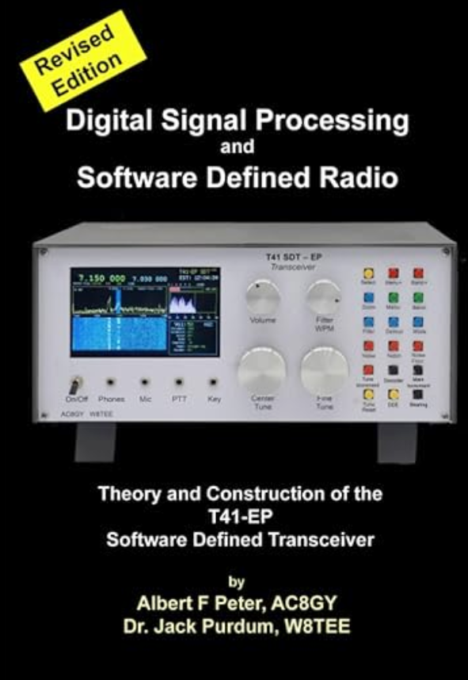
The T41 SDT
Time also included researching DSP and
SDR concepts and bringing them together
into a readable book.
We think this is the first book to discuss the DSP/SDR theory in a way that is understandable by non-EE readers and actually implements the theory in a working circuit.

Slide 28
The T41 SDT
Development Time – over 6 man-years.
1. How can it take that long?
a. At the start, it was just Al and I
b. It's designed for Experimenter's and
to be a teaching tool
c. WIBCIWA Syndrome

Slide 29
The T41 SDT
Development Time – over 4 man-years.
1. How can it take that long?
a. At the start, it was just Al and I
b. It's designed for Experimenter's and
to be a teaching tool
c. WIBCIWA Syndrome
Wouldn't It Be Cool If We Added...

Slide 30
The T41 SDT
Development Time – over 4 man-years.
1. How can it take that long?
a. At the start, it was just Al and I
b. It's designed for Experimenter's and
to be a teaching tool
c. WIBCIWA Syndrome
Wouldn't It Be Cool If We Added...
          d. Features not found in most HF/kit
          SDR's

Slide 31
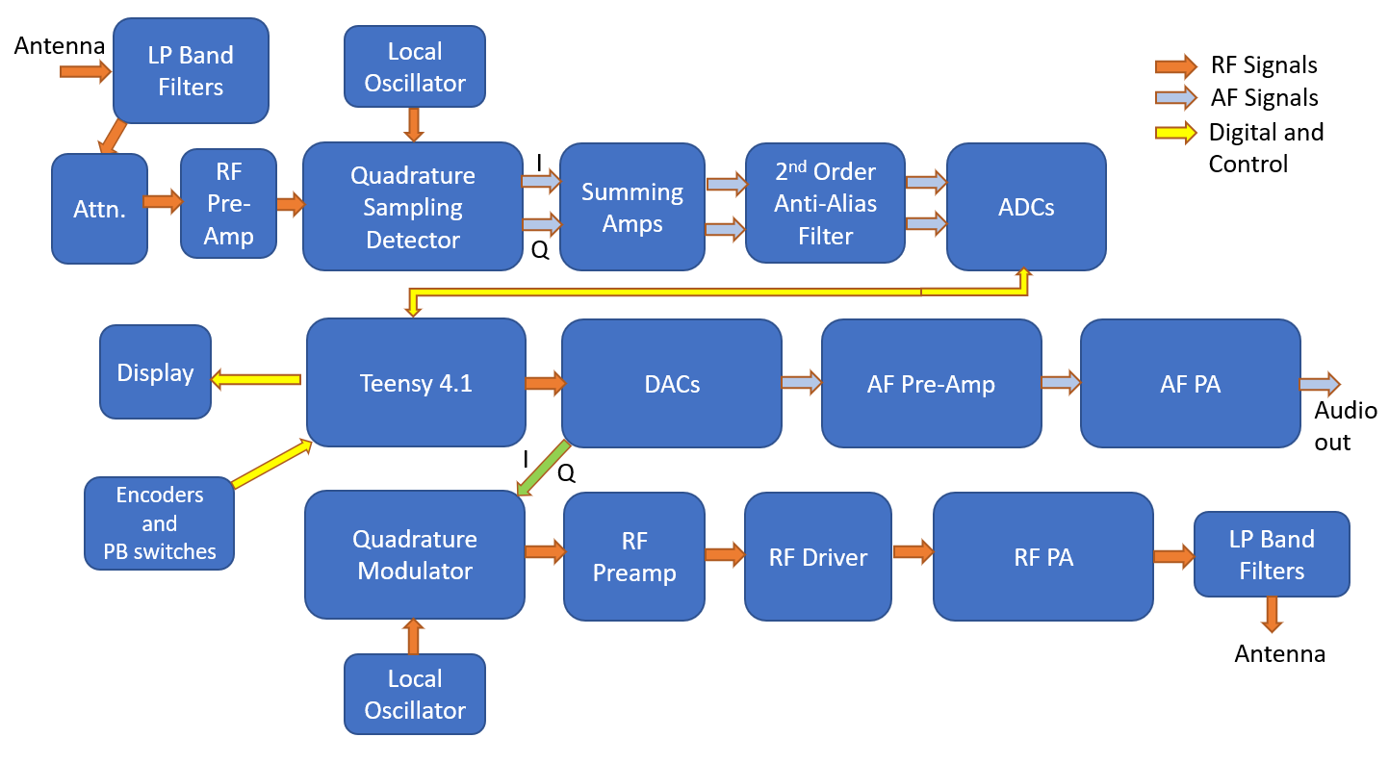
T41 SDT Block Diagram

Slide 32
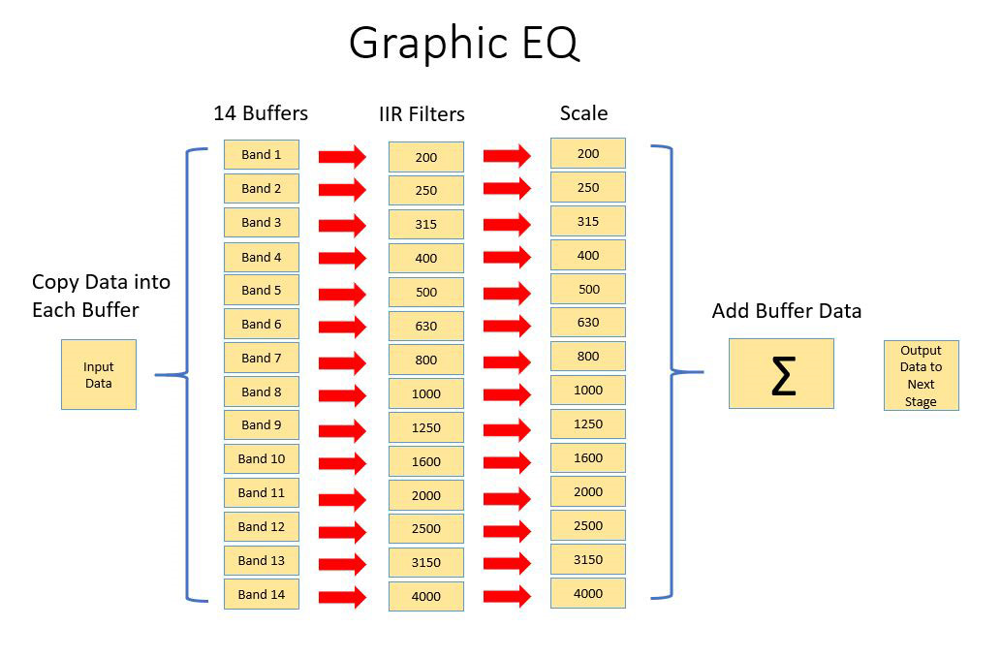
T41 SDT Block Diagram
A considerable amount of time was spent on designing those
aspects of an SDT that make it a high performance radio. For
example, the mic equalizer, not often found in less expensive
radios, uses a 14-band buffer system:

Slide 33
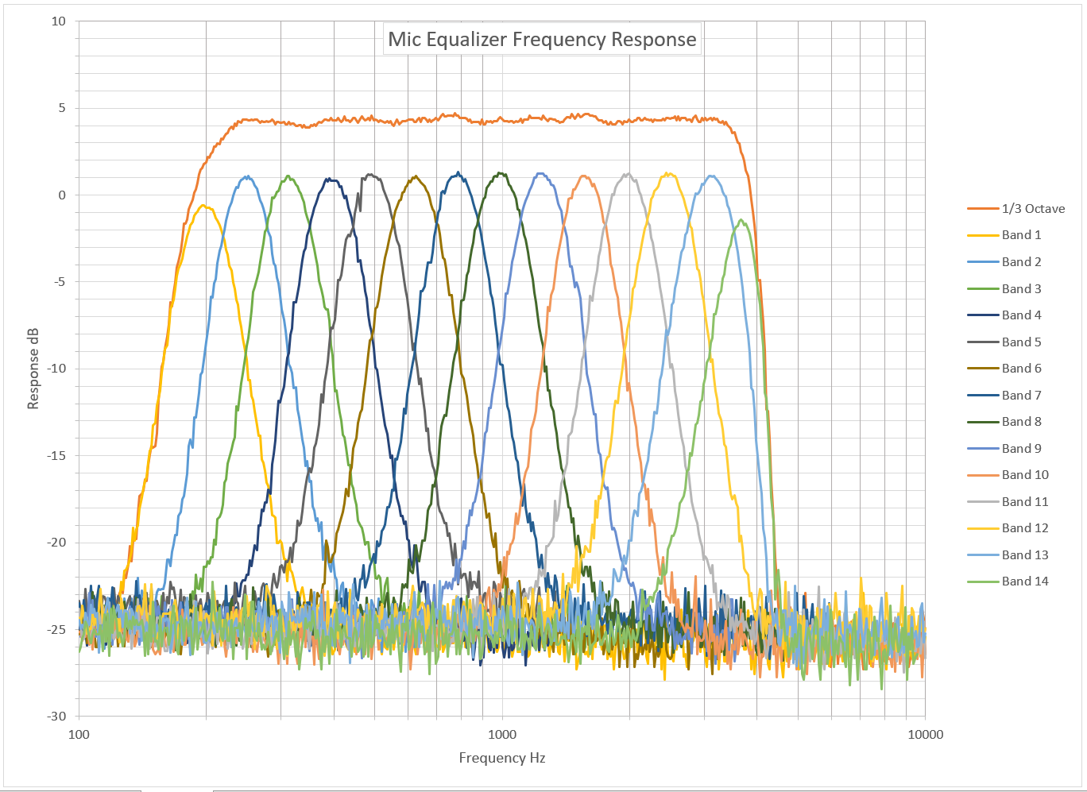
Plot of 14-band mic equalizer
Note overall flat top response and steep filter skirts.

Slide 34
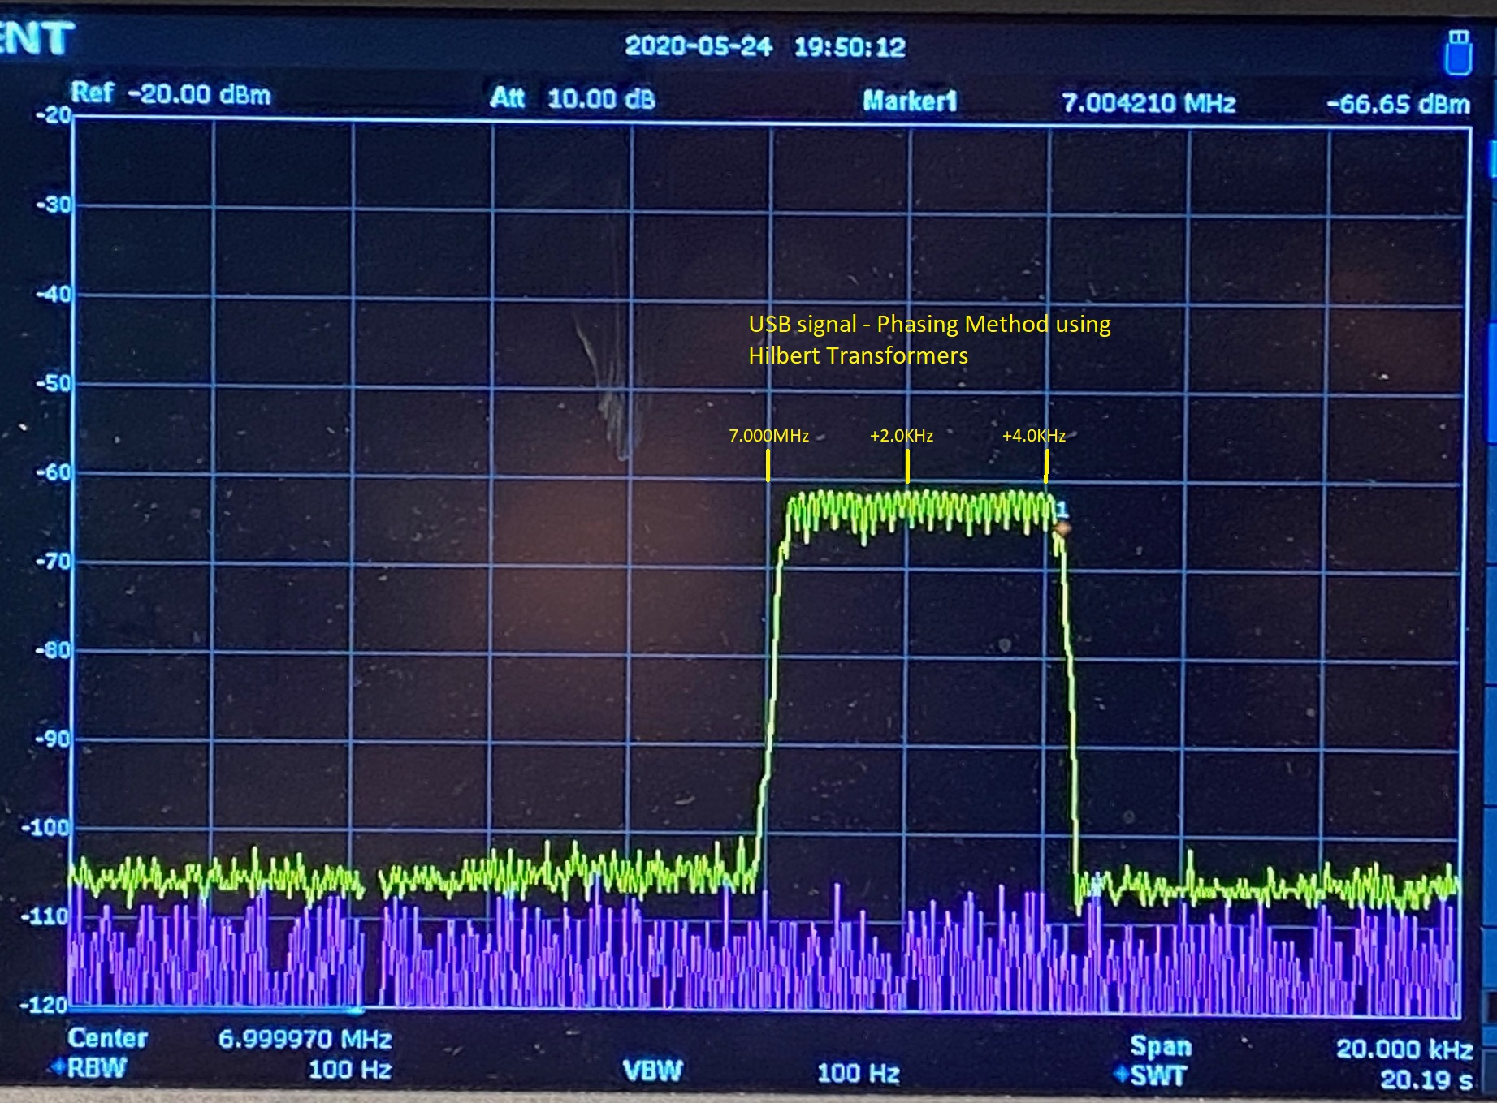
USB signal – phasing method using Hilbert Transforms
Note sharpness of skirts

Slide 35
New Algorithms
The T41-EP ALP CW Decoder
A new algorithm based on Al's decoding algorithm which includes:
1. Signal scaling and clipping

Slide 36
New Algorithms
The T41-EP ALP CW Decoder
A new algorithm based on Al's decoding algorithm which includes:
1. Signal scaling and clipping
2. Realtime historgram signal processing using
the hypergeometric mean

Slide 37
New Algorithms
The T41-EP ALP CW Decoder
A new algorithm based on Al's decoding algorithm which includes:
1. Signal scaling and clipping
2. Histogram signal processing using
hypergeometric mean
3. Correlation analysis against sine wave

Slide 38
New Algorithms
The T41-EP ALP CW Decoder
A new algorithm based on Al's decoding algorithm which includes:
1. Signal scaling and clipping
2. Histogram signal processing using
hypergeometric mean
3. Correlation analysis against sine wave
4. Goertzel Algorithm in conjunction with audio
Tuning

Slide 39
New Algorithms
The T41-EP ALP CW Decoder
A new algorithm based on Al's decoding algorithm which includes:
1. Signal scaling and clipping
2. Histogram signal processing using
hypergeometric mean
3. Correlation analysis against sine wave
4. Goertzel Algorithm in conjunction with audio
Tuning
5. Binary search tree for fast character lookup

Slide 40
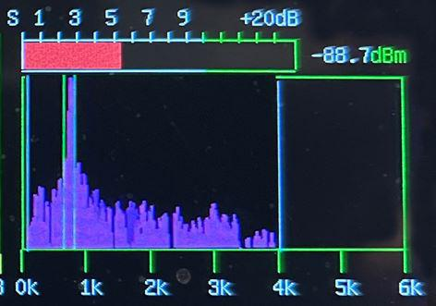
The Goertzel algorithm can perform tone detection using much less CPU horsepower than the Fast Fourier Transform. The algorithm requires centering the CW signal within the algorithm's band width.
Because the T41-EP has a real-time audio plot, we can display the band width as two vertical lines on the audio plot. The band is centered on 750Hz:

Slide 41
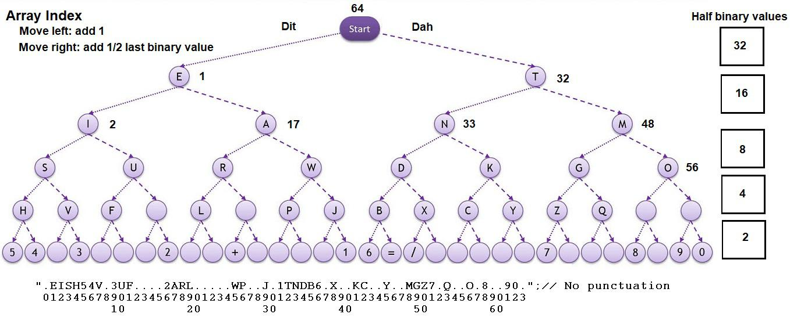
With a CW signal is within the Goertzel's band pass, use the combined ALP components to identify a dit or a dah, then use a binary search tree to decode the ASCII letter.

Slide 42
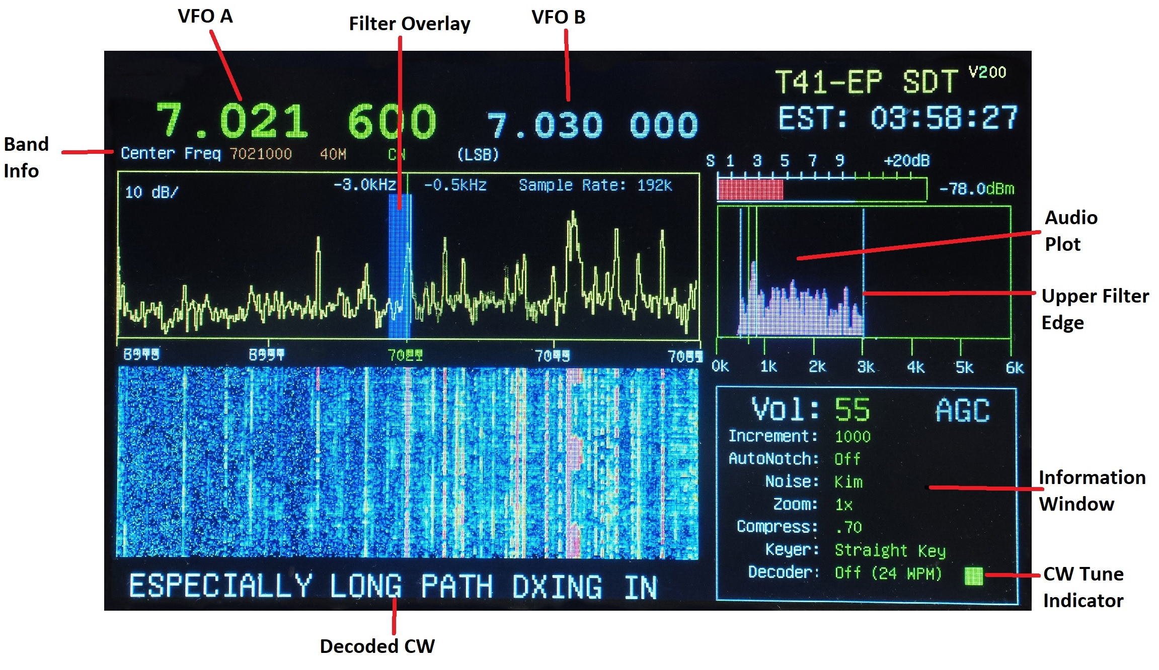
T41-EP Main Display Elements

Slide 43
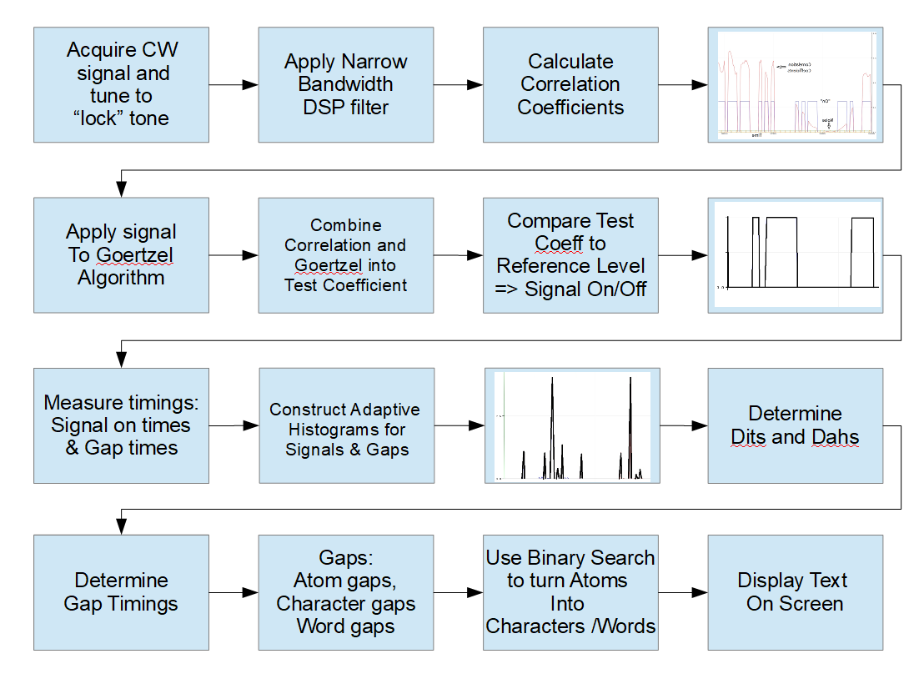
Summary of ALP CW Decoder:

Slide 44
Al: You have a video of the decoder running. Perhaps insert it here??

Slide 45
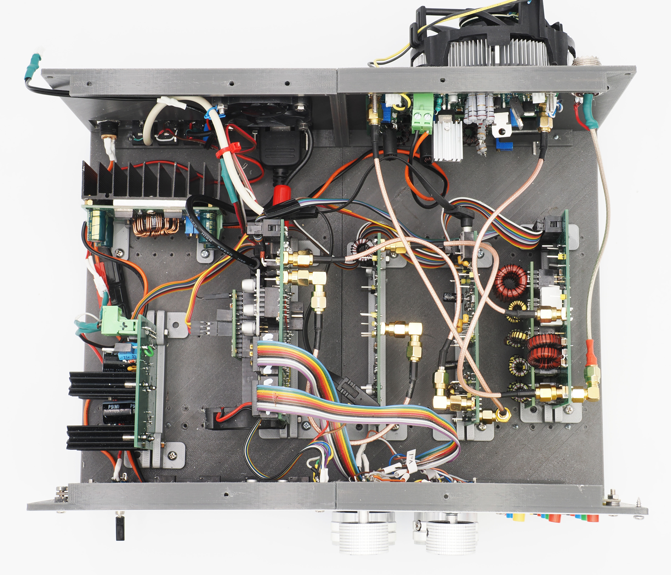
The T41-EP SDT
View of interior (V11):

Slide 46
Do any of you have a more up-to-date shot of the interior?
It doesn't have to be “working”, only a top view of the interior

Slide 47
There are a number of changes on the V12 board.
Dr. Schmidt will discuss some of the major changes

Slide 48
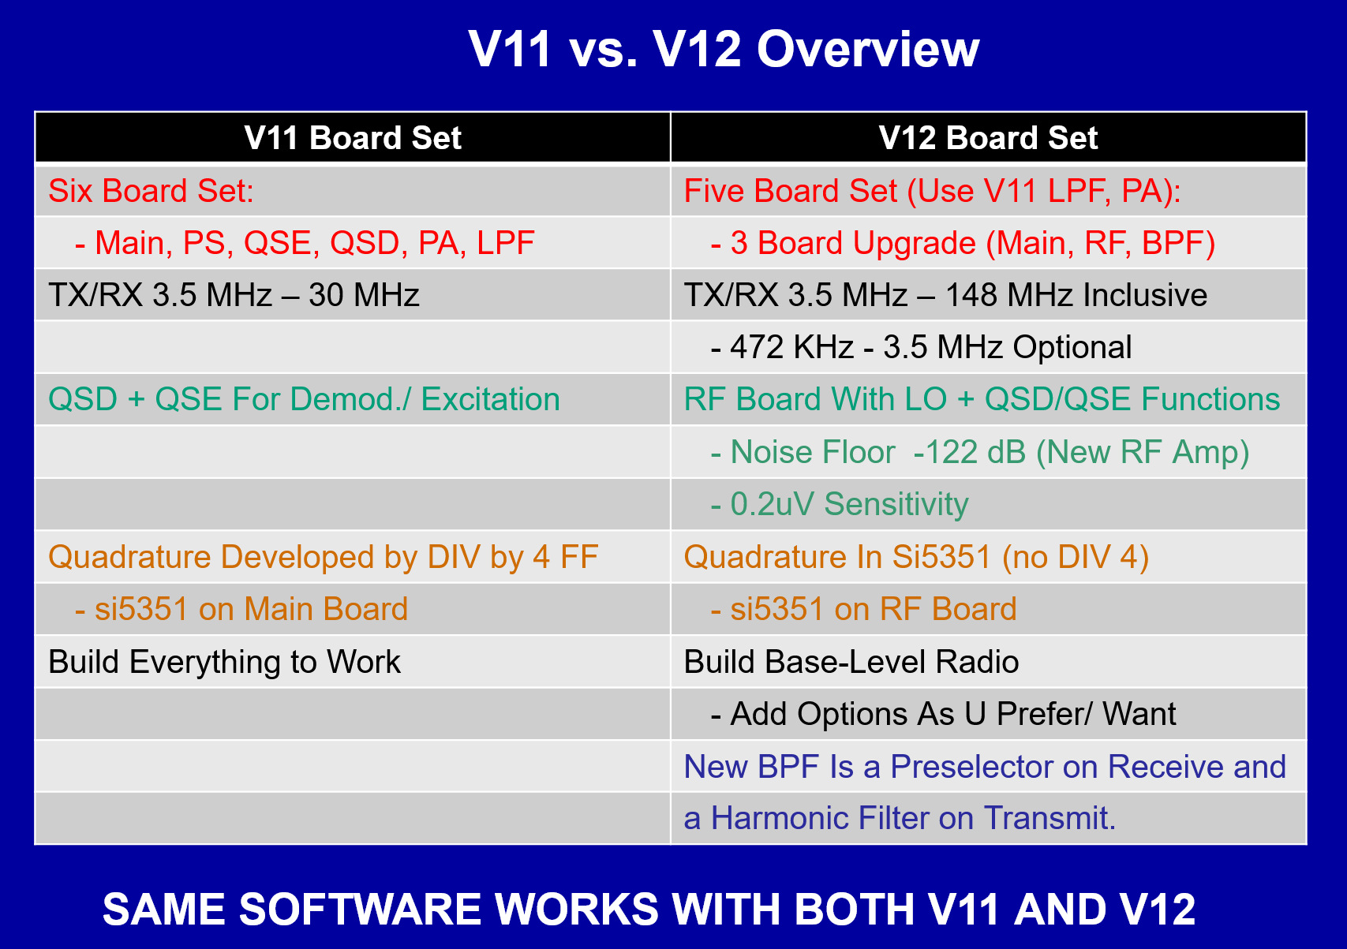

Slide 49
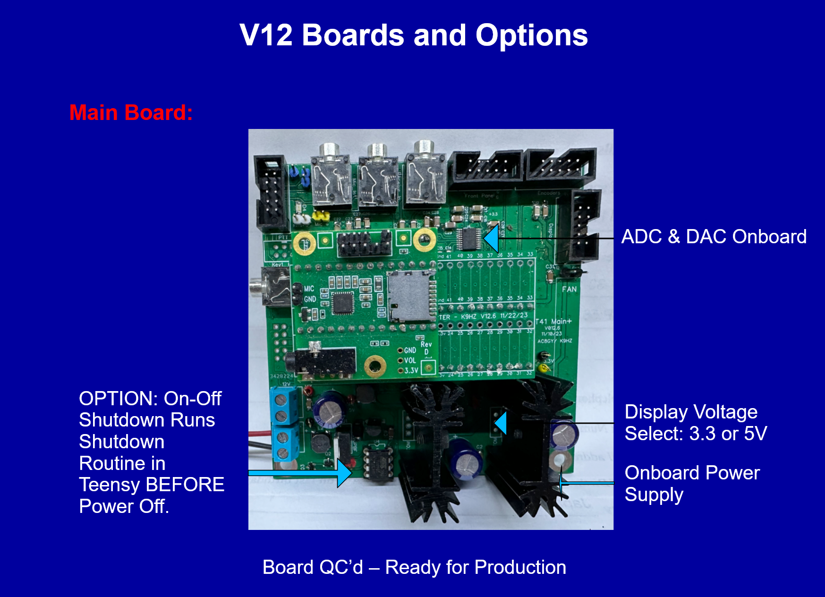

Slide 50
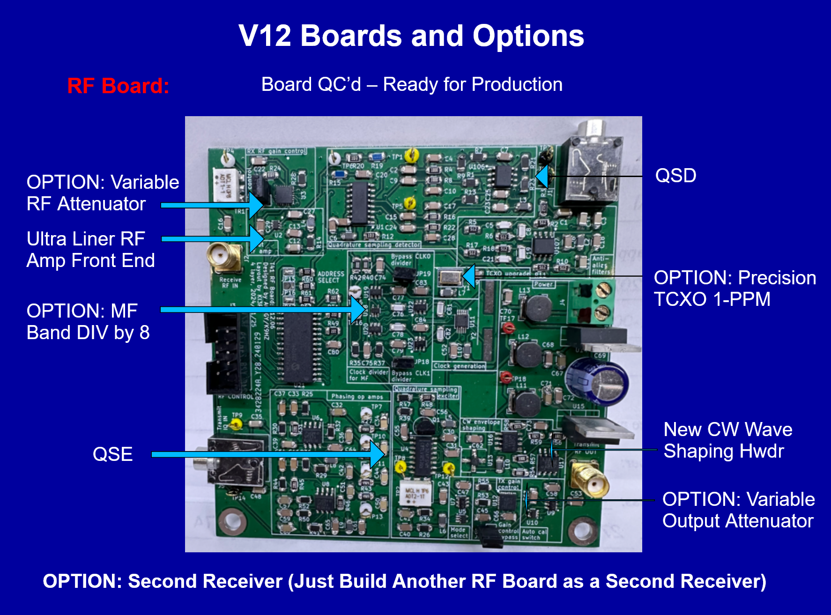

Slide 51
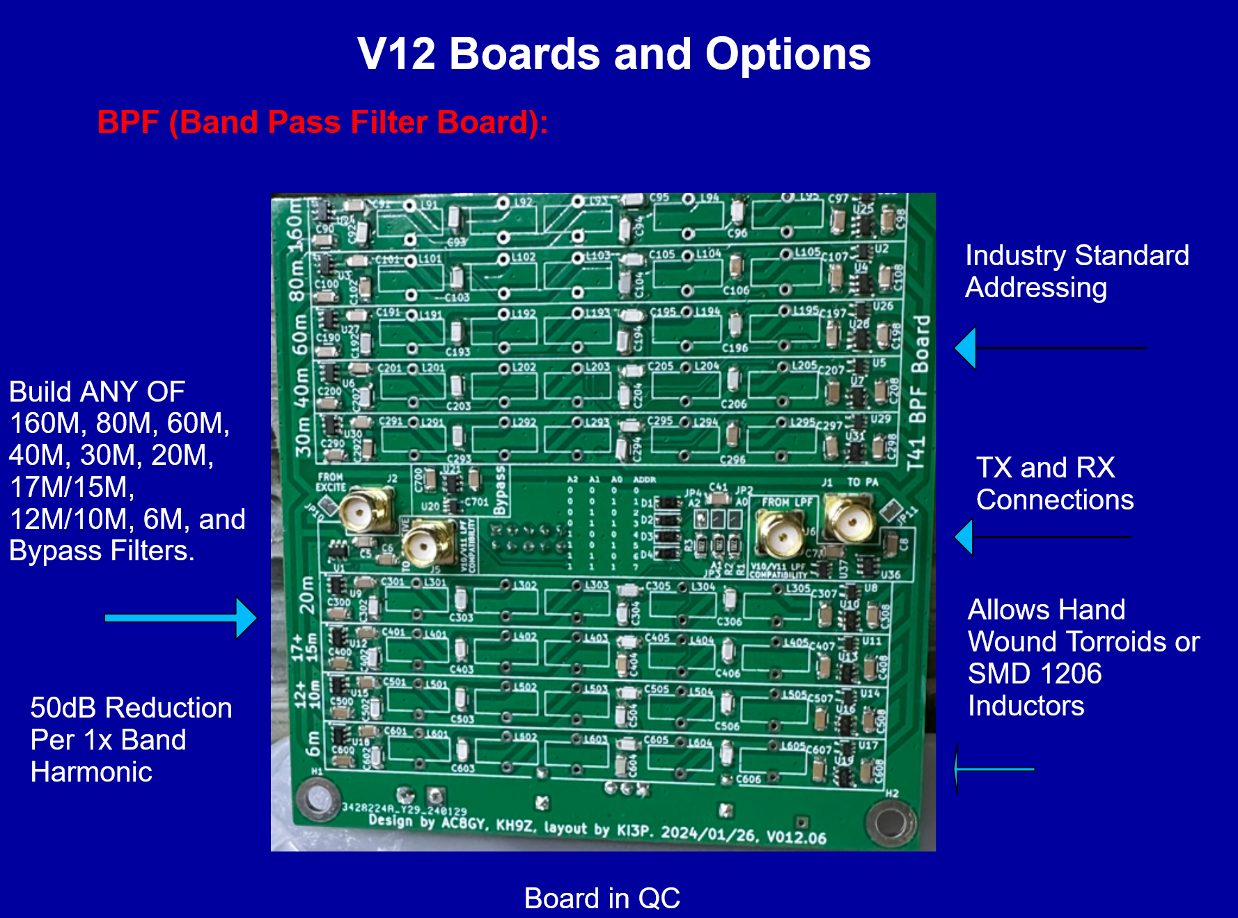

Slide 52
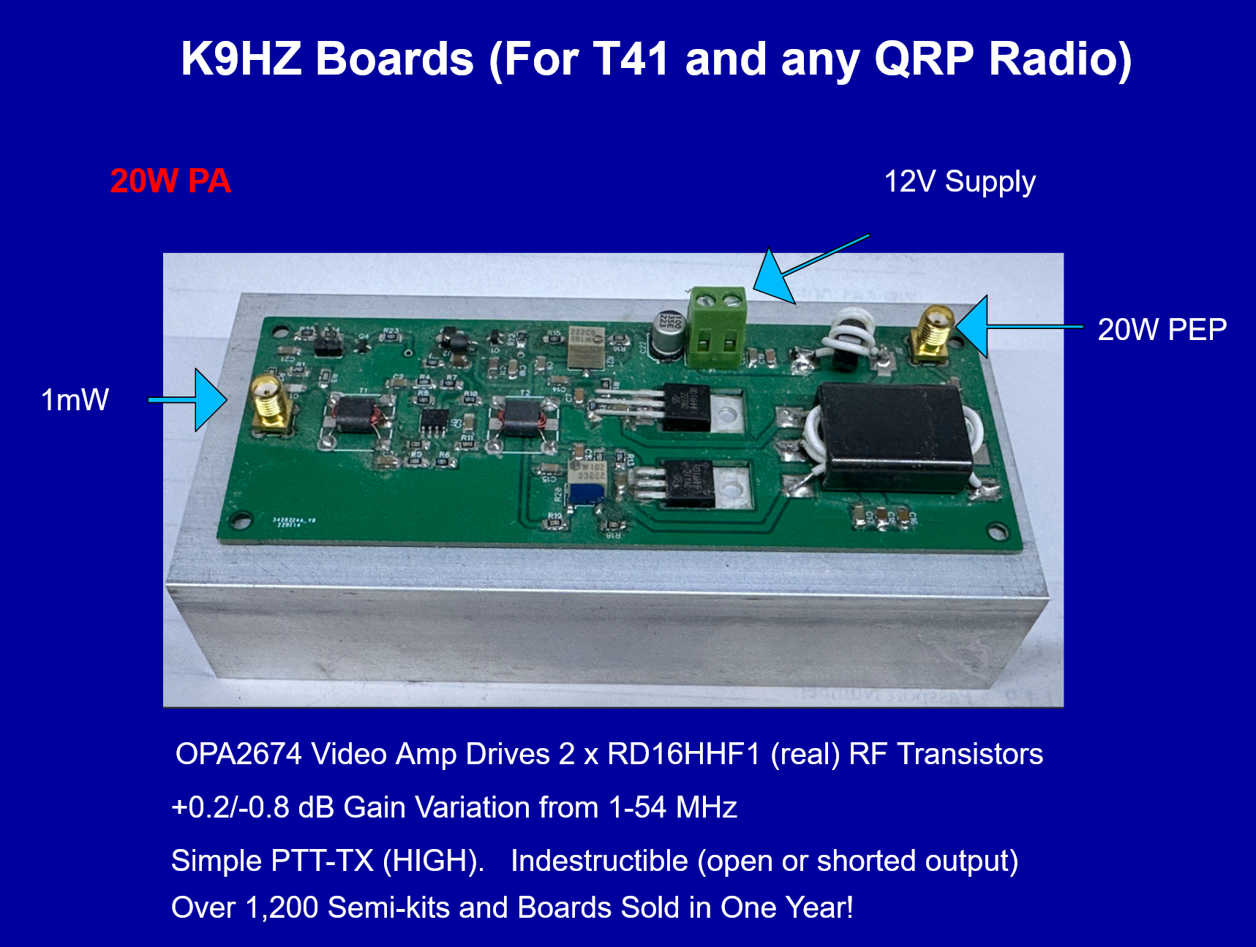

Slide 53
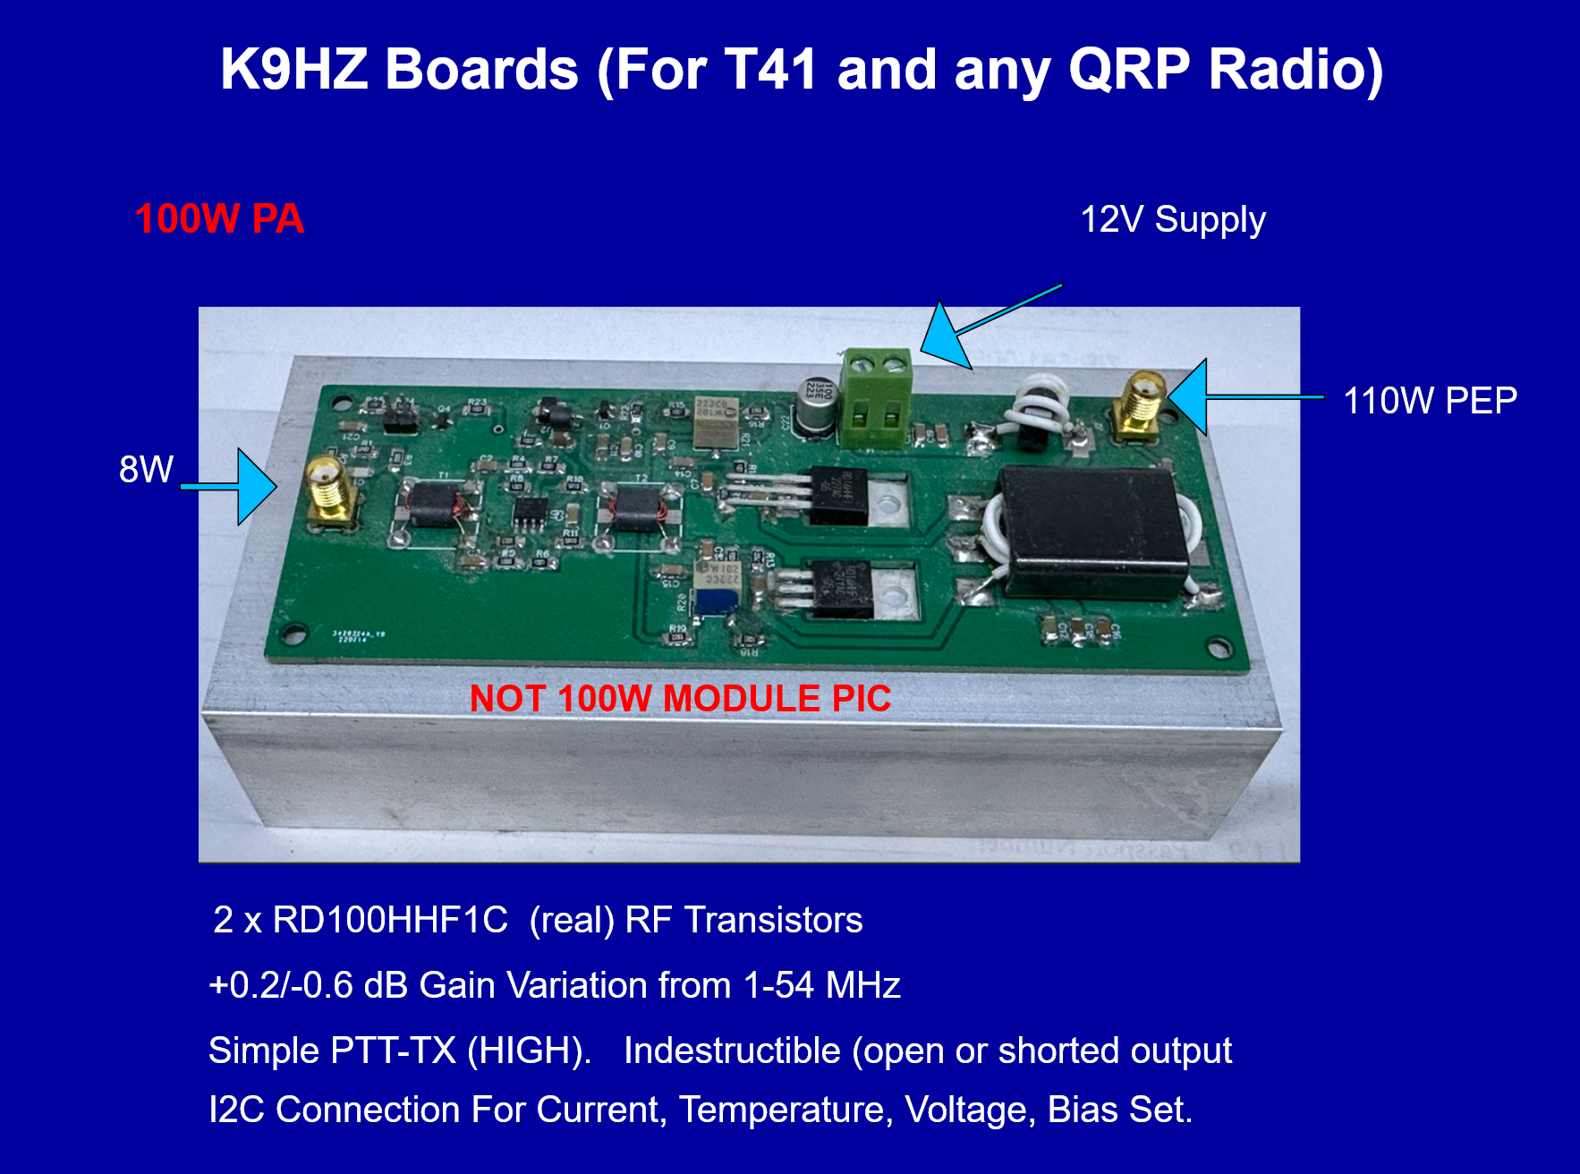

Slide 54
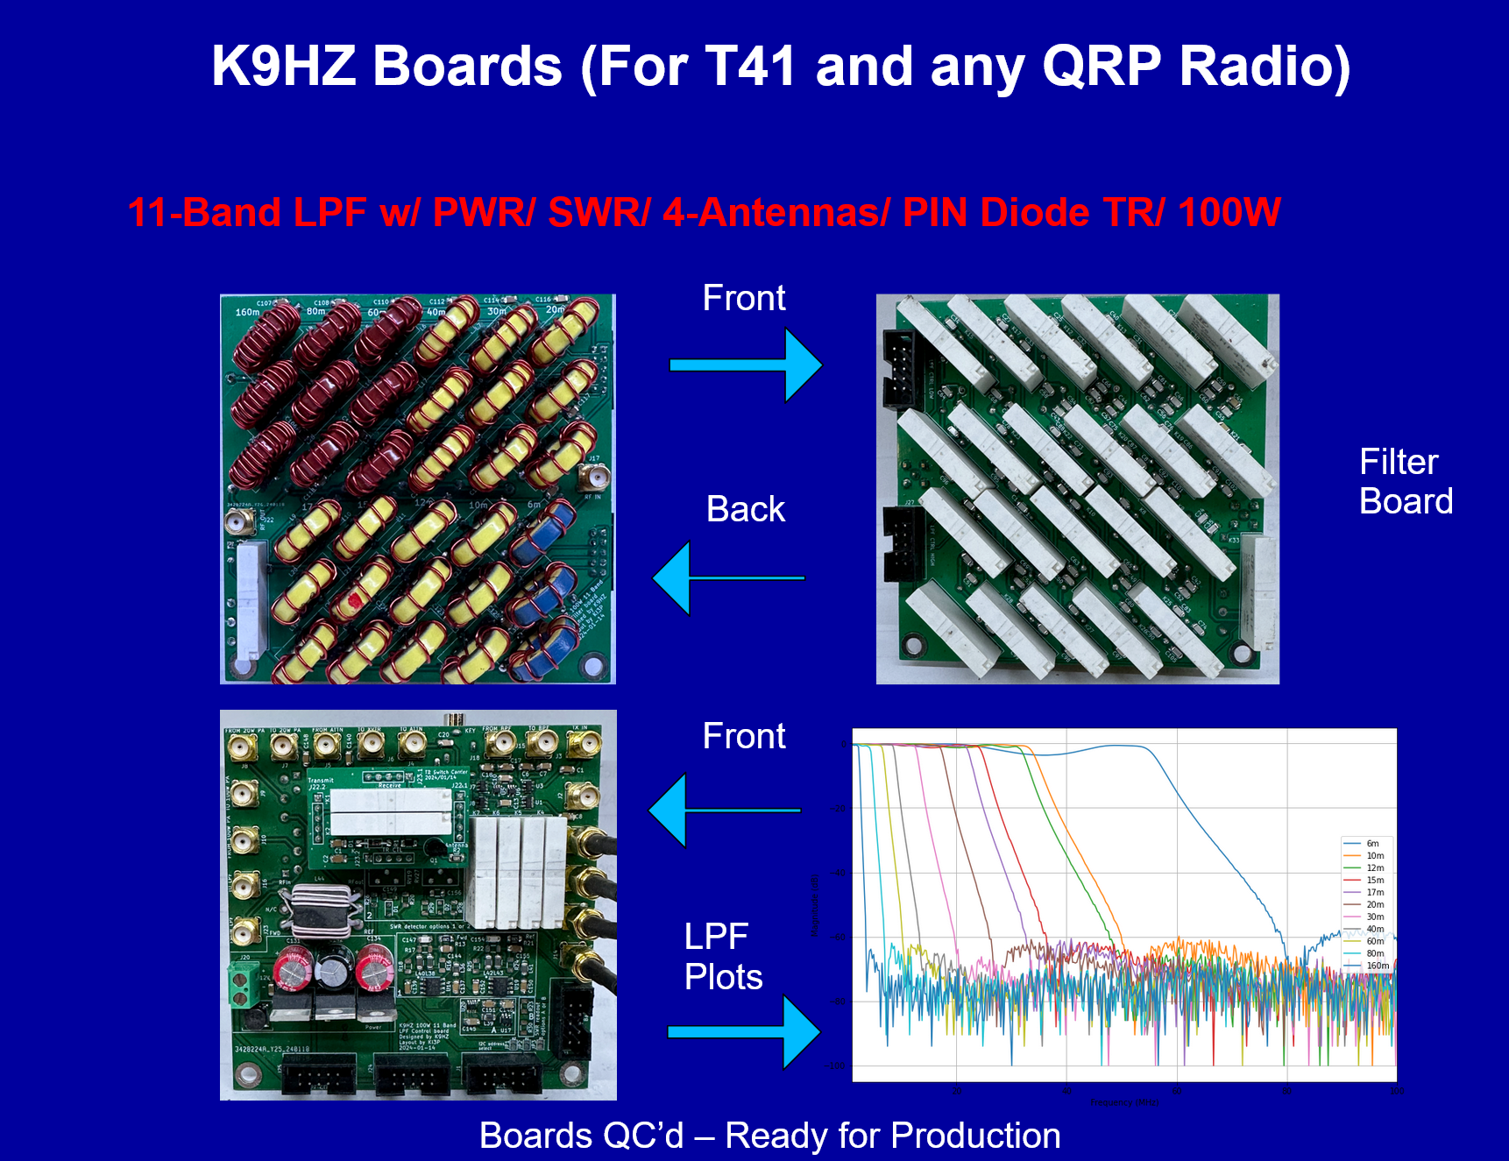

Slide 55
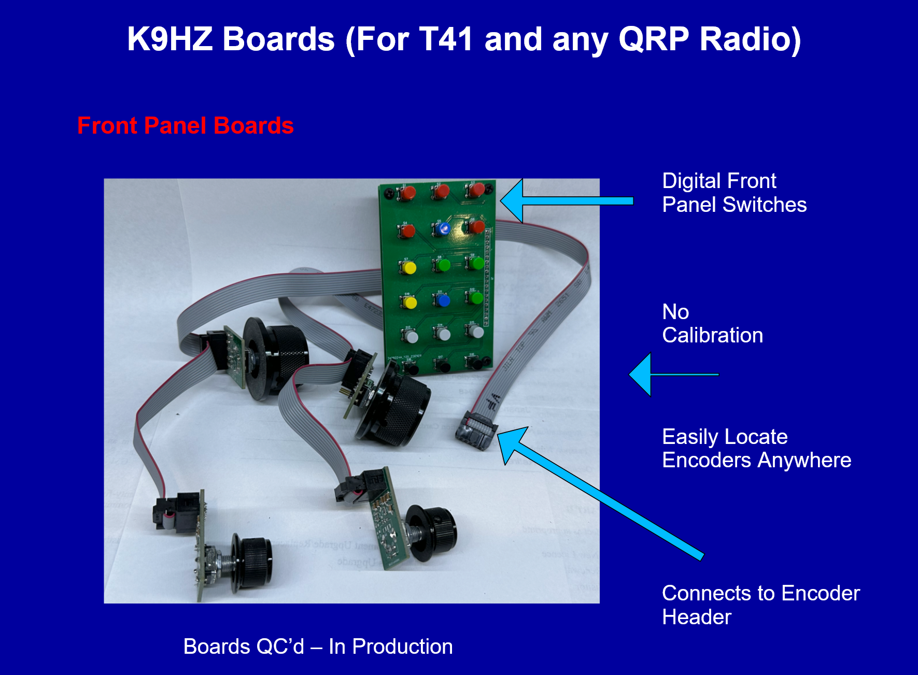

Slide 56
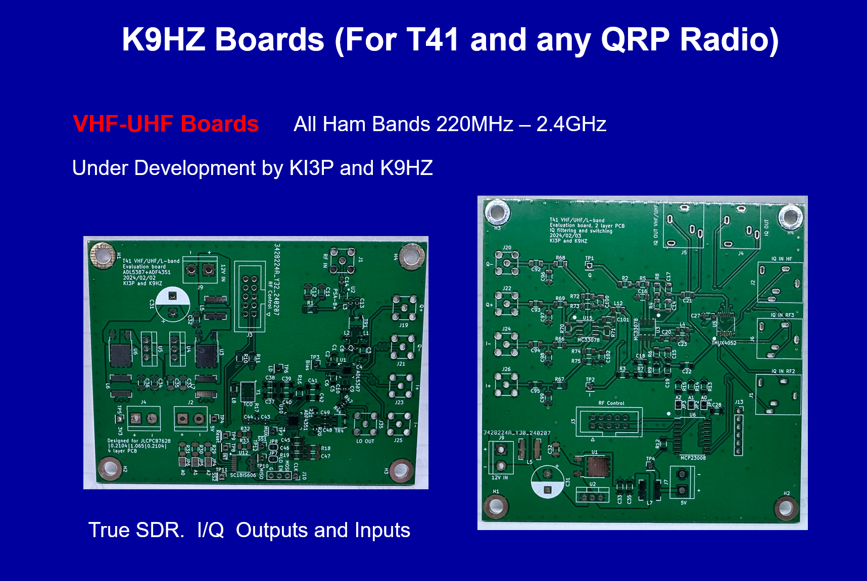

Slide 57
Greg: You might add some info about your planned changes.

Slide 58
Conclusion
We think the T41 fulfills its original design goals of
providing a high performance HF, multi-band, multi-
mode, SDR transceiver with reasonable power (20W,
upgradable to 100W) at a reasonable price. Its Open
Source pedigree and its broad resource base means
it has sufficient resources to expand to your growing
needs.

Slide 59
Questions?

