Slide 1
MyTinerary
Doyle Ravnaas
CS 5200
12/10/2014

Slide 2
Problem Statement
Planning a trip involves a lot of details
Wouldn’t it be nice to store those details?
Flights
Links
Reservations
To Do lists

Slide 3
Proposed Solution
MyTinerary allows users to store and share trip details (flights, links, reservations, to do lists)
Also uses external services to enrich/enhance user supplied information (flight arrival/departure times, business location)
Business info from Yelp
Flight details from FlightAware

Slide 4
User Scenarios
Define a new trip
Add a reservation
Add a flight
Add ToDo list items
Mark ToDo list items complete
Save links for later reference
Share view of trip details with another user
Find a trip
Notify user when flight details change
Login using Facebook authentication

Slide 5
Technology Stack
Data store = SQL Azure DB
Hosting = Tomcat on Windows (and Azure VM)
Data access layer = JPA with MSFT OpenTech JDBC driver
External service layer = Java classes for Yelp and FlightAware, converting JSON results into JPA entities
Business layer = Java server side classes
Servlet with web service endpoints (though UI uses classes directly)
UI = Javascript/Jquery JSP with a little bit of Javascript

Slide 6
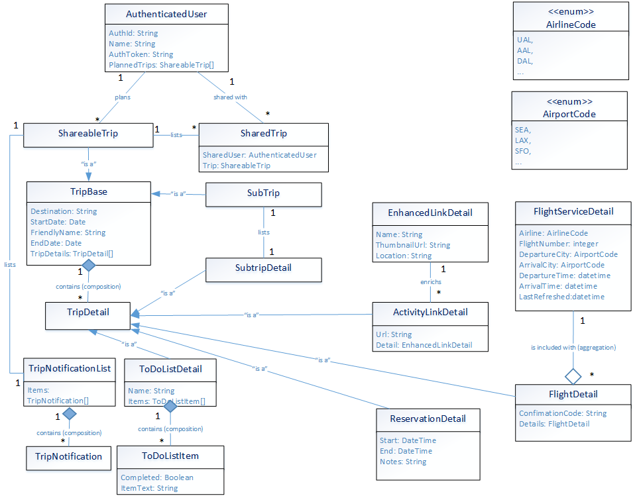
Data Model

Slide 7
Differences from original use cases & data model
Removed Service base class and derived external services
They are classes that encapsulate external service communication, but they are not part of relational model
ShareableTrip/SharedTrip/User relationship changed into mapping table
ShareableTrip now has a TripNotificationList containing 0..* TripNotifications

Slide 8
Limitations
Authentication is not “real” after initial login
UI is limited (“This isn’t a UI class”)
No validation, little error handling
Server side rendering means less responsive
Subtrips are in relational model but not exposed via DAO or UI (time limitations)
UI only allows one ToDo list per trip (but DAO allows multiple)
Edit and delete not fully implemented in UI (are implemented in DAO)

Slide 9
Project Metrics, highlights
16 JPA entities
16 SQL tables
10 Data access objects
3 External service wrappers
3 UI pages
(full metrics for rubric will be included in PDF)

