Slide 1

Live Cell Recognition and State Classification
Justin Baraboo, David Rodgers, Brendan O’Connor, Bill Capps

Slide 2
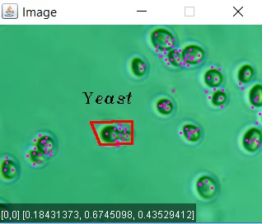
Problem
Given an image frame, can we tell
what type of cell we have and what
state of growth the cell is in?
We can have hundreds to thousands
of cells per frame and many frames
per second.

Slide 3
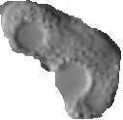



Idea
Sift Point feature classification for cell differentiation
Shape based feature for state classification
Red = Not fully implemented

Slide 4
Architecture and Workflow
sends model
Client
Kafka
Storm
MongoDB
Frame Metadata
SIFT Points
Shape Info
Relays Data
Live
Classification
Stores Model
Stores Results
Spark
File
Creates Decision Tree
For Use Cases
sends model

Slide 5
Storm Topology

Slide 6
Data Set
Trained on 1000 sift points from yeast (budding and single) and white blood cells
from about 10 images of each class.
 | sec | points | frames | runtime
white (3 vids) | 87 | 12300 | 2514 | 3:45
yeast (2 vid) | 19 | 16810 | 1268 | 3:40

Slide 7
Results
White Blood Cell Bolt
Yeast Cell Bolt
 |  | Predicted
 |  | White | NotWhite
Actual | White | 655 | 15638
 | NotWhite | 269 | 12657
 |  | Predicted
 |  | Yeast | NotYeast
Actual | Yeast | 110 | 16536
 | NotYeast | 97 | 12376

Slide 8
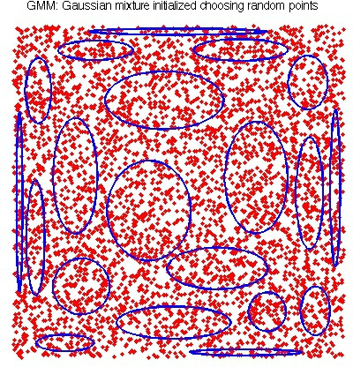
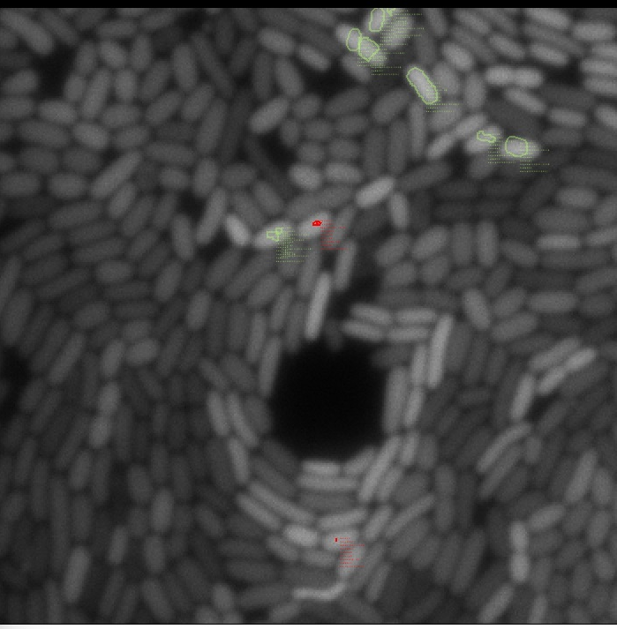
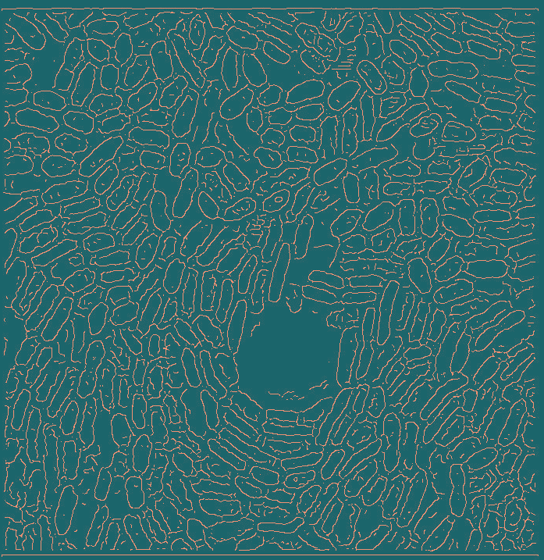
Future Work
Lineage Mapping
Implement Shape Based Features
(feature fusion is hard though)
Aggregate SIFT Points or use STIP Points
BoW, VLAD, Fisher, Super Vector
GMM Clustering
From VLFEAT
Canny Filter
of E. Coli

Slide 9
Questions?

