Slide 1
Spark: Cluster Computing with Working Sets
Justin Baraboo and David Rodgers

Slide 2
Spark
Built on top of Mesos
Map/Reduce
Good for reuse of working set of data across parallel operations:
Iterative jobs: machine learning, expectation maximization, parameter optimization
Interactive analytics

Slide 3
Spark Programming Model
Driver Program
RDDS, Parallel Operations
Shared Variables

Slide 4
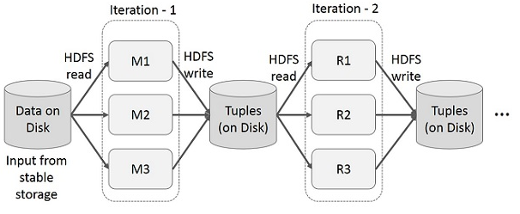
Iterative Operations in Map Reduce
Source: http://www.tutorialspoint.com/apache_spark/apache_spark_rdd.htm

Slide 5
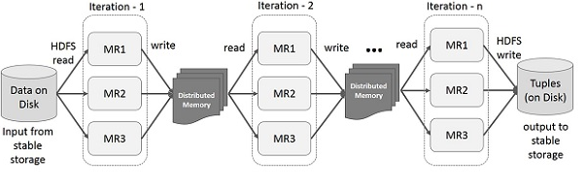
Iterative Operations in Spark
Source: http://www.tutorialspoint.com/apache_spark/apache_spark_rdd.htm

Slide 6
RDDS
Resilient Distributed Dataset
Fault tolerant, Partitioned across multiple machines, data
How to create:
File: sc.textFile(/*filelocation*/)
Parallelizing: sc.parallelize( /*list*/)
Transform RDD: rdd.map(), rdd.flatMap(), rdd.filter()
Changing persistence: rdd.cache(), rdd.saveAsTextFile()

Slide 7
Parallel Operations
Reduce: combines dataset elements using associative function
Collect: sends all elements of the data set to driver program.
Foreach: passes each element through a function

Slide 8
RDD Interface Implementation
getPartitions – returns a list of partition IDs
getIterator(partition)- iterates over a partition
getPreferredLocations(partitions)- task scheduling to achieve data locality
When a parallel operation is invoked, Spark creates a task to send to worker nodes.
Different RDDS differ only in how they implement RDD interface.

Slide 9
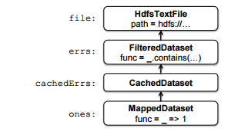
Fault Tolerance
RDDs can be reconstructed if node fails. A handle to an RDD contains enough information to compute the RDD from data in reliable storage.
Lineage
Datasets are stored in a chain of objects where each dataset object contains a pointer to its parent and information about how the parent was transformed.

Slide 10
RDD as an abstraction of Distributed Shared Memory
RDDs are like Distributed Shared Memory BUT
RDDs have a much more restricted programming model that allows for fault tolerance without having to checkpoint.
RDDs push computation to the data rather than letting arbitrary nodes access global address space.

Slide 11
Cluster Computing Frameworks
Issue: Extending MapReduce to support iterative jobs
Twister’s MapReduce framework
Allows long-lived map tasks to keep static data in memory between jobs
No fault tolerance implemented
Only one Map and one Reduce function
Spark’s RDDs
Multiple RDDs, alternating among them to run operations
Fault tolerant
Broadcast variables, reusability across parallel operations

Slide 12
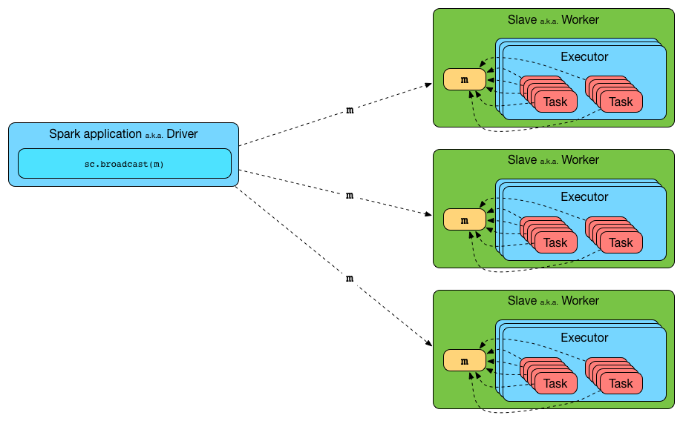
Shared Variables: Broadcast Variables
https://jaceklaskowski.gitbooks.io/mastering-apache-spark/content/spark-broadcast.html

Slide 13
Shared Variables: Accumulators
Each accumulator given a unique ID upon creation
On workers, separate copy of accumulator is created
Resets to 0 when task begins
Worker sends message to driver program containing updates made to various accumulators
Driver applies updates from each partition only once to prevent double counting

Slide 14
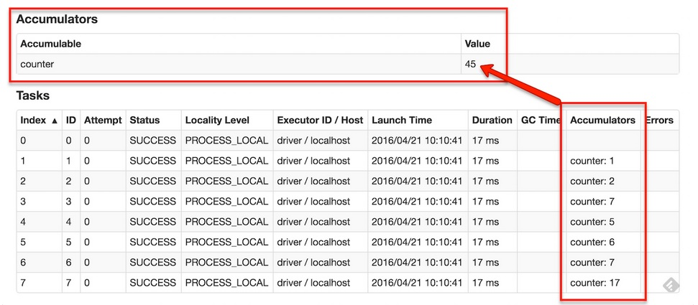
Shared Variables: Accumulators
https://jaceklaskowski.gitbooks.io/mastering-apache-spark/content/spark-accumulators.html

Slide 15
Spark Examples: Text Search
errs and ones are never materialized
val cachedErrs = errs.Cache()
- Enables parallel operations
val file = spark.textFile("hdfs://...")
val errs = file.filter(_.contains("ERROR"))
val ones = errs.map(_ => 1)
val count = ones.reduce(_+_)

Slide 16
Spark Examples: Logistic Regression
// Read points from a text file and cache them
val points = spark.textFile(...)
.map(parsePoint).cache()
// Initialize w to random D-dimensional vector
var w = Vector.random(D)
// Run multiple iterations to update w
for (i <- 1 to ITERATIONS) {
val grad = spark.accumulator(new Vector(D))
for (p <- points) { // Runs in parallel
val s = (1/(1+exp(-p.y*(w dot p.x)))-1)*p.y
grad += s*p.x
}
w -= grad.value
}
Syntax: “for” key word in Scala invokes “foreach” method of collection
for(p <- points) { body } = points.foreach(p => {body})
Accumulator to sum the variable gradient

Slide 17
Spark Examples: Alternating Least Squares (ALS)
val Rb = spark.broadcast(R)
for (i <- 1 to ITERATIONS) {
U = spark.parallelize(0 until u)
.map(j => updateUser(j, Rb, M))
.collect()
M = spark.parallelize(0 until m)
.map(j => updateUser(j, Rb, U))
.collect()
}
CPU intensive vs data-intensive
Parallelization of different users and movies on each node
R as a broadcast variable
- Prevents resending matrix R on each step

Slide 18
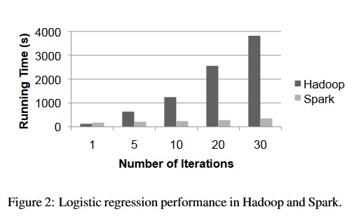
Results: Logistic Regression
29 GB Dataset
Spark: 10x faster
Crashing a node:
21% (50 seconds) slow-down for 10 iteration case
High recovery time; 12blocks/node
Smaller blocks = faster recovery

Slide 19
Results: Alternating Least Squares
Without broadcast variables:
Job time took up mostly by time spent resending rating matrix R
Time increases linearly with more nodes with naïve implementation of broadcast (e.g., HDFS)
Application-level multicast system helps, but resending R still costly
Caching R in memory on workers with a broadcast variable:
~3x improved performance

Slide 20
Questions?

