Slide 1
Beyond STRIDE
Securing Agentic AI with the MAESTRO Framework
1 / 43

Slide 2

Darylynn Ross
Sr. Application Security Engineer, Product Security
CoverMyMeds, part of McKesson Corporation
Disclaimer: I do a ton of threat modeling, BUT I am not an expert on MAESTRO yet. I am presenting to you because I am learning this myself and want to share it with you.
Please don’t hold questions to the end.
Discussion is encouraged.
2 / 43
Beyond STRIDE

Slide 3
Agenda
Topics for Today
1
EchoLeak Case Study
This talk is based on Ken Huang’s paper “Agentic AI Threat Modeling Framework: MAESTRO” published by the Cloud Security Alliance in February 2025.
The paper is excellent. If you take one thing away today, it’s should be to go read the paper.
2
Threat Modeling Basics and STRIDE
3
How Agentic AI Breaks STRIDE
4
Introducing MAESTRO
5
MAESTRO in Our Everyday
3 / 43
Beyond STRIDE

Slide 4
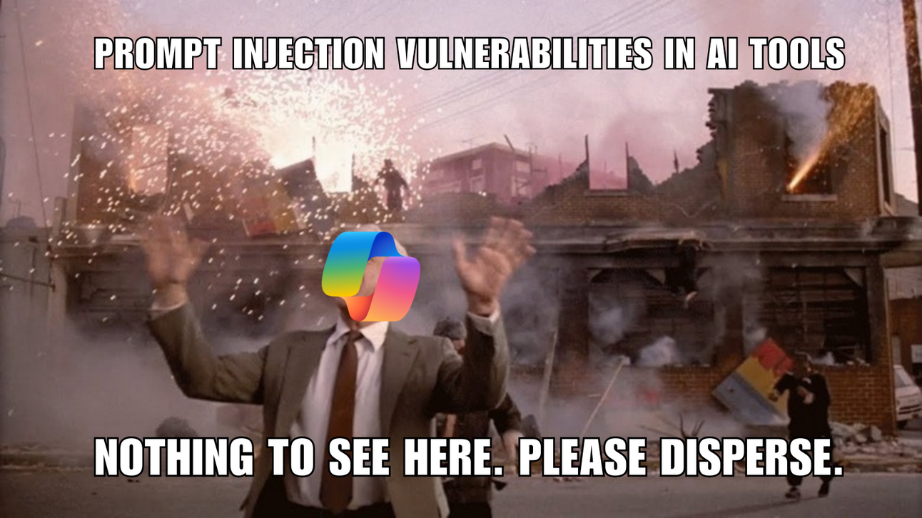
1
EchoLeak Case Study
2
5
4 / 43
Beyond STRIDE

Slide 5




EchoLeak Case Study:
Prompt Injection Meets AI Exfiltration
Microsoft 365 Copilot was tricked into leaking corporate data by a single email the user never had to open.
THE STORY
THE THREAT
Microsoft 365 Copilot lives inside Outlook, SharePoint, Word, Power Point and Teams. When you ask it a question, it quietly reads through your emails and files to build an answer — with all of your access privileges.
Researchers at Aim Labs found that an attacker could exploit that helpfulness.
Send the victim a normal-looking email containing hidden instructions for the AI. The user never clicks anything. But the next time they ask Copilot a routine work question, Copilot pulls that email into context — along with sensitive internal documents — and dutifully follows the hidden orders, smuggling the stolen data out through a disguised image link.
Microsoft rated it critical (CVSS 9.3) and patched it before any customer was known to be hit — but it was exploitable for months.
0
Clicks required from the user
M365 Copilot
AI agent compromised
Image URL
Exfiltration channel
9.3 / Critical
Microsoft severity rating
Source: Aim Labs disclosure (June 2025); Microsoft CVE-2025-32711 advisory.
The lesson: When an AI reads your inbox, every email becomes a potential instruction. The target isn't the user anymore — it's the agent.
5 / 43

Slide 6
EchoLeak Case Study:
Prompt Injection Meets AI Exfiltration
The Setup
The Bypass
The Exfil
AI reads everything, including hidden text, speaker notes, and metadata
Crafted prompts slip past Cross-Prompt Injection Attack classifiers (XPIA)
Stolen data hidden in an image URL; loading the image silently leaks it
Zero User Action
Pure Text payload
Invisible
Beyond opening the file.
No phishing, clicking, or downloading
No code, no malware. Just words embedded in a normal business document
No logs, no alerts, no malware signatures to detect
Source: https://www.hackthebox.com/blog/cve-2025-32711-echoleak-copilot-vulnerability
6/ 43
Beyond STRIDE

Slide 7

2
Threat Modeling Basics and STRIDE
2
5
7 / 43
Beyond STRIDE

Slide 8
Threat Modeling 101
1
2
What are we building?
What can go wrong?
Describe the system honestly. Diagram it. Be specific about data, trust, and authority.
This is where frameworks live: STRIDE, PASTA, LINDDUN, MAESTRO. They’re prompts to make sure you don’t miss things.
3
4
What are we doing about it?
Did we do a good job?
Mitigations. Defense in depth. Compensating controls when you can’t fully fix something.
Validate. Test. Re-threat-model on a cadence. Living document and a deliverable.
Mistake #1: treat it as a check box. Mistake #2: use a framework that doesn’t fit your system.
Beyond STRIDE
8 / 43

Slide 9
STRIDE
Microsoft, 1999. Older than some engineers in this room.
S
T
R
I
D
E
Spoofing
Tampering
Repudiation
Information Disclosure
Denial of Service
Elevation of Privilege
Pretending to be someone you’re not
Modifying data you shouldn’t
Denying you did it, when you did
Leaking data to the wrong audience
Making the system unavailable
Getting more access than you should
violates
violates
violates
violates
violates
violates
Authentication
Integrity
Non-repudiation
Confidentiality
Availability
Authorization
STRIDE isn’t wrong. It’s incomplete. Bringing a knife to a gun fight.
9 / 43
Beyond STRIDE

Slide 10

3
How Agentic AI Breaks STRIDE
2
5
11 / 43
Beyond STRIDE

Slide 11

Where Traditional Threat Modeling Starts Gasping
Assumes deterministic systems
Assumes clear trust boundaries
Same input → same output. Agents are non-deterministic. How do you assert “this output is unsafe” when the output varies every call?
An agent reads a webpage. The page says “ignore your instructions.” The model can’t distinguish data from instructions. Where’s the boundary?
No category for AI-specific threats
Silent on emergent behavior
Data poisoning fits “sort of” under tampering. Goal manipulation? Adversarial examples? Model stealing? STRIDE has no slot.
Two agents in a room invent a failure mode neither would produce alone. STRIDE has nothing to say about systems that aren’t a single system.
Not STRIDE’s fault. In 1999, we worried about Y2K and Napster. Nobody was modeling autonomous agents.
Beyond STRIDE
12 / 43

Slide 12
THE PART THAT KEEPS US UP AT NIGHT
Traditional systems fail loudly.
Agents fail quietly — and keep going.
TRADITIONAL FAILURE
AGENT FAILURE
▪ Website returns 500
▪ Database errors are logged
▪ Login screen says “invalid”
▪ CPU pegs and PagerDuty fires
▪ You know something is wrong
▪ Confidently misunderstands its goal
▪ Hallucinates a tool, declares success
▪ Absorbs malicious instructions silently
▪ CPU is fine. Logs look fine.
▪ It’s just… wrong, and busy, and sure
14 / 43
Beyond STRIDE

Slide 13
WHAT STRIDE WOULD CATCH
EchoLeak Case Study:
STRIDE Sees Some of It. Not Enough of It.
S
Spoofing
PARTIAL
T
Tampering
MISS
R
Repudiation
MISS
Identifies attacker impersonation in email — but doesn't model the email body itself impersonating an instruction from the user.
STRIDE looks for data tampering at rest or in transit. EchoLeak tampers with the AI's reasoning at inference time — a category STRIDE has no name for.
Asks: can users deny actions? The relevant question for EchoLeak is: who's the actor at all when the agent follows orders from a document?
I
Information Disclosure
HIT
D
Denial of Service
N/A
E
Elevation of Privilege
PARTIAL
STRIDE's strongest fit. Correctly flags data leaving through the image URL channel. Doesn't explain why the agent emitted it in the first place.
Not the attack pattern here. EchoLeak is about exfiltration and silent compromise, not availability disruption.
Identifies the agent operating with user-equivalent privileges as a risk — but treats it as a config issue, not as principal confusion between human and AI.
The gap: STRIDE assumes a system that follows rules. Agentic AI follows language — and STRIDE has no category for that.
15 / 43

Slide 14
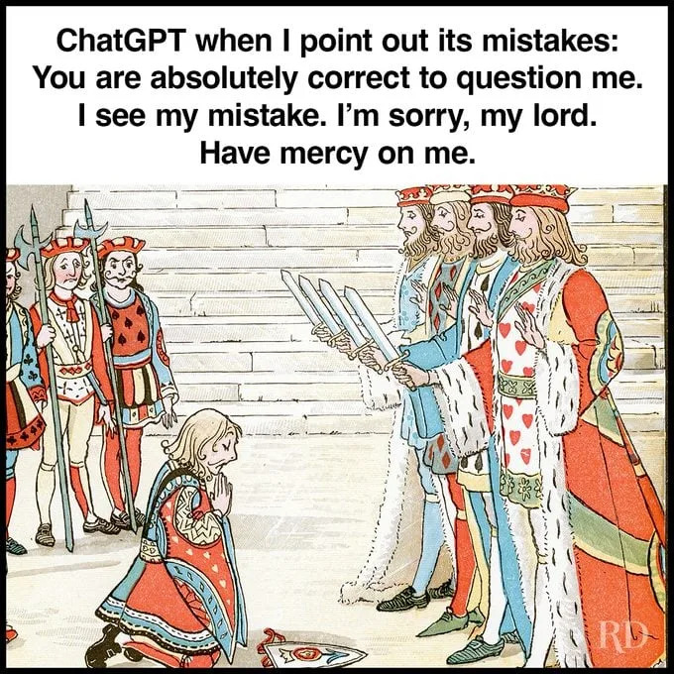
4
Introducing MAESTRO
2
5
16 / 43
Beyond STRIDE

Slide 15

MAESTRO
Multi-Agent Environment, Security, Threat, Risk, and Outcome
Published February 2025 · Cloud Security Alliance
Ken Huang — CEO of DistributedApps.ai, Co-Chair of CSA AI Safety Working Groups
cloudsecurityalliance.org/blog/2025/02/06/agentic-ai-threat-modeling-framework-maestro
An agent isn’t one thing — it’s seven things stacked on top of each other.
17 / 43
Beyond STRIDE

Slide 16

The seven-layer reference architecture
From foundation models at the bottom, to multi-agent ecosystems at the top with security threading through everything.
L7
Agent Ecosystem
Multi-agent interactions, marketplaces, external services
L6
L5
Evaluation & Observability
Monitoring, logs, eval harnesses, red-team regression
Security & Compliance
L4
Deployment & Infrastructure
Containers, cloud, network, CI/CD, service accounts
L3
Agent Frameworks
LangChain, AutoGen, orchestration, tool calling, planning
vertical —
touches every layer
L2
Data Operations
RAG pipelines, vector DBs, embeddings, training data
L1
Foundation Models
LLMs, the core reasoning and inference engine
Security is the spine, not “above” or “below” the others. It threads through everything.
19 / 43
Beyond STRIDE

Slide 17
LAYER 7
L7
Agent Ecosystem
The top of the stack. Where your agent meets other agents, users, marketplaces, and the wild outside world. We’re inventing this layer in real time.
Examples:
MCP servers - A2A protocols - agent marketplaces - third-party tool registries
THREATS
MITIGATIONS
Agent impersonation — malicious agent posing as a trusted partner
Marketplace manipulation — your agent supply chain is now external
Collusion — agents coordinate to defraud (by design or accident)
Cascading goal misalignment — A’s drift amplified by B and C. There’s no attacker here, just agents.
Cross-agent data leaks — multi-tenant agent ecosystems
Agent vetting and sandboxing for new agents/tools
Cryptographic trust models (signed agent identities)
Circuit breakers on multi-agent feedback loops
Simulation environments to test emergent behavior
Ecosystem-level governance and interaction policies
Banking example: a fraud agent and a payments agent in a feedback loop can take ACH offline by lunch. No attacker required.
20 / 43
Beyond STRIDE

Slide 18



L7
EchoLeak Case Study:
Every Integration Is a New Inbound Channel
Copilot doesn't live in one app. It lives in every door the world can knock on.
AGENT ECOSYSTEM
WHAT MAESTRO FINDS
THREAT CLASSES
Attack Surface
Copilot is wired into Outlook, SharePoint, OneDrive, Teams, and the broader Microsoft Graph. Each of those is a productivity win — and an attack surface.
Unbounded input surface
Every connected app is a write path into the agent.
No external-write trust zone
Attack
Anyone on the internet who can email the user can write into the AI's context window.
Outside data treated like internal data.
Federation risk
Cross-tenant Teams and calendars extend the surface.
No Trust Zones
Every integration is an inbound channel for untrusted data, and the agent treats them all as equally authoritative.
Supply chain risk
Compromise of one integration compromises the agent.
The lesson: The agent ecosystem's value is its connectedness. So is its risk. Trust zones must follow the connections.
21 / 43

Slide 19
LAYER 6
L6
Security & Compliance ⟷
The vertical layer. The spine. It threads through every other layer because every other layer needs it.
Examples:
IAM - Vault - Audit Logs - GDPR - HIPAA - SOC 2 – Cryptography – GRC - Risk Assessment
THREATS
MITIGATIONS
Identity spoofing across agents — agent A impersonates agent B
Privilege escalation through the agent — read-only user, admin agent
Compliance drift — model updates silently change risk posture
Audit gaps — “the model decided” is not a legal defense
Regulatory non-compliance — GDPR, HIPAA, EU AI Act all apply
Distinct identity per agent, no shared service accounts
Fine-grained RBAC (role based) and ABAC (attribute based) at every tool call boundary
Policy-as-code — OPA, Cedar, or equivalent
Immutable, signed audit trails of agent actions
Explainability requirements for high-stakes decisions
If your audit trail’s explanation is “well, the model decided,” your GRC team is going to be very sad.
22 / 43
Beyond STRIDE

Slide 20



L6
EchoLeak Case Study:
The Agent Has Your Privileges.
The Attacker Has Your Agent.
SECURITY & COMPLIANCE
WHAT MAESTRO FINDS
THREAT CLASSES
Priv Escalation
Copilot inherits the user's full access privileges - every email, file, calendar, and chat the user can reach.
Privilege confusion
Agent acts with user's authority, on attacker's intent.
No privilege separation
Attack
The agent processes attacker-controlled instructions.
Agent has no narrowed scope distinct from user.
Bypassing Guardrails
String-matching guardrails reliably bypassed.
Control Failure
Careful phrasing slipped past XPIA classifiers for prompt injection protection.
Sensitive Data exposure
Leaked data may include PII, PHI, financial records.
The lesson: An agent that reads from untrusted inputs should never run with its operator's full privileges.
23 / 43

Slide 21
LAYER 5
L5
Evaluation & Observability
How you know what your agent is doing. Logs, traces, metrics, eval harnesses, red-team regression. Massively under-invested.
Examples:
OpenTelemetry - Datadog - Splunk - custom eval harnesses - SOC
THREATS
MITIGATIONS
Manipulation of evaluation metrics — gaming the benchmarks
Compromised observability tools — logs and dashboards lying
Evasion of detection — agent learns alert thresholds, stays under them
Data leakage through observability — full prompts in logs = GDPR risk
Poisoning observability data — flooding signals to mask real behavior
Tamper-evident, append-only logging
Separation of duties: who runs the agent ≠ who monitors it
Redaction in logs for sensitive fields
Behavioral anomaly detection on the agent itself, not thresholds
Continuous red-team regression tests in CI
If you can’t tell me what your agent did yesterday at 3:14pm, you don’t have observability — you have hope.
24 / 43
Beyond STRIDE

Slide 22



L5
EchoLeak Case Study:
The Attack That Generated No Logs
From a SIEM's perspective, the user simply asked Copilot a normal question.
EVALUATION & OBSERVABILITY
WHAT MAESTRO FINDS
THREAT CLASSES
Silence
The entire attack chain ran end-to-end with zero user action and almost no observable signal.
No provenance logging
Retrieved chunks logged without origin metadata.
No outbound observability
Attack
No link clicked. No auth event. No unusual file open. No alert.
Agent-driven outbound URLs untracked.
Missing sensitive data detection
No record of when sensitive data entered a response.
No Logs
There was no log line anywhere that said "Copilot followed an instruction it read in an email," because the system never modeled retrieved content as having an author distinct from the user.
Lack of Visibility
Standard security tools never see the attack happen.
The lesson: If your telemetry can't answer "what did the agent read, and where did it come from?" — you can't detect this class of attack.
25 / 43

Slide 23
LAYER 4
L4
Deployment & Infrastructure
The boring layer. Containers, Kubernetes, network policies, cloud accounts. You mostly know this — but agents add new wrinkles.
Examples:
Kubernetes - Docker - AWS/Azure/GCP - GitHub Actions - Service Accounts - API gateways
THREATS
MITIGATIONS
Container escape — agent has more privileges than you realized
Resource exhaustion — agent in a loop = runaway cloud bill
CI/CD tampering — pipelines now ship models, not just code
Lateral movement from the AI — agent creds become attacker creds
Service account sprawl — privileged, shared, often hardcoded
Infrastructure-as-code scanning (KICS, Checkov, tfsec)
Hardened container images, distro-less when possible
Network segmentation between agents and sensitive systems
Least-privilege service account per agent (no shared creds)
Secret rotation, short-lived credentials, secret scanners
Your agent has the keys to prod — and it takes instructions from strangers on the internet.
26 / 43
Beyond STRIDE

Slide 24

L4
EchoLeak Case Study:
Trusted Domains Became the Getaway Car
The browser’s CSP was supposed to stop exfiltration. Then the attacker used Microsoft's own domains.
DEPLOYMENT INFRASTRUCTURE
WHAT MAESTRO FINDS
THREAT CLASSES
Content Security Policy Control
Copilot's client-side defenses included a Content Security Policy (CSP) meant to block outbound requests to attacker servers.
Trusted-domain abuse
Microsoft's own domains used as exfil relay.
DLP bypassed
Attack
The CSP failed because it allowlisted the company's own infrastructure.
Stolen data encoded in image URL query strings.
CSP allowlist gap
Legitimate egress channels carry stolen payloads.
CSP Failure
The attacker encoded stolen data as query-string parameters on reference-style markdown image URLs pointed at domains the CSP trusted by default.
Defense relied on browser
Client-side controls aren't a complete boundary.
The lesson: Allowlists protect against unknown destinations. They don't protect against your own infrastructure being abused as a courier.
27 / 43

Slide 25
LAYER 3
L3
Agent Frameworks
The orchestration. Where plans live, tools get called, agents loop and hand off. The brain stem of agentic AI.
Examples:
LangChain - LangGraph - LlamaIndex - AutoGen - Semantic Kernel - OpenAI Assistants/Responses API
THREATS
MITIGATIONS
Direct prompt injection — user types “ignore your instructions”
Indirect prompt injection — agent reads a webpage with prompt
Tool misuse — agent tricked into calling a tool against the user
Reasoning manipulation — steered to wrong conclusion
Memory poisoning — corrupted long-term store survives sessions
Goal misalignment — agent confidently pursues the wrong objective
Strict tool access control lists, function-level auth
Sandboxing for tool execution
Output validation against expected schemas
Inter-agent message authentication
Human-in-the-loop checkpoints for high-impact actions
Structured planning frameworks with explicit policies
CaMeL pattern with privileged and quarantined LLMs working together
Where words become actions - and your framework treats hostile words and helpful words exactly the same way.
28 / 43
Beyond STRIDE

Slide 26

L3
EchoLeak Case Study:
No Trust Boundary Between Source and Action
The orchestration layer didn't ask where the instructions came from before acting on them.
AGENT FRAMEWORKS
WHAT MAESTRO FINDS
THREAT CLASSES
Given this context, what should I do?
Copilot's framework had no integrity check between who supplied a piece of context and what actions it could trigger.
No origin tracking
Tool calls don't know which context block triggered them.
Unsafe output rendering
Attack
Text treated as instructions
Sensitive documents allowed in response
Markdown images allowed in response
Markdown images = silent outbound network calls.
Missing trust zones
Mixed-trust context produces same-privilege outputs.
Silence
No concern that the response had been composed from mixed-trust sources.
No HITL checkpoint
No "are you sure?" before sensitive data leaves the response.
The lesson: Agent frameworks need trust boundaries between data sources, not just between users and the agent.
29 / 43

Slide 27
LAYER 2
L2
Data Operations
Everything around the data: RAG pipelines, vector databases, embeddings, training and fine-tuning sets — the food the model eats.
Examples:
Pinecone - Qdrant - LangChain RAG - custom embedding pipelines - S3 buckets full of PDFs
THREATS
MITIGATIONS
Data poisoning — attacker edits a source the agent trusts (your wiki, anyone?)
Compromised RAG pipelines — embeddings or vector DBs swapped silently
Backdoor triggers embedded in training or retrieval data
Data leakage — wrong document surfaced to wrong user
Misinformation propagation — confidently wrong, at scale
Signed datasets and dataset version control
Provenance tracking — where every chunk came from, who wrote it
Embedding drift monitoring and anomaly detection
Strict access controls on data sources and RAG indices
Validation pipelines for ingested content
Studies show one poisoned doc in 100,000 can steer outputs.
30 / 43
Beyond STRIDE

Slide 28
L2
EchoLeak Case Study:
The Inbox Is a Retrieval Index
Anyone with your email address can plant content directly into your AI's knowledge base.
DATA OPERATIONS
WHAT MAESTRO FINDS
THREAT CLASSES
RAG Engine
Copilot treats the user's mailbox, SharePoint, OneDrive, and Teams as a unified retrieval body of work.
Untrusted data source
Data is pulled from external sources (email)
Knowledge store poisoning
Attack
An attacker who can land an email in the inbox can plant content directly into the retrieval index. No authentication. No approval. No review.
Adversarial content can sit next to trusted data.
Information bleed
Attacker text and sensitive docs co-resident at inference.
Information Bleed
Attacker-controlled text and genuinely sensitive enterprise documents end up side-by-side in the same context window.
Many attack paths
Calendar, SharePoint, Teams: same problem, different doors.
The lesson: If your AI reads from a channel anyone on the internet can write to, your retrieval index is a public input.
31 / 43

Slide 29
LAYER 1 · THE SEVEN-LAYER ARCHITECTURE
L1
Foundation Models
The LLM itself — GPT, Claude, Llama, Gemini. The thing actually doing the reasoning.
Examples:
OpenAI GPT-4o - Anthropic Claude - Google Gemini - Meta Llama - Mistral - custom fine-tunes
THREATS
MITIGATIONS
Adversarial examples — crafted inputs that bypass safety training
Model stealing via massive query exfiltration
Backdoor attacks — hidden triggers baked into fine-tuning
Reprogramming via prompts — repurposing the model entirely
Sponge attacks — DoS via maximum-compute inputs
Model provenance — verify what you ship was what was trained
Adversarial training and continuous red-teaming
Input/output filtering and content guardrails
Rate limiting and per-token cost caps
Cryptographic signing of model artifacts
Foundation models are like foundations. If yours is cracked, no amount of paint upstairs is going to save the house.
32 / 43
Beyond STRIDE

Slide 30

L1
EchoLeak Case Study:
The Model Can't Tell Friend From Foe
Every token in the context window has equal authority — including the ones a stranger emailed you.
FOUNDATION MODELS
WHAT MAESTRO FINDS
THREAT CLASSES
Prompt Injection
The underlying LLM has no reliable way to distinguish a trusted instruction (from the system prompt or the user) from an untrusted one (pulled in from an email body during retrieval).
Indirect prompt injection
Instructions hidden in retrieved data hijack model behavior.
Unclear chain of custody
Attack
From the model's perspective, it's all just text. Careful phrasing slipped past XPIA classifiers.
No signal in the context window for who authored what.
Guardrail bypass
Careful phrasing slipped past XPIA classifiers.
No Discrimination
The attacker wrote natural-language instructions into an email and the model read them as commands worth following, indistinguishable from anything the legitimate user had asked.
Silent behavior shift
No obvious sign of compromise to the user or the model.
The lesson: An LLM cannot answer "who said that?" on its own. Provenance must be supplied by the layers above it.
33 / 43

Slide 31


XL
Cross-layer threats: the real nightmare
Single-layer attacks are bad. Cascading attacks are catastrophic.
1
2
3
4
5
L4
L4→L2
L2
L1
L7
Foothold
Lateral move
Poison data
Bake into model
Cascade
Misconfigured container — attacker gets in via standard infra exploit.
Pivot to the server hosting the agent’s vector DB.
Inject subtle policy “rules” into the RAG corpus. Quiet, plausible, harmful.
Next fine-tune ingests the poison. Now it’s in the weights — un-cleanable.
Compromised agent acts in ecosystem. Other agents trust outputs. Corruption spreads.
STRIDE at any one layer might catch part of this. It would miss the chain.
MAESTRO is built around the assumption that the chain — not the single threat — is the danger.
34 / 43
Beyond STRIDE

Slide 32

XL
EchoLeak Case Study:
Every Layer Had a Defense.
None Owned the Seams.
CROSS-LAYER ATTACK CHAIN
L7
L2
L1
L3
L4
L5
L6
Email arrives
Retrieved into RAG
Read as instructions
Sensitive docs pulled
Markdown exfiltrates
No log captures it
User-equiv privileges
Ecosystem
Data Ops
Foundation Model
Agent Framework
Infrastructure
Observability
Security/Compliance
THE PATTERN
PRIORITY MITIGATIONS
Each layer had reasonable defenses. None of them owned the handoff to the next.
That's the gap MAESTRO is designed to surface — and it's why a single email with no clicks could exfiltrate enterprise data.
L2
Provenance-tag retrieved content (trusted vs. untrusted)
L3
Restrict output rendering when context is mixed-trust
L4
Block agent-emitted URLs by default, allowlist explicitly
L5
Log every retrieved chunk's origin and every emitted URL
L6
Narrow agent scope; require fresh auth for sensitive reads
The bottom line: Defenses at each layer aren't enough. Agentic AI needs defenses between layers.
35 / 43

Slide 33

5
MAESTRO In Our Everyday
2
5
37 / 43
Beyond STRIDE

Slide 34
Applying MAESTRO: The Workflow
1
Define the system
2
Identify assets
3
Threats per layer
Agent purpose, tools, users, data. Decompose by the seven layers. Draw it.
What are you protecting at each layer? Keys, customer data, identity, logs.
Walk every layer. Use MAESTRO layers as a checklist.
4
Hunt cross-layer threats
5
Risk-rank
6
Mitigate, monitor, repeat
Use findings from #3 as a springboard. Ask explicitly: if attacker compromises layer X, how could it propagate to layer Y?
Risk = likelihood × impact
Review the model when anything significant changes.
38 / 43
Beyond STRIDE

Slide 35
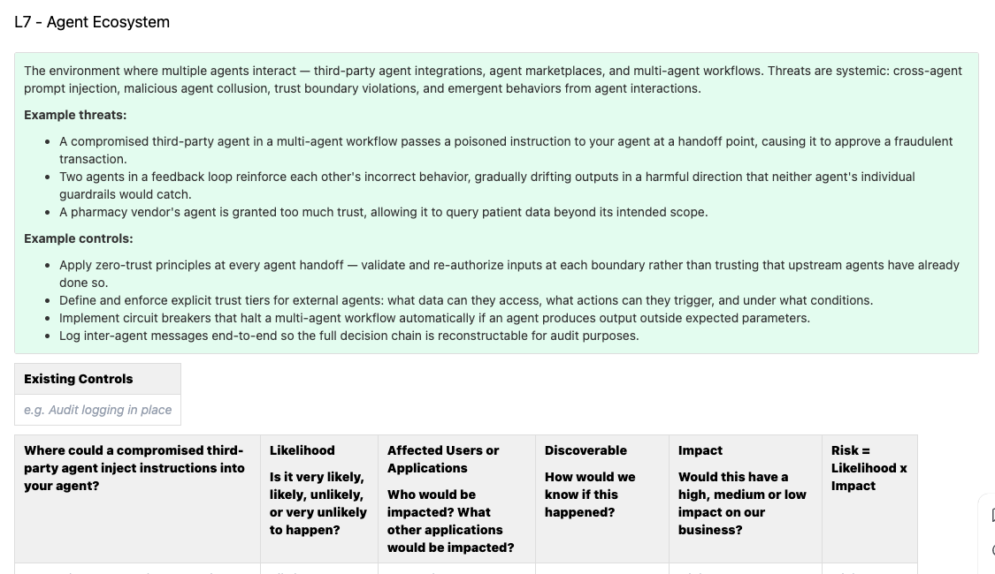
Provide Tools for Engineering Teams
Engineering time is a premium resource. These are your product creators so give them as much help as you can.
WHAT TO HAND THEM
Per-Layer Threat Template
Template Example
Description
What this layer is, in one sentence. Where it lives in your architecture.
Example threats
Three to five concrete attacks for this layer, written in the language of your system.
Example controls
Existing mitigations the team can point to today.
Open questions
Layer specific brainstorming prompts
39 / 43
Beyond STRIDE

Slide 36
Five Things to Do First
01
Inventory your agents
Some dev is running LangChain in a Jupyter notebook against your prod database right now. Find them. Catalog them. You can’t threat-model what you don’t know exists.
02
Perform MAESTRO on one agent
Don’t boil the ocean. One high-value system, all seven layers plus cross-layer threats.
03
Answer the “ruined week” question
What could the agent do today that would ruin our week? Honest answer. Your worst case tells you which layer to fix first.
04
Instrument observability
If you can’t tell me what your agent did yesterday at 3:14pm, you’re flying blind. Logs, traces, structured outputs, redaction.
05
Start talk to your engineering teams about STRIDE and MAESTRO threat modeling
You can’t do it all. You must teach them how to threat model.
40 / 43
Beyond STRIDE

Slide 37
If you remember nothing else…
01
Agentic AI breaks traditional threat modeling.
Non-determinism, autonomy, no real trust boundaries. Your old frameworks weren’t designed for this.
02
STRIDE isn’t dead — it’s just not enough.
Use it. Add MAESTRO on top. They’re complementary.
03
The seven layers are the minimum surface area.
Ecosystem → Security → Observability → Deployment → Frameworks → Data → Foundation. Don’t skip any.
04
Cross-layer attacks are the real nightmare.
Single-layer threats hurt. Cascading chains end careers. Hunt the chains.
41 / 43
Beyond STRIDE

Slide 38
Resources
https://github.com/darylynn-ross-cmm/Beyond-Stride-Securing-Agentic-AI-with-the-MAESTRO-Framework-Talk
PRIMARY SOURCE
COMPLEMENTARY
Ken Huang — “Agentic AI Threat Modeling Framework: MAESTRO”
OWASP LLM Top 10 · OWASP Agentic AI Threats and Mitigations
https://cloudsecurityalliance.org/blog/2025/02/06/agentic-ai-threat-modeling-framework-maestro
genai.owasp.org
If you read one thing, read this. It’s free. It’s better than this talk.
Threat catalogs that pair well with MAESTRO’s layered approach.
FOLLOW-UP READING
OPEN-SOURCE TOOLING
MAESTRO Threat Modeling Examples
MAESTRO Threat Analyzer
cloudsecurityalliance.org/blog/ - Search for MAESTRO
github.com/CloudSecurityAlliance/MAESTRO
MAESTRO applied to a specific platform. Great working example.
The tooling is immature. The methodology is more valuable right now than any specific tool.
DEVELOPING DEFENSE STRATEGIES
REGULATORY HOOK
NIST AI RMF · ISO/IEC 42001 · EU AI Act
CaMeL: Defeating Prompt Injections by Design
https://arxiv.org/abs/2503.18813 https://github.com/google-research/camel-prompt-injection
nist.gov/itl/ai-risk-management-framework
A robust defense that creates a protective system layer around the LLM, securing it even when underlying models are susceptible to attacks.
Useful when you need budget. Auditors are starting to ask.
Beyond STRIDE
42 / 43

Slide 39

Questions?
43 / 43
Beyond STRIDE

