Slide 1
CTO Offsite May 2026
Creating Technology Connections
Seth Eaton

Slide 2
Connecting Employees
Chief Technology Office
Technology Connection Networks (TCNs)
Amentum Podcast – What the Tech?

Slide 8
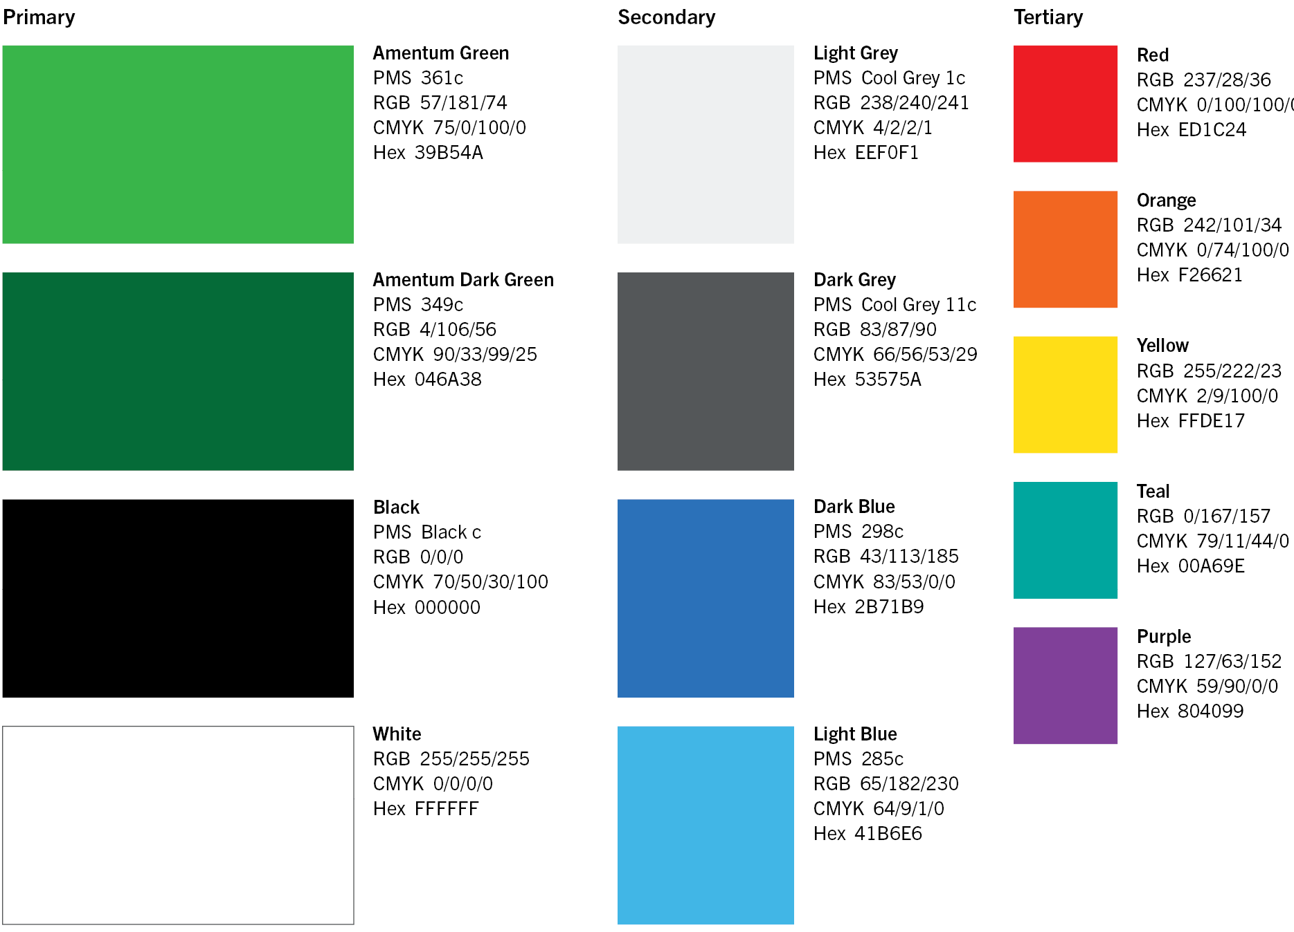
Color Palette
Primary Colors Shades of green are the leading colors within our palette. They are associated with stability, growth and the environment. Combined with the simplicity of black and grey, we create a distinctive and contemporary look and feel that reflects the leadership qualities we’ve ingrained in our brand.
Secondary Colors In the secondary palette, we have added shades of blue, useful for creating variety in content created for presentations, web and digital materials.
Tertiary Colors These colors should be used sparingly. They can be used to visualize data in charts, graphs and tables.

Slide 9
Sample charts

