Slide 1

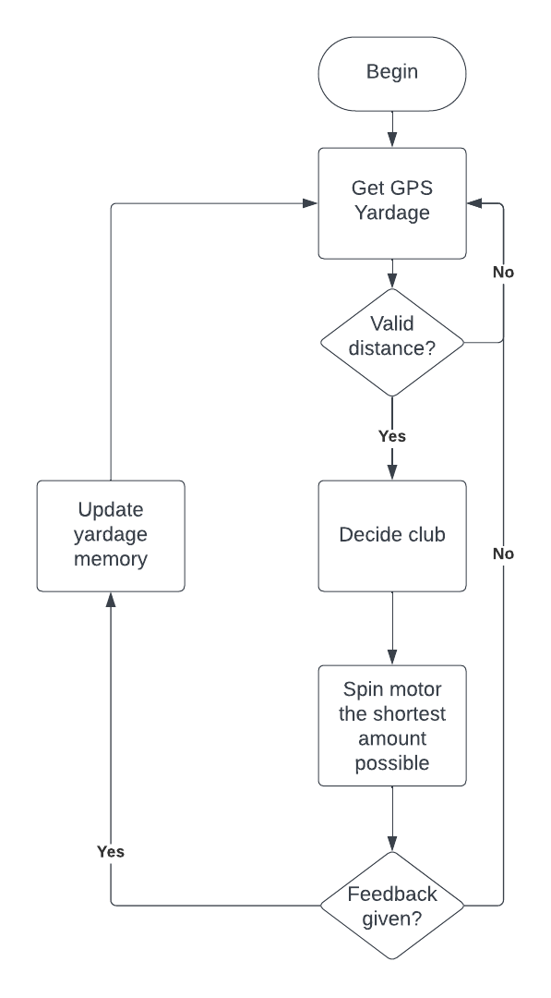
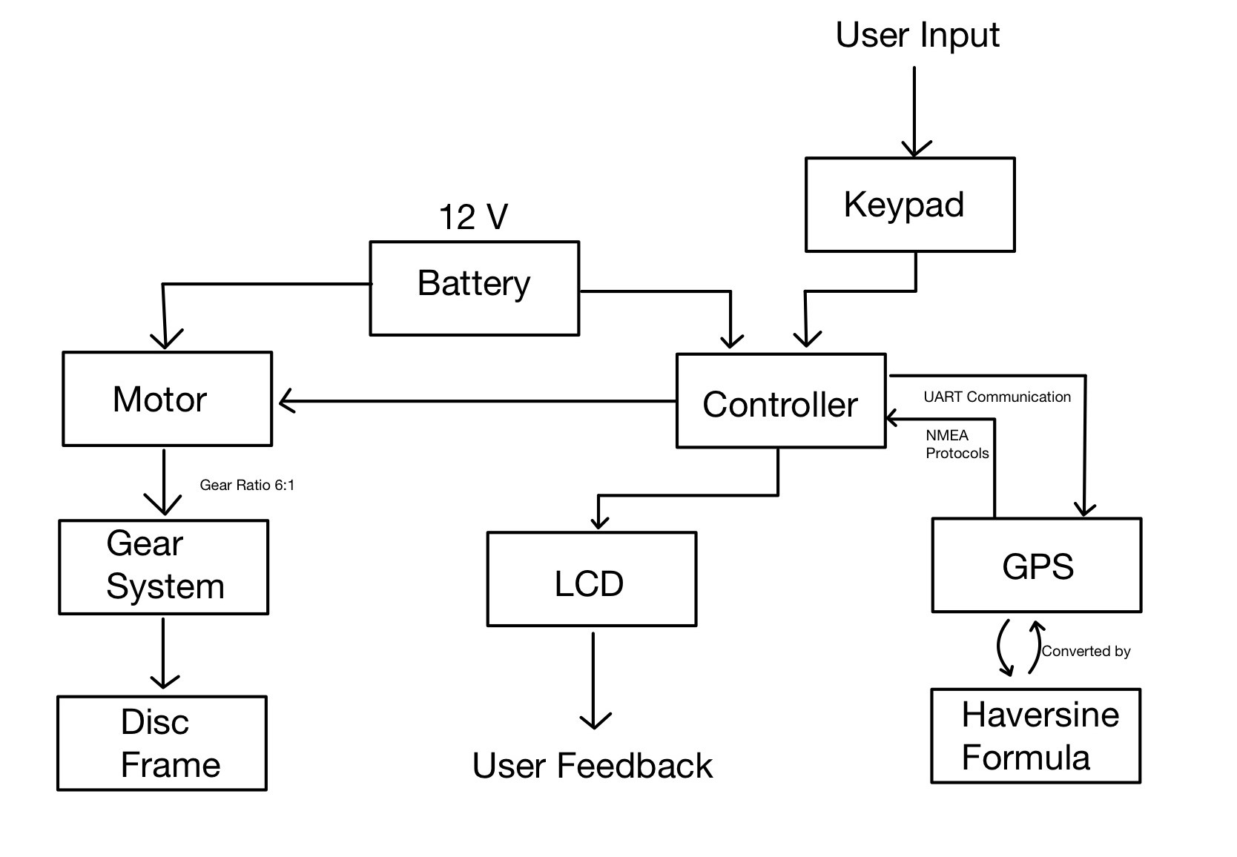
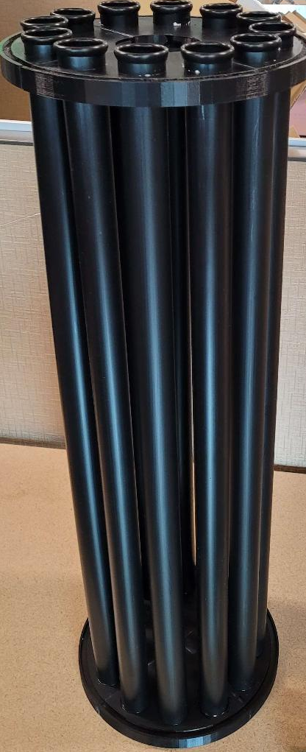

Electronic Caddy
Project
The Electronic Caddy is a GPS-based caddy built into a golf bag. This project aims to lower the golf score of the user. The project does this in several ways.
System
Allow users to give golf shot feedback
Implement user preferences
Use accurate GPS locations to determine yardage
Keep a consistent record of yardages between power cycles
Methods
Modular software approach to increase maintainability
NMEA GPS protocol produces within 2 yards of accuracy
FLASH memory usage to store data between power cycles
Liquid Crystal Display for informative feedback to the user
Customizable preferences stored in FLASH memory
Custom club yardages stored in FLASH memory
Rechargeable power system integrated into the bag
Conclusion
Results:
GPS accuracy within 2 yards
FLASH memory to store club yardages and user preferences
Accurate motor feedback to control club positioning
Future Improvements:
Dynamic course addition
Graphical User Interface (i.e. touchscreen, GPS imaging)
Weight and size reductions
Ashton Carlsen – ashtoncarlsen@yahoo.com David Rowbotham – david.rowbotham@usu.edu

