Slide 1


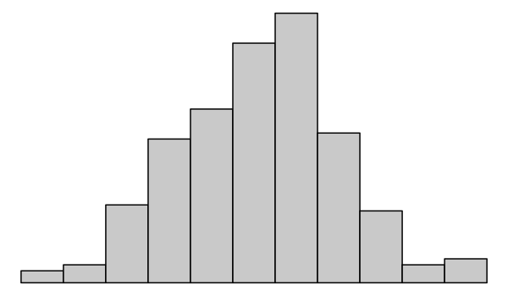
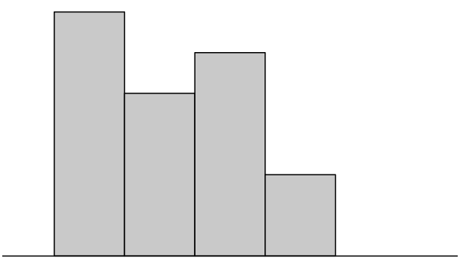
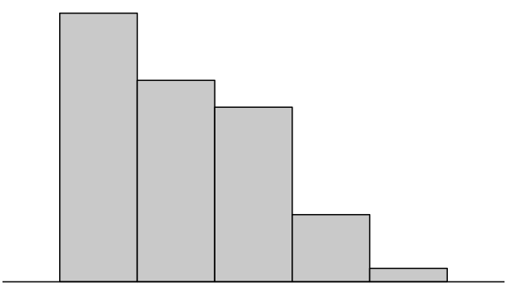



DESIGN
POPULATION
Sampling Distribution of Statistic
SAMPLE
Population Distribution
$$\hat{θ}$$
Empirical Distribution
Population Summary
$$θ^{∗}$$
Observed value for statistic
$$\hat{θ}$$

Slide 2
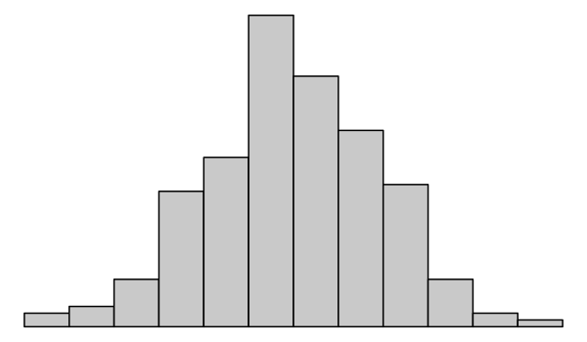
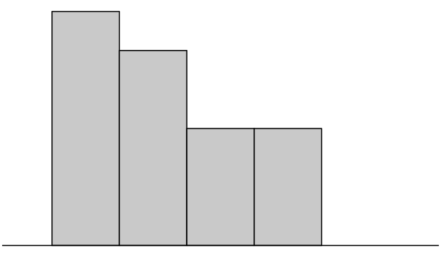

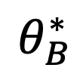
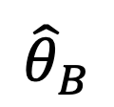
DESIGN
BOOTSTRAP
POPULATION
Bootstrap
Sampling Distribution of Statistic
BOOTSTRAP
SAMPLE
Bootstrap
Empirical Distribution
Bootstrap
Population Distribution
$${\hat{θ}}_{B}$$
Bootstrap Population Summary
Observed Bootstrap
Statistic
$$θ_{B}^{∗}$$
$${\hat{θ}}_{B}$$

Slide 3
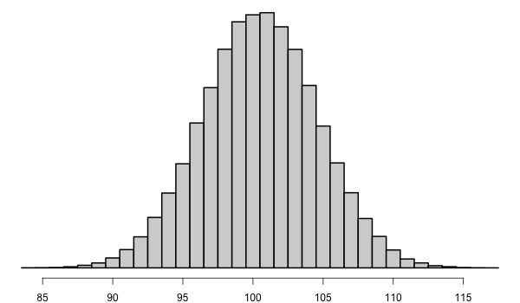
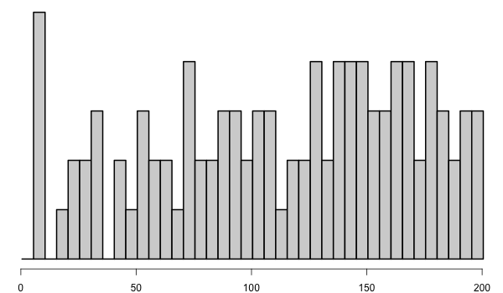
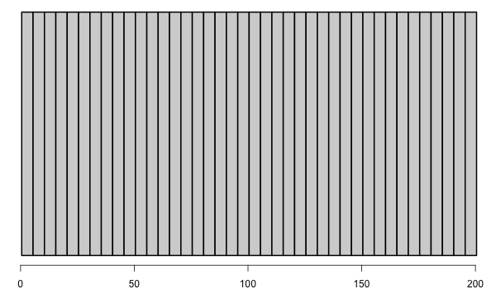







DESIGN
POPULATION
Sampling Distribution of Statistic
SAMPLE
$$\hat{θ}$$
Population Distribution
Empirical Distribution
$$E\left(\hat{θ}\right)=100.5$$
$$SD\left(\hat{θ}\right)=4.1$$
Observed
$$θ^{∗}= Avg(pop)=100.5$$
$$\hat{θ}=Avg(samp)=113.7$$
$$SD(pop) =57.7$$
$$SD(samp) =55.3$$

Slide 4
Draw #2
Draw #1

