Slide 2
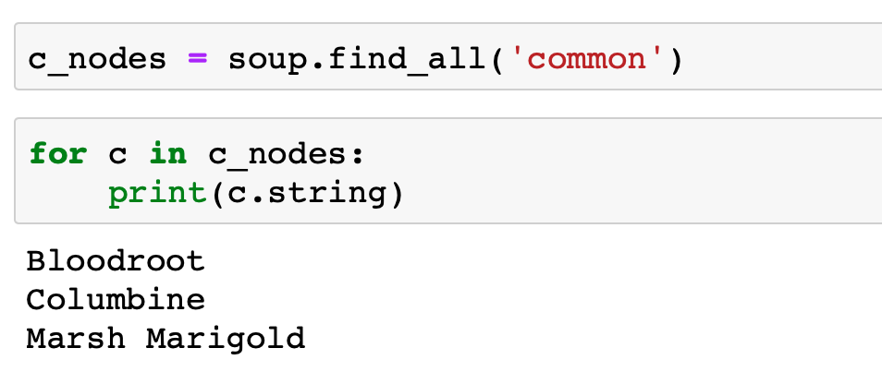
catalog
plant
plant
common
botanical
zone
light
price
Curr=USD
availability
date=031599
common
availability
date=022299
botanical
zone
light
price
Curr=CAD
Bloodroot
Sangui…
4
Mostly…
$2.44
Cardinal
Label…
2
Shade
$3.02

Slide 3
catalog
plant
plant
common
botanical
zone
light
price
Curr=USD
availability
date=031599
common
availability
date=022299
botanical
zone
light
price
Curr=CAD
Bloodroot
Sangui…
4
Mostly…
$2.44
Cardinal
Label…
2
Shade
$3.02

