Slide 1


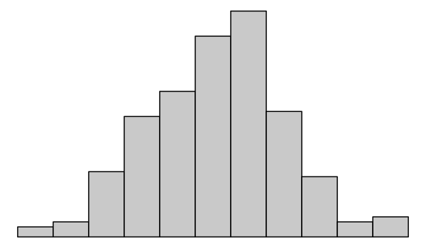
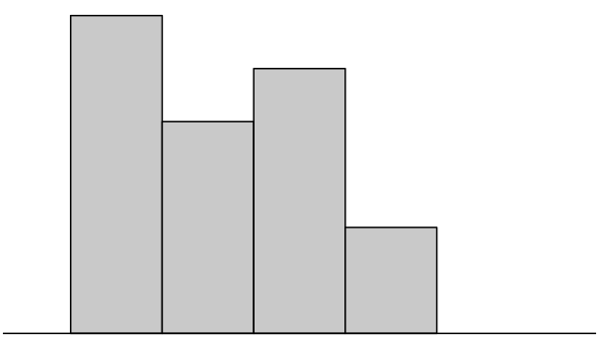
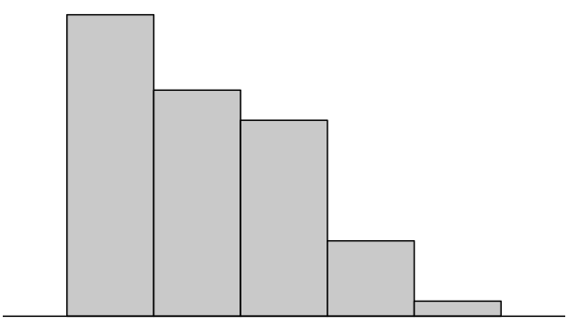

DESIGN
POPULATION
Sampling Distribution of Statistic
SAMPLE
Population Distribution
Empirical Distribution
*
〉
Population Summary
Observed Statistic

Slide 2
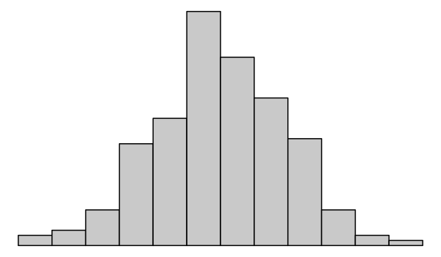
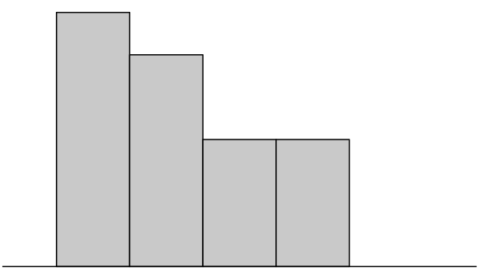
DESIGN
BOOTSTRAP
POPULATION
Bootstrap
Sampling Distribution of Statistic
BOOTSTRAP
SAMPLE
Bootstrap
Empirical Distribution
Bootstrap
Population Distribution
Bootstrap Population Summary
*
Observed Bootstrapped
Statistic
〉
B
B

