Slide 1


Slide 2

MS Amlin
Datinder Sekhri

Slide 3

Reporting a Breach
Most cases involving IT security breaches never get reported.
Avoids reputational damage, regulatory investigations and lawsuits. Yahoo were found guilty of this, as they did not report the attack as soon as they had realised.
The media are also not as interested in SMEs when compared to the larger global counterparts.
Forty-seven states, the District of Columbia, Guam, Puerto Rico and the Virgin Islands have enacted legislation requiring private, governmental or educational entities to notify individuals of security breaches of information involving personally identifiable information.

Slide 4
Why SMEs?
SMEs are targeted more often than others as they have a lack of resources invested in security, poor security technologies and very little training for employees to raise awareness.
Cyrus Walker, CEO of Chicago-based Data Defenders says research shows 80% of security-related incidents occur as a result of employee behaviour.
It’s also been estimated by cyber-security firms that 71% of breaches go undetected.
A report from McAfee found almost 90% of SMEs in the US do not use data protection for company and customer information, and less than half secured company email to prevent phishing scams.
Cybercrime costs the US economy $100bn a year and the global economy about $300bn annually, according to the Centre for Strategic and International Studies.

Slide 5
My Project
Hard to source the relevant data required, as IT security breaches in the US are not recorded very well.
Looked at how I could evaluate the level of risk. Pleasantly surprised when coming across the OWASP Risk Rating Methodology.
Decided to implement what I’ve learnt regarding Machine Learning into the project.
Can definitely be improved. I believe sourcing the data was the toughest challenge.

Slide 6
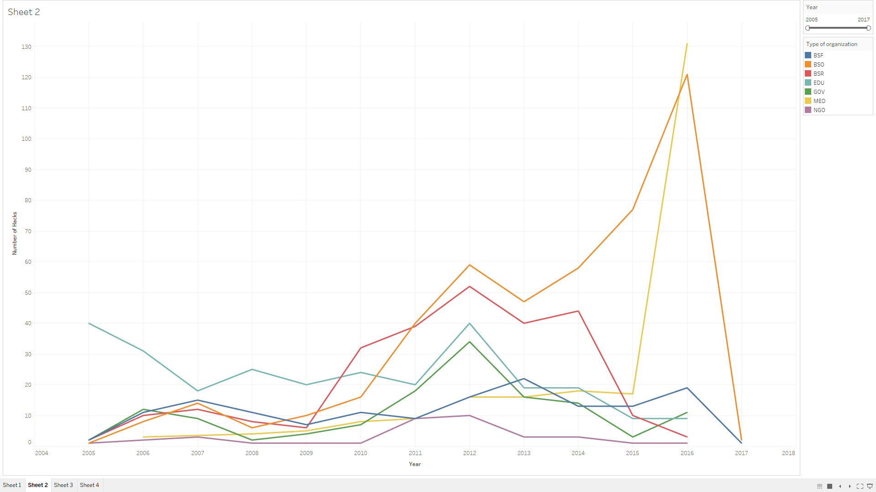

Slide 7
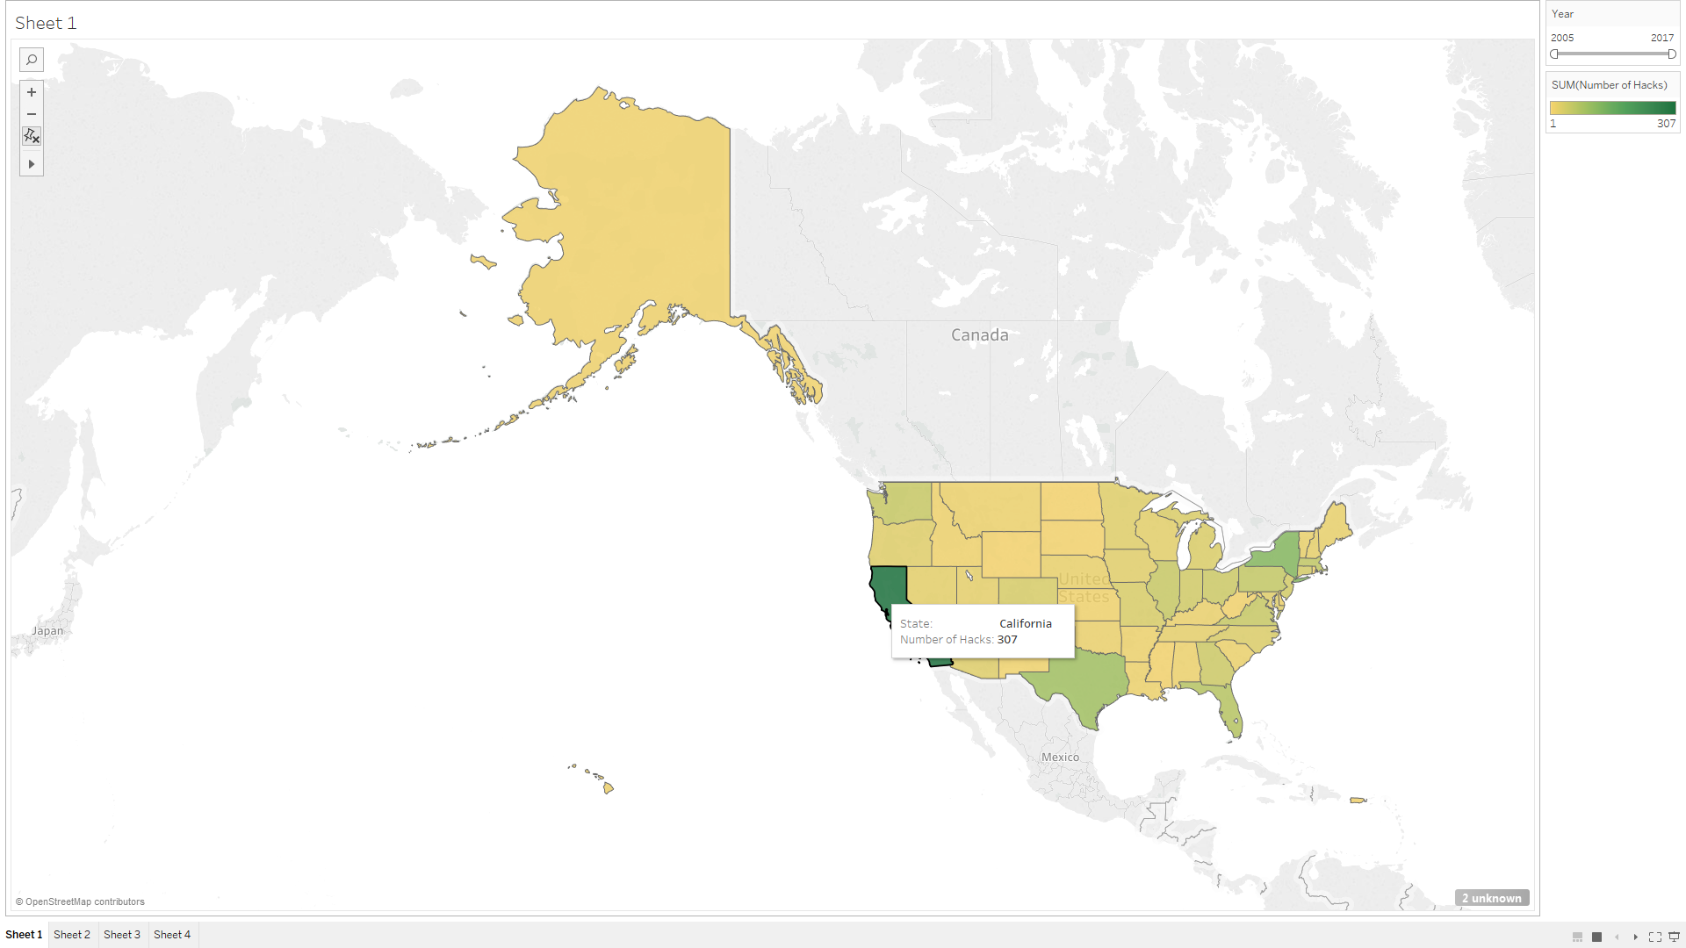

Slide 8
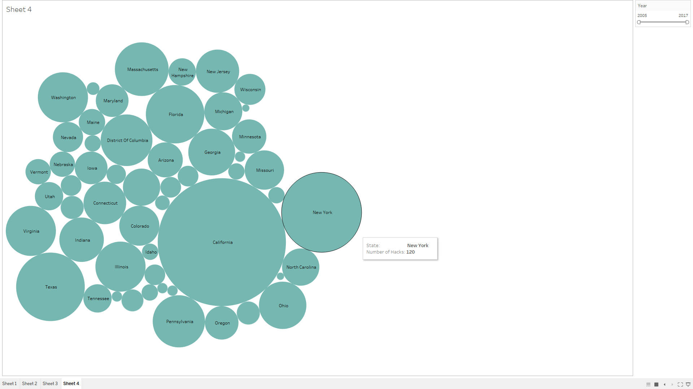

Slide 9
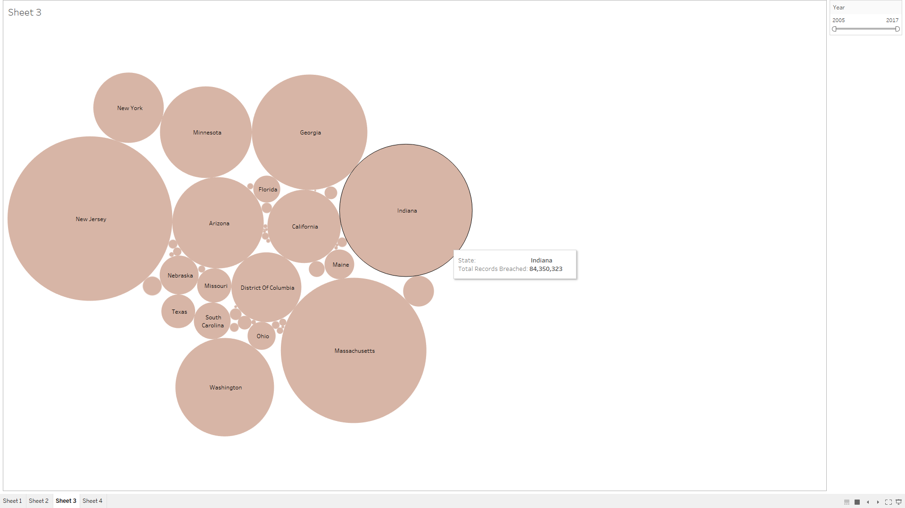

Slide 10
GPDR
Although GDPR doesn’t affect the US, I thought I’d outline the fines associated.
A two-tiered sanctions regime will apply. Breaches of some provisions by businesses, which law makers have deemed to be most important for data protection, could lead to fines of up to €20 million or 4% of global annual turnover for the preceding financial year, whichever is the greater, being levied by data watchdogs.
For other breaches, the authorities could impose fines on companies of up to €10m or 2% of global annual turnover, whichever is greater.
A huge emphasis on Cyber-Security in the EU.

Slide 11
Other Studies
90% of large organisations reported breaches in 2015, up from 81% in 2014, while 74% of small organisations said they had been breached in 2015, up from 60% in 2014.
PWC carried out the 2015 Information Security Breaches Survey, regarding the UK. I feel that this study is very credible as it is backed by the UK government and had 644 respondents.
The 2016 Cost of Data Breach Study: United States carried out by Ponemon Institute LLC gains some valuable insights also. However, I did not think it would be accurate to draw conclusions from a study involving 64 companies.
According to last years’ Internet Security Report, 60% of all target attacks involved SMEs. Also Ponemon Institute’s Cost of Data Breach Study revealed that in 2014 the average cost of attack for an SME with less than 100 employees was a massive $3.5 million.

Slide 12
CLIC
Came across cyber-liability insurance cover offered by Lloyd’s.
Puts retail and finance in the higher risk bracket.
The risk associated is derived from the technology and regulation around privacy. Both constantly changing, therefore the solutions provided via insurance need to be able to evolve.
CLIC has been present for over 10 years, but many insurers that offer it have not sold a single policy.
In many cases, insurers may not have understood the risk that they were actually taking on – this has been very much to do with both the lack of data for underwriting and the lack of knowledge by consumers to understand the risk transference benefits.

Slide 13
Helping SMEs
For small and medium-sized enterprises, there are very simple policies available, but sometimes these raise more questions than they answer.
They do not always provide a long list of exclusions or terms and definitions. At least with detailed polices you should know where you stand.
Think there is potential to offer a more detailed policy, by providing a data-driven product.
Insider threat needs to be looked at with a more detailed approach. Need to look at security, engagement and productivity.
Need to complete a thorough study similar to PWC, showing how the level of threat varies across industry.

Slide 14
Lowering the Number of Breaches
I believe that SMEs should begin to:
Partner with a trusted firm to provide relevant advice related to their security infrastructure, including technical testing such as security audits and penetration testing to determine where the firm’s weaknesses lie and improve organisational readiness.
Monitor networks for unusually high traffic volume.
Work with their financial institution to implement multi-factor authentication and dual controls for financial transactions.
Educate employees regarding good security habits including stronger administrative passwords, policies regarding email attachments, etc.

Slide 15
Thank you!

