Slide 1


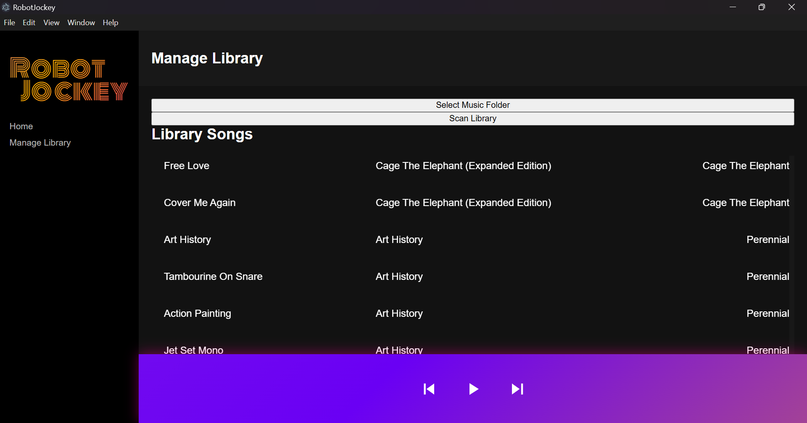
Offline AI-Powered Music Player with On-Device Mood Analysis
by D.S.Aditya
Introduction
Results
Discussion
Current Challenges in Music Recommendation:
Many services depend on cloud-based infrastructure, requiring constant internet access.
Audio is often streamed at sub-CD quality.
Playlist generation/analytics are typically unavailable in offline mode.
Research Gaps:
On device recommendations require efficient machine learning models.
Models need to balance speed and accuracy while dealing with limited compute resources.
Objective:
Predict mood/energy of a track using a neural network
Map natural language queries to mood/energy values using lightweight transformer embeddings.
Operate fully on device for accessibility without internet dependence.
Prediction Accuracy: R² = 0.74 on the DEAM dataset (~1800 songs, 45 seconds each)
Inference Speed: 220X real-time speed with CPU only inference. i.e 3 m 40 s of audio every second.
Generated playlists match query intent.
Achieved fully offline analysis and recommendations.
High inference speed demonstrates offline feasibility.
Entire albums can be processed in under 10 seconds.
Natural Language queries can be processed in under 1 second.
Embedding model can be used to factor lyrical content into song analysis.
P2P sharing can further streamline music analysis while not relying on expensive centralized servers.
Methods
UI/NLP Processor
Local SQLite Database
Audio analysis engine
Neural network for audio mood/energy prediction.
Transformer embeddings to map natural language queries to audio files.
Targeting CPU-only inference speeds of 1 minute of audio/second.

