Slide 1
Linear models and Nearest Neighbors
Andreas Müller

Slide 2
Supervised Learning
i.i.d.
Notes:
But let’s dive right back in into supervised learning.
As a reminder, in supervised learning, the dataset we learn form is input-output pairs (x_i, y_i), where x_i is some n_dimensional input, or feature vector, and y_i is the desired output we want to learn.
We assume these samples are drawn from some unknown joint distribution p(x, y).
You can think of this as there being some (not necessarily deterministic) process that goes from x_i to y_i, but that we don’t know.
We try to find a function that approximates the output y_i for each known input x_i. But we also demand that for new inputs x , and unobserved y, f(x) is approximately y.
I want to go through to simple examples of supervised algorithms today, nearest neighbors and nearest centroids.

Slide 3



Nearest neighbors
Notes:
Let’s say we have this two-class classification dataset here, with two features, one on the x axis and one on the y axis.
And we have three new points as marked by the stars here.
If I make a prediction using a one nearest neighbor classifier, what will it predict?
It will predict the label of the closest data point in the training set.
That is basically the simplest machine learning algorithm I can come up with.
Here’s the formula:
the prediction for a new x is the y_i so that x_i is the closest point in the training set.
Ok, so now how do we find out whether this model is any good?

Slide 4

Nearest neighbors
Notes:
So this was the predictions as made by one-nearest neighbor.
But we can also consider more neighbors, for example three. Here is the three nearest neighbors for each of the points and the corresponding labels.
We can then make a prediction by considering the majority among these three neighbors.
And as you can see, in this case all the points changed their labels! (I was actually quite surprised when I saw that, I just picked some points at random).
Clearly the number of neighbors that we consider matters a lot. But what is the right number?
The is a problem you’ll encounter a lot in machine learning, the problem of tuning parameters of the model, also called hyper-parameters, which can not be learned directly from the data.

Slide 5

Influence of n_neighbors
Notes:
Here’s an overview of how the classification changes if we consider different numbers of neighbors.
You can see as red and blue circles the training data. And the background is colored according to which class a datapoint would be assigned to for each location.
For one neighbor, you can see that each point in the training set has a little area around it that would be classified according to it’s label. This means all the training points would be classified correctly, but it leads to a very complex shape of the decision boundary.
If we increase the number of neighbors, the boundary between red and blue simplifies, and with 40 neighbors we mostly end up with a line.
This also means that now many of the training data points would be labeled incorrectly.

Slide 6

Model Complexity
Notes:
We can look at this in more detail by comparing training and test set scores for the different numbers of neighbors.
Here, I did a random 75%/25% split again. This is a very noisy plot as the dataset is very small and I only did a random split, but you can see a trend here.
You can see that for a single neighbor, the training score is 1 so perfect accuracy, but the test score is only 70%. If we increase the number of neighbors we consider, the training score goes down, but the test score goes up, with an optimum at 19 and 21, but then both go down again.
This is a very typical behavior, that I sketched in a schematic for you.

Slide 7
Nearest neighbors
Notes:
Let’s say we have this two-class classification dataset here, with two features, one on the x axis and one on the y axis.
And we have three new points as marked by the stars here.
If I make a prediction using a one nearest neighbor classifier, what will it predict?
It will predict the label of the closest data point in the training set.
That is basically the simplest machine learning algorithm I can come up with.
Here’s the formula:
the prediction for a new x is the y_i so that x_i is the closest point in the training set.
Ok, so now how do we find out whether this model is any good?

Slide 8
training set
1.1 | 2.2
6.7 | 0.5
2.4 | 9.3
1.5 | 0.0
0.5 | 3.5
5.1 | 9.7
3.7 | 7.8
0
1
1
0
1
0
0
X =
y =
test set
Notes:
We split the data into a training and a test set.
So we take some part of the data set, let’s say 75% and the corresponding output, and train the model, and then apply the model on the remaining 25% to compute the accuracy
How do we do this in scikit-learn?
With train_test_split.

Slide 9
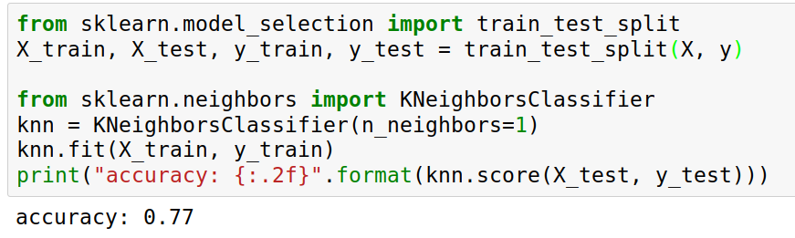
Implementing KNN in scikit-learn
Notes:
Ok so we import train_test_split form model selection, which does a random split into 75%/25%.
We provide it with the data X, which are our two features, and the labels y.
As you might already know, all the models in scikit-learn are implemented in python classes, with a single object used to build and store the model.
We start by importing our model, the KneighborsClassifier, and instantiate it with n_neighbors=1.
Then we can call the fit method to build the model, here knn.fit(X_train, y_train)
All models in scikit-learn have a fit-method, and all the supervised ones take the data X and the outcomes y.
Then, we can use knn.score to make predictions on the test data, and compare them against the true labels y_test.
For classification models, the score method will always compute accuracy. Who here has not seen this before?

Slide 10
Nearest neighbors
Notes:
So this was the predictions as made by one-nearest neighbor.
But we can also consider more neighbors, for example three. Here is the three nearest neighbors for each of the points and the corresponding labels.
We can then make a prediction by considering the majority among these three neighbors.
And as you can see, in this case all the points changed their labels! (I was actually quite surprised when I saw that, I just picked some points at random).
Clearly the number of neighbors that we consider matters a lot. But what is the right number?
The is a problem you’ll encounter a lot in machine learning, the problem of tuning parameters of the model, also called hyper-parameters, which can not be learned directly from the data.

Slide 11
Overfitting and Underfitting
Training
Sweet spot
Accuracy
Generalization
Underfitting
Overfitting
Model complexity
Notes:
Coming back to this chart, you usually find that non-parametric models are more likely to overfit, as they can increase their capacity to fit any dataset, while in some cases, a parametric model might not be able to fit some data.
Again, neural networks are somewhat their own thing, as usually people choose networks that could learn any possible data.

Slide 12
Influence of n_neighbors
Notes:
Here’s an overview of how the classification changes if we consider different numbers of neighbors.
You can see as red and blue circles the training data. And the background is colored according to which class a datapoint would be assigned to for each location.
For one neighbor, you can see that each point in the training set has a little area around it that would be classified according to it’s label. This means all the training points would be classified correctly, but it leads to a very complex shape of the decision boundary.
If we increase the number of neighbors, the boundary between red and blue simplifies, and with 40 neighbors we mostly end up with a line.
This also means that now many of the training data points would be labeled incorrectly.

Slide 13
Model Complexity
Notes:
We can look at this in more detail by comparing training and test set scores for the different numbers of neighbors.
Here, I did a random 75%/25% split again. This is a very noisy plot as the dataset is very small and I only did a random split, but you can see a trend here.
You can see that for a single neighbor, the training score is 1 so perfect accuracy, but the test score is only 70%. If we increase the number of neighbors we consider, the training score goes down, but the test score goes up, with an optimum at 19 and 21, but then both go down again.
This is a very typical behavior, that I sketched in a schematic for you.

Slide 14
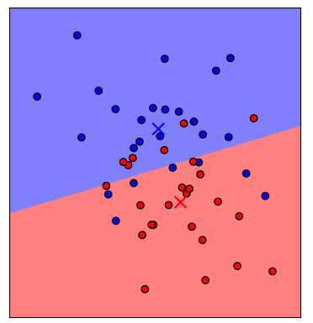
Nearest Centroid
Notes:
Before we go to more techniques to find the right hyper parameters, I want to introduce another simple model, nearest centroid.
The nearest centroid model simply computes the centroid, or the mean of each class, and classifies each point by which centroid is the closest.
You can write that down as a formula such as here, where x_i bar is the centroid, and I runs over the classes.
You can see that this yields a linear decision boundary between the two classes.

Slide 15
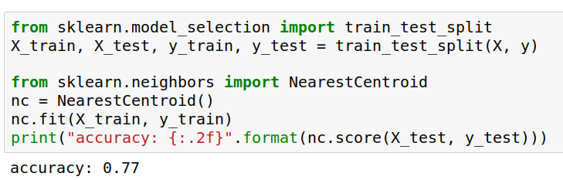
Nearest Centroids with scikit-learn
Notes:
Again, we can easily build this model with scikit-learn and evaluate it using a test set.
We use the train_test_split function to split the data into 75% training and 25% test data,
import the nearest centroid model, fit it on the training set, and compute the accuracy on the test set.
Questions so far?

Slide 16
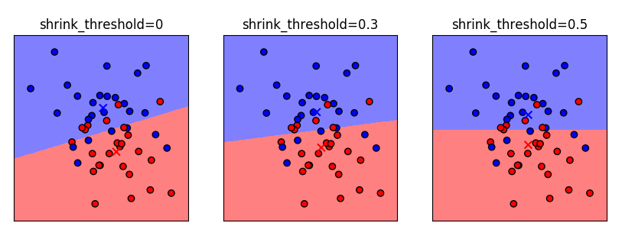
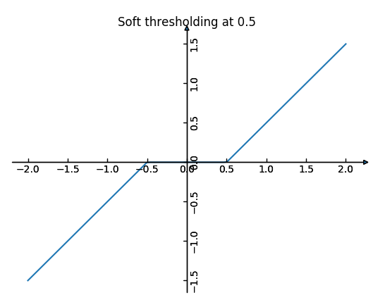
Nearest Shrunken Centroid
Notes:
There’s a variant of the nearest centroid called the nearest shrunken centroid, which allows you to limit model complexity.
In nearest shrunken centroid, you pick a positive shrinking threshold, and then you apply the soft-threshold function here to each of the centroids.
The soft-thresholding function shrinks each component of a vector towards zero by the threshold, and if that would cross zero, to set this component to zero.
Actually the mean of the data is subtracted beforehand so that this makes sense ;)
What that means is that if the centroids have an entry that is close to zero, this direction gets ignored.
Here you can see different settings of the shrinking threshold. No shrinking, a threshold of .3 and a threshold of .5.
Because the centers are less than .5 apart from the data mean, the last panel has a perfectly horizontal line.
When do you think NC works better than KNN? High dimensions!

Slide 17
Computational Properties Centroids
fit: O(n * p)
memory: O(n_classes * p)
predict: O(n_classes * p)
n = n_samples
p = n_features
Notes:
I want to compare some computational properties of the nearest shrunken centroid and k nearest neighbors.
What do you think are the important computational properties of machine learning models?
There are basically three: time to build the model, memory to store the model, and time to make a prediction.
What are those?
Fit time is simple, it’s computing the centroids which is n * p. Basically we need to look at each feature exactly once.
Memory is storing the centroids, which is number of classes times number of features, and predict time
is computing the distance to each of them, which is the same. When is this slow? Basically never - in high dim with only few important, maybe trees could be better, but we could also shrink those dimensions away.

Slide 18
Computational Properties Neighbors
fit: no time
memory: O(n * p)
predict: O(n * p)
Kd-tree
fit: O(p * n log n)
memory: O(n * p)
predict:
O(k * log(n))
FOR FIXED p!
n = n_samples
p = n_features
Notes:
Ok, now for the k nearest neighbors. How would you implement this? (brute force or neighbors structure)
When not using a structure: fit no time, memory is the whole dataset, and prediction requires comparing against all data points.
If we create a kd-tree or ball tree?
Fit takes O(n log n), memory is the same. Prediction might be faster in low dimensions.
What’s bad about this?
memory scales with data, prediction speed scales with data :-/
Can have high complexity models though.
When would you use one vs the other? Large datasets , high dimensions: use nearest centroid maybe.

Slide 19

Linear Models for Regression

Slide 20
Linear Regression
Ordinary Least Squares
Unique solution if has full rank.

Slide 21
Ridge Regression
Always has a unique solution.
Has tuning parameter alpha

Slide 22
IPython Notebook:
Part 5 – Linear Models for Regression

Slide 23
Linear Models for Classification

Slide 24
Linear models for binary classfiication

Slide 25


Slide 26

Logistic Regression

Slide 27
Penalized Logistic Regression
C is inverse to alpha (or alpha / n_samples)

Slide 28
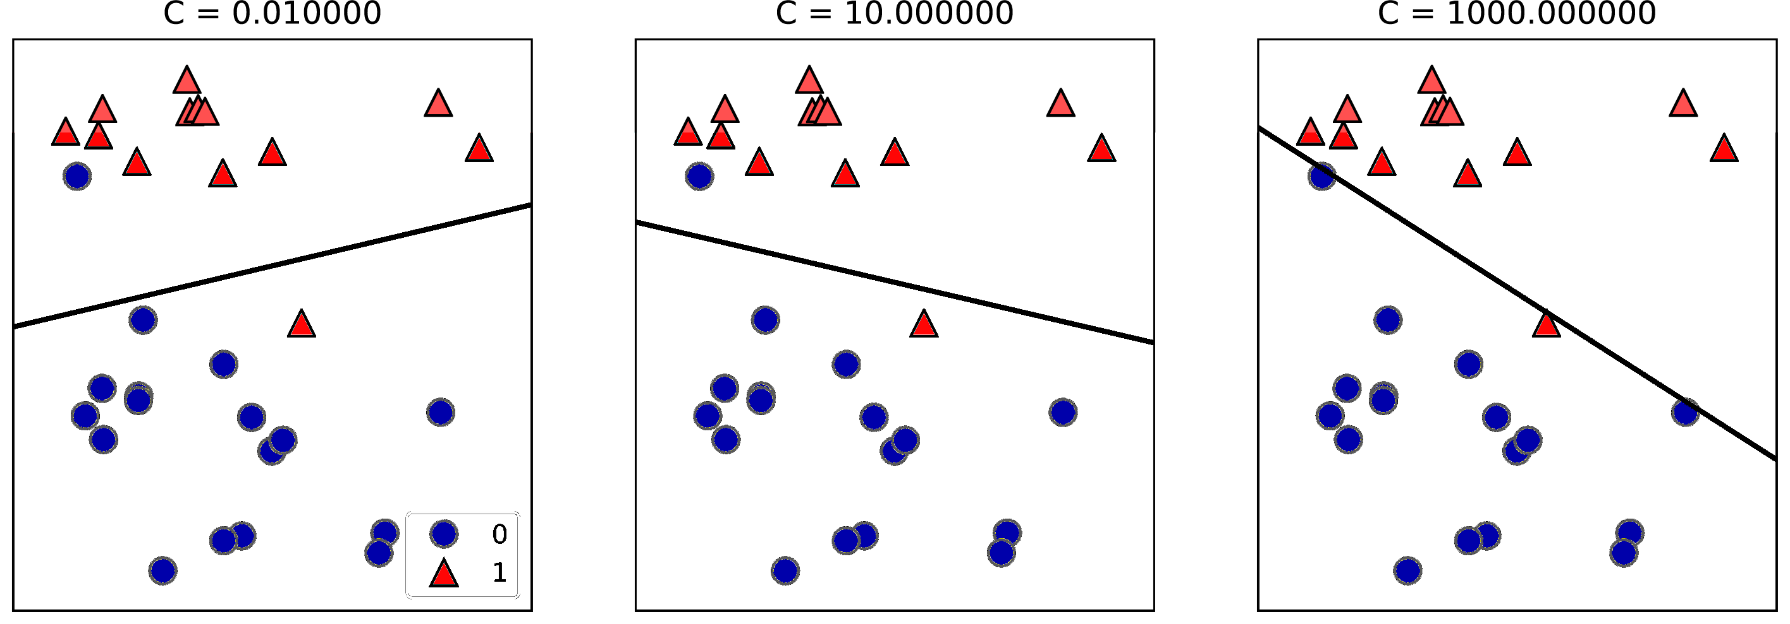

Slide 29
Multinomial Logistic Regression
Probabilistic multi-class model:

Slide 30


Slide 31
Linear Models for Regression

Slide 32
Linear Regression
Ordinary Least Squares
Unique solution if has full rank.

Slide 33
Ridge Regression
Always has a unique solution.
Has tuning parameter alpha

Slide 34
(regularized) Empirical Risk Minimization
Data fitting
Regularization
Notes:
This leads us to one of the core principles of machine learning, which I will only sketch here, but which is the essence of all the machine learning theory.
If we can find a model that fits the training data well, and that is “simple” then we are guaranteed that it will work well on new data.
The machine learning problem can then be formalized as minimizing the error on the training set, say the squared error, while constraining the model to be simple.
This is called “regularized empirical risk minimization” and that’s basically what all machine learning algorithms do, with different choices of the domain of f, and different choices of the regularizer R.

Slide 35

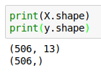
Boston Housing Dataset

Slide 36
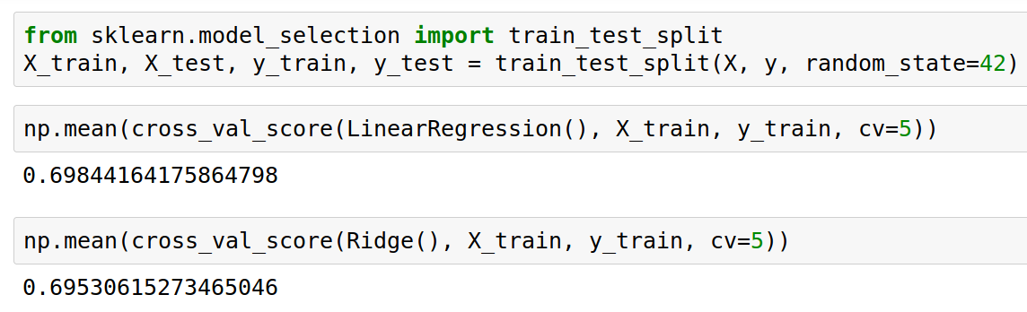
Score is always R^2 for regression!

Slide 37
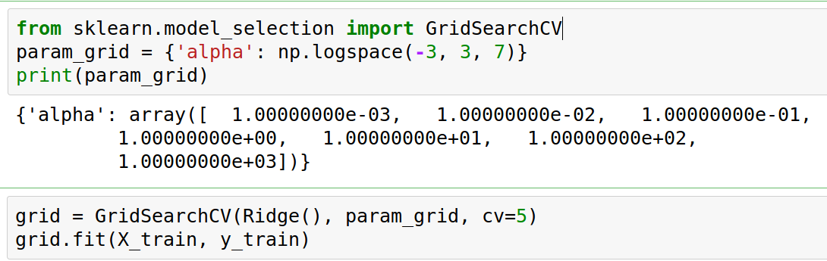
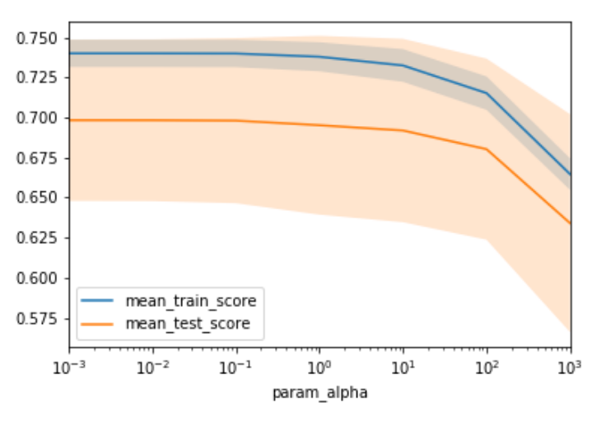

Slide 38
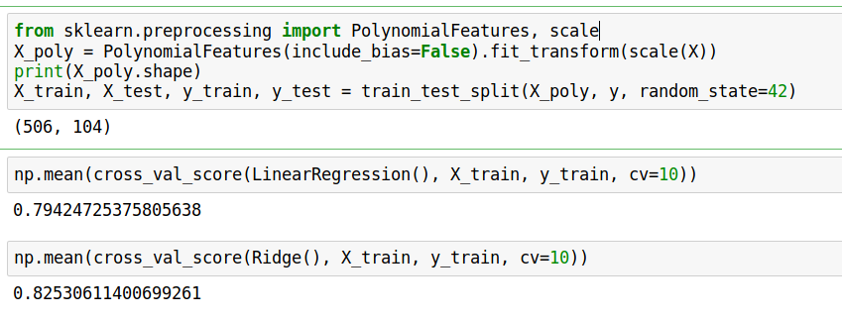
Adding features

Slide 39
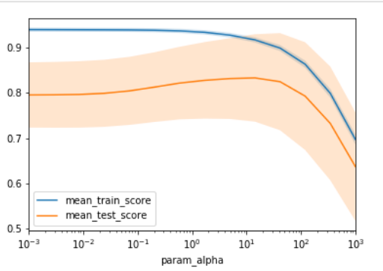
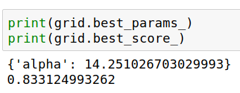

Slide 40
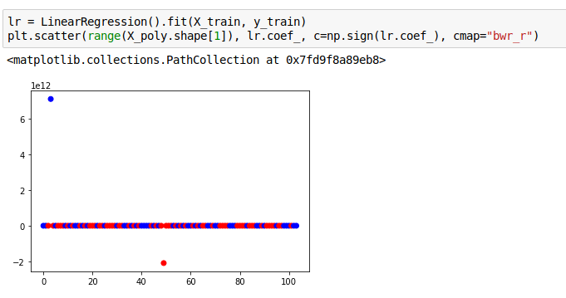
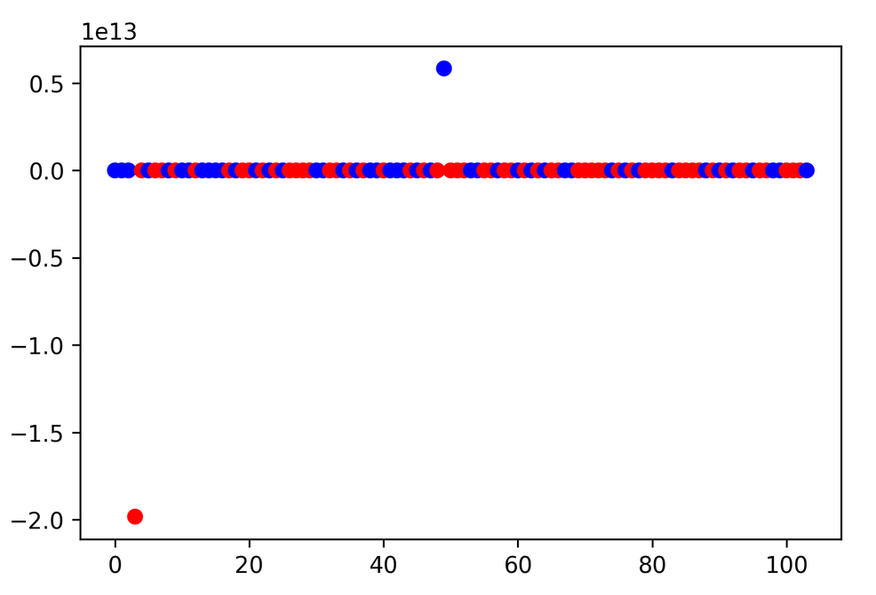
Plotting coefficient values (LR)

Slide 41
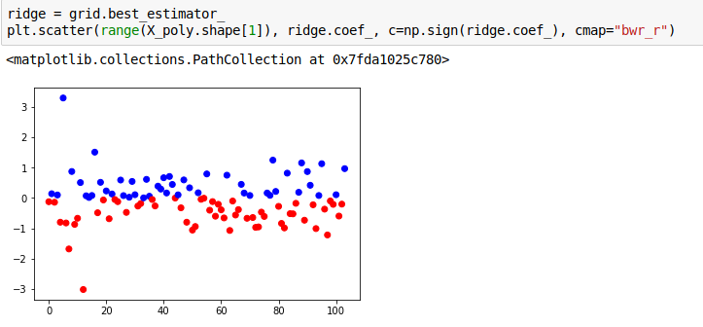
Ridge Coefficients

Slide 42
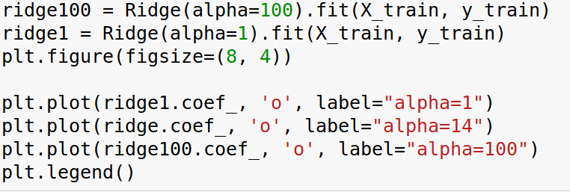
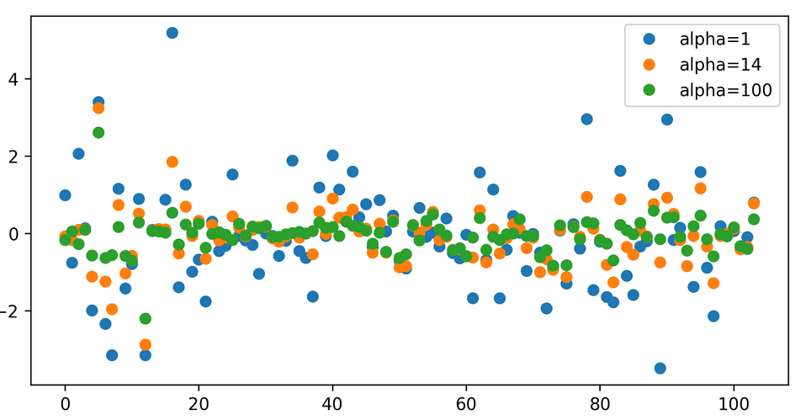

Slide 43
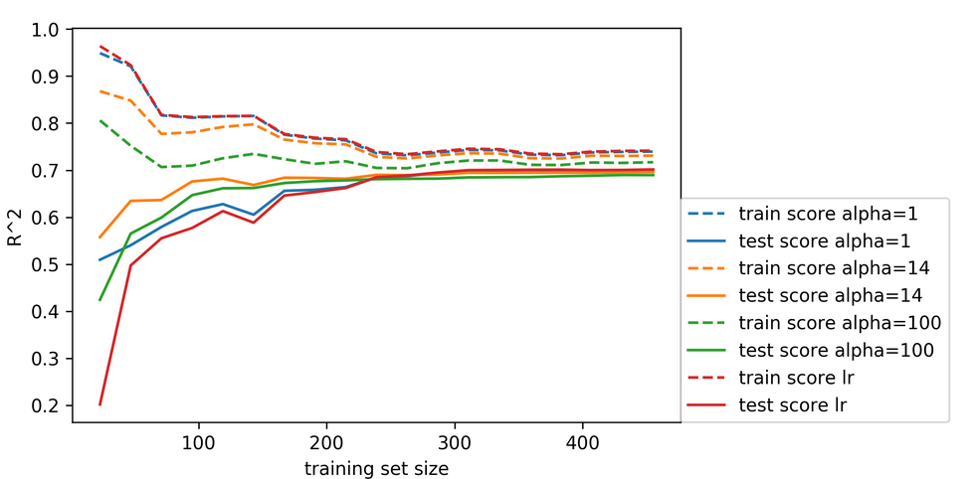
Learning Curve

Slide 44
W4995 Applied Machine Learning
Linear Models for Classification
02/06/17
Andreas Müller

Slide 45
Linear models for binary classfiication

Slide 47
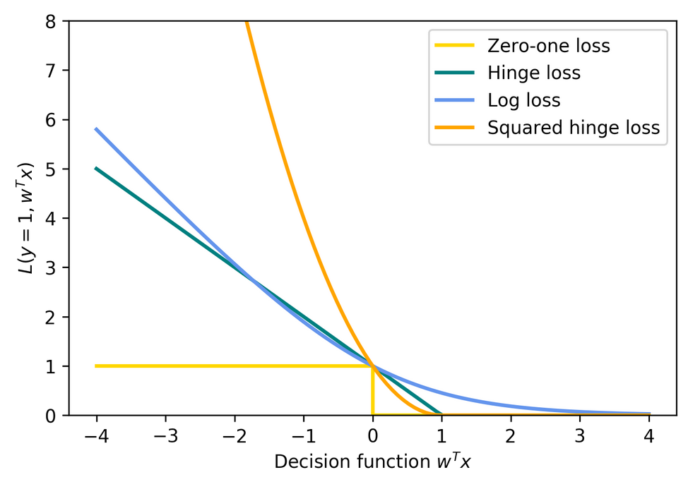
Picking a loss?
Obvious idea:
Minimize number of misclassifications aka 0-1 loss.
But: non-convex, not continuous => Relax

Slide 48
Logistic Regression

Slide 49
Penalized Logistic Regression
C is inverse to alpha (or alpha / n_samples)
Both versions strongly convex, l2 version smooth (differentiable).
All points contribute to w (dense solution to dual).

Slide 50
(soft margin) linear SVM
Both versions strongly convex, neither smooth.
Only some points contribute (the support vectors) to w (sparse solution to dual).

Slide 51
SVM or LogReg?
Do you need probability estimates?
ou
yes
It doesn’t matter
- try either / both
Logistic Regression
Need compact model or believe solution is sparse? Use L1.

Slide 52
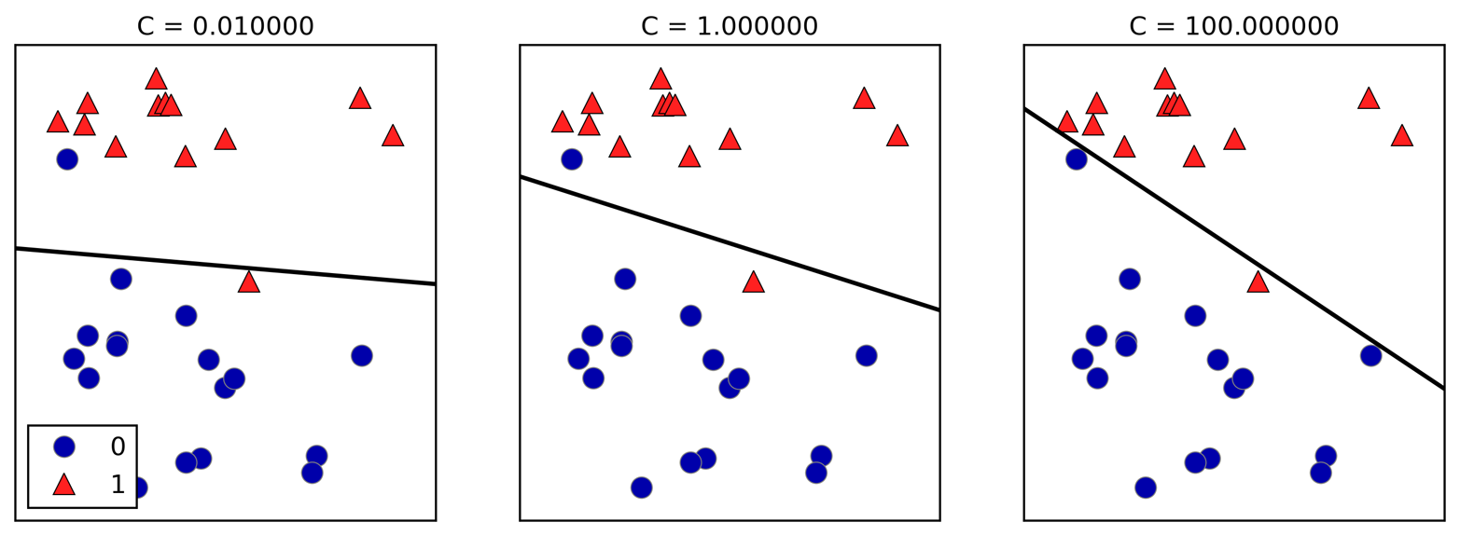
Effect of regularization
Small C (a lot of regularization) limits the influence of individual points!

Slide 53
Multiclass classification

Slide 54
Reduction to Binary classification
For 4 classes
One vs Rest
1v{2, 3, 4}, 2v{1, 3, 4}, 3v{1, 2, 4}, 4v{1, 2, 3}
n binary classifiers - each on all data
One vs One
1v2, 1v3, 1v4, 2v3, 2v4, 3v4
n * (n-1) / 2 binary classifiers - each on a fraction of the data
Standard

Slide 55
Prediction with One Vs Rest
“Class with highest score”
Unclear why it even works, but work well.

Slide 56
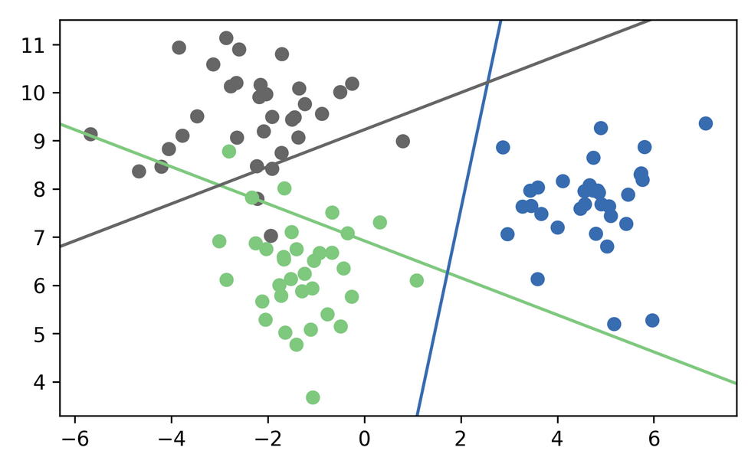
One vs Rest Prediction

Slide 57
One vs Rest Prediction

Slide 58
Prediction with One Vs One
“Vote for highest positives”
Classify by all classifiers.
Count how often each class was predicted.
Return most commonly predicted class.
Again – just a heuristic.

Slide 59
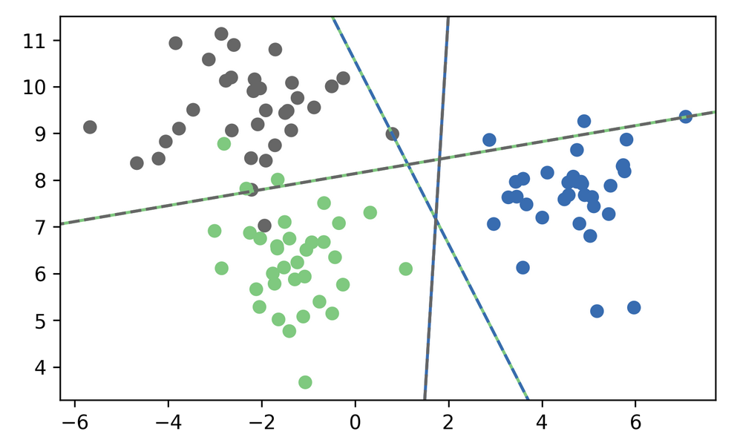
One vs One Prediction

Slide 60
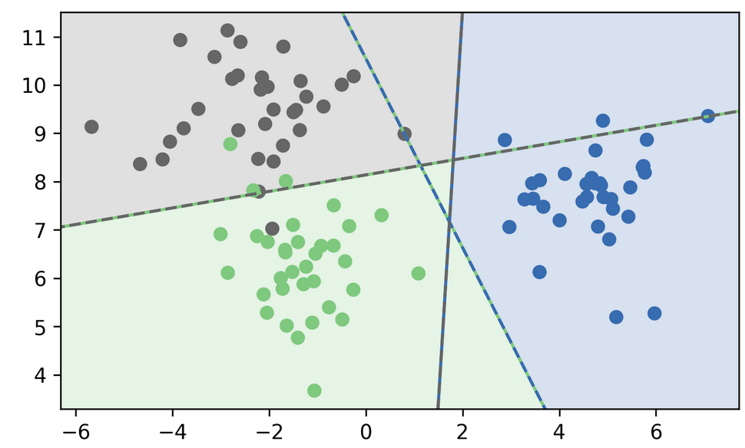

Slide 61
Multinomial Logistic Regression
Probabilistic multi-class model:
Same prediction rule as OvR!

Slide 62
In scikit-learn
OvO: only SVC
OvR: default for all linear models, even LogisticRegression
LogisticRegression(multinomial=True)
clf.decision_function = w^Tx
logreg.predict_proba
SVC(probability=True) not great

Slide 63
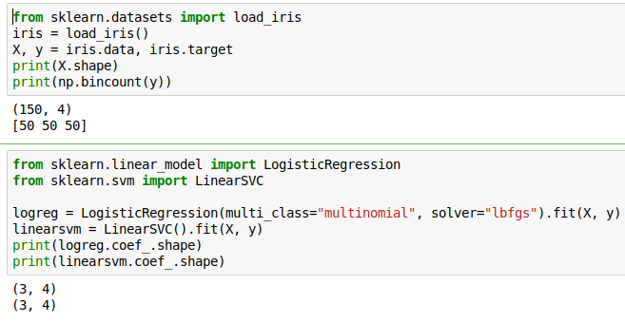
Multi-Class in Practice
OvR and multinomial LogReg produce one coef per class:
SVC would produce the same shape, but with different semantics!

Slide 64

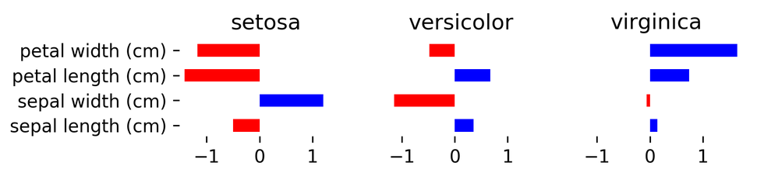
(after centering data, without intercept)

Slide 65
Computational Considerations
(for all linear models)

Slide 66
Solver choices
Don’t use SVC(kernel=’linear’), use LinearSVC
For n_features >> n_samples: Lars (or LassoLars) instead of Lasso.
For small n_samples (<10.000?), don’t worry.
LinearSVC, LogisticRegression: dual=False if n_samples >> n_features
LogisticRegression(solver=”sag”) for n_samples large.
Stochastic Gradient Descent for “n_samples really large”

Slide 67
Efficient Cross-validation

Slide 68
Models with build-in cross-validation
RidgeCV() - does GCV, approximation to LOO
LarsCV(), LassoLarsCV(), ElasticNetCV()
Use path-algorithms to compute the full solution path.
LogisticRegressionCV() uses warm-starts, doesn’t support all solvers.
All have reasonable build-in parameter grids.
For RidgeCV you can’t pick the “cv”!

Slide 69
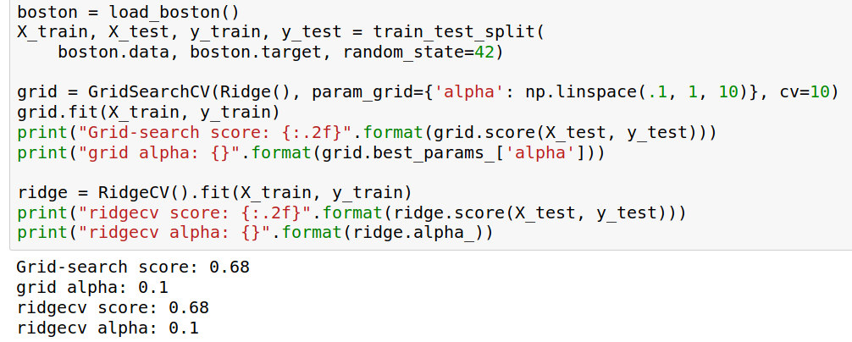
Using EstimatorCV

Slide 70
Stochastic Gradient Descent
(see http://leon.bottou.org/projects/sgd
and http://leon.bottou.org/papers/bottou-bousquet-2008
and http://scikit-learn.org/stable/modules/scaling_strategies.html)

Slide 71
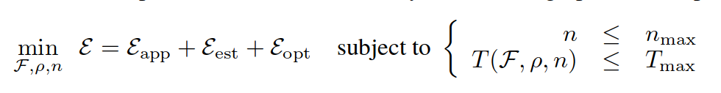
Decomposing Generalization Error
Error introduced by using the training set instead of “the true distribution”
Error of restricting f to family F
Error rho in finding the f that’s best on the training set.
Bottou et. al.

Slide 72
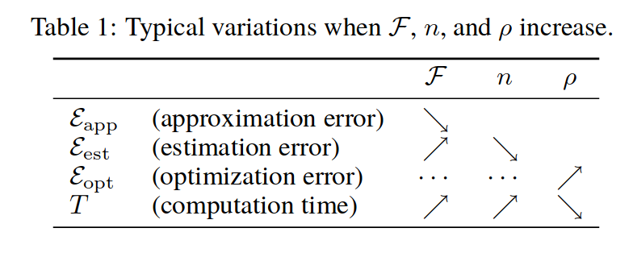

Slide 73
The Trade-off
If n_max large, we are constraint by T_max!
Making the optimization error small doesn’t matter if it means we can’t look at all training examples!
Trade optimization error for estimation error
use a worse algorithm but look at more data!

Slide 74
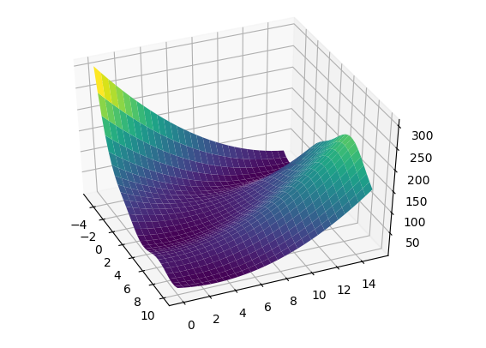
Reminder: Gradient Descent
Converges to local minimum

Slide 75
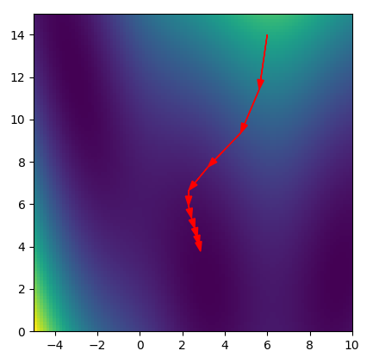
Reminder: Gradient Descent

Slide 76
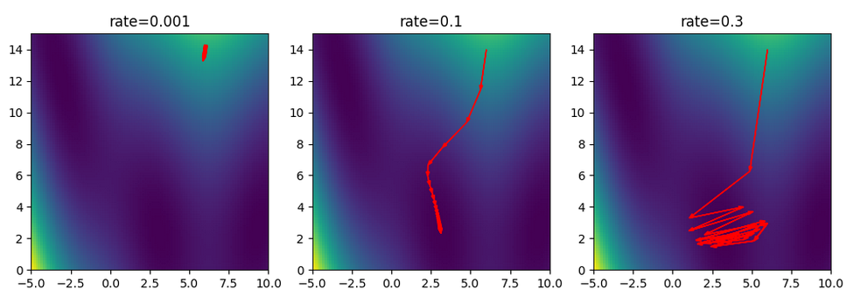
Picking a learning rate

Slide 77
Stochastic Gradient Descent
Logistic Regression:
Sum over data-points
Independent of data
Pick x_i randomly, then
Is a stochastic approximation of gradient of F with expectation the actual gradient.
In practice: just iterate over i.

Slide 78
SGD and partial_fit
SGDClassifier(), SGDRegressor() fast on very large datasets – have many different loss and regularization options.
Tuning learning rate and schedule can be tricky.
“optimal” learning rate only works with unit-variance data. Averaging can be helpful.
partial_fit allows working with out-of-memory data!

Slide 79
