Slide 1
Neural Networks
Andreas Müller

Slide 2
History
Nearly everything we talk about today existed ~1990
What changed?
  More data
  Faster computers (GPUs)
  Some improvements:
    relu
    Drop-out
    adam
    batch-normalization

Slide 3
Supervised Neural Networks
Non-linear models for classification and regression
Work well for very large datasets
Non-convex optimization
Notoriously slow to train – need for GPUs
Use dot products etc → require preprocessing, similar to SVM or linear models, unlike trees
MANY variants (Convolutional nets, Gated Recurrent neural networks, Long-Short-Term Memory, recursive neural networks, variational autoencoders, general adverserial networks, neural turing machines...)

Slide 4
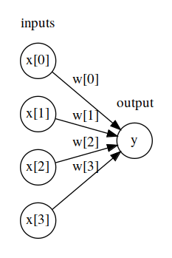
Logistic regression drawn as neural net

Slide 5
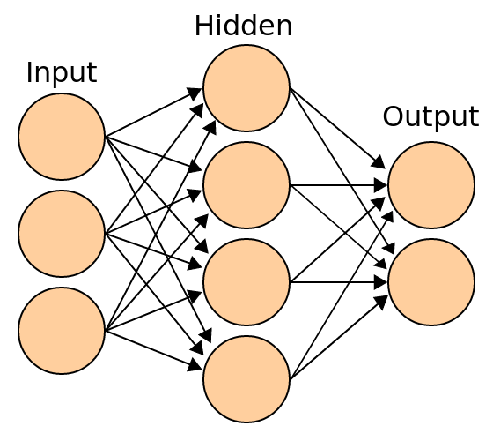
Basic Architecture
(for making predictions)
x
h(x) = f(Wx + b)
o(x) = g(W’h(x) + b’)
Notes:
First let’s describe how to make a prediction given a model.
Input denotes single sample, here three input features.
Hidden layer here 4 units is matrix multiply with W, b added (size of b is 4 here), followed by the univariate non-linear function f – sigmoid, tanh, rectifying linear function.
Output is a matrix multiplication with different weight matrix W’, b’ added (size 2 here), followed by another non-linear function g. The function g for the output layer is often different: identity for regression, soft-max for classification.
We want to learn W (3x4) W’ (4x2), b (4,), b’ (2,).
Can think of it as logistic regression with learning a non-linear basis transformation.

Slide 6
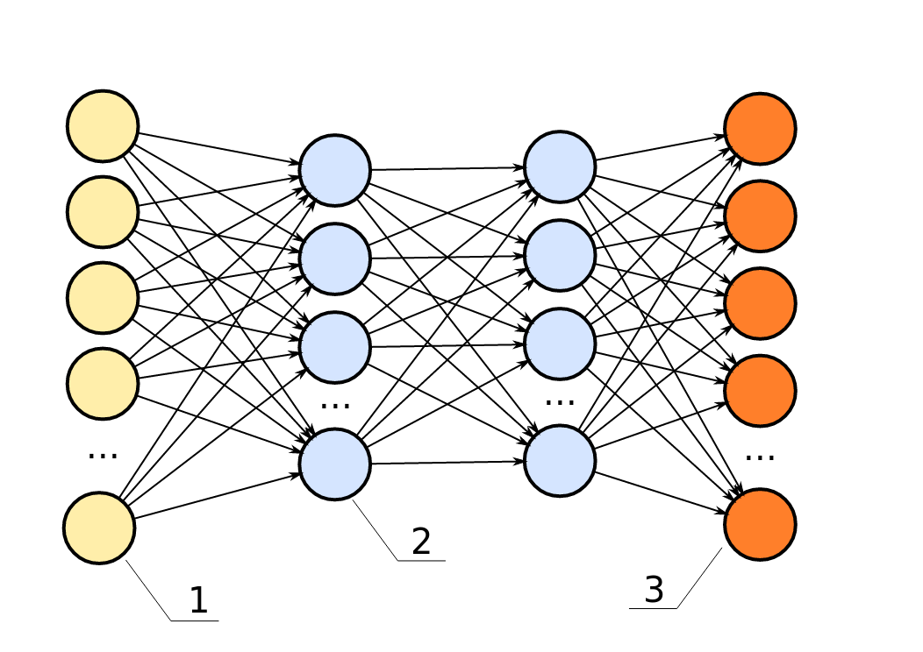
Can have arbitrary many layers
Notes:
Hidden layers usually all have the same non-linear function, weights are different for each layer.
Many layers → “deep learning”.
This is called a multilayer perceptron, feed-forward neural network, vanilla feed-forward neural network.
For regression usually single output neuron with linear activation.
For classification one-hot-encoding of classes, n_classes many output variables with softmax.

Slide 7
Nonlinear activation function
Notes:
Choices for activation function f of hidden layers.
Traditional tanh (or logistic sigmoid, not shown, but similar).
Tanh squashes to open interval (-1, 1).
Relu – recent trend, linear function x=y for positive, constant for negative values. Bias allows shifting the cut-off (~ linear splines)

Slide 8
Training objective
Could add regularization
squared loss for regression
cross-entropy loss (multi-class log-loss) for classification

Slide 9
Backpropagation
For gradient based-method need
backpropagation of gradient of layer above.
Gradient of
Non-linearity f
Input to 1st layer x
Backpropagation = Chain Rule + Dynamic Programming
Notes:
Easy to write down for last layer
Example for squared loss (g is identity for regression)
Can use the chain rule to compute other gradients
Bottom layers require partial derivatives of upper layers → reuse results
Backpropagation:
dynamic programming + chain rule
“backward pass” compute partial derivatives starting at the last layer.
You should try to go through that yourself once

Slide 10
But wait!
Notes:
relu is not differentiable.
But it’s differentiable almost anywhere.
“subgradient descent” - little issues in practice

Slide 11
Optimizing W, b
batch
minibatch
Online / stochastic
Notes:
Standard solvers: l-bfgs, newton, cg
Problem: Hessian too expensive, can to l-bfgs
Computing gradients over whole dataset expensive
Stochastic Gradient Descent to rescue
Actually use mini-batches

Slide 12
Learning Heuristics
Constant not good
Can decrease
Better: adaptive for each entry if Wi
State-of-the-art: adam (with magic numbers)
https://arxiv.org/pdf/1412.6980.pdf
http://sebastianruder.com/optimizing-gradient-descent/

Slide 13
Picking optimization algorithms
Small dataset: off the shelf like l-bfgs
Big dataset: adam
Have time & nerve: tune the schedule

Slide 14
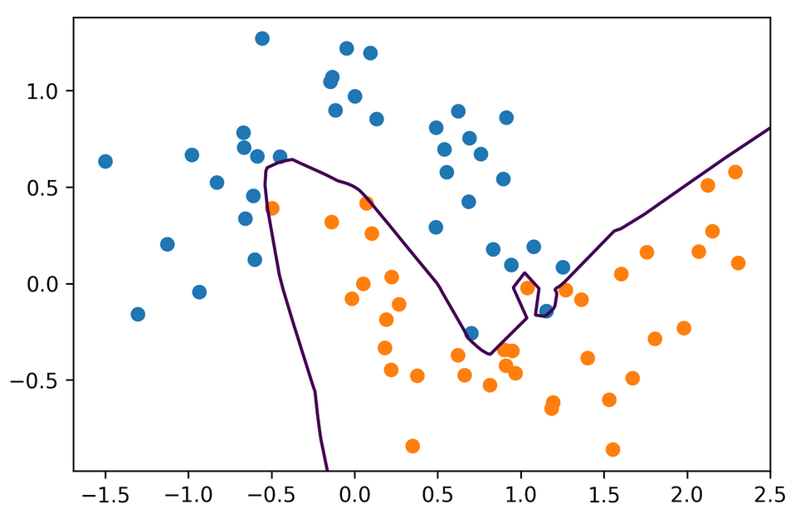
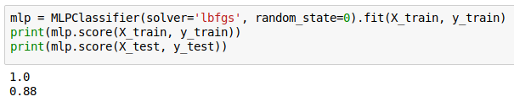
Neural Nets with sklearn
Notes:
Don’t user sklearn for anything but toy problems in neural nets.

Slide 15
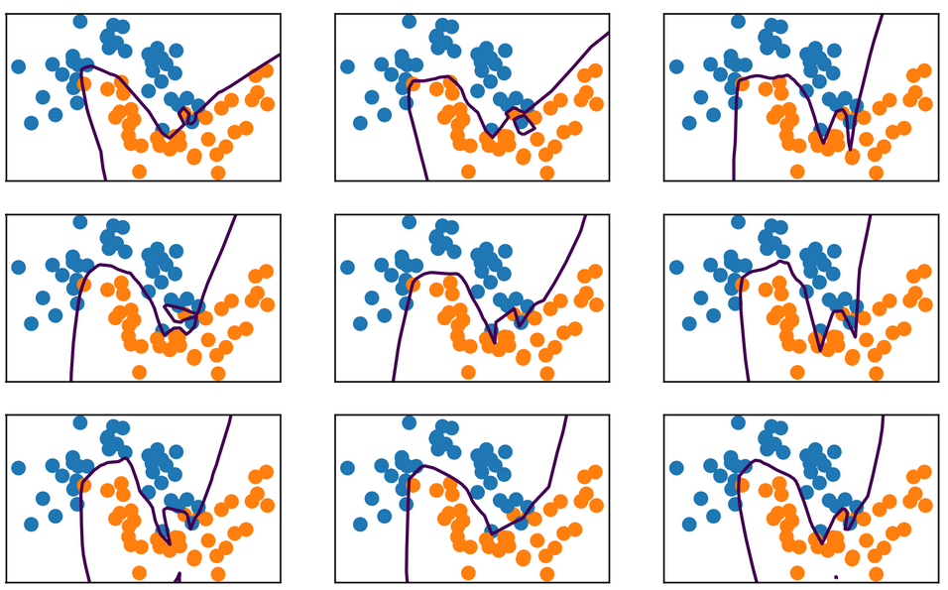
Random State
Notes:
This net is also way over capacity and can overfit in many ways.
Regularization might make it less dependent on initialization.

Slide 16
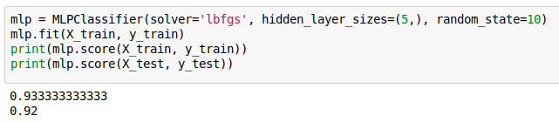
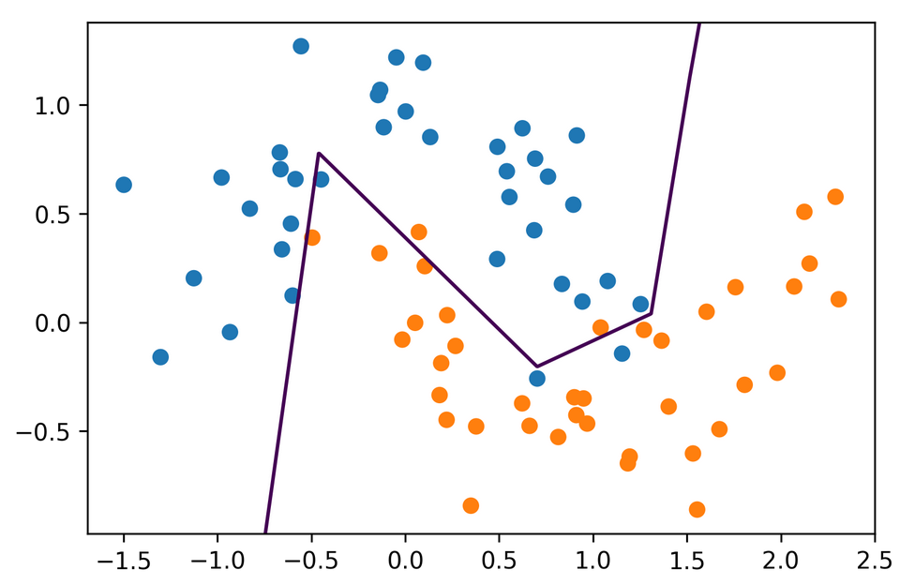
Hidden Layer Size

Slide 17
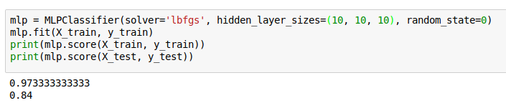
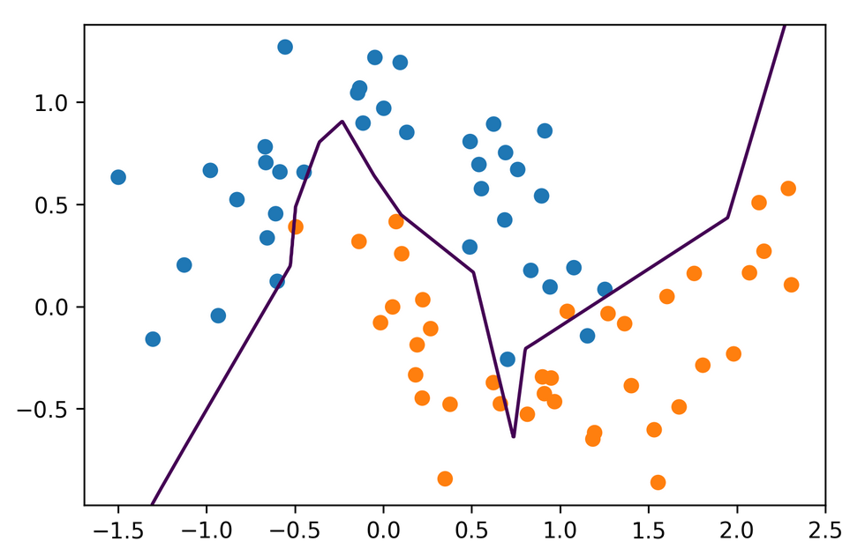
Hidden Layer Size

Slide 18
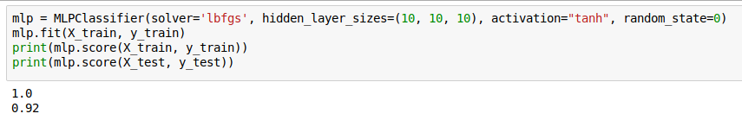
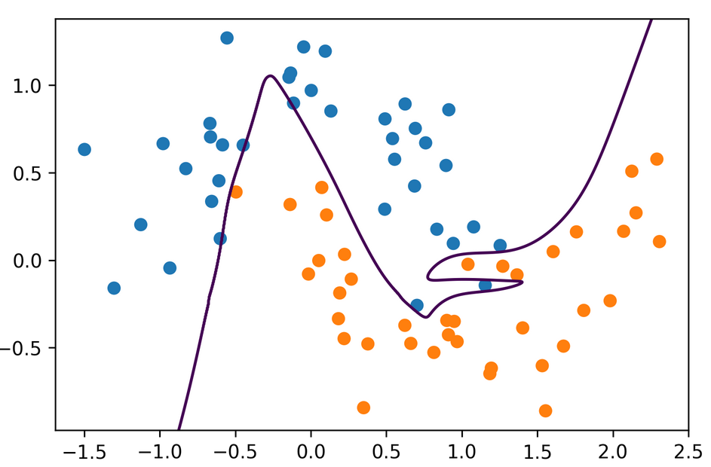
Activation Functions
Notes:
Using tanh we get smoother boundaries
Here actually it fits the data better.
It might be that relu doesn’t work that well with l-bfgs or with using these very small hidden layer sizes.
For large networks, relu is definitely preferred.

Slide 19
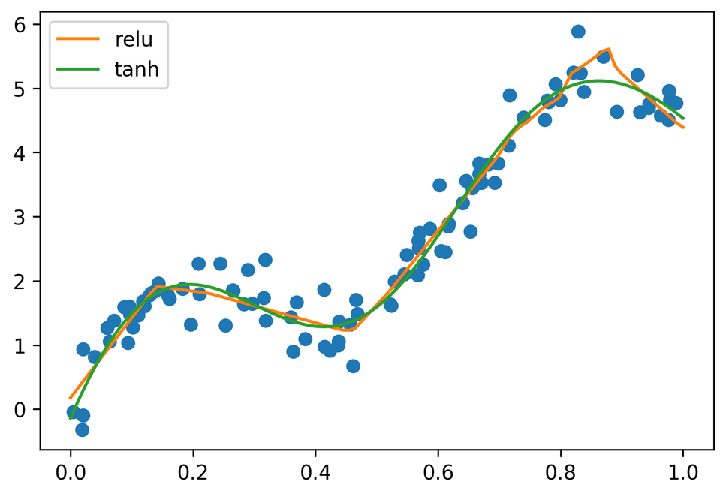

Regression

Slide 20
Complexity Control
Number of parameters
Regularization
Early stopping
(drop-out)

Slide 21
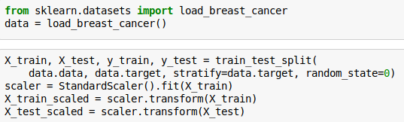

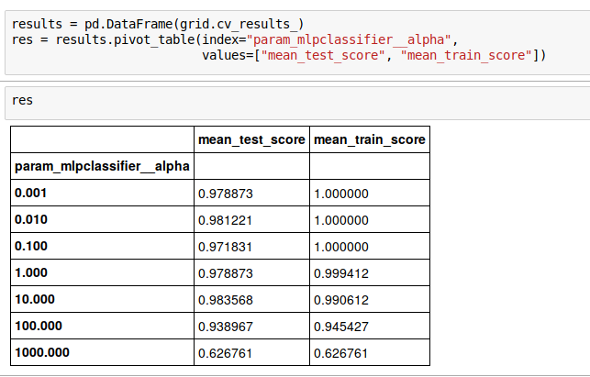
Grid-Searching Neural Nets

Slide 22
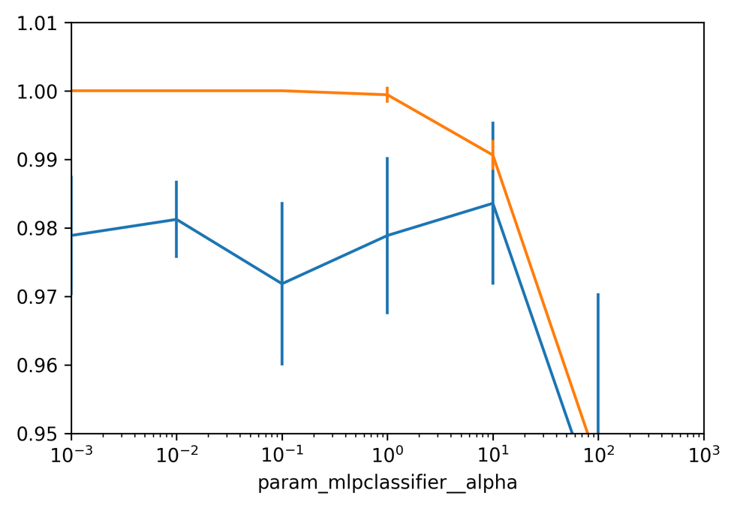

Slide 23
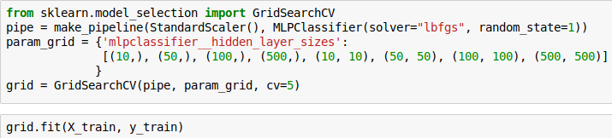
Searching hidden layer sizes

Slide 24
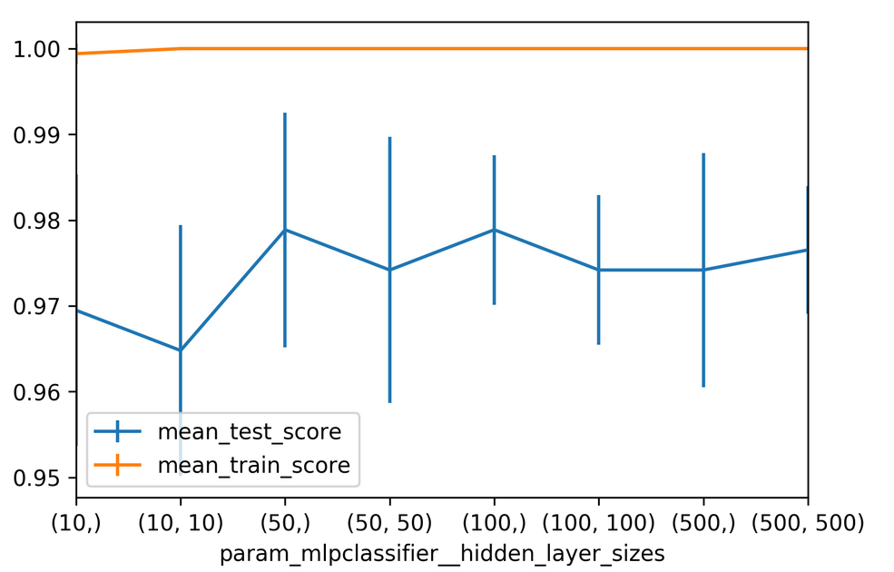

Slide 25
Getting flexible & Scaling up

Slide 26
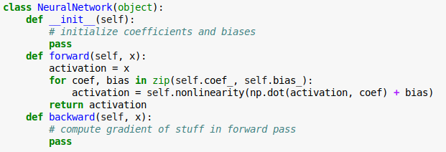
Write your own neural networks

Slide 27
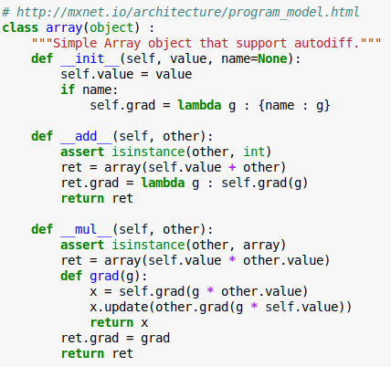
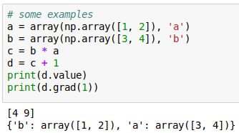
Autodiff

Slide 28
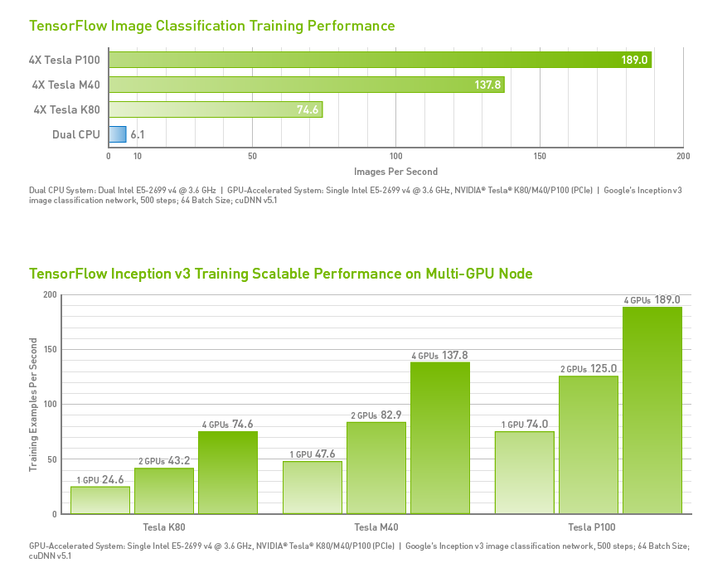
GPU Support
Notes:
From http://www.nvidia.com/object/gpu-accelerated-applications-tensorflow-benchmarks.html
Take with a grain of salt.

Slide 29
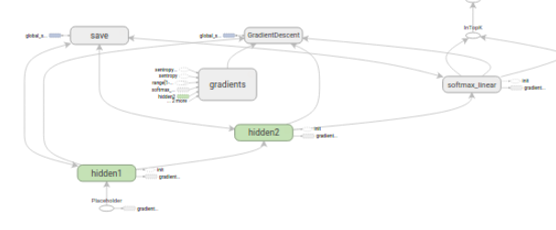
Computation Graph

Slide 30
All I want from a deep learning framework
Autodiff
GPU support
Optimization and inspection of computation graph
on-the-fly generation of the graph?
distribution over cluster?
Choices:
  TensorFlow
  Theano
  Torch (lua)

Slide 31
Deep Learning Libraries
tf.learn (Tensorflow)
Keras (Tensorflow, Theano)
Lasagna (Theano)
Torch.nn / PyTorch (torch)
Chainer (chainer)
MXNet (MXNet)
Also see: http://mxnet.io/architecture/program_model.html

Slide 32
W4995 Applied Machine Learning
More Neural Networks
04/17/17
Andreas Müller

Slide 33
Getting flexible & Scaling up
Notes:
So today we’ll talk about using neural nets beyond scikit-learn.
There are two main motivations for this: scaling to larger datasets and larger networks using GPUs, and having more flexible ways to create the neural network architectures.
If you want to get serious about neural nets, you are likely to include some modifications to the standard network. So how could you go about doing that?

Slide 34
Write your own neural networks
Notes:
It’s actually pretty straight-forward to write the prediction functions, or forward pass of a neural network. There is matrix multiplications and nonlinearities. It quickly becomes more complicated when you use some of the tricks we’ll discuss today, but even for this writing down the gradient can be a bit tricky and something people used to get wrong all the time.
So they came up with a trick that avoided having to write down the gradients yourself, also known as the backward pass.
That trick is autodiff.

Slide 35
Autodiff
Notes:
Here is a toy implementation of the idea behind autodiff. It’s a class called array with some operations such as addition of integer and multiplication with other arrays.
It also has a method that returns the gradient called grad. The gradient of the array is just the identity function.
The trick is what happens with the addition and multiplication. If you add something to an array or you multiply two arrays, the result again is an array, and has again a gradient. The product actually has two gradients, one for each array involved.
The magic here is that while we are doing some computation, we are keep track of that computation and building up a graph of how to compute the gradient of it.

Slide 36
Autodiff
Notes:
On the right you can see the result of adding two arrays and then computing the gradient at a particular location.
FIXME the gradient of multiplication?
Any computation in the neural network is a simple operation like a matrix multiplication, addition or non-linearity. If we write down the derivative of each of these, we can keep track of our computation and automatically get the derivative.
It’s really easy to implement but really helpful.
Keep in mind that we actually hard-code the derivative for each operation, there is no symbolic differentiation involved.

Slide 37
GPU Support
Notes:
From http://www.nvidia.com/object/gpu-accelerated-applications-tensorflow-benchmarks.html
Take with a grain of salt.
An important limitation of GPUs is that they usually have much less memory than the RAM, and memory copies between RAM and GPU are somewhat expensive.

Slide 38
Computation Graph
Notes:
Autodiff doesn’t solve all of the problems, though. Depending on which derivations you need to compute, you need to store different intermediate results (the net activation in backprob for example).
Given the limited amount of memory available, it’s important to know what to store and what can be discarded. That requires an end-to-end view of the computation, which can be summarized as a graph.
Then you can use knowledge about the computation graph to decide what results to cache, what results to throw away and when to communicate between CPU and GPU.
Having a representation of the graph also helps with visual debugging and understanding your network structure. The computation graph is more complex than the network graph because it includes intermediate results and gradient computations.

Slide 39
All I want from a deep learning framework
Autodiff
GPU support
Optimization and inspection of computation graph
on-the-fly generation of the graph?
distribution over cluster?
Choices:
  TensorFlow
  Theano
  Torch (lua)
Notes:
So create deep learning model efficiently, I need support for auto diff, computation on a GPGPU, and optimization and inspection of the computation graph.
There is some more advanced features that can come in handy for research, like on-the-fly generation of computation graphs, and distributing the network over multiple GPUs or over a cluster.
At least the first three are all provided by the TensorFlow, Theano and Torch frameworks, which are the most established deep learning frameworks.
These don’t provide deep learning models, they are infrastructure, more like numpy on steroids than sklearn.
Theano was an early deep learning library for python, but I think it has become less relevant since tensorflow got released.

Slide 40
Deep Learning Libraries
tf.learn (Tensorflow)
Keras (Tensorflow, Theano)
Lasagna (Theano)
Torch.nn / PyTorch (torch)
Chainer (chainer)
MXNet (MXNet)
Also see: http://mxnet.io/architecture/program_model.html
Notes:
Then there are actual deep learning libraries that provide higher level interfaces built on top of this infrastructure.
There are a lot of these right now given the deep learning hype, I want to point out a couple.
There is tf.learn, a high-level interface to tensorflow, including a scikit-learn compatible API.
There’s keras, which supports both Tensorflow and theano, there’s lasagna, which I think has seen less activity recently, and torch.nn (lua) and pytorch building on top of the torch framework.
Then there are two projects that are deep learning libraries but that also come with their own framework underneath, chainer and mxnet.
I think right now Keras with tensorflow is the most commonly used one, and I want to go into those two a bit more. But these all have their pros and cons.

Slide 41
Quick look at TensorFlow
“down to the metal” - don’t use for everyday tasks
Three steps for learning:
  Build the computation graph (using array operations and functions etc)
  Create an Optimizer (gradient descent, adam, …) attached to the graph.
  Run the actual computation.

Slide 42
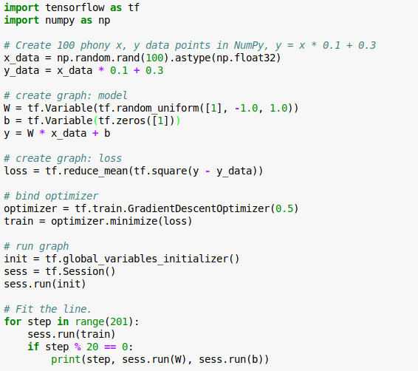
No computation
Allocate variables
All the work / computation
https://www.tensorflow.org/versions/r0.10/get_started/

Slide 43
A little more tf
Everything passed to the graph is a “tensor”
Either “variable”, “constant”, “placeholder”
Learned parameters: variables
Data: placeholders (data is assigned using “feed”)

Slide 44
Great Resources!
https://www.tensorflow.org/versions/r0.10/tutorials/
http://playground.tensorflow.org
https://www.tensorflow.org/versions/r0.10/get_started/basic_usage
https://www.tensorflow.org/versions/r0.10/tutorials/mnist/beginners/
Note: tf.learn is now officially tf.contrib.learn
Tensorboard web interface

Slide 45
Introduction to Keras

Slide 46
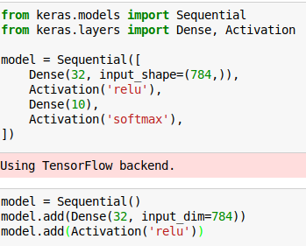

Keras Sequential
Notes:
There are two interfaces to keras, sequential and the functional, but we’ll only discuss sequential.
Sequential is for feed-forward neural networks where one layer follows the other. You specify the layers as a list, similar to a sklearn pipeline.
Dense layers are just matrix multiplications. Here we have a neural net with 32 hidden units for the mnist dataset with 10 outputs. The hidden layer non-linearity is relu, the output if softmax for multi-class classification.
You can also instantiate an empty sequential model and then add steps to it.
For the first layer we need to specify the input shape so the model knows the sizes of all the matrices. The following layers can infer the sizes from the previous layers.

Slide 47
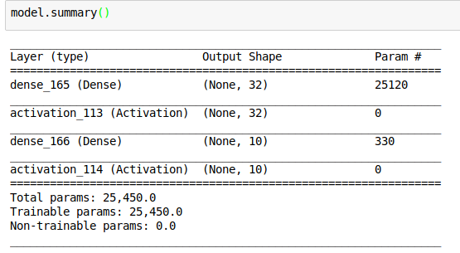

Slide 48
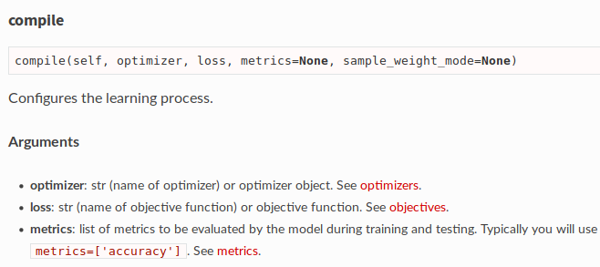
Setting optimizer
Notes:
Compile method picks optimization procedure and loss

Slide 49
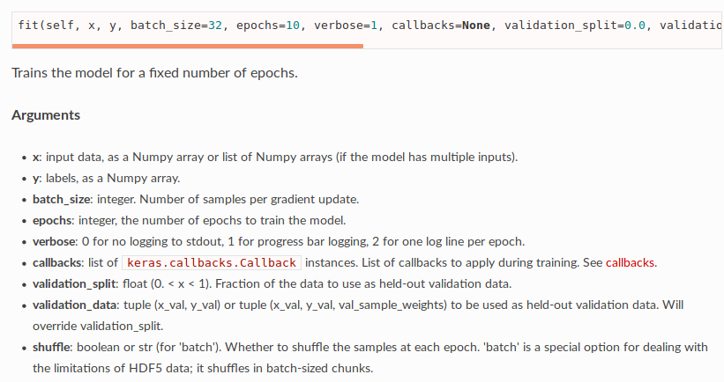
Training the model

Slide 50
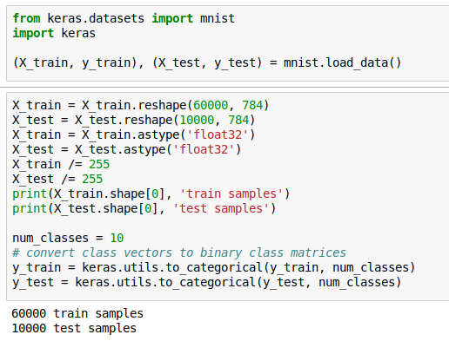
Preparing MNIST data

Slide 51
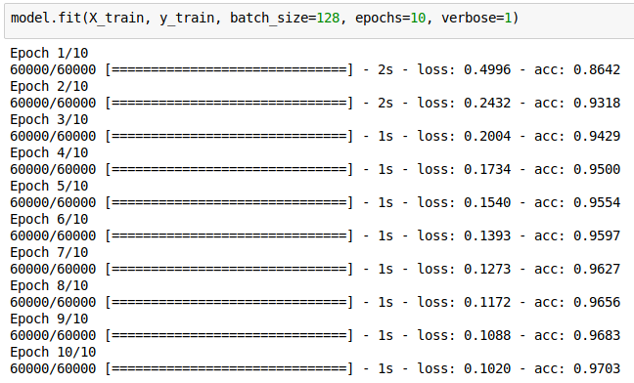
Fit model

Slide 52
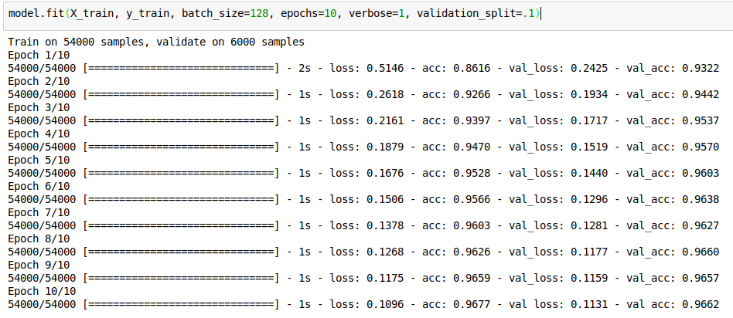
Fit with Validation

Slide 53
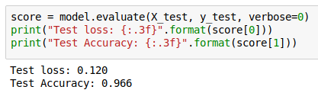
Evaluating on Test Set

Slide 54
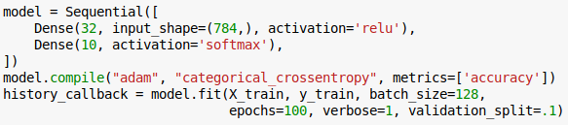
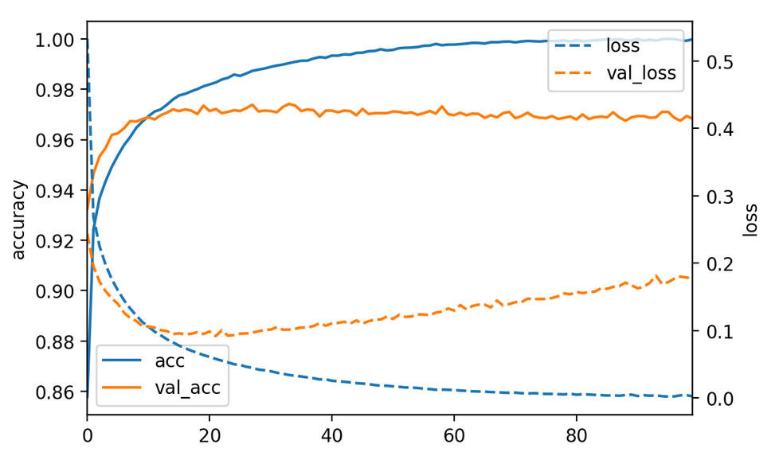
Loggers and Callbacks

Slide 55
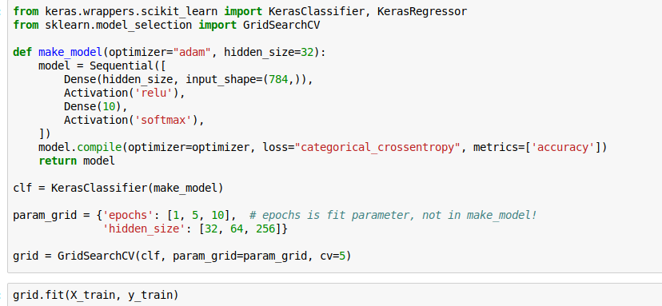
Wrappers for sklearn
See https://keras.io/scikit-learn-api/
Notes:
Useful for grid-search.
You need to define a callable that returns a compiled model.
You can search parameters that in Keras would be passed to “fit” like the number of epochs.

Slide 56
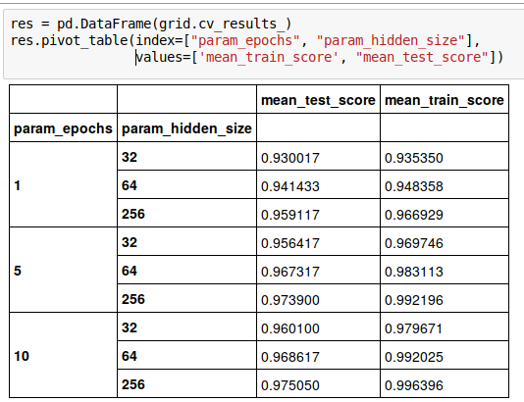
Notes:
Training longer overfits more and more units overfit more, but both also lead to better results.
We should probably train much longer actually.
Setting the number of epochs via cross-validation is a bit silly since it means starting from scratch again each time. Using early stopping would be better.

Slide 57
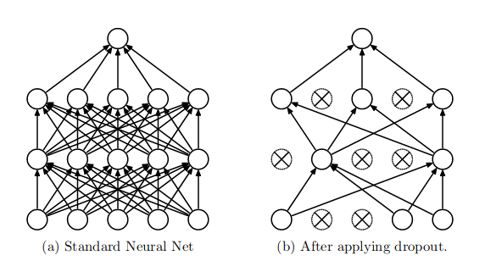
Drop-out Regularization
Randomly set activations to zero:
https://www.cs.toronto.edu/~hinton/absps/JMLRdropout.pdf
Rate often as high as .5, i.e. 50% of units set to zero!
Predictions: use all weights, down-weight by rate
Notes:
Drop out is a very successful regularization technique developed in 2014. It is an extreme case of adding noise to the input, a previously established method to avoid overfitting.
Instead of adding noise, we actually set given inputs to 0. And not only on the input layer, also the intermediate layer.
For each sample, and each iteration we pick different nodes. Randomization avoids overfitting to particular examples.

Slide 58
Ensemble Interpretation
Every possible configuration represents different network.
With p=.5 we jointly learn networks
Networks share weights
For last layer dropout: prediction is approximate geometric mean of predictions of sub-networks.

Slide 59
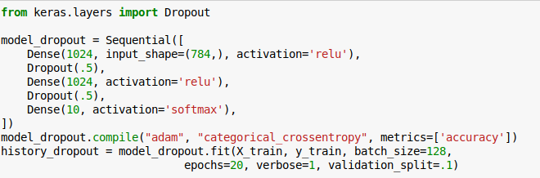
Implementing Drop-Out

Slide 60
When to use drop-out
Avoids overfitting
Allows using much deeper and larger models
Slows down training somewhat
Wasn’t able to produce better results on MNIST (I don’t have a GPU) but should be possible

Slide 61
Convolutional neural networks

Slide 62
Idea
Translation invariance
Weight sharing

Slide 63
Definition of Convolution
0 1 2 0 1 1 0 0 1 0
-1 2 -1
-1 2 -1
-1 2 -1
0 3 -3 ...
Notes:
The definition is symmetric in f, but usually one is the input signal, say f, and g is a fixed “filter” that is applied to it.
You can imagine the convolution as g sliding over f.
If the support of g is smaller than the support of f (it’s a shorter non-zero sequence) then you can think of it as each entry in f * g depending on all entries of g multiplied with a local window in f.
Not that the output is shorter than the input by half the size of g. this is called a valid convolution.
We could also extend f with zeros, and get a result that is larger than f by half the size of g, that’s called a full convolution. We can also just pad a little bit and get something that is of the same size as f.
Also not that the filter g is flipped as it’s indexed with -m

Slide 64
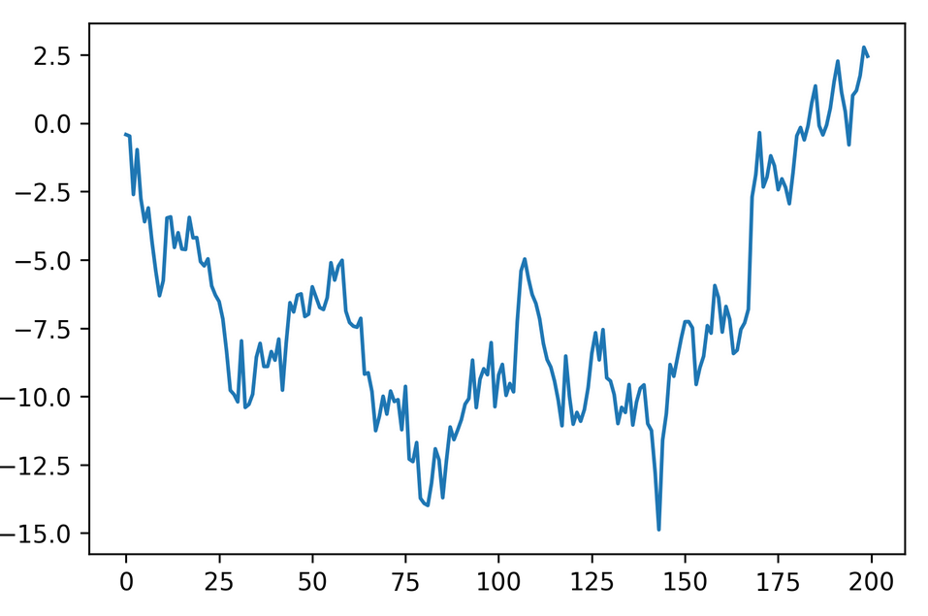
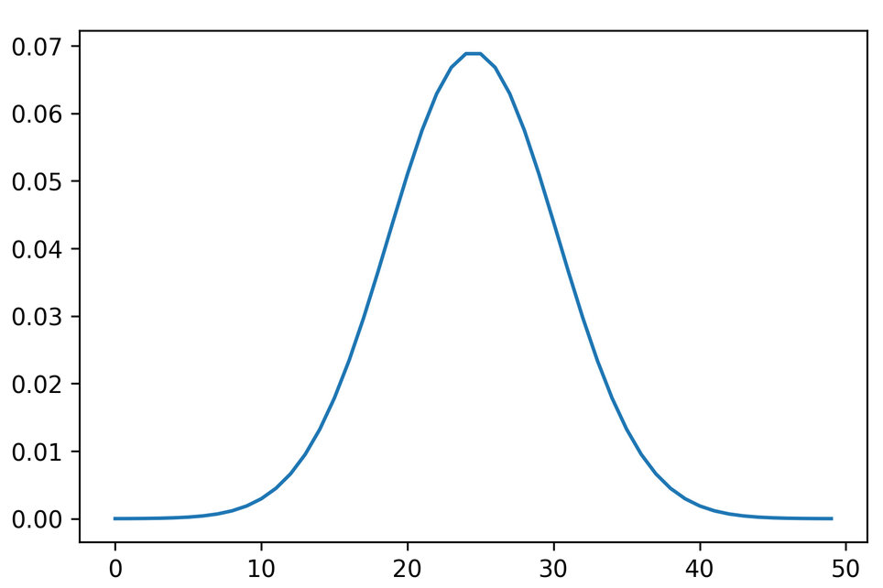
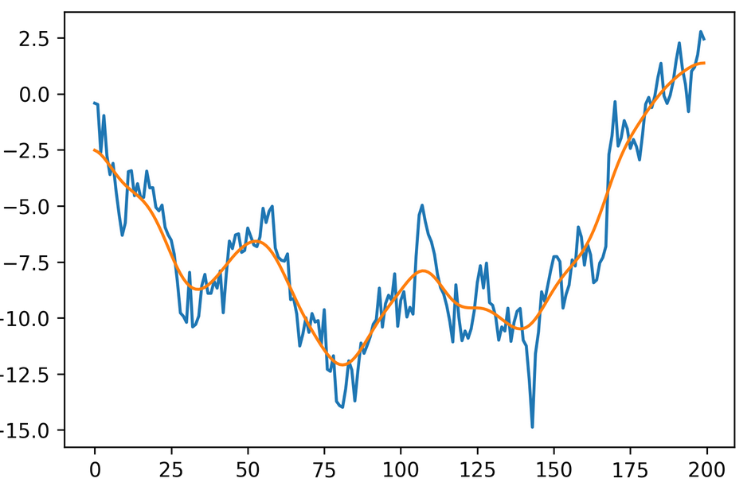
1d example: Gaussian smoothing
*
=

Slide 65
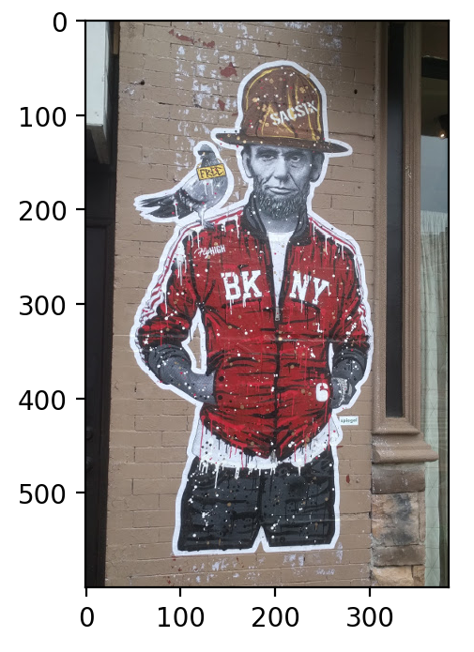
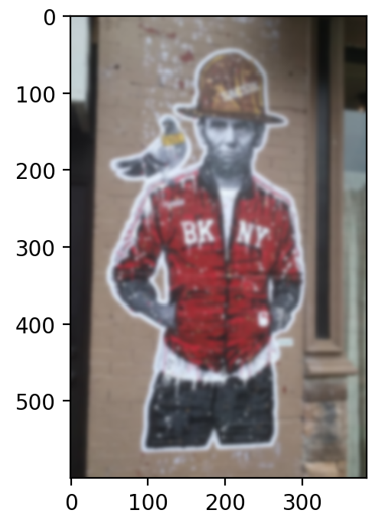
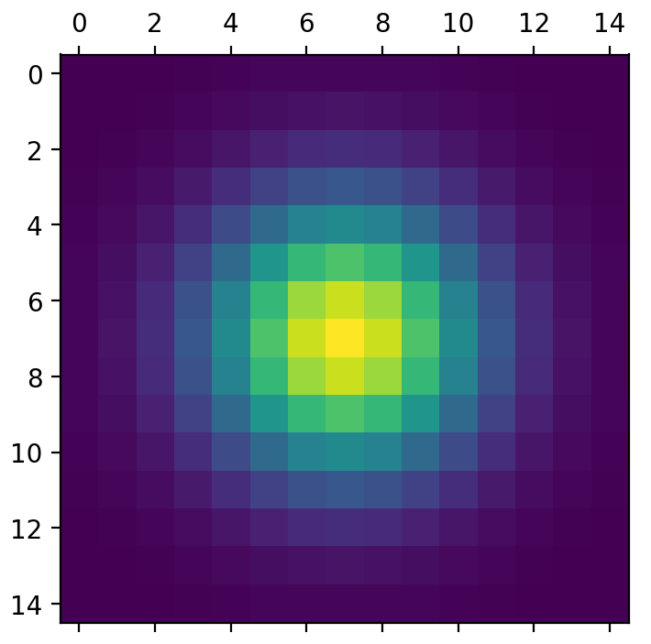
2d smoothing

Slide 66
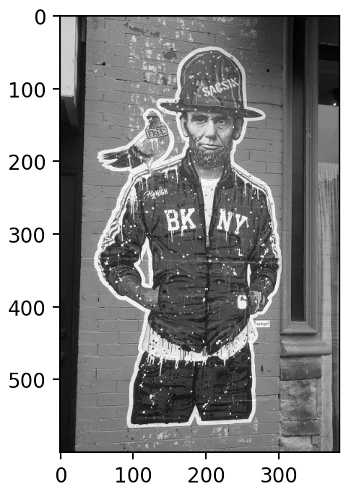
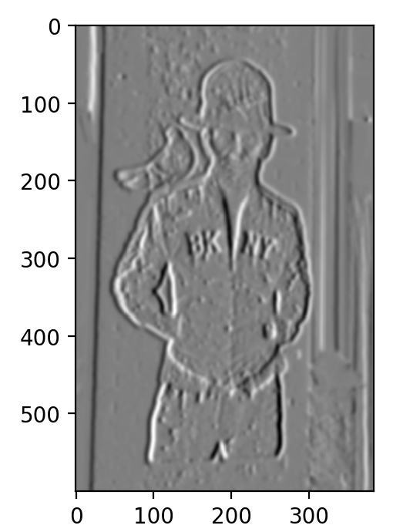
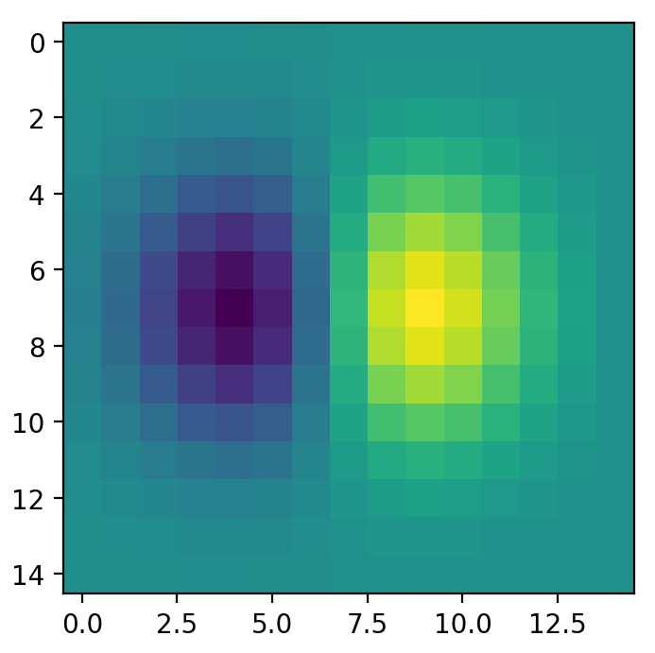
2d Gradients

Slide 67
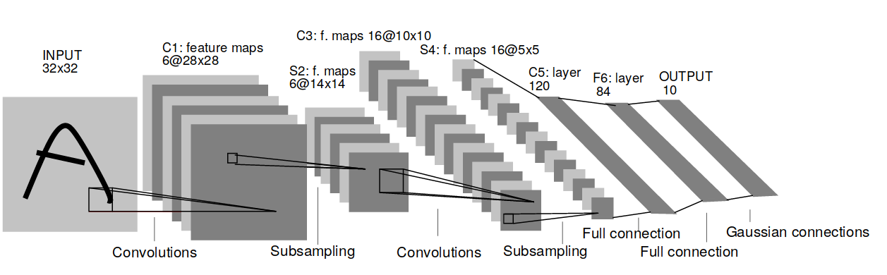
Convolutional Neural Networks
Y. LeCun, L. Bottou, Y. Bengio, and P. Haffner.
Gradient-based learning applied to document recognition
Notes:
Here is the architecture of an early convolutional net form 1998. The basic architecture in current networks is still the same.
You can multiple layers of convolutions and resampling operations. You start convolving the image, which extracts local features. Each convolutions creates new “feature maps” that serve as input to later convolutions.
To allow more global operations, after the convolutions the image resolution is changed. Back then it was subsampling, today it is max-pooling.
So you end up with more and more feature maps with lower and lower resolution.
At the end, you have some fully connected layers to do the classificattion.

Slide 68
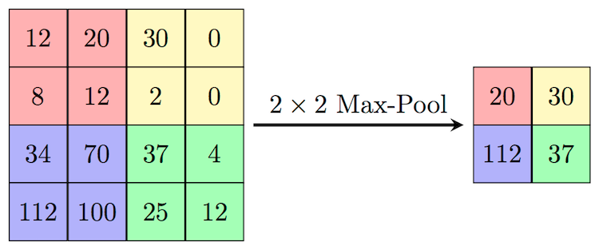
Max pooling
Need to remember position of maximum for back-propagation.
Again not differentiable → subgradient descent

Slide 69
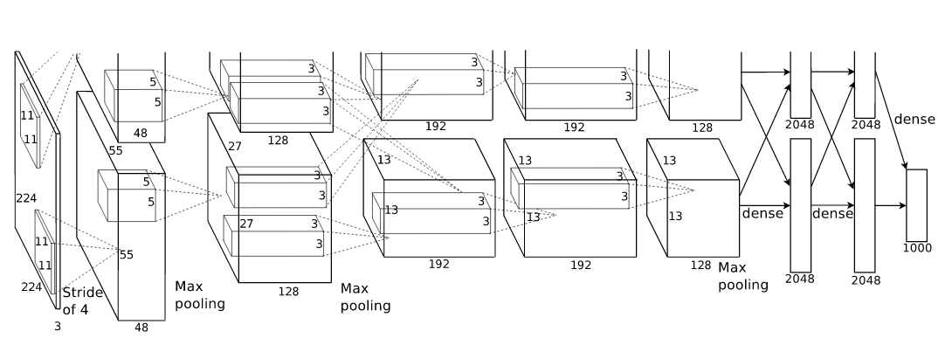


Alex Net
VGG 16
conv <receptive field size>-<number of channels>
Notes:
Here are two more recent architectures, AlexNet from 2012 and VGG net from 2015.
These nets are typically very deep, but often have very small convolutions. In VGG there are 3x3 convolutions and even 1x1 convolutions which serve to summarize multiple feature maps into one.
There is often multiple convolutions without pooling in between but pooling is definitely essential.

Slide 70
W4995 Applied Machine Learning
Even More Neural Networks
04/19/17
Andreas Müller

Slide 71
General notes for HW4
Never iterate over rows in a dataframe!
Use series.str for string operations (columns are series)

Slide 72
Convolutional neural networks

Slide 73
2d smoothing

Slide 74
2d Gradients

Slide 75
Convolutional Neural Networks
Y. LeCun, L. Bottou, Y. Bengio, and P. Haffner.
Gradient-based learning applied to document recognition
Notes:
Here is the architecture of an early convolutional net form 1998. The basic architecture in current networks is still the same.
You can multiple layers of convolutions and resampling operations. You start convolving the image, which extracts local features. Each convolutions creates new “feature maps” that serve as input to later convolutions.
To allow more global operations, after the convolutions the image resolution is changed. Back then it was subsampling, today it is max-pooling.
So you end up with more and more feature maps with lower and lower resolution.
At the end, you have some fully connected layers to do the classificattion.

Slide 76


Slide 77

Deconvolution
https://www.cs.nyu.edu/~fergus/papers/zeilerECCV2014.pdf

Slide 78


Slide 79


Slide 80
Conv-nets with keras

Slide 81

Preparing data
Channels
Notes:
For convolutional nets the data is n_samples, width, height, channels.
MNIST has one channel because it’s grayscale. Often you have RGB channels or possibly Lab.
The position of the channels is configurable, using the “channels_first” and “channels_last” options – but you shouldn’t have to worry about that.

Slide 82

Create tiny network
Notes:
For convolutional nets we need 3 new layer types: Conv2d for 2d convolutions, MaxPooling2d for max pooling and Flatten go reshape the input for a dense layer.
There are many other options but these are the most commonly used ones.

Slide 83


Number of Parameters
Convolutional network for MNIST
Dense network for MNIST

Slide 84


Train and Evaluate

Slide 85


Visualize filters

Slide 86


Slide 87
Batch normalization

Slide 88

Batch Normalization
https://arxiv.org/abs/1502.03167
Notes:
Another relatively recent advance in neural networks is batch normalization. The idea is that neural networks learn best when the input is zero mean and unit variance. We can scale the data to get that.
But each layer inside a neural network is itself a neural network with inputs given by the previous layer. And that output might have much larger or smaller scale (depending on the activation function).
Batch normalization re-normalizes the activations for a layer for each batch during training (as the distribution over activation changes). The avoids saturation when using saturating functions.
To keep the expressive power of the model, additional scale and shift parameters are learned that are applied after the per-batch normalization.

Slide 89

Tiny convnet with Batch Normalization

Slide 90

Learning speed (and accuracy)

Slide 91

For larger (64 filters) net

Slide 92
VGG and Imagenet Filters

Slide 93


Inspecting VGG

Slide 94


VGG filters

Slide 95



Slide 96



Slide 97

https://blog.keras.io/how-convolutional-neural-networks-see-the-world.html

Slide 98
Using pre-trained networks
Train on “large enough” data.
Apply to new “small” dataset.
Take activations of last or second to last fully connected layer.
See http://cs231n.github.io/transfer-learning/
Notes:
Often we have a small but specific image dataset for a particular application. Training a neural net is not feasible unless we have tens of thousands or hundreds of thousands of images.
However, if we have a convolutional neural net that was already trained on a large dataset that is similar enough, we can hope that the features it learned are also helpful for our task.
The easiest way to adapt a trained network to a new task is to just apply it to our dataset and take the activations of the second to last or last layer.
If the original task was rich enough – say 10000 different classes as in imagenet – these layers contain a lot of information about the image.
We can then use these activations as features for another classifier like a linear model or smaller dense neural network.

Slide 99
Using pre-trained networks
Train on “large enough” data.
Apply to new “small” dataset.
Take activations of last or second to last fully connected layer.
Notes:
The main point is that we don’t need to retrain all the weights in the network. You can think of it as retraining only the last layer – the classification layer – of the network, while holding all the convolutional filters fixed. If they learned generic patterns like edges and patterns, these will still be useful for your task.
You can download pre-trained neural networks for many architectures online.
Using a pre-trained network is sometimes also known as transfer learning.
This potentially doesn’t work with images from a very different domain, like medical images.

Slide 100


Ball snake vs Carpet Python

Slide 101





Slide 102


Carpet Python (100 total)
Ball Snake (100 total)

Slide 103



Extracting Features using VGG

Slide 104

Classification with Logreg
Caveat: I haven’t really checked if these make sense.

Slide 105
Finetuning
Start with pre-trained net
Back-propagate error through all layers
“tune” filters to new data.
See https://keras.io/applications/
Notes:
A more complicated variant of this is to load a network trained on some other dataset, and replace the last layer with your classification task.
Instead of training only the last layer, we can also keep training all the previous layers, backpropagating the gradient through the network and adjusting the previously learned filters for our task.
You can think of this as warm-starting a neural network from one that was trained on another dataset.
If you do that, we often want to train the last layer a little bit before we backpropagate through the network. Otherwise the random initialization of the last layer might destroy the filters that we used for initialization.

Slide 106

Adverserial Samples
Right column: correctly classified image, left column classified as Ostrich.
Center: difference.
Intriguing properties of neural networks https://arxiv.org/abs/1312.6199
Notes:
Since convolutional neural nets are so good at image recognition, some people think they are pretty infallible. But they are not. There is this interesting paper about intriguing properties of neural networks, that introduces adverserial samples.
Adverserial samples are samples that were created by an adversary or attacker to fool your model. Here, they changed images to be classified as Ostrich by AlexNet trained on imagenet.
The picture on the left is change just slightly, and went from correctly classified to classified as Ostrich.
This technique uses gradient descent on the input and requires access to all the weights in the network to create the samples.
Given how high-dimensional the input space is, this is not very surprising from a mathematical perspective, but it might be somewhat unexpected.

